Slide 2
Such people, Paul writes, are ”not holding fast to the Head, from whom the whole body, nourished and knit together through its joints and ligaments, grows with a growth that is from God.” Colossians 2:19

Slide 3
I. Connect (Hebrews 10:24-25)
“When you come together it is not for the better but for the worse.” 1st Corinthians 11:17
“When you come together as a church, I hear that there are divisions among you.” 1st Corinthians 11:18
“Do you despise the church of God and humiliate those who have nothing? What shall I say to you?” 1st Corinthians 11:22
“For anyone who eats and drinks without discerning the body eats and drinks judgment on himself. That is why many of you are weak and ill, and some have died.” 1st Corinthians 11:29-30

Slide 4
I. Connect (Hebrews 10:24-25)
Through our faith in Christ, God has given us “the right to become children of God, who were born…of God.” John 1:12-13
“In Christ we, though many, form one body, and each member belongs to all the others.” Romans 12:5, NIV
We will one day welcome one another “into the eternal dwellings.” Luke 16:9
What other interests, passions, or affections should be allowed to compete with my life’s most vital connection?

Slide 5
I. Connect (Hebrews 10:24-25)
24 And let us consider how to stir up one another to love and good works, 25 not neglecting to meet together, as is the habit of some, but encouraging one another, and all the more as you see the Day drawing near.

Slide 6
I. Connect (Hebrews 10:24-25)
24 And let us consider how to stir up one another to love and good works, 25 not neglecting to meet together, as is the habit of some, but encouraging one another, and all the more as you see the Day drawing near.
We “wrestle…against the rulers, against the authorities, against the cosmic powers over this present darkness, against the spiritual forces of evil in the heavenly places.” Ephesians 6:12
“Preserve me, O God, for in you I take refuge.” Psalm 16:1

Slide 7
I. Connect (Hebrews 10:24-25)
24 And let us consider how to stir up one another to love and good works, 25 not neglecting to meet together, as is the habit of some, but encouraging one another, and all the more as you see the Day drawing near.
We need one another and that need is as much a life sustaining necessity for our souls as food and water are for our bodies.

Slide 8
II. Care (Galatians 6:2)
“If anyone has the world’s goods and sees his brother in need, yet closes his heart against him, how does God’s love abide in him? Little children, let us not love in word or talk but in deed and in truth.” 1st John 3:17-18
“Bear one another’s burdens, and so fulfill the law of Christ.” Galatians 6:2
“Count it all joy, my brothers, when you meet trials of various kinds.” James 1:2

Slide 9
II. Care (Galatians 6:2)
“Like cold water to a thirsty soul, so is good news from a far country” Proverbs 25:25
“How beautiful upon the mountains are the feet of him who brings good news.” Isaiah 52:7

Slide 10
III. The Refuge Revisited (Psalm 36:7-9)
7 How precious is your steadfast love, O God! The children of mankind take refuge in the shadow of your wings. 8 They feast on the abundance of your house, and you give them drink from the river of your delights. 9 For with you is the fountain of life; in your light do we see light.
Every work of ministry we pursue as a church should rise from the singular motivation to show our love for Him, to glorify Him, to honor His name as holy, and to be obedient to do His will. Everything we do apart from this grace fueled motivation is in vain. “Apart from me you can do nothing.” John 15:5

Slide 11
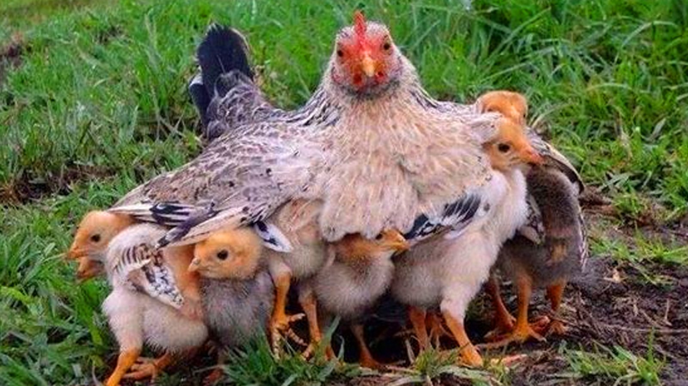
III. The Refuge Revisited (Psalm 36:7-9)
“How often would I have gathered your children together as a hen gathers her brood under her wings, and you were not willing!” Matthew 23:37

Slide 12
III. The Refuge Revisited (Psalm 36:7-9)
We strive to be a church whose ministries foster real connection in relationship with God, and by that relationship, real Christlike connection with one another.
We strive to be a church whose ministries bring care and well-being into one another’s lives, knowing one another’s burdens well and loving well to lift those burdens, all unto our mutual joy in the Lord.

Slide 13
III. The Refuge Revisited (Psalm 36:7-9)
We can only be a Refuge if the children of mankind know to come and take refuge in the shadow of His wings. As Paul writes in Romans 10:14-15, “How then will they call on him in whom they have not believed? And how are they to believe in him of whom they have never heard? And how are they to hear without someone preaching? And how are they to preach unless they are sent? As it is written, “‘How beautiful are the feet of those who preach the good news!’”

Slide 14
III. The Refuge Revisited (Psalm 36:7-9)
We strive to be a church whose ministries foster real connection in relationship with God, and by that relationship, real Christlike connection with one another.
We strive to be a church whose ministries bring care and well-being into one another’s lives, knowing one another’s burdens well and loving well to lift those burdens, all unto our mutual joy in the Lord.
We strive to Reach. We strive to be a church whose ministries accomplish the good end of carrying the gospel to places near and far.

Slide 15
III. The Refuge Revisited (Psalm 36:7-9)
“God doesn’t call the equipped. He equips the called.”
“To equip the saints for the work of ministry, for building up the body of Christ, until we all attain to the unity of the faith and of the knowledge of the Son of God, to mature manhood, to the measure of the stature of the fullness of Christ.” Ephesians 4:12-13

Slide 16
III. The Refuge Revisited (Psalm 36:7-9)
We labor as Christ’s co-laborers, doing the work of building disciples who can Connect, Care, Equip, and Reach in obedience to everything Christ has commanded us, all by the power of the Holy Spirit and to the glory of God.

