Slide 1
Scripture Reading
2nd Chronicles 34:1-7
Page 453 in the seat back bibles

Slide 2
“If there was anything eight years of competition had taught me, it was that in competing against the best in the world in ten grueling events, anything can go wrong before you cross the finish line.”

Slide 3
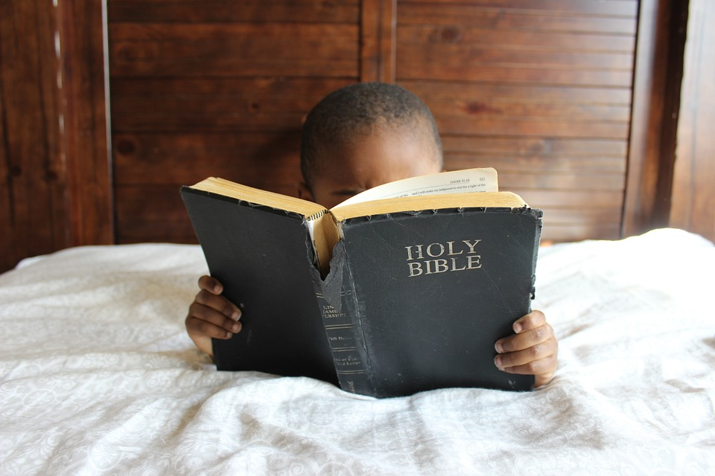
Honor God Now and Always
“I focus on this one thing: Forgetting the past and looking forward to what lies ahead, I press on to reach the end of the race and receive the heavenly prize for which God, through Christ Jesus, is calling us.” Philippians 3:13-14, NLT
2nd Chronicles 34:1-7

Slide 4
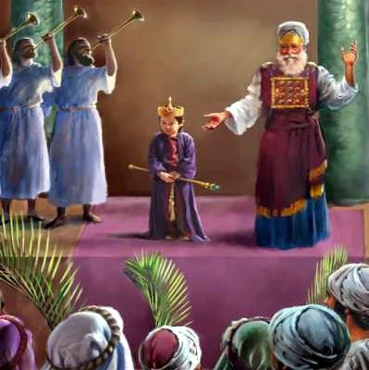
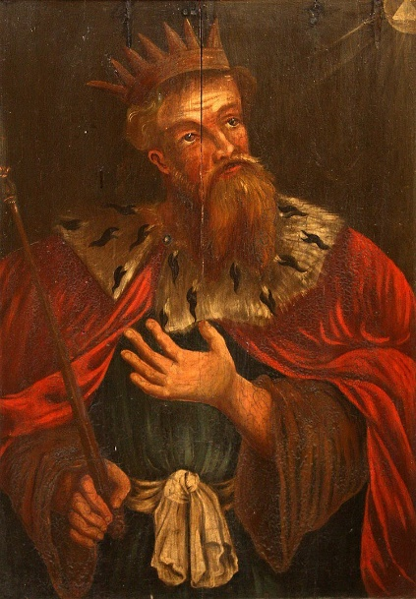
I. The boy Josiah “did what was right in the eyes of the Lord” (verses 1-3a)
1 Josiah was eight years old when he began to reign, and he reigned thirty-one years in Jerusalem.
60 years of wickedness
Manasseh (grandfather)
Josiah
Amon (father)

Slide 5
I. The boy Josiah “did what was right in the eyes of the Lord” (verses 1-3a)
2 And he did what was right in the eyes of the Lord, and walked in the ways of David his father; and he did not turn aside to the right hand or to the left. 3 For in the eighth year of his reign, while he was yet a boy, he began to seek the God of David his father…

Slide 6
I. The boy Josiah “did what was right in the eyes of the Lord” (verses 1-3a)
2 And he did what was right in the eyes of the Lord, and walked in the ways of David his father; and he did not turn aside to the right hand or to the left. 3 For in the eighth year of his reign, while he was yet a boy, he began to seek the God of David his father…
16 years old

Slide 7
II. The young man Josiah did the Lord’s will (verses 3b-7)
Jesus’ Disciples => Followed Him 3 years and then gave them their mission to make disciples
Paul prepared for his mission to the Gentiles for 3 years (Galatians 1:17-18)
Even “Jesus grew in wisdom and in stature and in favor with God and all the people” (Luke 2:52, NLT) until it was time for Him to begin His work of bringing salvation to the world.

Slide 8
II. The young man Josiah did the Lord’s will (verses 3b-7)
Josiah devoted himself to removing idolatry from his kingdom (3b-5)
“You shall not make for yourself a carved image, or any likeness of anything that is in heaven above, or that is in the earth beneath, or that is in the water under the earth. You shall not bow down to them or serve them.” Exodus 20:4-5
3 …and in the twelfth year he began to purge Judah and Jerusalem of the high places, the Asherim, and the carved and the metal images.

Slide 9
II. The young man Josiah did the Lord’s will (verses 3b-7)
Josiah devoted himself to removing idolatry from his kingdom (3b-5)
4 And they chopped down the altars of the Baals in his presence, and he cut down the incense altars that stood above them. And he broke in pieces the Asherim and the carved and the metal images, and he made dust of them and scattered it over the graves of those who had sacrificed to them. 5 He also burned the bones of the priests on their altars and cleansed Judah and Jerusalem.

Slide 10
II. The young man Josiah did the Lord’s will (verses 3b-7)
Josiah turned to the Lord while he was still a youth and sought the Lord’s direction in his life, and as a very young man (just out of high school by our standards), Josiah’s life became laser focused on doing what God had called him to do

Slide 11
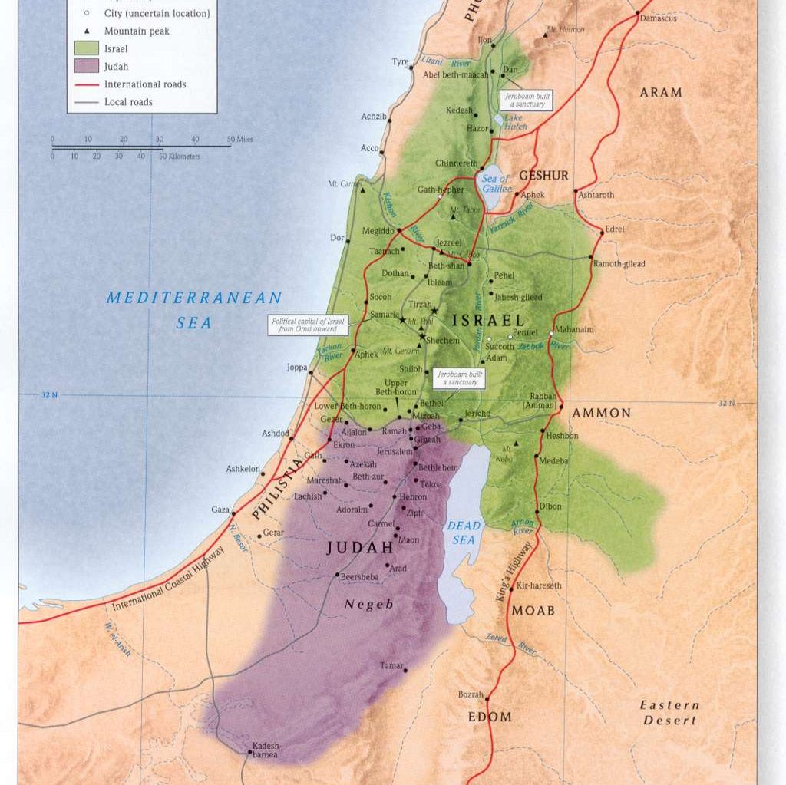
II. The young man Josiah did the Lord’s will (verses 3b-7)
Exiled kingdom
Josiah went above and beyond to remove idolatry from God’s people (6-7)
Josiah’s kingdom

Slide 12
II. The young man Josiah did the Lord’s will (verses 3b-7)
Josiah went above and beyond to remove idolatry from God’s people (6-7)
Josiah’s kingdom

Slide 13
II. The young man Josiah did the Lord’s will (verses 3b-7)
Josiah went above and beyond to remove idolatry from God’s people (6-7)
6 And in the cities of Manasseh, Ephraim, and Simeon, and as far as Naphtali, in their ruins all around, 7 he broke down the altars and beat the Asherim and the images into powder and cut down all the incense altars throughout all the land of Israel. Then he returned to Jerusalem.
“And if anyone forces you to go one mile, go with him two miles.” Matthew 5:41

Slide 14
III. Honor God now and always
Seek the Lord now and always
“Seek the Lord and his strength; seek his presence continually!” Psalm 105:4
“And I tell you, ask, and it will be given to you; seek, and you will find; knock, and it will be opened to you.” Luke 11:8-9

Slide 15
III. Honor God now and always
Through our devoted service to Him
“And whatever you do, in word or deed, do everything in the name of the Lord Jesus, giving thanks to God the Father through him.” Colossians 3:17

Slide 16
III. Honor God now and always
Six years after Josiah had purged idolatry from the land (age 26), Josiah began directing the work to repair the temple, the place where God called His people to come and worship Him.
“Hilkiah the priest found the Book of the Law” 2nd Chronicles 34:14

Slide 17
III. Honor God now and always
Huldah’s message from the Lord to Josiah
“Thus says the Lord, the God of Israel: Regarding the words that you have heard, because your heart was tender and you humbled yourself before God when you heard his words against this place and its inhabitants, and you have humbled yourself before me and have torn your clothes and wept before me, I also have heard you, declares the Lord.” 2nd Chronicles 34:26-27

Slide 18
III. Honor God now and always
Honor the truth of His word with humble-hearted repentance
Josiah was just as devoted to sharing God’s word with the people and calling them to repentance as he was to purging idolatry from the land: “All his days they did not turn away from following the Lord, the God of their fathers.” 2nd Chronicles 34:33
Seek the spiritual well-being of others as well as ourselves

Slide 19
III. Honor God now and always
One more lesson to learn from Josiah
“No Passover like it had been kept in Israel since the days of Samuel the prophet. None of the kings of Israel had kept such a Passover as was kept by Josiah, and the priests and the Levites, and all Judah and Israel who were present, and the inhabitants of Jerusalem.” 2nd Chronicles 35:18
We honor God now and always with faithful worship

Slide 20
III. Honor God now and always
“Honor him in your youth.” Ecclesiastes 12:1, NLT
Josiah did so from his childhood on. And in the end, we could say of Josiah what Paul says of himself. “The time of my departure has come. I have fought the good fight, I have finished the race, I have kept the faith.” 2nd Timothy 4:6-7

Slide 21
Closing Thoughts & Benediction

