Slide 1
Scripture Reading
2nd Kings 5:1-14
Page 365-66 in the seat back bibles

Slide 3
The Mighty Faith of a Little Girl
2nd Kings 5:1-14

Slide 4
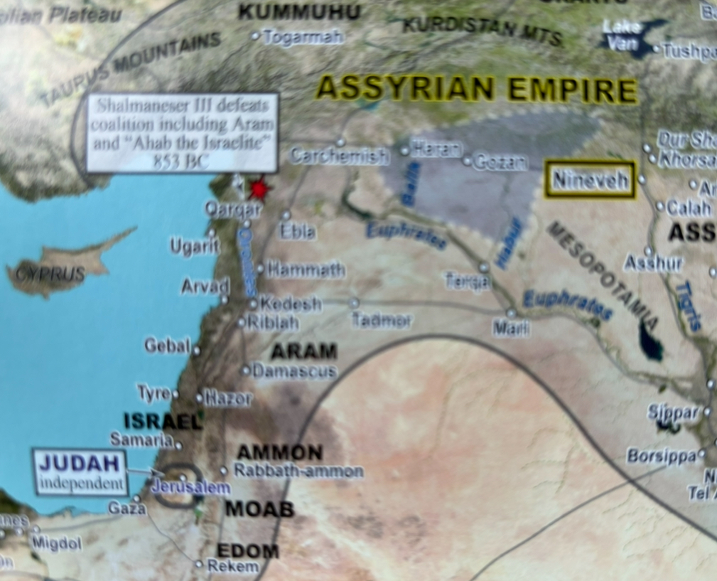
I. Naaman’s servant girl showed great faith, courage, and care (verses 1-5a)
1 Naaman, commander of the army of the king of Syria, was a great man with his master and in high favor, because by him the Lord had given victory to Syria. He was a mighty man of valor, but he was a leper.

Slide 5
I. Naaman’s servant girl showed great faith, courage, and care (verses 1-5a)
2 Now the Syrians on one of their raids had carried off a little girl from the land of Israel, and she worked in the service of Naaman’s wife.

Slide 6
I. Naaman’s servant girl showed great faith, courage, and care (verses 1-5a)
3 She said to her mistress, “Would that my lord were with the prophet who is in Samaria! He would cure him of his leprosy.”

Slide 7
I. Naaman’s servant girl showed great faith, courage, and care (verses 1-5a)
4 So Naaman went in and told his lord, “Thus and so spoke the girl from the land of Israel.” 5 And the king of Syria said, “Go now, and I will send a letter to the king of Israel.”

Slide 8
II. The testimony of Naaman’s servant girl brought Naaman to Israel (verses 5b-7)
5 …So he went, taking with him ten talents of silver, six thousand shekels of gold, and ten changes of clothing. 6 And he brought the letter to the king of Israel, which read, “When this letter reaches you, know that I have sent to you Naaman my servant, that you may cure him of his leprosy.”

Slide 9
II. The testimony of Naaman’s servant girl brought Naaman to Israel (verses 5b-7)
7 And when the king of Israel read the letter, he tore his clothes and said, “Am I God, to kill and to make alive, that this man sends word to me to cure a man of his leprosy? Only consider, and see how he is seeking a quarrel with me.”
When it’s all said and done, Naaman trusted his little servant girl’s plan and the two kings took the plan and made it all about what they could do, and they failed miserably.

Slide 10
III. The testimony of Naaman’s servant girl brought Naaman to Elisha (verses 8-12)
8 But when Elisha the man of God heard that the king of Israel had torn his clothes, he sent to the king, saying, “Why have you torn your clothes? Let him come now to me, that he may know that there is a prophet in Israel.”
3 …Would that my lord were with the prophet who is in Samaria!

Slide 11
III. The testimony of Naaman’s servant girl brought Naaman to Elisha (verses 8-12)
9 So Naaman came with his horses and chariots and stood at the door of Elisha’s house. 10 And Elisha sent a messenger to him, saying, “Go and wash in the Jordan seven times, and your flesh shall be restored, and you shall be clean.” 11 But Naaman was angry and went away, saying, “Behold, I thought that he would surely come out to me and stand and call upon the name of the Lord his God, and wave his hand over the place and cure the leper.

Slide 12
III. The testimony of Naaman’s servant girl brought Naaman to Elisha (verses 8-12)
12 Are not Abana and Pharpar, the rivers of Damascus, better than all the waters of Israel? Could I not wash in them and be clean?” So he turned and went away in a rage.
Once more, the plan for Naaman’s healing needs to get back on track, and it does.
But once more, this happens through an unexpected source.

Slide 13
IV. The intervention of Naaman’s servants brought healing for Naaman (verses 13-14)
13 Naaman’s servants went to him and said, “My father, if the prophet had told you to do some great thing, would you not have done it? How much more, then, when he tells you, ‘Wash and be cleansed’!” (NIV)
14 So he went down and dipped himself seven times in the Jordan, according to the word of the man of God, and his flesh was restored like the flesh of a little child, and he was clean.

Slide 14
IV. The intervention of Naaman’s servants brought healing for Naaman (verses 13-14)
13 Naaman’s servants went to him and said, “My father, if the prophet had told you to do some great thing, would you not have done it? How much more, then, when he tells you, ‘Wash and be cleansed’!” (NIV)
14 So he went down and dipped himself seven times in the Jordan, according to the word of the man of God, and his flesh was restored like the flesh of a little child, and he was clean.

Slide 15
Then he returned to the man of God, he and all his company, and he came and stood before him. And he said, “Behold, I know that there is no God in all the earth but in Israel; so accept now a present from your servant.” But he said, “As the Lord lives, before whom I stand, I will receive none.” And he urged him to take it, but he refused. Then Naaman said, “If not, please let there be given to your servant two mule loads of earth, for from now on your servant will not offer burnt offering or sacrifice to any god but the Lord. In this matter may the Lord pardon your servant: when my master goes into the house of Rimmon to worship there, leaning on my arm, and I bow myself in the house of Rimmon, when I bow myself in the house of Rimmon, the Lord pardon your servant in this matter.” He said to him, “Go in peace.” 2nd Kings 5:15-19

Slide 16
Naaman was a mighty man of valor, but it wasn’t by Naaman’s might or the might of kings that he was healed and saved. It was the power of God working through The Mighty Faith of a Little Girl that healed and saved Naaman.

Slide 17
1) Trust God in all your circumstances, whether things are going good or things are going bad.
2) Be faithful to the Lord in all these circumstances.
3) Don’t be afraid or ashamed to share the truth about God to others, especially when they clearly need to hear the truth you know.
4) Always strive to have a reputation God is pleased with in all your relationships with other people, whether those people are other kids or grownups.
5) Care about the people God brings into your life, no matter who they are.

Slide 18
6) Don’t ever forget that God can do great and mighty things through the faith of a little child, and some of those great and mighty things last forever.
It’s your faith and trust in Him that makes your faith mighty!

