Slide 1
Scripture Reading
1st Samuel 16:1-13
Page 282 in the seat back bibles

Slide 3
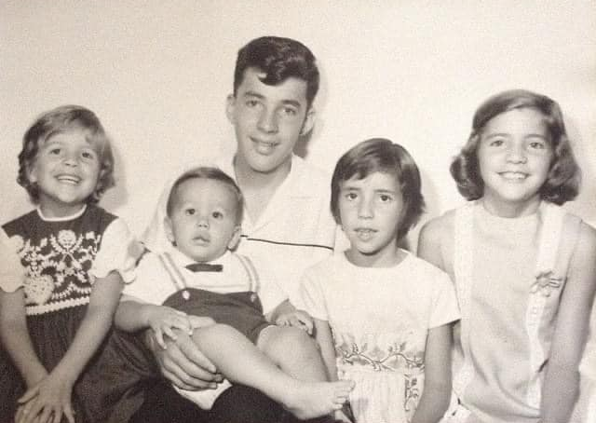

Slide 4
A Boy after God’s Own Heart
“God chose things despised by the world, things counted as nothing at all, and used them to bring to nothing what the world considers important.”
1st Corinthians 1:28, NLT
1st Samuel 16:1-13

Slide 5
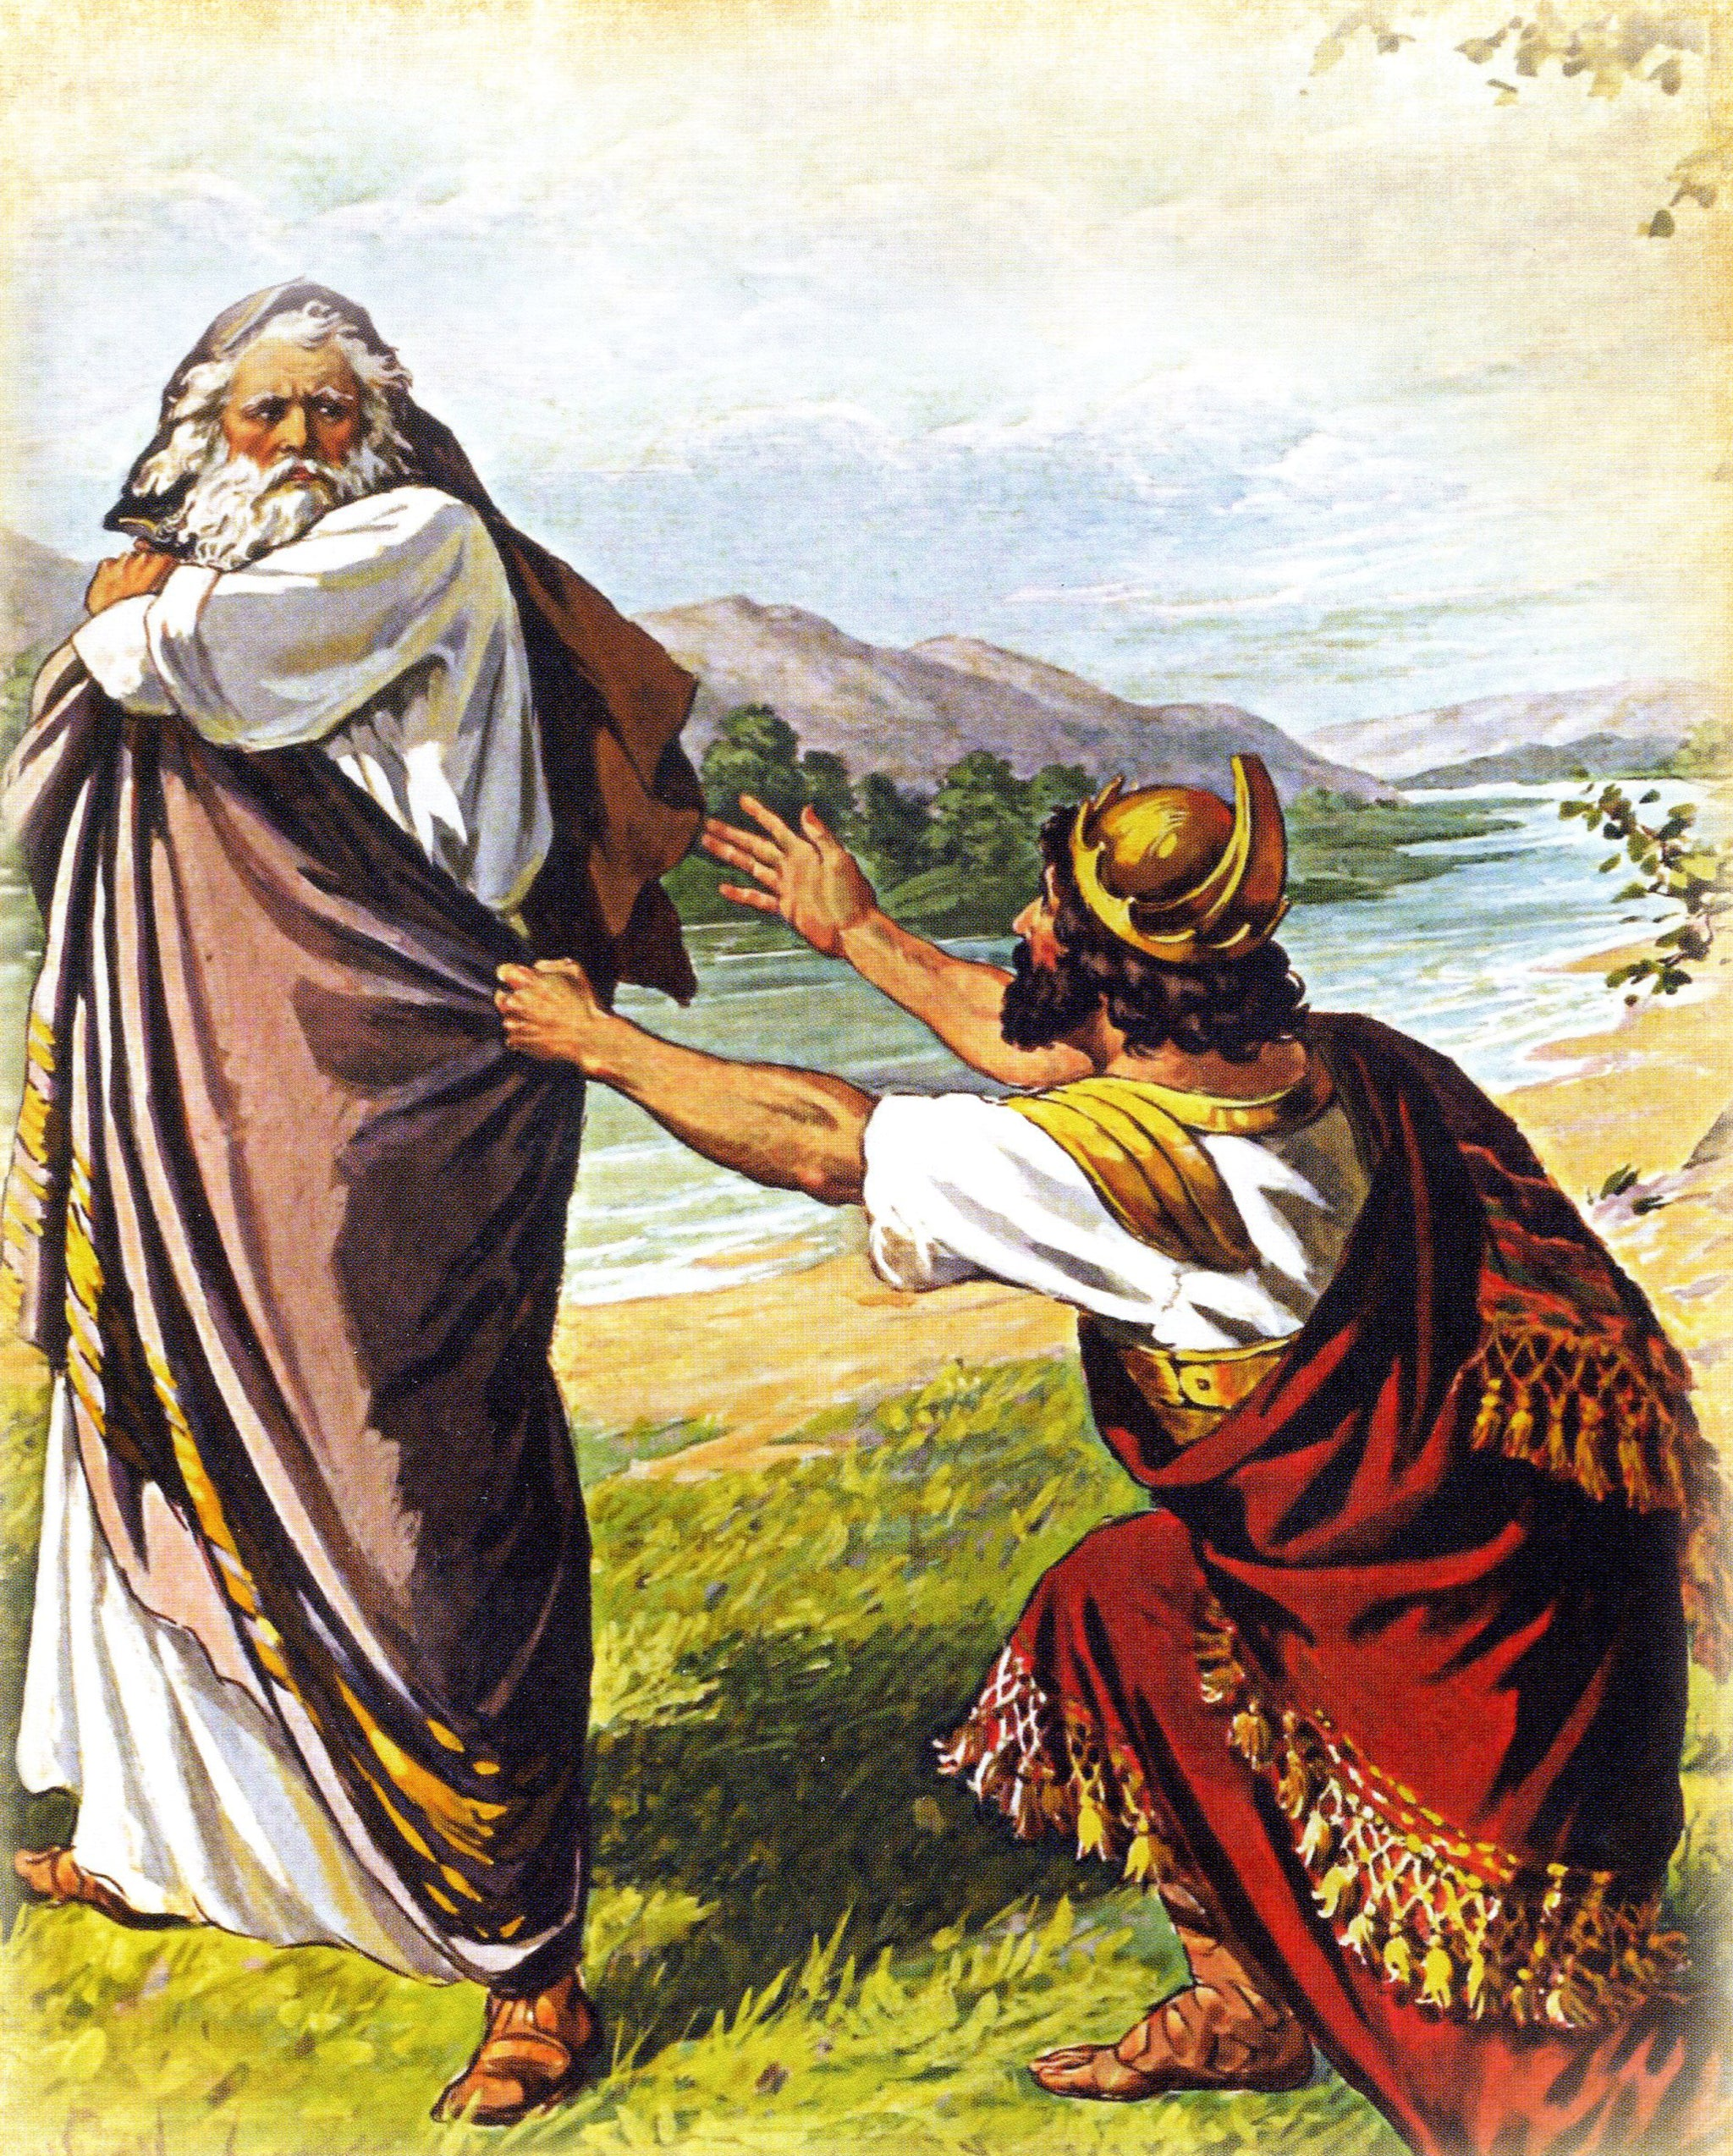
I. The Lord sends Samuel on a mission to anoint the king He has chosen (verses 1-5)
“Samuel said to Saul, ‘I will not return with you. For you have rejected the word of the Lord, and the Lord has rejected you from being king over Israel. As Samuel turned to go away, Saul seized the skirt of his robe, and it tore. And Samuel said to him, ‘The Lord has torn the kingdom of Israel from you this day and has given it to a neighbor of yours, who is better than you.’” 1st Samuel 15:26-28

Slide 6
I. The Lord sends Samuel on a mission to anoint the king He has chosen (verses 1-5)
1 The Lord said to Samuel, “How long will you grieve over Saul, since I have rejected him from being king over Israel? Fill your horn with oil, and go. I will send you to Jesse the Bethlehemite, for I have provided for myself a king among his sons.”

Slide 7
I. The Lord sends Samuel on a mission to anoint the king He has chosen (verses 1-5)
2 And Samuel said, “How can I go? If Saul hears it, he will kill me.” And the Lord said, “Take a heifer with you and say, ‘I have come to sacrifice to the Lord.’ 3 And invite Jesse to the sacrifice, and I will show you what you shall do. And you shall anoint for me him whom I declare to you.”

Slide 8
I. The Lord sends Samuel on a mission to anoint the king He has chosen (verses 1-5)
4 Samuel did what the Lord commanded and came to Bethlehem. The elders of the city came to meet him trembling and said, “Do you come peaceably?” 5 And he said, “Peaceably; I have come to sacrifice to the Lord. Consecrate yourselves, and come with me to the sacrifice.” And he consecrated Jesse and his sons and invited them to the sacrifice.

Slide 9
II. The Lord rejects human standards in choosing His king (verses 6-10)
6 When they came, he looked on Eliab and thought, “Surely the Lord’s anointed is before him.”

Slide 10
II. The Lord rejects human standards in choosing His king (verses 6-10)
7 But the Lord said to Samuel, “Do not look on his appearance or on the height of his stature, because I have rejected him. For the Lord sees not as man sees: man looks on the outward appearance, but the Lord looks on the heart.”

Slide 11
II. The Lord rejects human standards in choosing His king (verses 6-10)
8 Then Jesse called Abinadab and made him pass before Samuel. And he said, “Neither has the Lord chosen this one.” 9 Then Jesse made Shammah pass by. And he said, “Neither has the Lord chosen this one.” 10 And Jesse made seven of his sons pass before Samuel. And Samuel said to Jesse, “The Lord has not chosen these.”

Slide 12
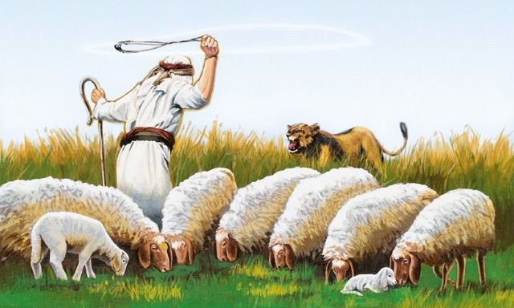
III. The Lord chooses a boy after His own heart to be king (verses 11-13)
11 Then Samuel said to Jesse, “Are all your sons here?” And he said, “There remains yet the youngest, but behold, he is keeping the sheep.” And Samuel said to Jesse, “Send and get him, for we will not sit down till he comes here.”

Slide 13
III. The Lord chooses a boy after His own heart to be king (verses 11-13)
11 Then Samuel said to Jesse, “Are all your sons here?” And he said, “There remains yet the youngest, but behold, he is keeping the sheep.” And Samuel said to Jesse, “Send and get him, for we will not sit down till he comes here.”

Slide 14
III. The Lord chooses a boy after His own heart to be king (verses 11-13)
12 And he sent and brought him in. Now he was ruddy and had beautiful eyes and was handsome. And the Lord said, “Arise, anoint him, for this is he.” 13 Then Samuel took the horn of oil and anointed him in the midst of his brothers. And the Spirit of the Lord rushed upon David from that day forward. And Samuel rose up and went to Ramah.
“He raised up David to be their king, of whom he testified and said, ‘I have found in David the son of Jesse a man after my heart, who will do all my will.’” Acts 13:22

Slide 15
III. The Lord chooses a boy after His own heart to be king (verses 11-13)
12 And he sent and brought him in. Now he was ruddy and had beautiful eyes and was handsome. And the Lord said, “Arise, anoint him, for this is he.” 13 Then Samuel took the horn of oil and anointed him in the midst of his brothers. And the Spirit of the Lord rushed upon David from that day forward. And Samuel rose up and went to Ramah.

Slide 16
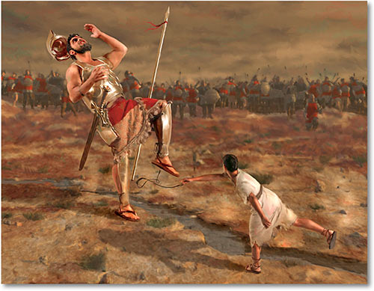
III. The Lord chooses a boy after His own heart to be king (verses 11-13)
And when the Philistine looked and saw David, he disdained him, for he was but a youth…Then David said to the Philistine, “You come to me with a sword and with a spear and with a javelin, but I come to you in the name of the Lord of hosts, the God of the armies of Israel, whom you have defied. This day the Lord will deliver you into my hand.” 1st Samuel 17:42, 45-46

Slide 17
III. The Lord chooses a boy after His own heart to be king (verses 11-13)
“God chose things despised by the world, things counted as nothing at all, and used them to bring to nothing what the world considers important.” 1st Corinthians 1:28, NLT

Slide 18
“When David, the youngest of the sons in Jesse’s family was selected as the Lord’s anointed, he joined a venerable crowd of Torah patriarchs selected by God in a way that confounded social norms. Other men who were not firstborn but who were selected by the Lord over their more socially powerful older brothers include Seth, Noah, Isaac, Jacob, Joseph, Ephraim, Moses, and perhaps Abraham. It seems that the biblical record deliberately creates the impression that Yahweh prefers to use disenfranchised members of society—earlier in 1 Samuel the barren woman Hannah and the child Samuel—to do his most significant work.” Robert Bergen

Slide 19
Imagine a church where…
When kids come to know Christ and grow in their relationship, that we’re just as deliberate in integrating them into the ministry of the church as we are with our adults.
The kids understand they have a life in Christ and are called to serve Him with their life now.
All of this happens, and no one feels weird about it or even tries to make it feel weird.
God is praised because our will isn’t an obstacle to His delight in doing great things through unexpected people, to include our kids.

Slide 20
What if we confound social norms sometimes to discover the blessing of kingdom norms.

Slide 21
Benediction

