Slide 1
Our mission as an intimate family of believers brought together by Jesus Christ is to love God, build disciples, and carry the gospel to places near and far, all by the power of the Holy Spirit and to the glory of God.

Slide 2
“Big Shoes for a young boy”
“Don’t let the excitement of youth cause you to forget your Creator. Honor him in your youth.” Ecclesiastes 12:1, NLT
1st Samuel 3:1-19

Slide 3
“Oh, my lord! As you live, my lord, I am the woman who was standing here in your presence, praying to the Lord. For this child I prayed, and the Lord has granted me my petition that I made to him. Therefore I have lent him to the Lord. As long as he lives, he is lent to the Lord.” 1st Samuel 1:26-28

Slide 4
“Big Shoes for a young boy”
1st Samuel 3:1-19

Slide 5
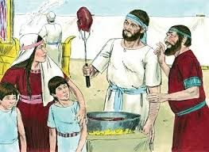
I. The Lord called Samuel as Samuel faithfully served (verses 1-9)
1 Now the boy Samuel was ministering to the Lord in the presence of Eli. And the word of the Lord was rare in those days; there was no frequent vision. 2 At that time Eli, whose eyesight had begun to grow dim so that he could not see, was lying down in his own place. 3 The lamp of God had not yet gone out, and Samuel was lying down in the temple of the Lord, where the ark of God was.

Slide 6
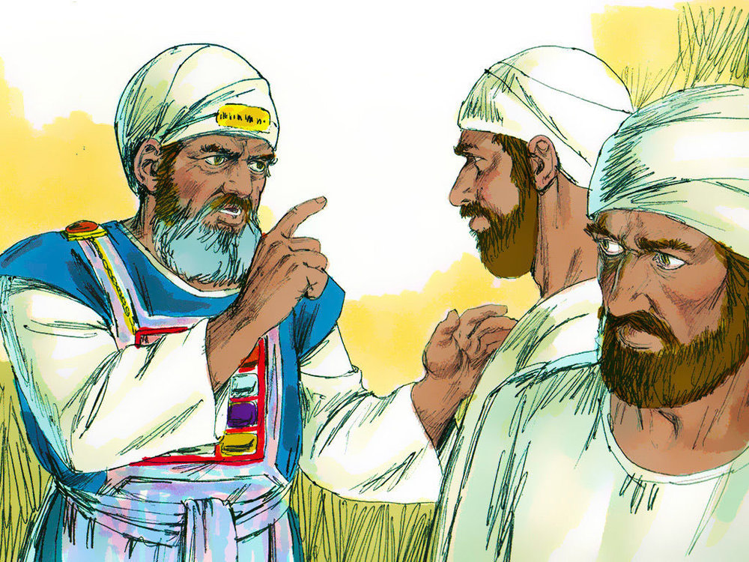
I. The Lord called Samuel as Samuel faithfully served (verses 1-9)
1 Now the boy Samuel was ministering to the Lord in the presence of Eli. And the word of the Lord was rare in those days; there was no frequent vision. 2 At that time Eli, whose eyesight had begun to grow dim so that he could not see, was lying down in his own place. 3 The lamp of God had not yet gone out, and Samuel was lying down in the temple of the Lord, where the ark of God was.

Slide 7
I. The Lord called Samuel as Samuel faithfully served (verses 1-9)
Eli was faithless and no longer worthy of hearing from the Lord. He had become spiritually blind.
1 Now the boy Samuel was ministering to the Lord in the presence of Eli. And the word of the Lord was rare in those days; there was no frequent vision. 2 At that time Eli, whose eyesight had begun to grow dim so that he could not see, was lying down in his own place. 3 The lamp of God had not yet gone out, and Samuel was lying down in the temple of the Lord, where the ark of God was.

Slide 8
I. The Lord called Samuel as Samuel faithfully served (verses 1-9)
4 Then the Lord called Samuel, and he said, “Here I am!” 5 and ran to Eli and said, “Here I am, for you called me.” But he said, “I did not call; lie down again.” So he went and lay down. 6 And the Lord called again, “Samuel! “and Samuel arose and went to Eli and said, “Here I am, for you called me.” But he said, “I did not call, my son; lie down again.”

Slide 9
I. The Lord called Samuel as Samuel faithfully served (verses 1-9)
7 Samuel did not yet know the Lord, and the word of the Lord had not yet been revealed to him.

Slide 10
I. The Lord called Samuel as Samuel faithfully served (verses 1-9)
8 And the Lord called Samuel again the third time. And he arose and went to Eli and said, “Here I am, for you called me.” Then Eli perceived that the Lord was calling the boy. 9 Therefore Eli said to Samuel, “Go, lie down, and if he calls you, you shall say, ‘Speak, Lord, for your servant hears.’” So Samuel went and lay down in his place.

Slide 11
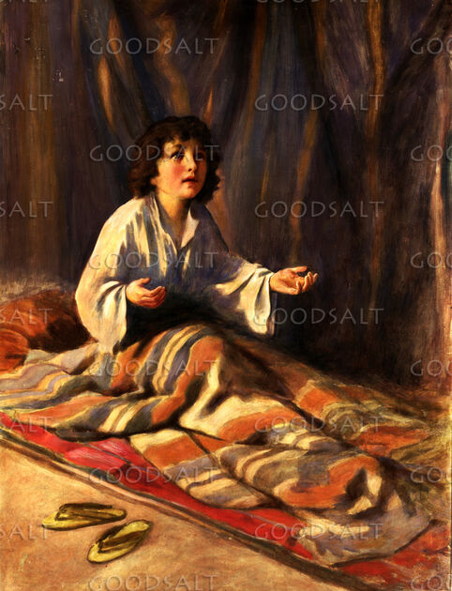
II. The Lord called Samuel to serve in a matter of great importance (verses 10-14)
10 And the Lord came and stood, calling as at other times, “Samuel! Samuel!” And Samuel said, “Speak, for your servant hears.”
“The angel of the Lord called to him from heaven and said, ‘Abraham, Abraham!’ And he said, ‘Here I am.’” Genesis 22:11

Slide 12
II. The Lord called Samuel to serve in a matter of great importance (verses 10-14)
10 And the Lord came and stood, calling as at other times, “Samuel! Samuel!” And Samuel said, “Speak, for your servant hears.”
“God called to him out of the bush, ‘Moses, Moses!’ And he said, ‘Here I am.’” Exodus 3:4

Slide 13
II. The Lord called Samuel to serve in a matter of great importance (verses 10-14)
11 Then the Lord said to Samuel, “Behold, I am about to do a thing in Israel at which the two ears of everyone who hears it will tingle. 12 On that day I will fulfill against Eli all that I have spoken concerning his house, from beginning to end. 13 And I declare to him that I am about to punish his house forever, for the iniquity that he knew, because his sons were blaspheming God, and he did not restrain them. 14 Therefore I swear to the house of Eli that the iniquity of Eli’s house shall not be atoned for by sacrifice or offering forever.”

Slide 14
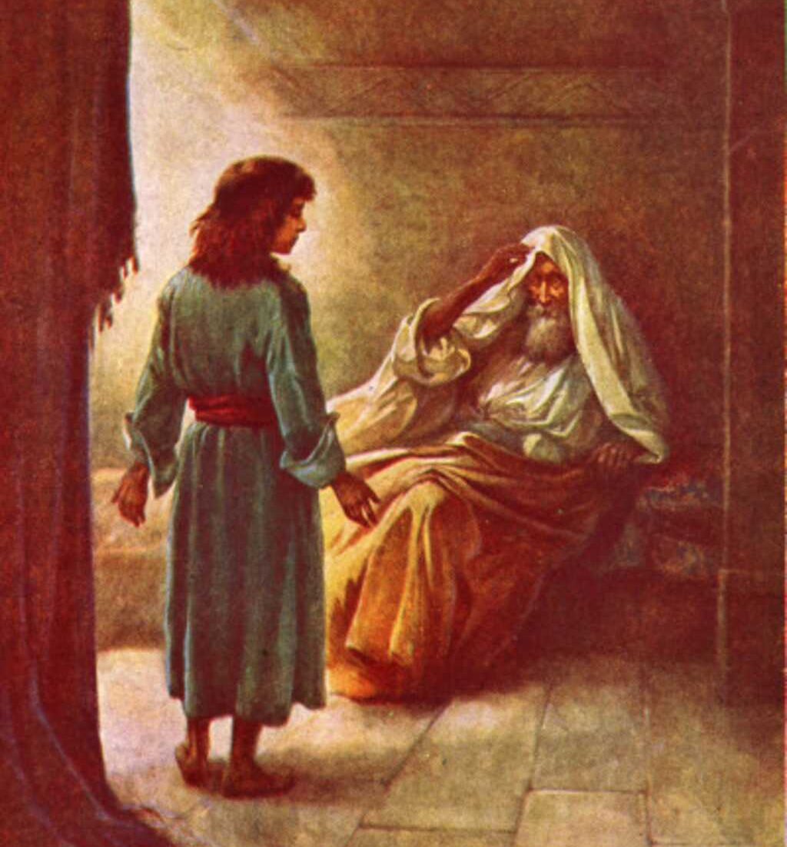
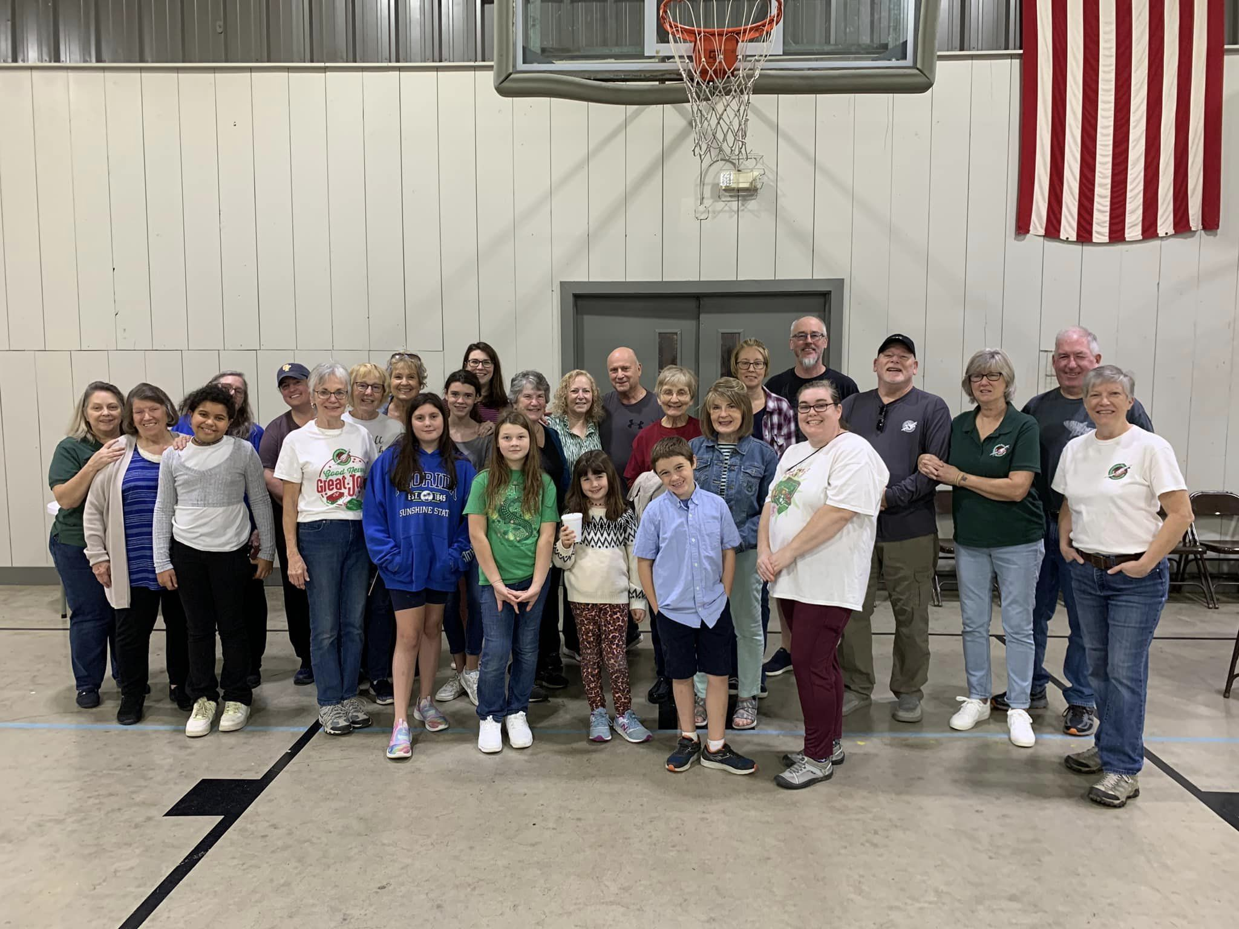
III. The Lord enabled Samuel to serve Him courageously and faithfully (verses 15-19)
15 Samuel lay until morning; then he opened the doors of the house of the Lord. And Samuel was afraid to tell the vision to Eli.

Slide 15
III. The Lord enabled Samuel to serve Him courageously and faithfully (verses 15-19)
16 But Eli called Samuel and said, “Samuel, my son.” And he said, “Here I am.” 17 And Eli said, “What was it that he told you? Do not hide it from me. May God do so to you and more also if you hide anything from me of all that he told you.” 18 So Samuel told him everything and hid nothing from him. And he said, “It is the Lord. Let him do what seems good to him.”

Slide 16
III. The Lord enabled Samuel to serve Him courageously and faithfully (verses 15-19)
When you come to know the Lord by placing your faith and trust in Jesus Christ, Samuel’s example teaches you a lot about what your new life in Christ looks like. You may be serving Him in what appears to be little ways, but God can do great things through the little things you’re doing. And if He calls you to do bigger things, remember, it’s never about what you can do. It’s always about what He can do through you, and nothing is too big for Him.

Slide 17
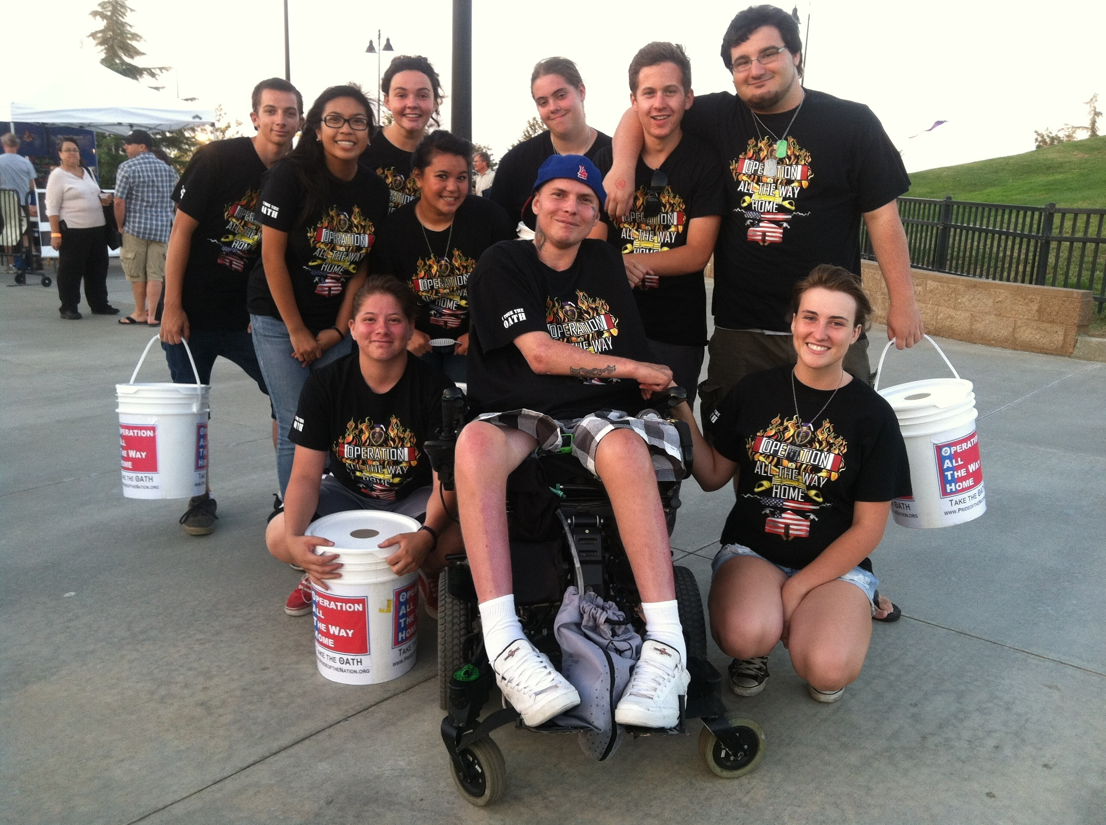
III. The Lord enabled Samuel to serve Him courageously and faithfully (verses 15-19)

Slide 18
III. The Lord enabled Samuel to serve Him courageously and faithfully (verses 15-19)
He builds a relationship with you as He faithfully leads you through the life He calls you to live.
19 And Samuel grew, and the Lord was with him and let none of his words fall to the ground.
“Oh, taste and see that the Lord is good!” Psalm 34:8
“I know who God has created me to be and how my purpose fits with his plans for the world.”

