Slide 1
Scripture Reading
Matthew 27:62 – 28:15
Page 992-93 in the seat back bibles

Slide 2
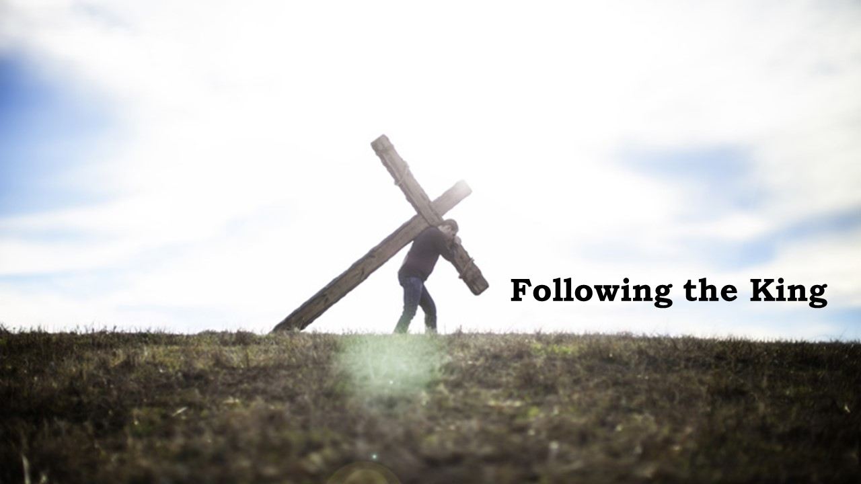
“It was the best of times, it was the worst of times, it was the age of wisdom, it was the age of foolishness, it was the epoch of belief, it was the epoch of incredulity, it was the season of Light, it was the season of Darkness…” Charles Dickens, A Tale of Two Cities

Slide 3
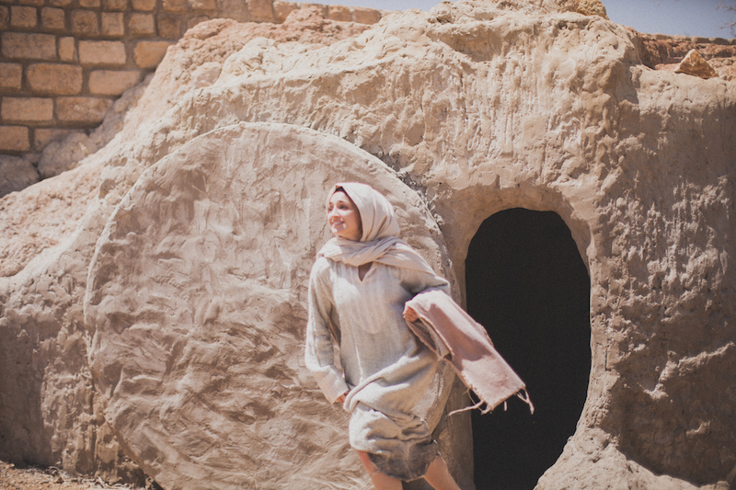
A Tale of two kingdoms
Matthew 27:62 – 28:15
…Christ the firstfruits, then at his coming those who belong to Christ. 1st Corinthians 15:23

Slide 4
I. The Jewish religious leaders sought to bury the truth about the King
“God raised him up, loosing the pangs of death, because it was not possible for him to be held by it.” Acts 2:24

Slide 5
I. The Jewish religious leaders sought to bury the truth about the King
The Jewish religious leaders sought to contain the resurrection by the power of Rome (verses 62-66)
62 The next day, that is, after the day of Preparation, the chief priests and the Pharisees gathered before Pilate 63 and said, “Sir, we remember how that impostor said, while he was still alive, ‘After three days I will rise.’ 64 Therefore order the tomb to be made secure until the third day, lest his disciples go and steal him away and tell the people, ‘He has risen from the dead,’ and the last fraud will be worse than the first.”

Slide 6
I. The Jewish religious leaders sought to bury the truth about the King
The Jewish religious leaders sought to contain the resurrection by the power of Rome (verses 62-66)
65 Pilate said to them, “You have a guard of soldiers. Go, make it as secure as you can.” 66 So they went and made the tomb secure by sealing the stone and setting a guard.

Slide 7
I. The Jewish religious leaders sought to bury the truth about the King
The power of Rome withered before the power of God (verses 1-4)
“The kings of the earth set themselves, and the rulers take counsel together, against the Lord and against his Anointed, saying ‘Let us burst their bonds apart and cast away their cords from us.’ He who sits in the heavens laughs; the Lord holds them in derision.” Psalm 2:2-4

Slide 8
I. The Jewish religious leaders sought to bury the truth about the King
The power of Rome withered before the power of God (verses 1-4)
1 Now after the Sabbath, toward the dawn of the first day of the week, Mary Magdalene and the other Mary went to see the tomb. 2 And behold, there was a great earthquake, for an angel of the Lord descended from heaven and came and rolled back the stone and sat on it. 3 His appearance was like lightning, and his clothing white as snow.

Slide 9
I. The Jewish religious leaders sought to bury the truth about the King
The power of Rome withered before the power of God (verses 1-4)
4 And for fear of him the guards trembled and became like dead men.

Slide 10
I. The Jewish religious leaders sought to bury the truth about the King
Rome’s power was reduced to a testimony of lies (verses 11-15)
11 While they were going, behold, some of the guard went into the city and told the chief priests all that had taken place. 12 And when they had assembled with the elders and taken counsel, they gave a sufficient sum of money to the soldiers 13 and said, “Tell people, ‘His disciples came by night and stole him away while we were asleep.’ 14 And if this comes to the governor’s ears, we will satisfy him and keep you out of trouble.”

Slide 11
I. The Jewish religious leaders sought to bury the truth about the King
Rome’s power was reduced to a testimony of lies (verses 11-15)
15 So they took the money and did as they were directed. And this story has been spread among the Jews to this day.
“Christ Jesus is the one who died—more than that, who was raised—who is at the right hand of God, who indeed is interceding for us.” Romans 8:34

Slide 12
II. The King raised the truth up from the grave
“I lay down my life that I may take it up again. No one takes it from me, but I lay it down of my own accord. I have authority to lay it down, and I have authority to take it up again.” John 10:17-18

Slide 13
II. The King raised the truth up from the grave
The King’s power is made perfect in weakness (verses 1-7)
1 Now after the Sabbath, toward the dawn of the first day of the week, Mary Magdalene and the other Mary went to see the tomb.
“On the evening of that day, the first day of the week, the doors being locked where the disciples were for fear of the Jews…” John 20:19
4 And for fear of him the guards trembled and became like dead men.

Slide 14
II. The King raised the truth up from the grave
The King’s power is made perfect in weakness (verses 1-7)
4 And for fear of him the guards trembled and became like dead men. 5 But the angel said to the women, “Do not be afraid, for I know that you seek Jesus who was crucified.
“My grace is sufficient for you, for my power is made perfect in weakness.” 2nd Corinthians 12:9

Slide 15
II. The King raised the truth up from the grave
The King’s power is made perfect in weakness (verses 1-7)
Unlike the guards, the women are fit for further direction.
6 He is not here, for he has risen, as he said. Come, see the place where he lay. 7 Then go quickly and tell his disciples that he has risen from the dead, and behold, he is going before you to Galilee; there you will see him. See, I have told you.”

Slide 16
II. The King raised the truth up from the grave
The King’s victory is proclaimed by those who “Go!” (verses 8-10)
8 So they departed quickly from the tomb with fear and great joy, and ran to tell his disciples. 9 And behold, Jesus met them and said, “Greetings!” And they came up and took hold of his feet and worshiped him.

Slide 17
II. The King raised the truth up from the grave
The King’s victory is proclaimed by those who “Go!” (verses 8-10)
8 So they departed quickly from the tomb with fear and great joy, and ran to tell his disciples. 9 And behold, Jesus met them and said, “Greetings!”* And they came up and took hold of his feet and worshiped him.
* I am glad to see you!

Slide 18
II. The King raised the truth up from the grave
The King’s victory is proclaimed by those who “Go!” (verses 8-10)
10 Then Jesus said to them, “Do not be afraid; go and tell my brothers to go to Galilee, and there they will see me.”
“Then he appeared to more than five hundred brothers at one time, most of whom are still alive.” 1st Corinthians 15:6

Slide 19
GO tell the Disciples!!!
GO to the nations!!!
GO to Galilee!!!

Slide 20
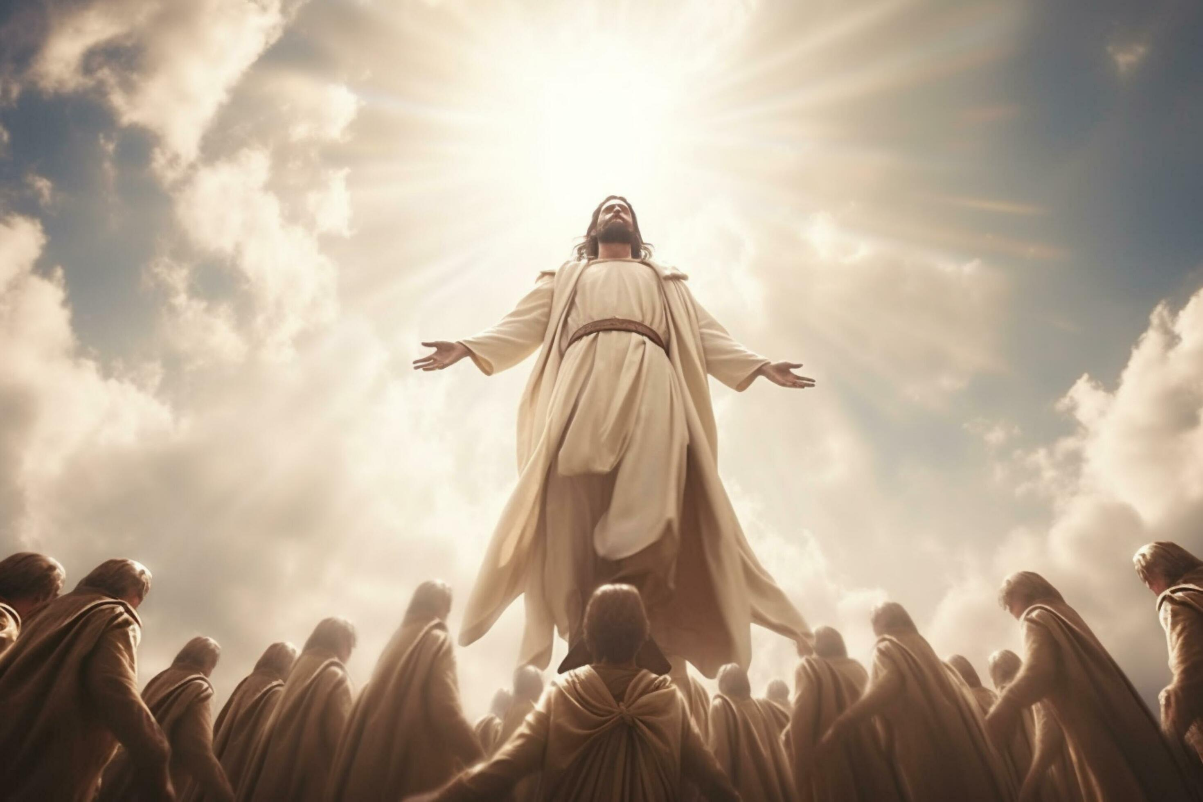
Benediction

