Slide 1
Scripture Reading
Matthew 26:1-16
Pages 988-89 in the seat back bibles

Slide 2
“Men of Israel, hear these words: Jesus of Nazareth, a man attested to you by God with mighty works and wonders and signs that God did through him in your midst, as you yourselves know— this Jesus, delivered up according to the definite plan and foreknowledge of God, you crucified and killed by the hands of lawless men.” Acts 2:22-23

Slide 3
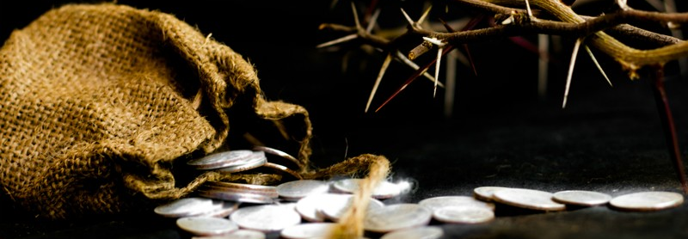
The triumphal exit
“For this reason the Father loves me, because I lay down my life that I may take it up again. No one takes it from me, but I lay it down of my own accord. I have authority to lay it down, and I have authority to take it up again.” John 10:17-18
Matthew 26:1-16

Slide 4
I. The King is Lord over the wicked plots of men (verses 1-5)
1 When Jesus had finished all these sayings, he said to his disciples, 2 “You know that after two days the Passover is coming, and the Son of Man will be delivered up to be crucified.”

Slide 5
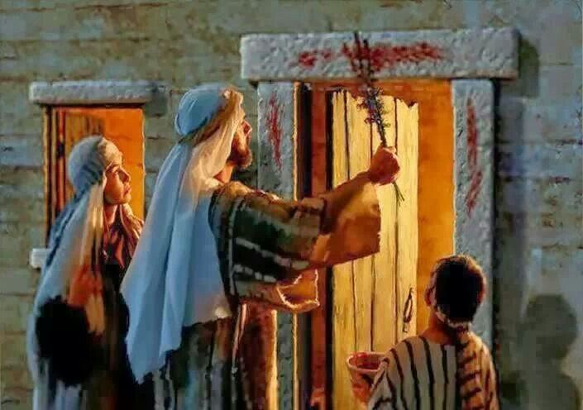
I. The King is Lord over the wicked plots of men (verses 1-5)
1 When Jesus had finished all these sayings, he said to his disciples, 2 “You know that after two days the Passover is coming, and the Son of Man will be delivered up to be crucified.”

Slide 6
I. The King is Lord over the wicked plots of men (verses 1-5)
3 Then the chief priests and the elders of the people gathered in the palace of the high priest, whose name was Caiaphas, 4 and plotted together in order to arrest Jesus by stealth and kill him. 5 But they said, “Not during the feast, lest there be an uproar among the people.”
“What are we to do? For this man performs many signs. If we let him go on like this, everyone will believe in him, and the Romans will come and take away both our place and our nation.” John 11:47-48

Slide 7
II. The King is worthy of all honor and praise (verses 6-13)
6 Now when Jesus was at Bethany in the house of Simon the leper, 7 a woman came up to him with an alabaster flask of very expensive ointment, and she poured it on his head as he reclined at table.
“The house was filled with the fragrance of the perfume.” John 12:3

Slide 8
II. The King is worthy of all honor and praise (verses 6-13)
8 And when the disciples saw it, they were indignant, saying, “Why this waste? 9 For this could have been sold for a large sum and given to the poor.”
“There were some who said to themselves indignantly.” Mark 14:4
Judas Iscariot…said “Why…?” John 12:4-5

Slide 9
II. The King is worthy of all honor and praise (verses 6-13)
8 And when the disciples saw it, they were indignant, saying, “Why this waste? 9 For this could have been sold for a large sum and given to the poor.”
“But when the chief priests and the scribes saw the wonderful things that he did, and the children crying out in the temple, ‘Hosanna to the Son of David!’ they were indignant.” Matthew 21:15

Slide 10
II. The King is worthy of all honor and praise (verses 6-13)
10 But Jesus, aware of this, said to them, “Why do you trouble the woman? For she has done a beautiful thing to me. 11 For you always have the poor with you, but you will not always have me.
“But blessed are your eyes, for they see, and your ears, for they hear. For truly, I say to you, many prophets and righteous people longed to see what you see, and did not see it, and to hear what you hear, and did not hear it.” Matthew 13:16-17

Slide 11
II. The King is worthy of all honor and praise (verses 6-13)
12 In pouring this ointment on my body, she has done it to prepare me for burial. 13 Truly, I say to you, wherever this gospel is proclaimed in the whole world, what she has done will also be told in memory of her.”
8 …“Why this waste?

Slide 12
III. The King is detested by friend and foe alike (verses 14-16)
14 Then one of the twelve, whose name was Judas Iscariot, went to the chief priests 15 and said, “What will you give me if I deliver him over to you?” And they paid him thirty pieces of silver. 16 And from that moment he sought an opportunity to betray him.

Slide 13
III. The King is detested by friend and foe alike (verses 14-16)
14 Then one of the twelve, whose name was Judas Iscariot, went to the chief priests 15 and said, “What will you give me if I deliver him over to you?” And they paid him thirty pieces of silver. 16 And from that moment he sought an opportunity to betray him.

Slide 14
III. The King is detested by friend and foe alike (verses 14-16)
15 and said, “What will you give me if I deliver him over to you?” And they paid him thirty pieces of silver.
“So I became the shepherd of the flock doomed to be slaughtered.” Zechariah 11:7
“But I became impatient with them, and they also detested me.” Zechariah 11:8

Slide 15
III. The King is detested by friend and foe alike (verses 14-16)
15 and said, “What will you give me if I deliver him over to you?” And they paid him thirty pieces of silver.
“Then I said to them, ‘If it seems good to you, give me my wages; but if not, keep them.’ And they weighed out as my wages thirty pieces of silver. Then the Lord said to me, “Throw it to the potter”—the lordly price at which I was priced by them. So I took the thirty pieces of silver and threw them into the house of the Lord, to the potter.” Zechariah 11:12-13

Slide 16
III. The King is detested by friend and foe alike (verses 14-16)
The cross was His greater purpose in coming. His “Triumphal exit” without which true Hosannas could not be possible. His “Triumphal exit” by which “he will save his people from their sins.” (Matthew 1:21) The true Passover was coming when “the Lamb of God…takes away the sin of the world.” (John 1:29)

Slide 17
Benediction

