Slide 1
Scripture Reading
Matthew 24:42 – 25:30
Pages 987-88 in the seat back bibles

Slide 2
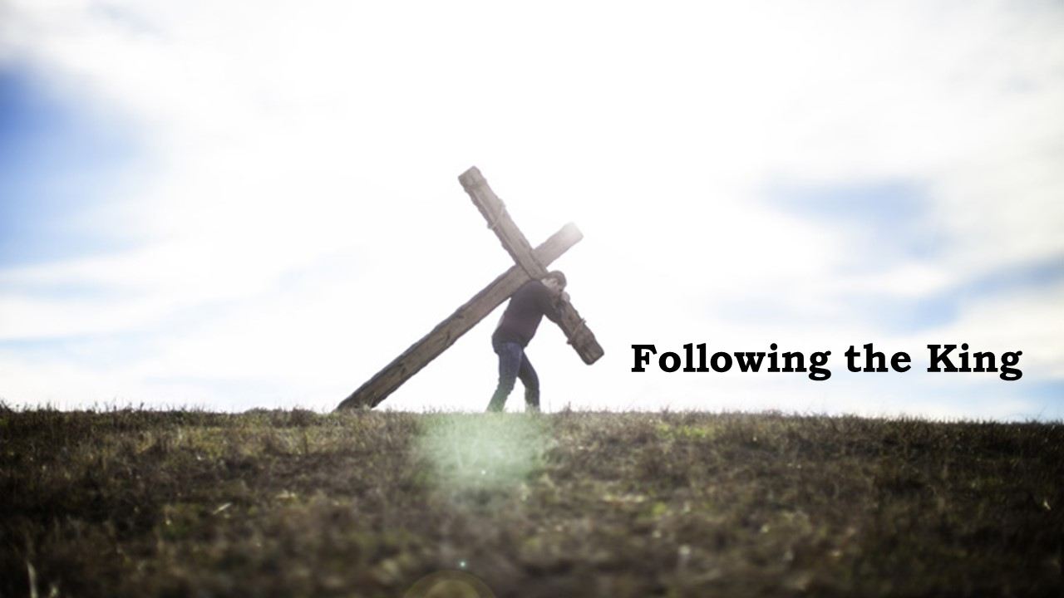
“Without a biblical worldview, all the great teaching goes in one ear and out the other. There are no intellectual pegs…in the mind of the individual to hang these truths on. So, they just pass through. They don’t stick. They don’t make a difference.”
George Barna

Slide 3


Enter into the joy of your master!
Matthew 24:42-25:30

Slide 4
I. Faithfully serve the King at all times until He returns (verses 42-51)
42 Therefore, stay awake, for you do not know on what day your Lord is coming. 43 But know this, that if the master of the house had known in what part of the night the thief was coming, he would have stayed awake and would not have let his house be broken into. 44 Therefore you also must be ready, for the Son of Man is coming at an hour you do not expect.

Slide 5
I. Faithfully serve the King at all times until He returns (verses 42-51)
45“Who then is the faithful and wise servant, whom his master has set over his household, to give them their food at the proper time? 46 Blessed is that servant whom his master will find so doing when he comes. 47 Truly, I say to you, he will set him over all his possessions.

Slide 6
I. Faithfully serve the King at all times until He returns (verses 42-51)
45“Who then is the faithful and wise servant, whom his master has set over his household, to give them their food at the proper time? 46 Blessed is that servant whom his master will find so doing when he comes. 47 Truly, I say to you, he will set him over all his possessions.
As His servants, we are the Father’s children, “and if children, then heirs—heirs of God and fellow heirs with Christ, provided we suffer with him in order that we may also be glorified with him.” Romans 8:17

Slide 7
I. Faithfully serve the King at all times until He returns (verses 42-51)
48 But if that wicked servant says to himself, ‘My master is delayed,’ 49 and begins to beat his fellow servants and eats and drinks with drunkards, 50 the master of that servant will come on a day when he does not expect him and at an hour he does not know 51 and will cut him in pieces and put him with the hypocrites. In that place there will be weeping and gnashing of teeth.
“Not only is it obedient to stay the course of faithfulness, but it is a lot less work than trying to reform a corrupt life.” Stu Weber

Slide 8
II. Always be prepared for the King’s return (verses 1-13)
24:42 Therefore, stay awake…
25:13 Watch therefore, for you know neither the day nor the hour.
In this parable, Jesus is still emphasizing our need to be prepared for His coming with a sense of urgency, purpose, and determination.
25:1 “Then the kingdom of heaven will be like ten virgins who took their lamps and went to meet the bridegroom.

Slide 9
II. Always be prepared for the King’s return (verses 1-13)
2 Five of them were foolish,* and five were wise. 3 For when the foolish took their lamps, they took no oil with them, 4 but the wise took flasks of oil with their lamps.
* Or “stupid” (the Greek word μωρός from which we get our word “moron”)

Slide 10
II. Always be prepared for the King’s return (verses 1-13)
2 Five of them were foolish,* and five were wise. 3 For when the foolish took their lamps, they took no oil with them, 4 but the wise took flasks of oil with their lamps.
* Or “stupid” (the Greek word μωρός from which we get our word “moron”)

Slide 11
II. Always be prepared for the King’s return (verses 1-13)
5 As the bridegroom was delayed, they all became drowsy and slept. 6 But at midnight there was a cry, ‘Here is the bridegroom! Come out to meet him.’ 7 Then all those virgins rose and trimmed their lamps. 8 And the foolish said to the wise, ‘Give us some of your oil, for our lamps are going out.’ 9 But the wise answered, saying, ‘Since there will not be enough for us and for you, go rather to the dealers and buy for yourselves.’

Slide 12
II. Always be prepared for the King’s return (verses 1-13)
“For godly grief produces a repentance that leads to salvation without regret, whereas worldly grief produces death.” 2nd Corinthians 7:10
“For see what earnestness this godly grief has produced in you, but also what eagerness to clear yourselves, what indignation, what fear, what longing, what zeal, what punishment! At every point you have proved yourselves innocent in the matter.” 2nd Corinthians 7:11

Slide 13
II. Always be prepared for the King’s return (verses 1-13)
10 And while they were going to buy, the bridegroom came, and those who were ready went in with him to the marriage feast, and the door was shut. 11 Afterward the other virgins came also, saying, ‘Lord, lord, open to us.’ 12 But he answered, ‘Truly, I say to you, I do not know you.’
13 Watch therefore, for you know neither the day nor the hour.

Slide 14
III. In faith, hope, and love, invest all that the King has entrusted to you for His purposes (verses 14-30)
14 “For it will be like a man going on a journey, who called his servants and entrusted to them his property. 15 To one he gave five talents, to another two, to another one, to each according to his ability. Then he went away. 16 He who had received the five talents went at once and traded with them, and he made five talents more. 17 So also he who had the two talents made two talents more. 18 But he who had received the one talent went and dug in the ground and hid his master’s money.

Slide 15
III. In faith, hope, and love, invest all that the King has entrusted to you for His purposes (verses 14-30)
It doesn’t matter what He has given you. It matters that we are faithful with what He has entrusted to us.

Slide 16
III. In faith, hope, and love, invest all that the King has entrusted to you for His purposes (verses 14-30)
19 Now after a long time the master of those servants came and settled accounts with them.
“They will say, ‘Where is the promise of his coming? For ever since the fathers fell asleep, all things are continuing as they were from the beginning of creation.’ 2nd Peter 3:4

Slide 17
III. In faith, hope, and love, invest all that the King has entrusted to you for His purposes (verses 14-30)
20 And he who had received the five talents came forward, bringing five talents more, saying, ‘Master, you delivered to me five talents; here, I have made five talents more.’ 21 His master said to him, ‘Well done, good and faithful servant. You have been faithful over a little; I will set you over much. Enter into the joy of your master.’ 22 And he also who had the two talents came forward, saying, ‘Master, you delivered to me two talents; here, I have made two talents more.’ 23 His master said to him, ‘Well done, good and faithful servant. You have been faithful over a little; I will set you over much. Enter into the joy of your master.’

Slide 18
III. In faith, hope, and love, invest all that the King has entrusted to you for His purposes (verses 14-30)
20 And he who had received the five talents came forward, bringing five talents more, saying, ‘Master, you delivered to me five talents; here, I have made five talents more.’ 21 His master said to him, ‘Well done, good and faithful servant. You have been faithful over a little; I will set you over much. Enter into the joy of your master.’ 22 And he also who had the two talents came forward, saying, ‘Master, you delivered to me two talents; here, I have made two talents more.’ 23 His master said to him, ‘Well done, good and faithful servant. You have been faithful over a little; I will set you over much. Enter into the joy of your master.’

Slide 19
III. In faith, hope, and love, invest all that the King has entrusted to you for His purposes (verses 14-30)
24 He also who had received the one talent came forward, saying, ‘Master, I knew you to be a hard man, reaping where you did not sow, and gathering where you scattered no seed, 25 so I was afraid, and I went and hid your talent in the ground. Here, you have what is yours.’ 26 But his master answered him, ‘You wicked and slothful servant! You knew that I reap where I have not sown and gather where I scattered no seed? 27 Then you ought to have invested my money with the bankers, and at my coming I should have received what was my own with interest.

Slide 20
III. In faith, hope, and love, invest all that the King has entrusted to you for His purposes (verses 14-30)
28 So take the talent from him and give it to him who has the ten talents. 29 For to everyone who has will more be given, and he will have an abundance. But from the one who has not, even what he has will be taken away. 30 And cast the worthless servant into the outer darkness. In that place there will be weeping and gnashing of teeth.’

Slide 21
III. In faith, hope, and love, invest all that the King has entrusted to you for His purposes (verses 14-30)
28 So take the talent from him and give it to him who has the ten talents. 29 For to everyone who has will more be given, and he will have an abundance. But from the one who has not, even what he has will be taken away. 30 And cast the worthless servant into the outer darkness. In that place there will be weeping and gnashing of teeth.’

Slide 22
A much better ending
“For the wages of sin is death, but the free gift of God is eternal life in Christ Jesus our Lord.” Romans 6:23

Slide 23
Enter into the joy of your master!

Slide 24
Benediction

