Slide 2
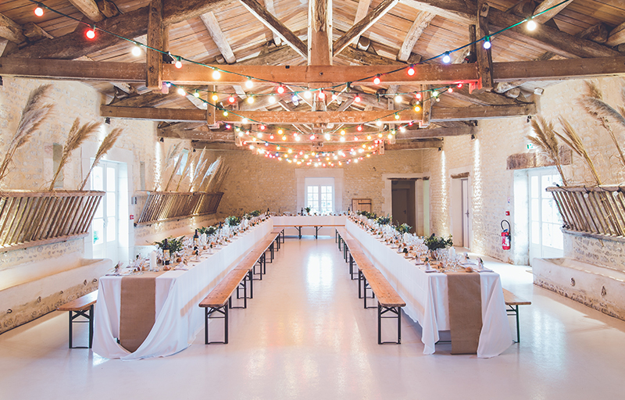
Matthew
22:1-14
Many are invited but few are chosen

Slide 3
I. God’s grace towards the Jewish ruling authorities was exhaustive (verses 1-4)
1 And again Jesus spoke to them in parables, saying, 2“The kingdom of heaven may be compared to a king who gave a wedding feast* for his son, 3 and sent his servants to call those who were invited to the wedding feast, but they would not come. 4 Again he sent other servants, saying, ‘Tell those who are invited, “See, I have prepared my dinner, my oxen and my fat calves have been slaughtered, and everything is ready. Come to the wedding feast.”’
* See Revelation 19:7

Slide 4
II. The Jewish ruling authorities had exhausted God’s grace (verses 5-8)
5 But they paid no attention and went off, one to his farm, another to his business, 6 while the rest seized his servants, treated them shamefully, and killed them.
5 But they made light of it… New Revised Standard Version

Slide 5
II. The Jewish ruling authorities had exhausted God’s grace (verses 5-8)
7 The king was angry, and he sent his troops and destroyed those murderers and burned their city. 8 Then he said to his servants, ‘The wedding feast is ready, but those invited were not* worthy.
* Imperfect tense – repeated action in the past

Slide 6
II. The Jewish ruling authorities had exhausted God’s grace (verses 5-8)
7 The king was angry, and he sent his troops and destroyed those murderers and burned their city. 8 Then he said to his servants, ‘The wedding feast is ready, but those invited were not worthy.
“O Jerusalem, Jerusalem, the city that kills the prophets and stones those who are sent to it! How often would I have gathered your children together as a hen gathers her brood under her wings, and you were not willing! Behold, your house is forsaken.” Luke 13:34-35

Slide 7
III. God’s grace is available to all through His Son (verses 9-10)
9 Go therefore to the main roads and invite to the wedding feast as many as you find.’ 10 And those servants went out into the roads and gathered all whom they found, both bad and good. So the wedding hall was filled with guests.
“Worthy are you to take the scroll and to open its seals, for you were slain, and by your blood you ransomed people for God from every tribe and language and people and nation, and you have made them a kingdom and priests to our God, and they shall reign on the earth.” Revelation 5:9-10

Slide 8
IV. Many are invited but few are chosen (verses 11-14)
11“But when the king came in to look at the guests, he saw there a man who had no wedding garment. 12 And he said to him, 'Friend,* how did you get in here without a wedding garment?’ And he was speechless. 13 Then the king said to the attendants, ‘Bind him hand and foot and cast him into the outer darkness. In that place there will be weeping and gnashing of teeth.’
* Someone who has some association with the broader group, but not the necessary association to be part of the broader group

Slide 9
IV. Many are invited but few are chosen (verses 11-14)
14 “ For many are invited, but few are chosen.” NIV
“The Lord…is patient toward you, not wishing that any should perish, but that all should reach repentance.” 2nd Peter 3:9
“Who then can be saved?” (Matthew 19:25) and Jesus’ response “With man this is impossible, but with God all things are possible.” (Matthew 19:26)

Slide 10
IV. Many are invited but few are chosen (verses 11-14)
14 “ For many are invited, but few are chosen.” NIV
“For the gate is narrow and the way is hard that leads to life, and those who find it are few.” Matthew 7:14
“And Isaiah cries out concerning Israel: ‘Though the number of the sons of Israel be as the sand of the sea, only a remnant of them will be saved.’” Romans 9:27

Slide 11
IV. Many are invited but few are chosen (verses 11-14)
14 “ For many are invited, but few are chosen.” NIV
Claims to being a Christian nation based on identity and culture distort the nature of the gospel and the church by forcing upon both the belief that they conform to this world and not to the truth of God’s word, typically out of an ignorance over what God’s word actually teaches!

Slide 12
IV. Many are invited but few are chosen (verses 11-14)
14 “ For many are invited, but few are chosen.” NIV
“And I saw no temple in the city, for its temple is the Lord God the Almighty and the Lamb. And the city has no need of sun or moon to shine on it, for the glory of God gives it light, and its lamp is the Lamb. By its light will the nations walk, and the kings of the earth will bring their glory into it, and its gates will never be shut by day—and there will be no night there. They will bring into it the glory and the honor of the nations. But nothing unclean will ever enter it, nor anyone who does what is detestable or false, but only those who are written in the Lamb’s book of life.” Revelation 21:22-27

Slide 13
Benediction

