Slide 1
Scripture Reading
Numbers 6:22-27
Page 135 in the seat back bibles

Slide 2
The Lord bless you and keep you
Numbers 6:22-27

Slide 3
Numbers 6:22-27
22 The Lord spoke to Moses, saying, 23 “Speak to Aaron and his sons, saying, Thus you shall bless the people of Israel: you shall say to them, 24 The Lord bless you and keep you; 25 the Lord make his face to shine upon you and be gracious to you; 26 the Lord lift up his countenance upon you and give you peace. 27 “So shall they put my name upon the people of Israel, and I will bless them.”

Slide 4
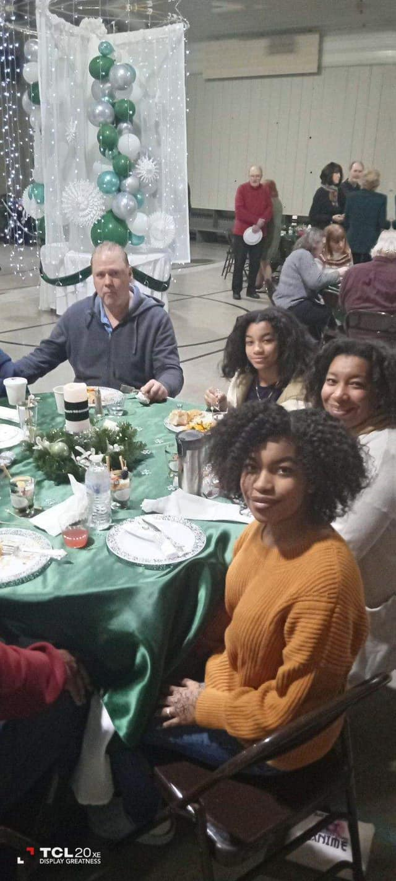
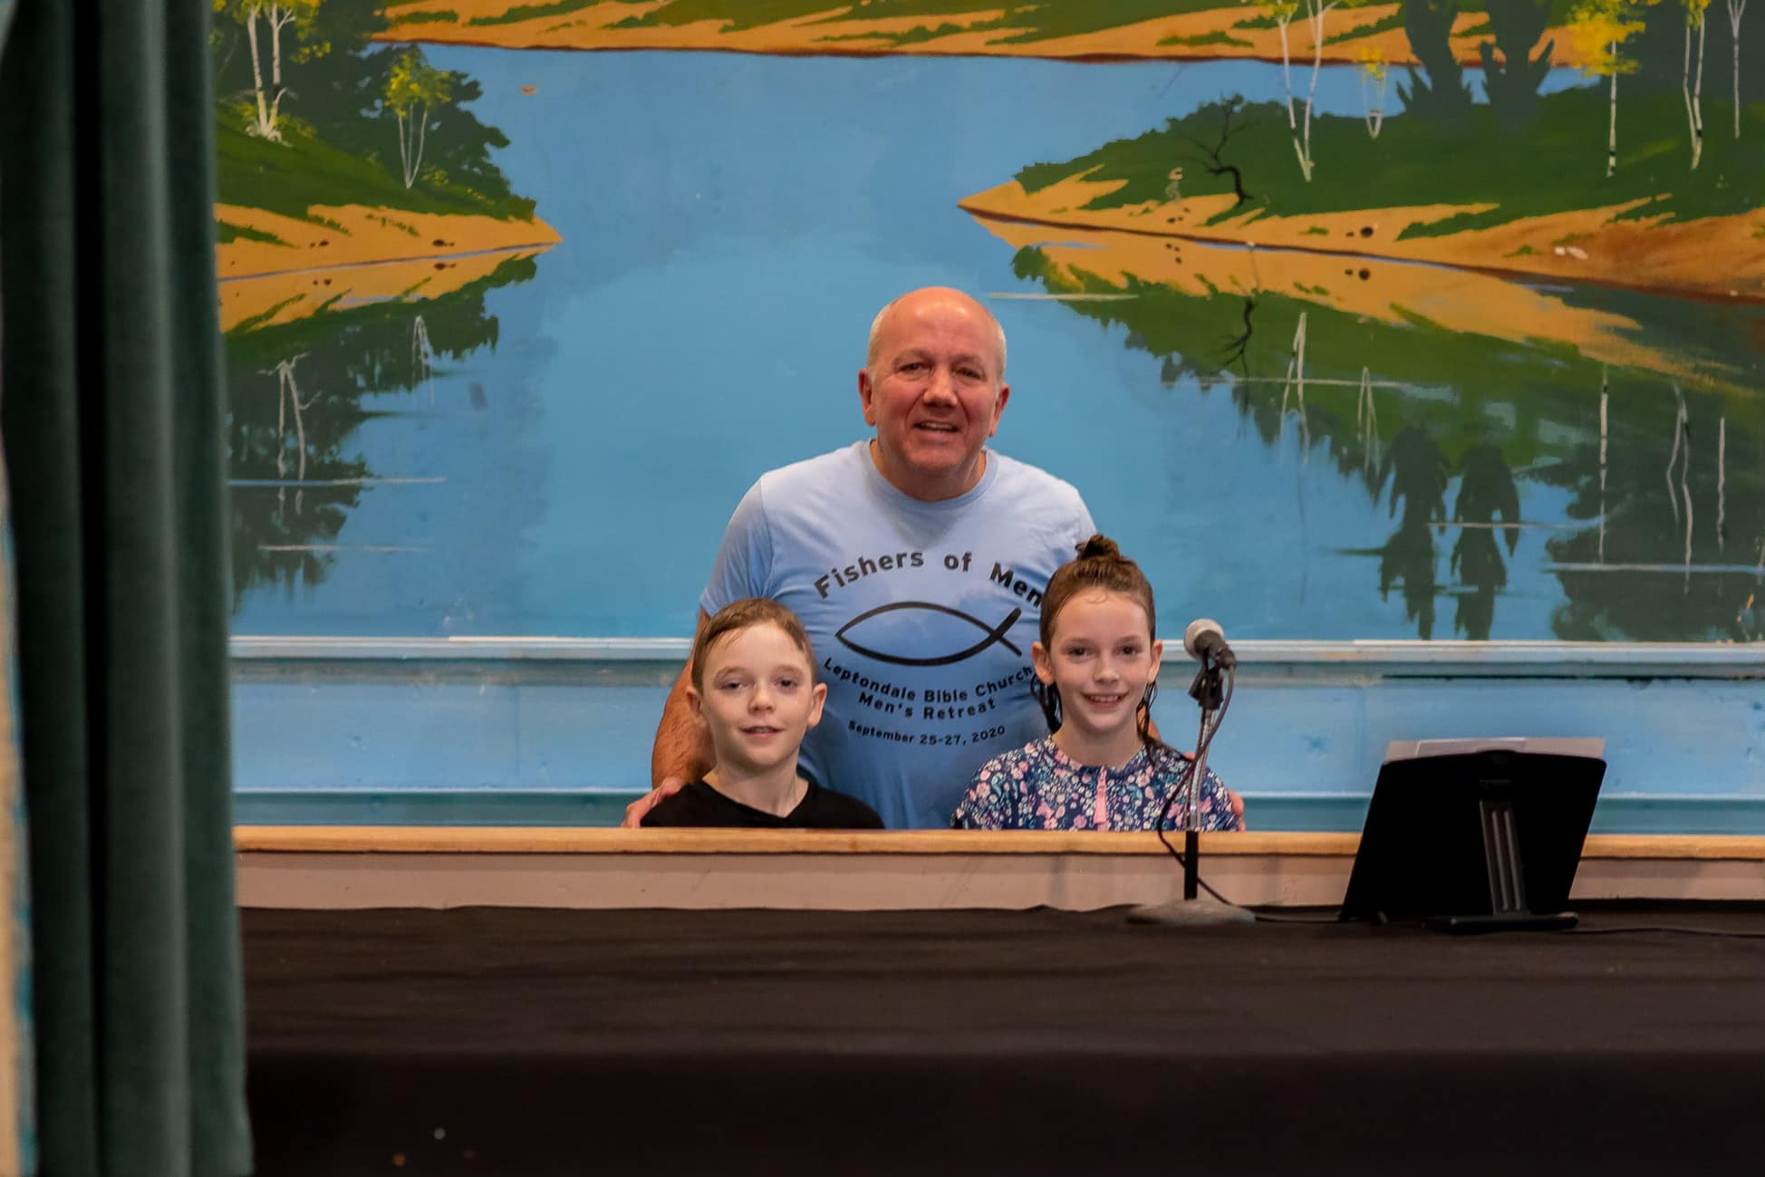
January
Raelyn & Shepherd’s Baptism
Pastor’s Reception

Slide 5
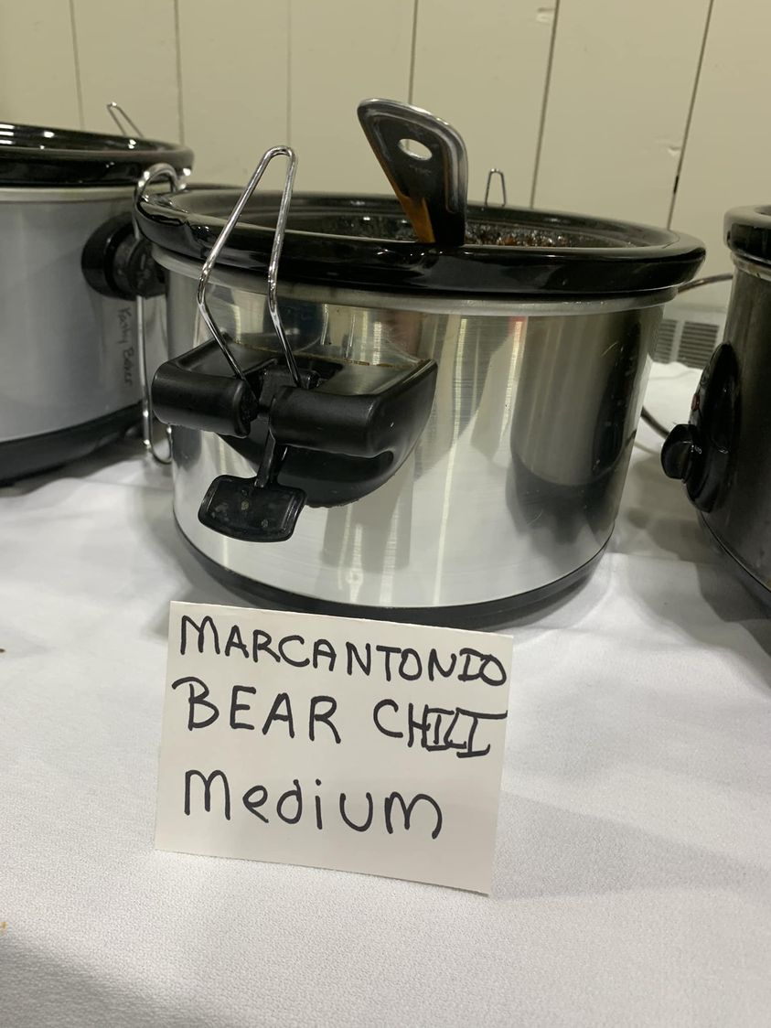
February
3rd Cycle of Grief Share
Not your average Fellowship Meal!

Slide 6
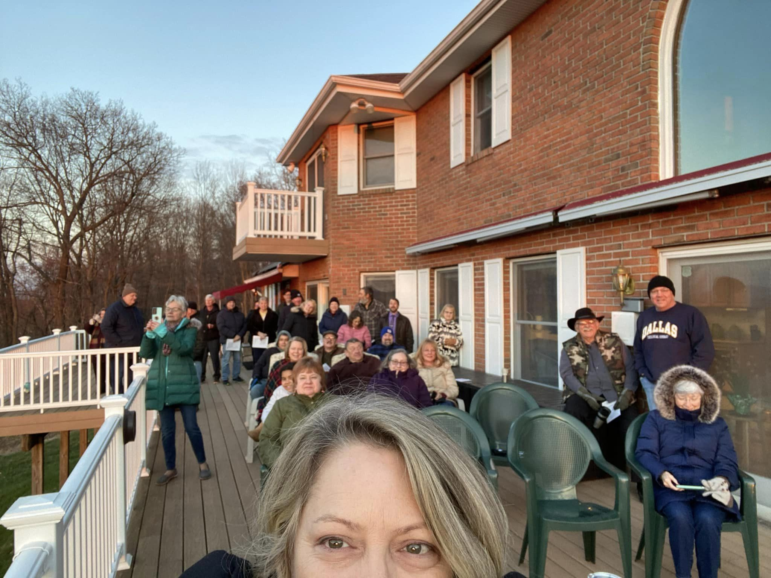
April
Easter Services
Sunrise Service at Tony & Lorraine’s

Slide 7
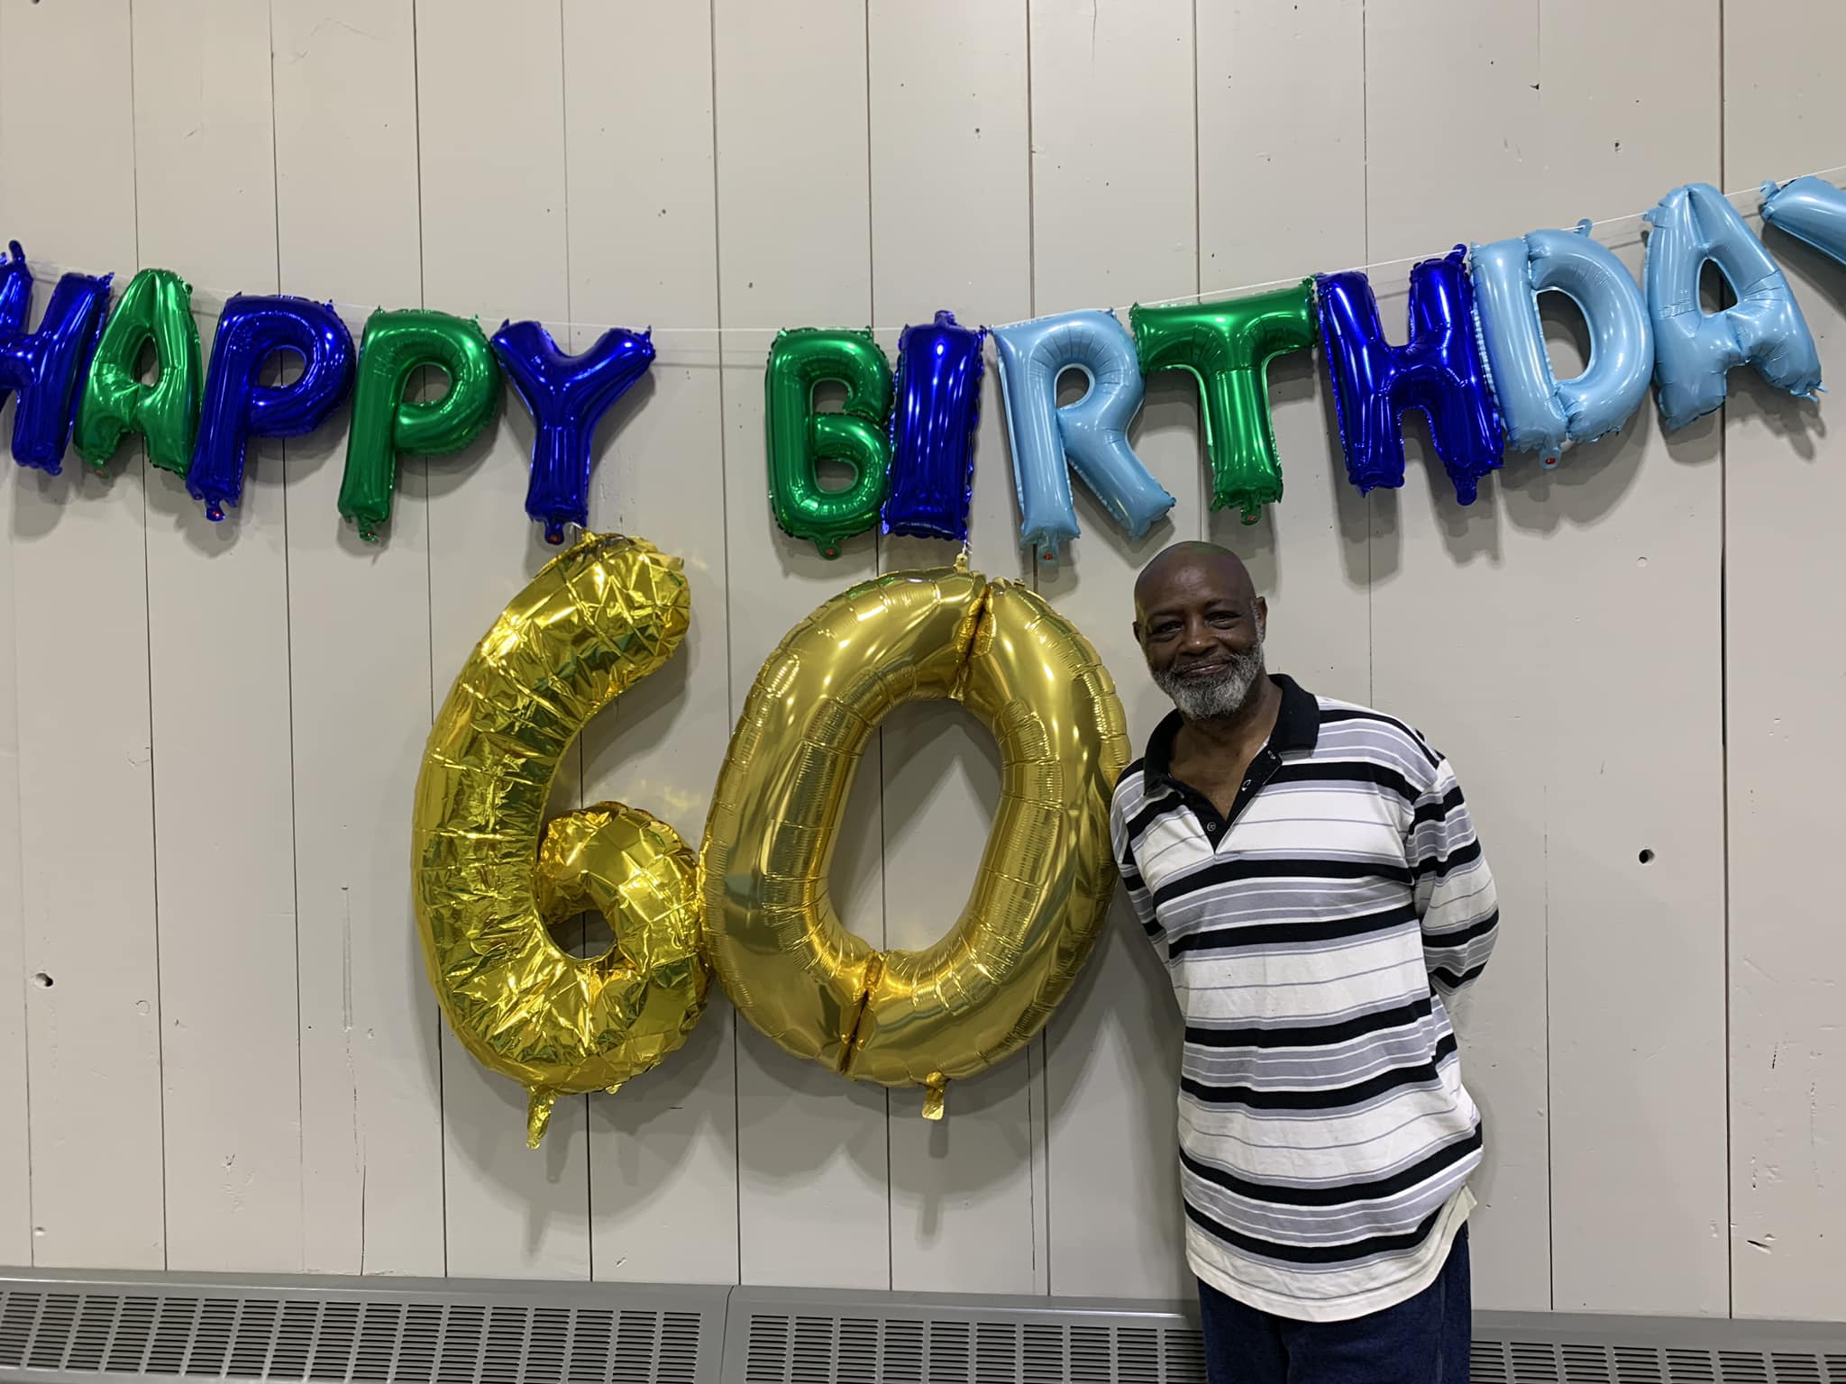
April
Ricky’s 60th birthday

Slide 8
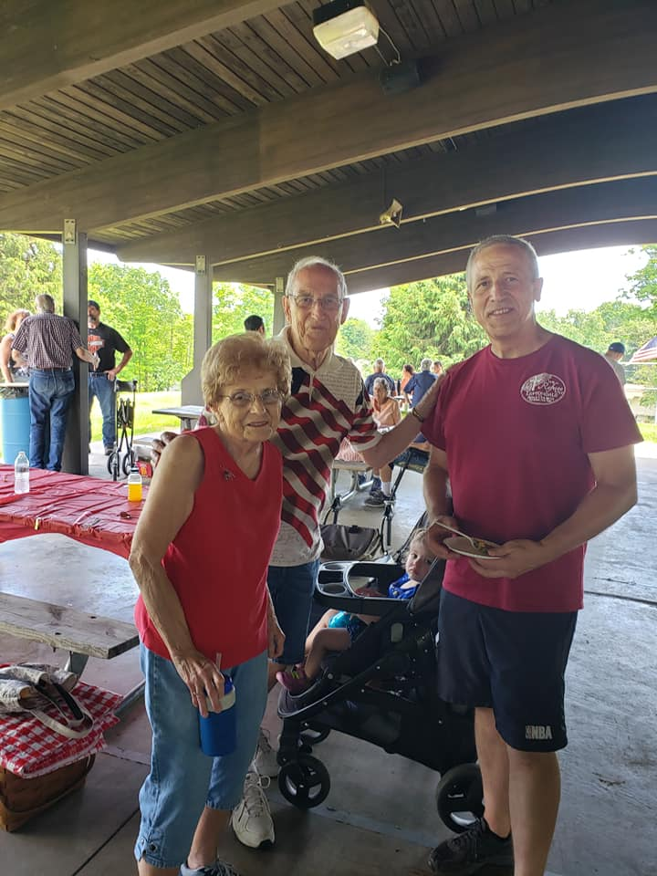
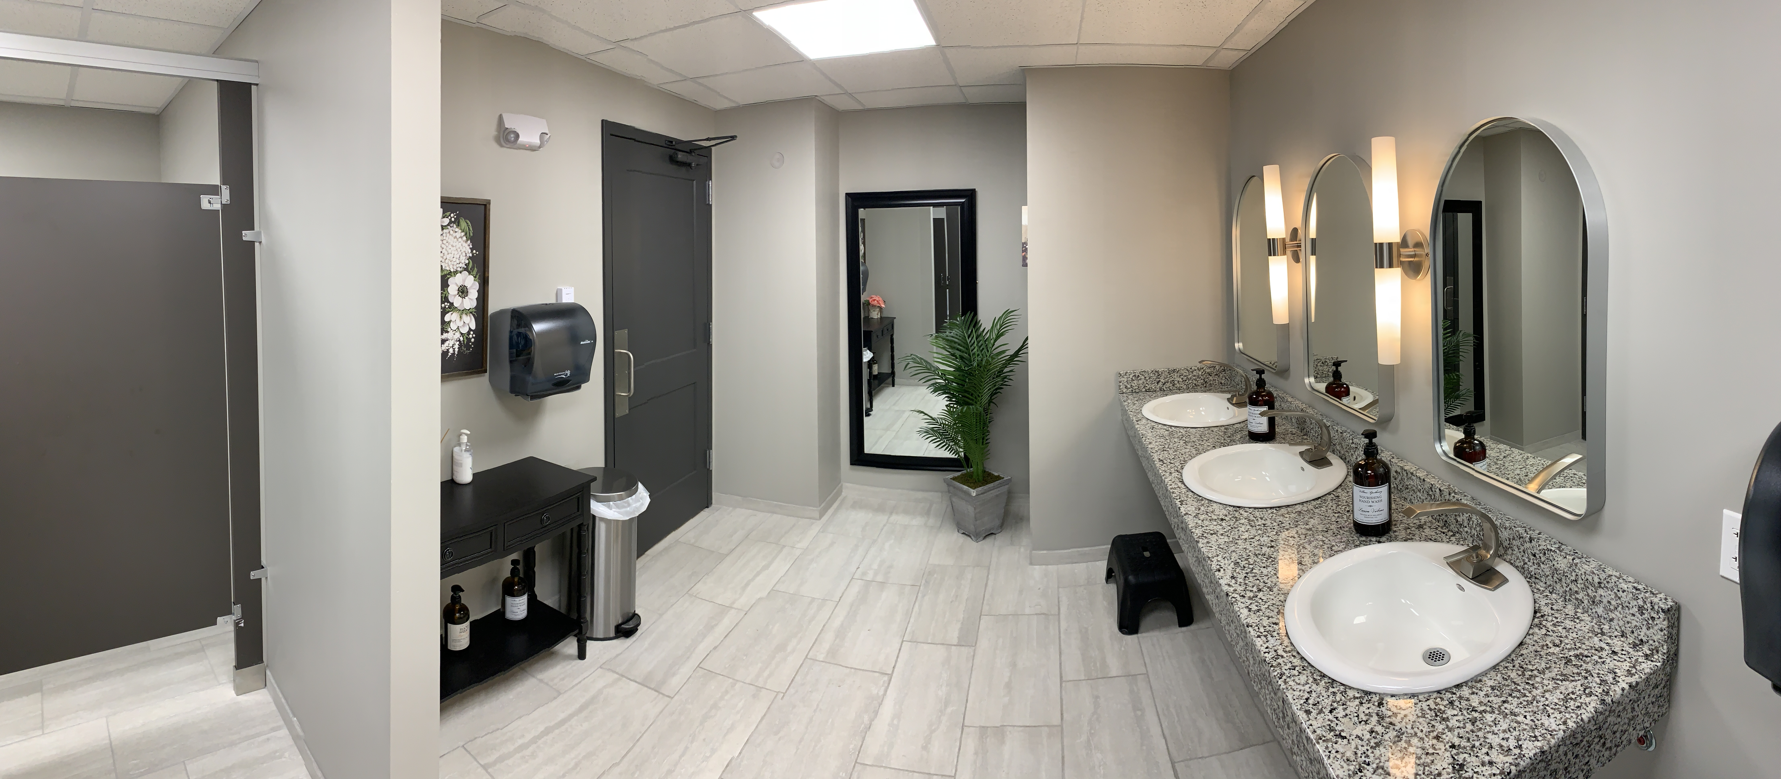
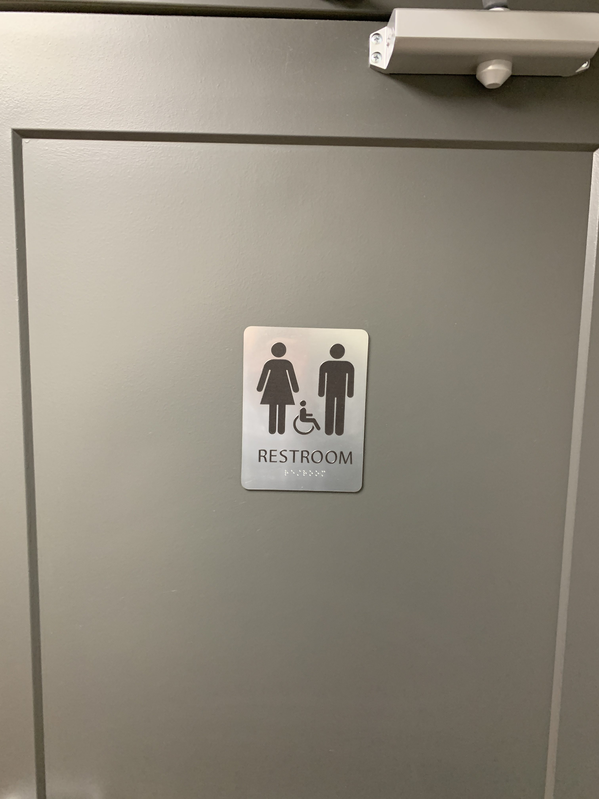
May
Newly Renovated Restrooms
Memorial Day Picnic

Slide 9
June
Peters’ visit
C.R.E.W. Kickoff!

Slide 10
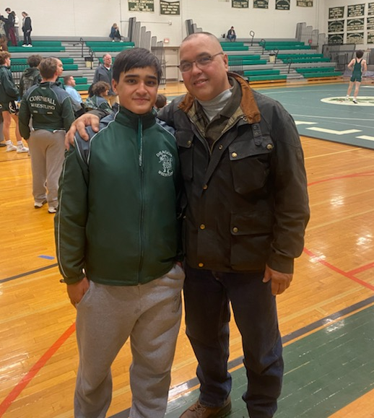
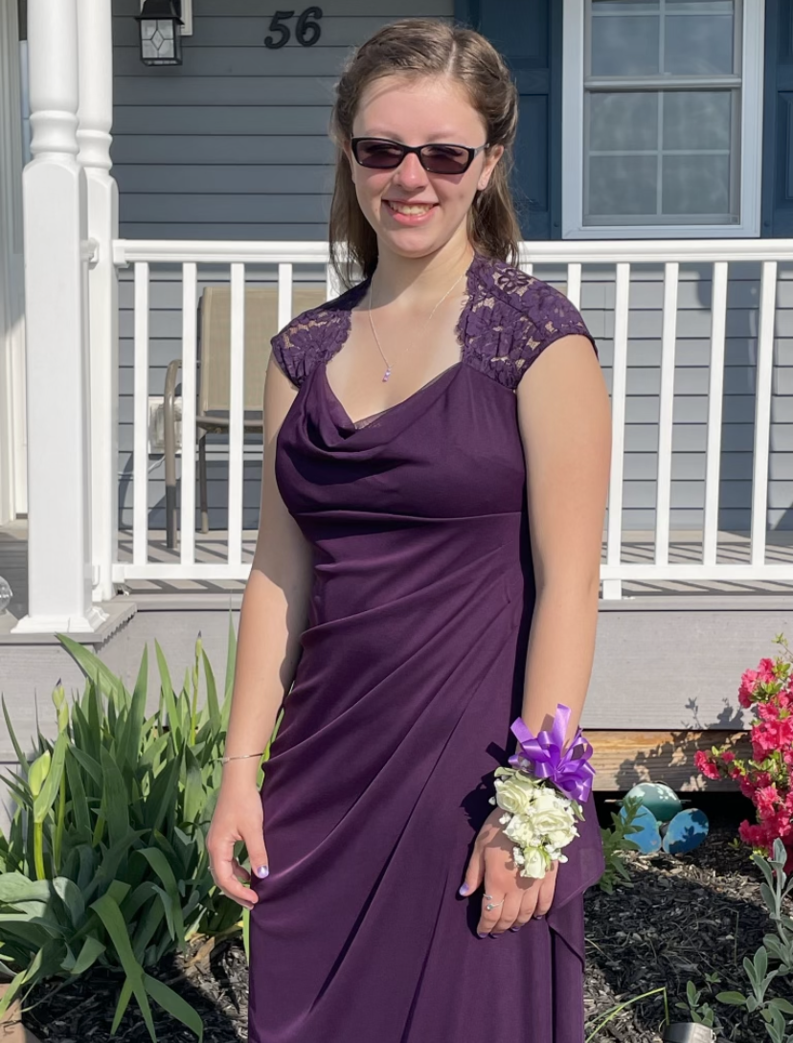
June
Graduating Seniors

Slide 11
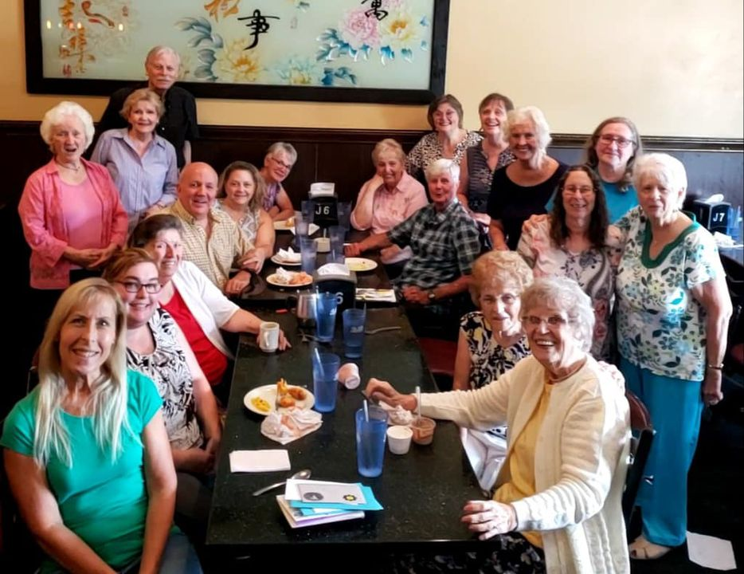
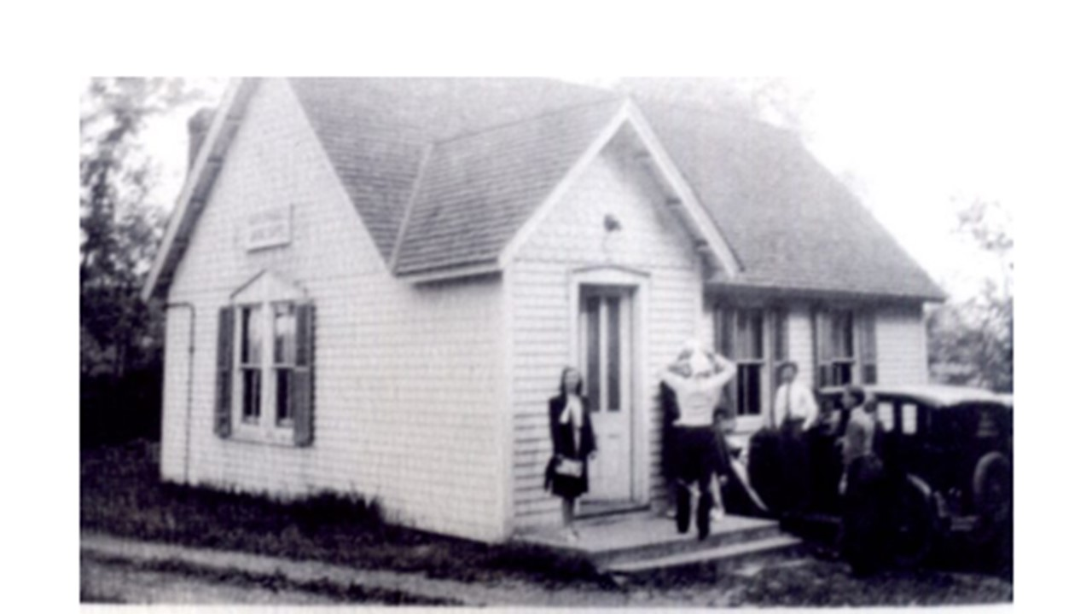
July
Farewell to Wilma
125 years of ministry!

Slide 12
August
National Night Out
Cycle 4 of Grief Share

Slide 13
August
JOY Group trip to Sight and Sound to see “Moses”
C.R.E.W. Closing Program

Slide 14
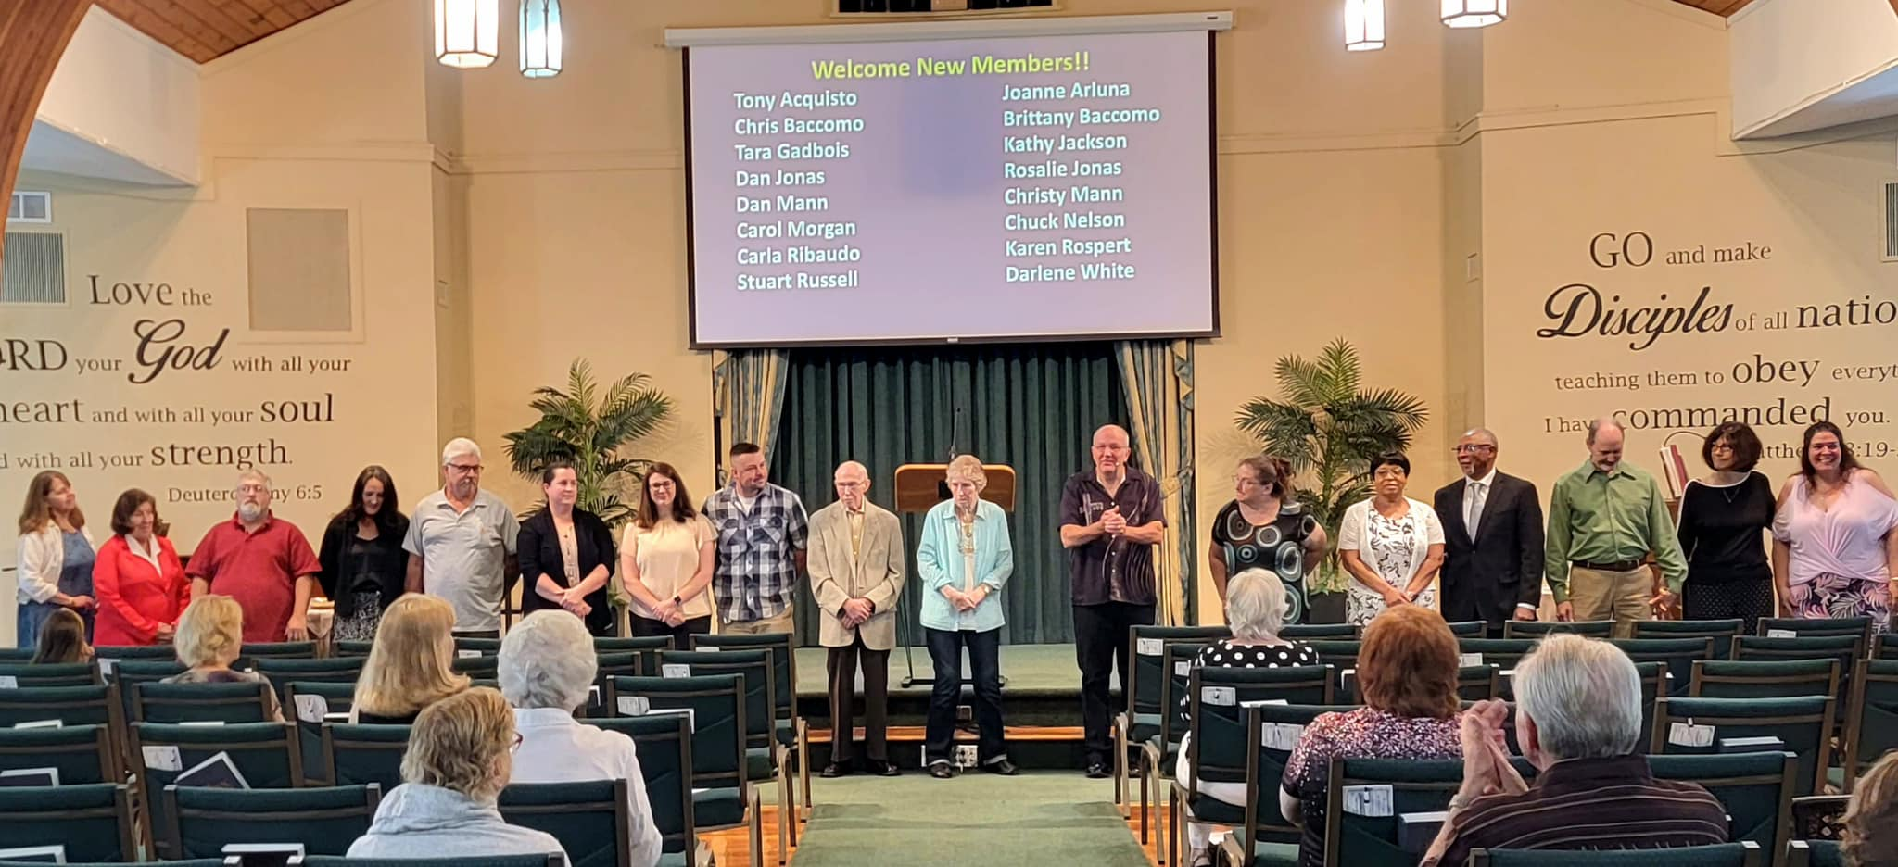
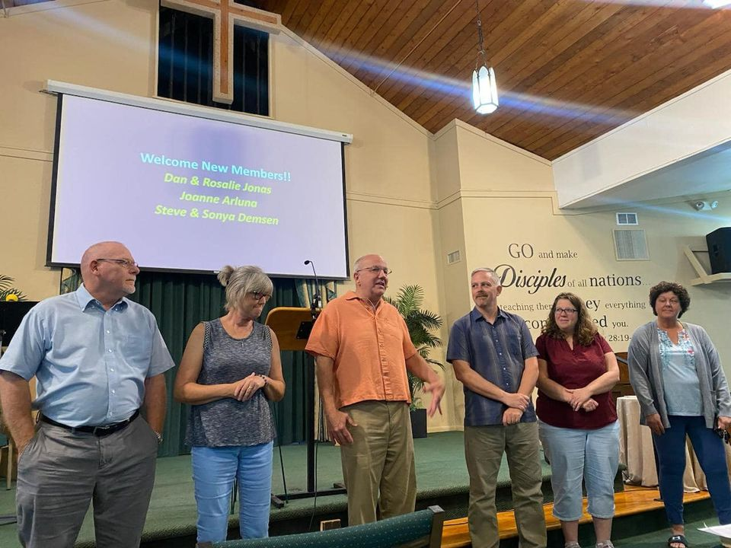
August
16 new members!!

Slide 15
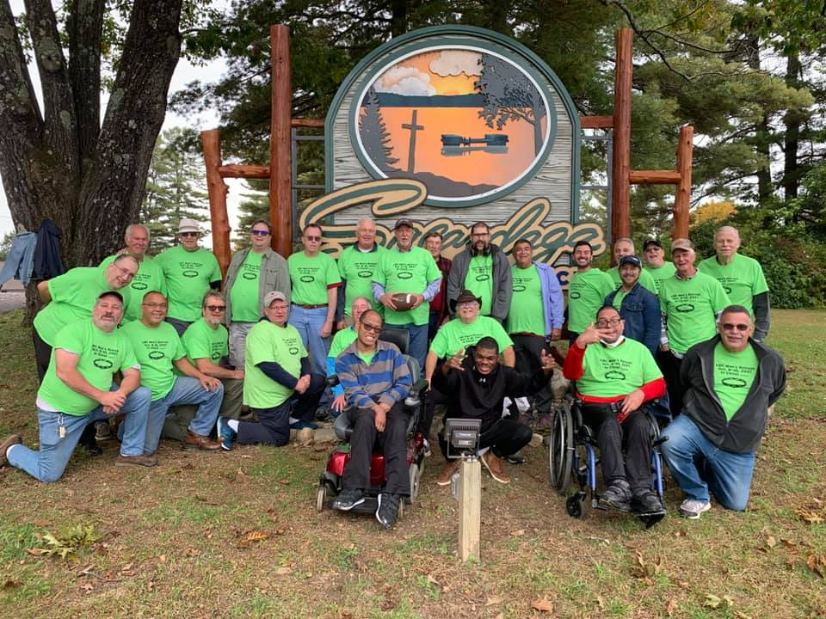
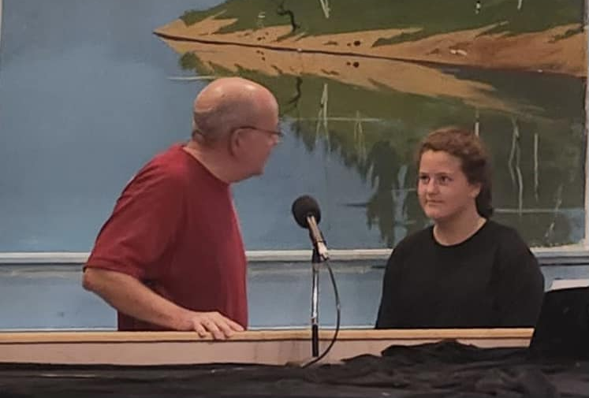
September
Men’s Retreat
Rebekah’s Baptism

Slide 16
October
Shoebox Packing Party
Fall Festival

Slide 17
November
Thanksgiving Community Meal

Slide 18
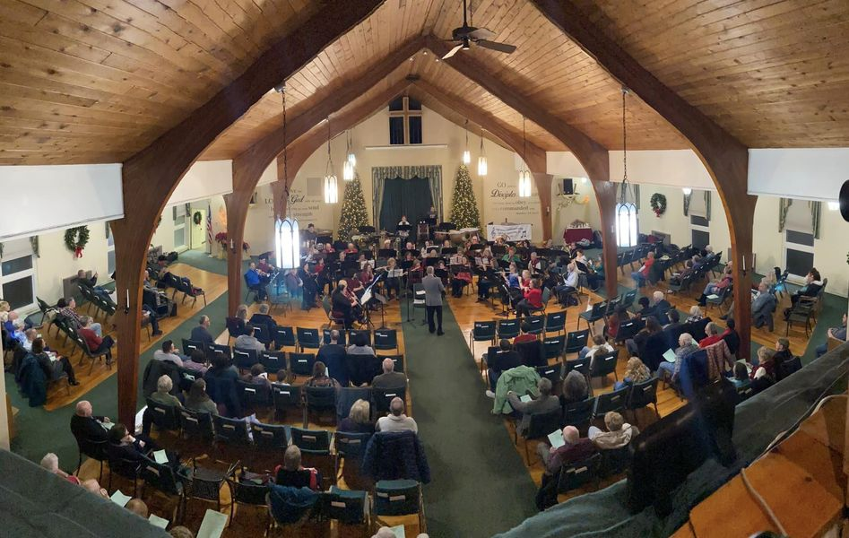
December
JOY
WITW
EG
C.R.E.W.
Pine Bush Community Band
BSF’s

Slide 19
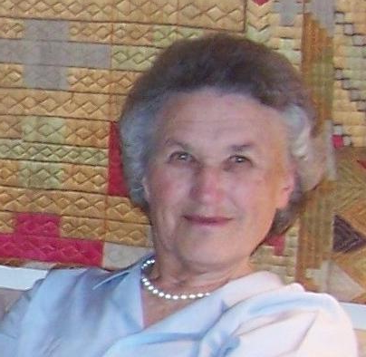
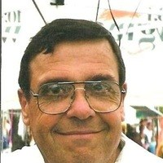
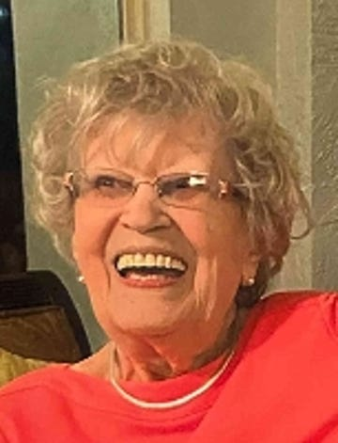
In fond memory
“…that you may not grieve as others do who have no hope. Therefore encourage one another.” 1st Thessalonians 4:13 & 18

Slide 20
Psalm 90:16-17
16 Let your work be shown to your servants, and your glorious power to their children. 17 Let the favor of the Lord our God be upon us, and establish the work of our hands upon us; yes, establish the work of our hands!

Slide 21
Benediction

