Slide 1
Scripture Reading
Matthew 21:1-11
Page 981-82 in the seat back bibles

Slide 3
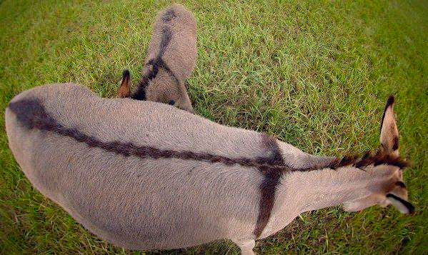
Honor the King
Matthew 21:1-11

Slide 4
I. The King is coming (verses 1-5)

Slide 5
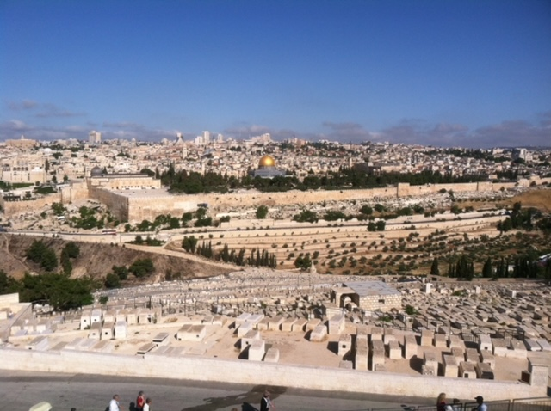

Slide 6
I. The King is coming (verses 1-5)
1 Now when they drew near to Jerusalem and came to Bethphage, to the Mount of Olives, then Jesus sent two disciples, 2 saying to them, “Go into the village in front of you, and immediately you will find a donkey tied, and a colt with her. Untie them and bring them to me. 3 If anyone says anything to you, you shall say, ‘The Lord needs them,’ and he will send them at once.”

Slide 7
I. The King is coming (verses 1-5)
4 This took place to fulfill what was spoken by the prophet, saying, 5 “Say to the daughter of Zion, ‘Behold, your king is coming to you, humble, and mounted on a donkey, on a colt, the foal of a beast of burden.’”
As the prophesy in Zechariah 9 teaches, He is “righteous and having salvation” (9:9). And He will ultimately rid this world of war and all the means to make war, speaking “peace to the nations” He will “rule…from sea to sea, and from the River to the ends of the earth” (9:10).

Slide 8
II. The king is honored (verses 6-9)
6 The disciples went and did as Jesus had directed them. 7 They brought the donkey and the colt* and put on them their cloaks, and he sat on them.
“In the midst, then, of this excited crowd, an unbroken animal remains calm under the hands of the Messiah who controls nature.” D.A. Carson
* A young colt “on which no one has ever sat.” Mark 11:2

Slide 9
II. The king is honored (verses 6-9)
8 Most of the crowd spread their cloaks on the road, and others cut branches from the trees and spread them on the road. 9 And the crowds that went before him and that followed him were shouting, “Hosanna to the Son of David! Blessed is he who comes in the name of the Lord! Hosanna in the highest!”

Slide 10
III. Honor the King (verses 10-11)
“Then they said to him, ‘What must we do, to be doing the works of God?’ Jesus answered them, ‘This is the work of God, that you believe in him whom he has sent.’” John 6:28-29

Slide 11
III. Honor the King (verses 10-11)
8 Most of the crowd spread their cloaks on the road, and others cut branches from the trees and spread them on the road. 9 And the crowds that went before him and that followed him…
“The next day the large crowd that had come to the feast heard that Jesus was coming to Jerusalem. So they took branches of palm trees and went out to meet him.” John 12:12-13

Slide 12
III. Honor the King (verses 10-11)
10 And when he entered Jerusalem, the whole city was stirred up,* saying, “Who is this?” 11 And the crowds said, “This is the prophet Jesus, from Nazareth of Galilee.”
10 As he entered Jerusalem the whole city was thrown into an uproar… NET
* To agitate

Slide 13
III. Honor the King (verses 10-11)
10 And when he entered Jerusalem, the whole city was stirred up, saying, “Who is this?” 11 And the crowds said, “This is the prophet Jesus, from Nazareth of Galilee.”
Faith is not the foremost thing in honoring God. The object of your faith is the foremost thing in honoring God.

Slide 14
III. Honor the King (verses 10-11)
“The principle is this: What we revere, we resemble, either for ruin or restoration. To commit ourselves to some part of the creation more than the Creator is idolatry. And when we worship something in creation, we become like it, as spiritually lifeless and insensitive to God as a piece of wood, rock, or stone.” G.K. Beale, We Become What We Worship

Slide 15
Benediction
Our Father in heaven, your name be honored as holy. Your kingdom come. Your will be done on earth as it is in heaven.
Give us today our daily bread.
And forgive us our debts, as we also have forgiven our debtors.
And do not bring us into﻿ temptation, but deliver us from the evil one.
Matthew 6:9-13, CSB

