Slide 1
Scripture Reading
Matthew 20:29-34
Page 981 in the seat back bibles

Slide 3
Be the Least of These
Matthew 20:29-34

Slide 4
“For consider your calling, brothers: not many of you were wise according to worldly standards, not many were powerful, not many were of noble birth. But God chose what is foolish in the world to shame the wise; God chose what is weak in the world to shame the strong; God chose what is low and despised in the world, even things that are not, to bring to nothing things that are.” 1st Corinthians 1:26-28

Slide 5
I. The King is coming (verse 29)
“Take my yoke upon you, and learn from me, for I am gentle and lowly in heart…” Matthew 11:29
The gentle and lowly King of kings will enter Jerusalem “humble, and mounted on a donkey.” Matthew 21:5

Slide 6
I. The King is coming (verse 29)
29 And as they went out of Jericho, a great crowd followed him.
“As he drew near to Jericho…” Luke 18:35

Slide 8
I. The King is coming (verse 29)
29 And as they went out of Jericho, a great crowd followed him.

Slide 9
II. The least of these honor the King (verses 30-31)
30 And behold, there were two blind men sitting by the roadside, and when they heard that Jesus was passing by, they cried out, “Lord, have mercy on us, Son of David!” 31 The crowd rebuked them, telling them to be silent, but they cried out all the more, “Lord, have mercy on us, Son of David!”
“And they came to Jericho. And as he was leaving Jericho with his disciples and a great crowd, Bartimaeus, a blind beggar, the son of Timaeus, was sitting by the roadside.” Mark 10:46

Slide 10
II. The least of these honor the King (verses 30-31)
30 And behold, there were two blind men sitting by the roadside, and when they heard that Jesus was passing by, they cried out, “Lord, have mercy on us, Son of David!” 31 The crowd rebuked them, telling them to be silent, but they cried out all the more, “Lord, have mercy on us, Son of David!”
“Jesus mercifully healed the men despite the opposition of the crowds that, like the disciples, wanted to bask in his glory but not practice his compassion.” D.A. Carson

Slide 11
III. The least of these follow the King (verses 32-34)
32 And stopping, Jesus called them and said, “What do you want me to do for you?” 33 They said to him, “Lord, let our eyes be opened.” 34 And Jesus in pity touched their eyes, and immediately they recovered their sight and followed him.
“Not many…wise according to worldly standards, not many…powerful, not many…of noble birth. But God chose what is foolish in the world…what is weak in the world…what is low and despised in the world…” 1st Corinthians 1:26-28

Slide 12
IV. Be The least of these
Be like Jesus
“For to this you have been called, because Christ also suffered for you, leaving you an example, so that you might follow in his steps.” 1st Peter 2:21
“Whoever says he abides in him ought to walk in the same way in which he walked.” 1st John 2:6
“I have been crucified with Christ. It is no longer I who live, but Christ who lives in me. And the life I now live in the flesh I live by faith in the Son of God.” Galatians 2:20
“Take my yoke upon you, and learn from me, for I am gentle and lowly in heart…” Matthew 11:29

Slide 13
IV. Be The least of these
Be like Jesus
He didn’t cling to the majesty and privilege which was His as One who is fully God along with the Father and the Spirit. He emptied himself and took on the form of a servant in taking on our humanity. And as a servant, he humbled himself by becoming obedient to the point of death, even death on a cross. The creator and sustainer of the universe became the least of these. Philippians 2

Slide 14
IV. Be The least of these
Share and practice Jesus’ priorities
“For I was hungry and you gave me food, I was thirsty and you gave me drink, I was a stranger and you welcomed me, I was naked and you clothed me, I was sick and you visited me, I was in prison and you came to me.” Matthew 25:35-36
“Truly, I say to you, as you did it to one of the least of these my brothers, you did it to me.” Matthew 25:40

Slide 15
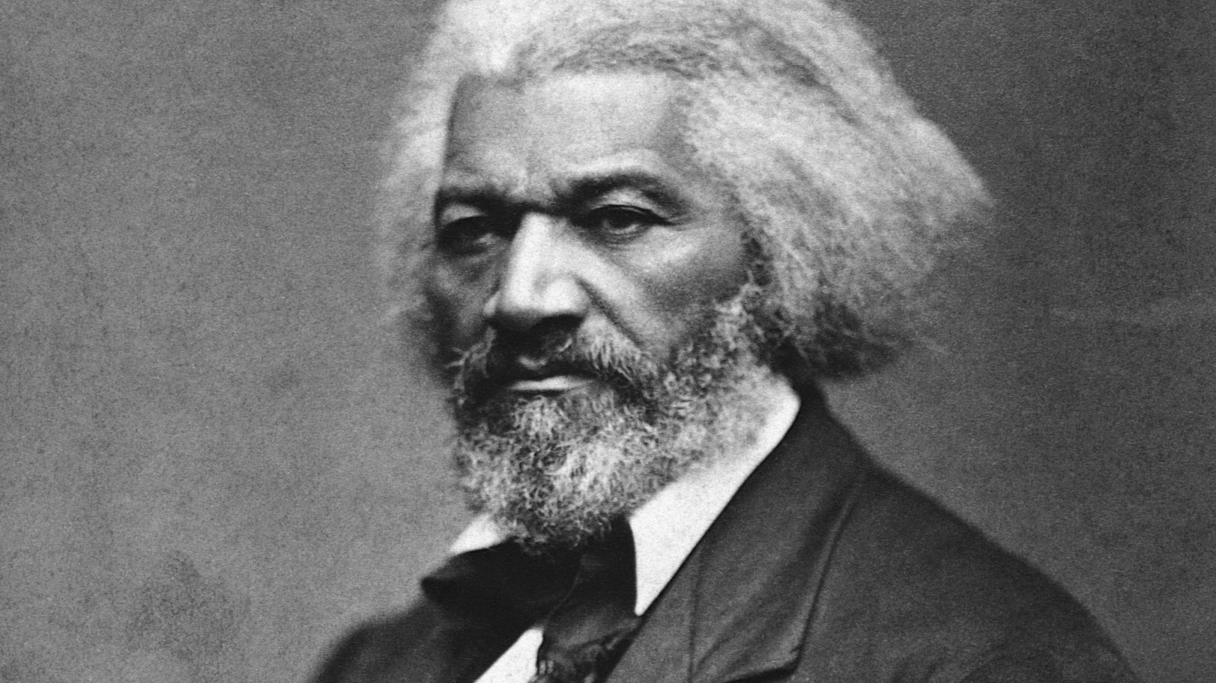
IV. Be The least of these
Reject the hypocrisy of the crowd
“Between the Christianity of this land, and the Christianity of Christ, I recognize the widest possible difference.”

Slide 16
IV. Be The least of these
Reject the hypocrisy of the crowd
“Between the Christianity of this land, and the Christianity of Christ, I recognize the widest possible difference.”

Slide 17
Benediction

