Slide 1
Scripture Reading
Matthew 20:17-28
Page 981 in the seat back bibles

Slide 2
"How do you reconcile the humility of faith with the egotism of superstardom, the purity of the Holy Spirit with the material excess of show business, the drive to achieve musical greatness with the posture of surrender to grace?" Bono

Slide 3
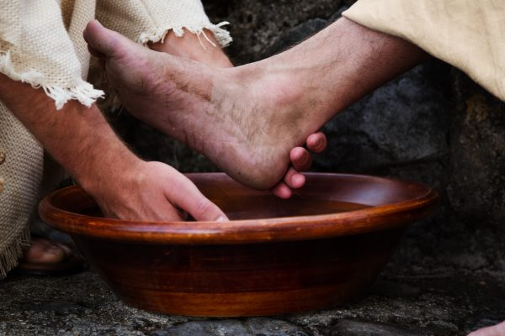
True greatness is found in humble service to the Father
Matthew 20:17-28

Slide 4
I. Jesus exemplified true greatness (verses 17-19)
“Let the little children come to me and do not hinder them, for to such belongs the kingdom of heaven.” Matthew 19:14
“It is easier for a camel to go through the eye of a needle than for a rich person to enter the kingdom of God.” Matthew 19:24
“Truly, I say to you, in the new world, when the Son of Man will sit on his glorious throne, you who have followed me will also sit on twelve thrones, judging the twelve tribes of Israel.” Matthew 19:28
“But many who are first will be last, and the last first.” Matthew 19:30

Slide 5
I. Jesus exemplified true greatness (verses 17-19)
17 And as Jesus was going up to Jerusalem, he took the twelve disciples aside, and on the way he said to them, 18 “See, we are going up to Jerusalem. And the Son of Man will be delivered over to the chief priests and scribes, and they will condemn him to death 19 and deliver him over to the Gentiles to be mocked and flogged and crucified, and he will be raised on the third day.”

Slide 6
I. Jesus exemplified true greatness (verses 17-19)
17 And as Jesus was going up to Jerusalem, he took the twelve disciples aside, and on the way he said to them, 18 “See, we are going up to Jerusalem. And the Son of Man will be delivered over to the chief priests and scribes, and they will condemn him to death 19 and deliver him over to the Gentiles to be mocked and flogged and crucified, and he will be raised on the third day.”
“Christ also suffered for you, leaving you an example, so that you might follow in his steps.” 1st Peter 2:21

Slide 7
II. The disciples desired worldly greatness (verses 20-24)
20 Then the mother of the sons of Zebedee came up to him with her sons, and kneeling before him she asked him for something. 21 And he said to her, “What do you want?” She said to him, “Say that these two sons of mine are to sit, one at your right hand and one at your left, in your kingdom.”
“The woman and the two disciples were assuming that greatness in God’s kingdom was based on status, rank, power, and authority. They also made the mistake Jesus warned against in 19:30–20:16: they were seeking to influence God’s bestowal of reward.” Stu Weber

Slide 8
II. The disciples desired worldly greatness (verses 20-24)
22 Jesus answered, “You do not know what you are asking. Are you able to drink the cup that I am to drink?” They said to him, “We are able.” 23 He said to them, “You will drink my cup, but to sit at my right hand and at my left is not mine to grant, but it is for those for whom it has been prepared by my Father.”
“I, John, your brother and partner in the tribulation and the kingdom and the patient endurance that are in Jesus, was on the island called Patmos on account of the word of God and the testimony of Jesus.” Revelation 1:9

Slide 9
II. The disciples desired worldly greatness (verses 20-24)
24 And when the ten heard it, they were indignant at the two brothers.
“We all want to be great, but we don't want folks to know we want to be great.” Pastor Phil Lineberger

Slide 10
III. True greatness is found in humble service to the Father (verses 25-28)
True greatness sets aside power and privilege (25-26)
25 But Jesus called them to him and said, “You know that the rulers of the Gentiles lord it over them, and their great ones exercise authority over them. 26 It shall not be so among you…
It looks like Jesus “Who, being in very nature God, did not consider equality with God something to be used to his own advantage; rather, he made himself nothing by taking the very nature of a servant…” Philippians 2:6-7, NIV

Slide 11
III. True greatness is found in humble service to the Father (verses 25-28)
True greatness serves and submits to one another (26-27)
26 …But whoever would be great among you must be your servant, 27 and whoever would be first among you must be your slave…
Greatness in the kingdom comes by being a devoted servant to all within the body, not from a motive to become great (sit…at your right hand), but from a motive of love for the only one who is truly great: God alone.

Slide 12
III. True greatness is found in humble service to the Father (verses 25-28)
True greatness serves and submits to one another (26-27)
In Ephesians 5:19-20, Paul paints a picture of the body of Christ in beautiful harmony, “addressing one another in psalms and hymns and spiritual songs, singing and making melody to the Lord with your heart, giving thanks always and for everything to God the Father in the name of our Lord Jesus Christ.”
And it’s in the context of this beautiful healthy harmony that Paul gives us the key: submitting to one another out of reverence for Christ. Ephesians 5:21

Slide 13
III. True greatness is found in humble service to the Father (verses 25-28)
True greatness serves and submits to one another (26-27)
“Love one another with brotherly affection. Outdo one another in showing honor.” Romans 12:10

Slide 14
III. True greatness is found in humble service to the Father (verses 25-28)
True greatness exalts faithful humility (26-28)
26 …whoever would be great among you must be your servant, 27 and whoever would be first among you must be your slave…
28 even as the Son of Man came not to be served but to serve, and to give his life as a ransom for many.”

Slide 15
III. True greatness is found in humble service to the Father (verses 25-28)
True greatness exalts faithful humility (26-28)
28 even as the Son of Man came not to be served but to serve, and to give his life as a ransom for many.”
“Peter took him aside and began to rebuke him, saying, ‘Far be it from you, Lord! This shall never happen to you.’ But he turned and said to Peter, ‘Get behind me, Satan! You are a hindrance to me. For you are not setting your mind on the things of God, but on the things of man.’” Matthew 16:22-23

Slide 16
III. True greatness is found in humble service to the Father (verses 25-28)
True greatness exalts faithful humility (26-28)
28 even as the Son of Man came not to be served but to serve, and to give his life as a ransom for many.”
“Take your son, your only son Isaac, whom you love, and go to the land of Moriah, and offer him there as a burnt offering on one of the mountains of which I shall tell you.” Genesis 22:2

Slide 17
III. True greatness is found in humble service to the Father (verses 25-28)
True greatness exalts faithful humility (26-28)
28 even as the Son of Man came not to be served but to serve, and to give his life as a ransom for many.”
“Rise and go to the street called Straight, and at the house of Judas look for a man of Tarsus named Saul, for behold, he is praying, and he has seen in a vision a man named Ananias come in and lay his hands on him so that he might regain his sight.” Acts 9:11-12

Slide 18
III. True greatness is found in humble service to the Father (verses 25-28)
True greatness exalts faithful humility (26-28)
28 even as the Son of Man came not to be served but to serve, and to give his life as a ransom for many.”
“You will drink my cup.” Matthew 20:23
“My Father, if it be possible, let this cup pass from me; nevertheless, not as I will, but as you will.” Matthew 26:39

Slide 19
Benediction

