Slide 1
Scripture Reading
John 1:1-14

Slide 2
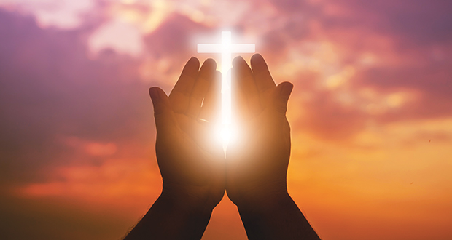
The Light of the World

Slide 4
I. Jesus is the true light because He is God (verses 1-3)
1 In the beginning was the Word, and the Word was with God, and the Word was God. 2 He was in the beginning with God. 3 All things were made through him, and without him was not any thing made that was made.

Slide 5
I. Jesus is the true light because He is God (verses 1-3)
1 In the beginning was the Word, and the Word was with God, and the Word was God. 2 He was in the beginning with God. 3 All things were made through him, and without him was not any thing made that was made.
“By faith we understand that the universe was created by the word of God, so that what is seen was not made out of things that are visible.” Hebrews 11:3

Slide 6
I. Jesus is the true light because He is God (verses 1-3)
1 In the beginning was the Word, and the Word was with God, and the Word was God. 2 He was in the beginning with God. 3 All things were made through him, and without him was not any thing made that was made.
Today’s passage teaches that Jesus brings us great and eternal blessings, but He can only bring us these blessings if He is who John says He is in verses 1-3 and we truly take John’s message to be true.

Slide 7
II. Jesus the true light brings eternal life (verses 4-5)
4 In him was life, and the life was the light of men. 5 The light shines in the darkness, and the darkness has not overcome it.
Paul shares how Jesus gave him his calling on the road to Damascus, telling Paul He was sending him to the Gentiles “to open their eyes, so that they may turn from darkness to light and from the power of Satan to God.” Acts 26:18

Slide 8
II. Jesus the true light brings eternal life (verses 4-5)
4 In him was life, and the life was the light of men. 5 The light shines in the darkness, and the darkness has not overcome it.
Paul shares how Jesus gave him his calling on the road to Damascus, telling Paul He was sending him to the Gentiles “to open their eyes, so that they may turn from darkness to light and from the power of Satan to God.” Acts 26:18

Slide 9
III. The offer of eternal life has been testified to all the world (verses 6-9)
6 There was a man sent from God, whose name was John. 7 He came as a witness, to bear witness about the light, that all might believe through him. 8 He was not the light, but came to bear witness about the light.
“You will be my witnesses in Jerusalem and in all Judea and Samaria, and to the end of the earth.” Acts 1:8

Slide 10
III. The offer of eternal life has been testified to all the world (verses 6-9)
6 There was a man sent from God, whose name was John. 7 He came as a witness, to bear witness about the light, that all might believe through him. 8 He was not the light, but came to bear witness about the light.
Remember, “You are the light of the world” (Matthew 5:14) called to “let your light shine before others, so that they may see your good works and give glory to your Father who is in heaven” (Matthew 5:16).

Slide 11
III. The offer of eternal life has been testified to all the world (verses 6-9)
9 The true light, which gives light to everyone, was coming into the world.

Slide 12
IV. The promise of eternal life is received only by those who believe in Jesus (verses 10-13)
10 He was in the world, and the world was made through him, yet the world did not know him. 11 He came to his own, and his own people did not receive him.

Slide 13
IV. The promise of eternal life is received only by those who believe in Jesus (verses 10-13)
12 But to all who did receive him, who believed in his name, he gave the right to become children of God, 13 who were born, not of blood nor of the will of the flesh nor of the will of man, but of God.
This is a radically new life which you can’t earn. You can only receive it as a right given to you by Jesus through your faith in Him. And it’s so radically new that it requires a new birth, not in all the ways that humanity can bring life into the world, but of God, through Jesus Christ who brings true light and life into this world.

Slide 14
V. Jesus is the true light because He is God with us (verse 14)
“Then the cloud covered the tent of meeting, and the glory of the Lord filled the tabernacle.” Exodus 40:34
“Behold, the virgin shall conceive and bear a son, and they shall call his name Immanuel” (which means, God with us).” Matthew 1:23
14 And the Word became flesh and dwelt among us, and we have seen his glory, glory as of the only Son from the Father, full of grace and truth.

Slide 15
Eternal Life
“Thanks be to God for his inexpressible gift!” 2nd Corinthians 9:15

Slide 16
Benediction
Come behold the wondrous myst'ry Slain by death the God of life But no grave could e'er restrain Him Praise the Lord He is alive What a foretaste of deliv'rance How unwavering our hope Christ in power resurrected As we will be when He comes

