Slide 1
Scripture Reading
John 9:1-7
Page 1064 in the seat back bibles

Slide 2
The Light of the World

Slide 3
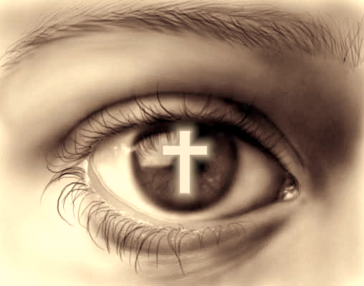
Jesus gives us true sight
John 9:1-7 (1-38)

Slide 4
I. We can see life’s trials to the glory of God (verses 1-5)
1 As he passed by, he saw a man blind from birth. 2 And his disciples asked him, “Rabbi, who sinned, this man or his parents, that he was born blind?” 3 Jesus answered, “It was not that this man sinned, or his parents, but that the works of God might be displayed in him. 4 We must work the works of him who sent me while it is day; night is coming, when no one can work. 5 As long as I am in the world, I am the light of the world.”

Slide 5
I. We can see life’s trials to the glory of God (verses 1-5)
1 As he passed by, he saw a man blind from birth. 2 And his disciples asked him, “Rabbi, who sinned, this man or his parents, that he was born blind?” 3 Jesus answered, “It was not that this man sinned, or his parents, but that the works of God might be displayed in him. 4 We must work the works of him who sent me while it is day; night is coming, when no one can work. 5 As long as I am in the world, I am the light of the world.”

Slide 6
II. We can see Jesus’ direction through the eyes of faith (verses 6-7)
6 Having said these things, he spit on the ground and made mud with the saliva. Then he anointed the man’s eyes with the mud 7 and said to him, “Go, wash in the pool of Siloam” (which means Sent). So he went and washed and came back seeing.

Slide 7
III. We can see Jesus as the source of our blessings (verses 8-12)
“With respect to this they are surprised when you do not join them in the same flood of debauchery, and they malign you.” 1st Peter 4:4

Slide 8
III. We can see Jesus as the source of our blessings (verses 8-12)
8 The neighbors and those who had seen him before as a beggar were saying, “Is this not the man who used to sit and beg?” 9 Some said, “It is he.” Others said, “No, but he is like him.” He kept saying, “I am the man.” 10 So they said to him, “Then how were your eyes opened?” 11 He answered, “The man called Jesus made mud and anointed my eyes and said to me, ‘Go to Siloam and wash.’ So I went and washed and received my sight.” 12 They said to him, “Where is he?” He said, “I do not know.”

Slide 9
III. We can see Jesus as the source of our blessings (verses 8-12)
8 The neighbors and those who had seen him before as a beggar were saying, “Is this not the man who used to sit and beg?” 9 Some said, “It is he.” Others said, “No, but he is like him.” He kept saying, “I am the man.” 10 So they said to him, “Then how were your eyes opened?” 11 He answered, “The man called Jesus made mud and anointed my eyes and said to me, ‘Go to Siloam and wash.’ So I went and washed and received my sight.” 12 They said to him, “Where is he?” He said, “I do not know.”

Slide 10
IV. We can see the worlds opposition to Jesus and stand firm with Him (verses 13-34)
13 They brought to the Pharisees the man who had formerly been blind. 14 Now it was a Sabbath day when Jesus made the mud and opened his eyes.

Slide 11
IV. We can see the worlds opposition to Jesus and stand firm with Him (verses 13-34)
15 So the Pharisees again asked him how he had received his sight. And he said to them, “He put mud on my eyes, and I washed, and I see.” 16 Some of the Pharisees said, “This man is not from God, for he does not keep the Sabbath.” But others said, “How can a man who is a sinner do such signs?” And there was a division among them. 17 So they said again to the blind man, “What do you say about him, since he has opened your eyes?” He said, “He is a prophet.”

Slide 12
IV. We can see the worlds opposition to Jesus and stand firm with Him (verses 13-34)
18 The Jews did not believe that he had been blind and had received his sight, until they called the parents of the man who had received his sight 19 and asked them, “Is this your son, who you say was born blind? How then does he now see?” 20 His parents answered, “We know that this is our son and that he was born blind. 21 But how he now sees we do not know, nor do we know who opened his eyes. Ask him; he is of age. He will speak for himself.” 22 (His parents said these things because they feared the Jews, for the Jews had already agreed that if anyone should confess Jesus to be Christ, he was to be put out of the synagogue.) 23 Therefore his parents said, “He is of age; ask him.”

Slide 13
IV. We can see the worlds opposition to Jesus and stand firm with Him (verses 13-34)
24 So for the second time they called the man who had been blind and said to him, “Give glory to God. We know that this man is a sinner.”
32 Never since the world began has it been heard that anyone opened the eyes of a man born blind. 33 If this man were not from God, he could do nothing.”
34 They answered him, “You were born in utter sin, and would you teach us?” And they cast him out.

Slide 14
IV. We can see the worlds opposition to Jesus and stand firm with Him (verses 13-34)
“It is before his own master that he stands or falls. And he will be upheld, for the Lord is able to make him stand.” Romans 14:4
“I can do all things through him who strengthens me.” Philippians 4:13

Slide 15
V. Jesus gives us true sight (verses 35-38)
35 Jesus heard that they had cast him out, and having found him he said, “Do you believe in the Son of Man?” 36 He answered, “And who is he, sir, that I may believe in him?” 37 Jesus said to him, “You have seen him, and it is he who is speaking to you.” 38 He said, “Lord, I believe,” and he worshiped him.
“Have you believed because you have seen me? Blessed are those who have not seen and yet have believed.” John 20:29

Slide 16
True Direction!
Eternal Life!
“Thanks be to God for his inexpressible gift!” 2nd Corinthians 9:15
True Life Now!
True Sight!

Slide 17
Benediction

