Slide 1
Scripture Reading
John 8:12-18
Pages 1062-63 in the seat back bibles

Slide 2
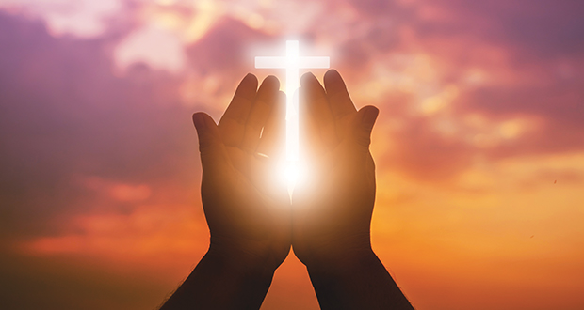
The Light of the World

Slide 3
Know Jesus and know where you’re going!
John 8:12-18

Slide 4
I. All who follow Jesus walk in His light (verse 12)
12 Again Jesus spoke to them, saying, “I am the light of the world. Whoever follows me will not walk in darkness, but will have the light of life.”
“I am the living bread that came down from heaven. If anyone eats of this bread, he will live forever.” John 6:51
On the last day of the feast, the great day, Jesus stood up and cried out, “If anyone thirsts, let him come to me and drink. Whoever believes in me, as the Scripture has said, ‘Out of his heart will flow rivers of living water.’” John 7:37-38

Slide 5
II. All who follow Jesus know His testimony about Himself is true (verses 13-18)
Those who walk in darkness cannot accept Jesus’ testimony (13-14)
13 So the Pharisees said to him, “You are bearing witness about yourself; your testimony is not true.” 14 Jesus answered, “Even if I do bear witness about myself, my testimony is true, for I know where I came from and where I am going, but you do not know where I come from or where I am going.

Slide 6
II. All who follow Jesus know His testimony about Himself is true (verses 13-18)
Those who walk in darkness cannot accept Jesus’ testimony (13-14)
13 So the Pharisees said to him, “You are bearing witness about yourself; your testimony is not true.” 14 Jesus answered, “Even if I do bear witness about myself, my testimony is true, for I know where I came from and where I am going, but you do not know where I come from or where I am going.

Slide 7
II. All who follow Jesus know His testimony about Himself is true (verses 13-18)
All who follow Jesus know Him and the Father who sent Him (15-18)
15 You judge according to the flesh; I judge no one. 16 Yet even if I do judge, my judgment is true, for it is not I alone who judge, but I and the Father who sent me.
“It is no longer because of what you said that we believe, for we have heard for ourselves, and we know that this is indeed the Savior of the world.” John 4:42

Slide 8
II. All who follow Jesus know His testimony about Himself is true (verses 13-18)
All who follow Jesus know Him and the Father who sent Him (15-18)
17 In your Law it is written that the testimony of two people is true. 18 I am the one who bears witness about myself, and the Father who sent me bears witness about me.”

Slide 9
II. All who follow Jesus know His testimony about Himself is true (verses 13-18)
All who follow Jesus know Him and the Father who sent Him (15-18)
“Father, the hour has come; glorify your Son that the Son may glorify you, since you have given him authority over all flesh, to give eternal life to all whom you have given him. And this is eternal life, that they know you, the only true God, and Jesus Christ whom you have sent. I glorified you on earth, having accomplished the work that you gave me to do. And now, Father, glorify me in your own presence with the glory that I had with you before the world existed.” John 17:1-5

Slide 10
True Direction!
Eternal Life!
“Thanks be to God for his inexpressible gift!” 2nd Corinthians 9:15
True Life Now!

Slide 11
Benediction

Slide 12
III. Know Jesus and know where you’re going!
25 Jesus answered them, “I told you, and you do not believe. The works that I do in my Father’s name bear witness about me, 26 but you do not believe because you are not among my sheep. 27 My sheep hear my voice, and I know them, and they follow me. 28 I give them eternal life, and they will never perish, and no one will snatch them out of my hand. 29 My Father, who has given them to me, is greater than all, and no one is able to snatch them out of the Father’s hand. 30 I and the Father are one.”

Slide 13
III. Know Jesus and know where you’re going!
25 Jesus answered them, “I told you, and you do not believe. The works that I do in my Father’s name bear witness about me, 26 but you do not believe because you are not among my sheep. 27 My sheep hear my voice, and I know them, and they follow me. 28 I give them eternal life, and they will never perish, and no one will snatch them out of my hand. 29 My Father, who has given them to me, is greater than all, and no one is able to snatch them out of the Father’s hand. 30 I and the Father are one.”

Slide 14
III. Know Jesus and know where you’re going!
25 Jesus answered them, “I told you, and you do not believe. The works that I do in my Father’s name bear witness about me, 26 but you do not believe because you are not among my sheep. 27 My sheep hear my voice, and I know them, and they follow me. 28 I give them eternal life, and they will never perish, and no one will snatch them out of my hand. 29 My Father, who has given them to me, is greater than all, and no one is able to snatch them out of the Father’s hand. 30 I and the Father are one.”

Slide 15
III. Know Jesus and know where you’re going!
25 Jesus answered them, “I told you, and you do not believe. The works that I do in my Father’s name bear witness about me, 26 but you do not believe because you are not among my sheep. 27 My sheep hear my voice, and I know them, and they follow me. 28 I give them eternal life, and they will never perish, and no one will snatch them out of my hand. 29 My Father, who has given them to me, is greater than all, and no one is able to snatch them out of the Father’s hand. 30 I and the Father are one.”

Slide 16
III. Know Jesus and know where you’re going!
25 Jesus answered them, “I told you, and you do not believe. The works that I do in my Father’s name bear witness about me, 26 but you do not believe because you are not among my sheep. 27 My sheep hear my voice, and I know them, and they follow me. 28 I give them eternal life, and they will never perish, and no one will snatch them out of my hand. 29 My Father, who has given them to me, is greater than all, and no one is able to snatch them out of the Father’s hand. 30 I and the Father are one.”

