Slide 1
Scripture Reading
Matthew 19:13-30
Page 980 in the seat back bibles

Slide 3
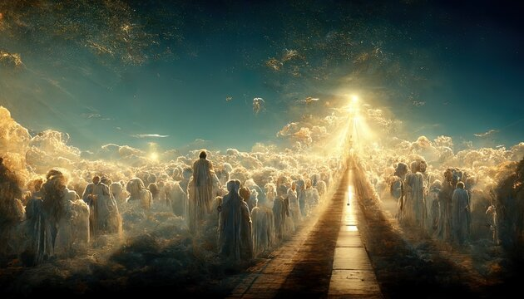
Come to God on His terms and inherit eternal life!
Matthew 19:13-30

Slide 4
I. The kingdom of heaven belongs to those with humble faith (verses 13-15)
13 Then children were brought to him that he might lay his hands on them and pray. The disciples rebuked the people, 14 but Jesus said, “Let the little children come to me and do not hinder them, for to such belongs the kingdom of heaven.” 15 And he laid his hands on them and went away.

Slide 5
II. Those who seek the kingdom of heaven on their own terms will not enter it (verses 16-26)
It is impossible for humanity to merit life in the kingdom (16-22 & 26)
16 And behold, a man came up to him, saying, “Teacher, what good deed must I do to have eternal life?” 17 And he said to him, “Why do you ask me about what is good? There is only one who is good. If you would enter life, keep the commandments.”
“The very commandment that promised life proved to be death to me. For sin, seizing an opportunity through the commandment, deceived me and through it killed me. So the law is holy, and the commandment is holy and righteous and good.” Romans 7:10-12

Slide 6
II. Those who seek the kingdom of heaven on their own terms will not enter it (verses 16-26)
It is impossible for humanity to merit life in the kingdom (16-22 & 26)
18 He said to him, “Which ones?” And Jesus said, “You shall not murder, You shall not commit adultery, You shall not steal, You shall not bear false witness, 19 Honor your father and mother, and, You shall love your neighbor as yourself.”
“You shall not covet.” Exodus 20:17

Slide 7
II. Those who seek the kingdom of heaven on their own terms will not enter it (verses 16-26)
It is impossible for humanity to merit life in the kingdom (16-22 & 26)
20 The young man said to him, “All these I have kept. What do I still lack?” 21 Jesus said to him, “If you would be perfect, go, sell what you possess and give to the poor, and you will have treasure in heaven; and come, follow me.” 22 When the young man heard this he went away sorrowful, for he had great possessions.

Slide 8
II. Those who seek the kingdom of heaven on their own terms will not enter it (verses 16-26)
It is impossible for humanity to merit life in the kingdom (16-22 & 26)
20 The young man said to him, “All these I have kept. What do I still lack?” 21 Jesus said to him, “If you would be perfect, go, sell what you possess and give to the poor, and you will have treasure in heaven; and come, follow me.” 22 When the young man heard this he went away sorrowful, for he had great possessions.

Slide 9
II. Those who seek the kingdom of heaven on their own terms will not enter it (verses 16-26)
Who is picture #2?
He’s someone who believes he can attain God’s promise of eternal life in His kingdom on his own.
He believes he’s a good man who does good things, and that’s good enough for God.
He has a personal standard for what’s good enough for God, and he believes he meets that standard.
His standard both narrows down what God’s word teaches and misunderstands even what he has narrowed it down to.

Slide 10
II. A hard heart desires license more than grace (verses 7-12)
Life in the kingdom is only possible by the grace of God (23-26)
23 And Jesus said to his disciples, “Truly, I say to you, only with difficulty will a rich person enter the kingdom of heaven. 24 Again I tell you, it is easier for a camel to go through the eye of a needle than for a rich person to enter the kingdom of God.” 25 When the disciples heard this, they were greatly astonished, saying, “Who then can be saved?” 26 But Jesus looked at them and said, “With man this is impossible, but with God all things are possible.”
“Most Jews expected the rich to inherit eternal life, not because their wealth could buy their way in, but because their wealth testified to the blessing of the Lord on their lives.” D.A. Carson

Slide 11
II. A hard heart desires license more than grace (verses 7-12)
Life in the kingdom is only possible by the grace of God (23-26)
23 And Jesus said to his disciples, “Truly, I say to you, only with difficulty will a rich person enter the kingdom of heaven. 24 Again I tell you, it is easier for a camel to go through the eye of a needle than for a rich person to enter the kingdom of God.” 25 When the disciples heard this, they were greatly astonished, saying, “Who then can be saved?” 26 But Jesus looked at them and said, “With man this is impossible, but with God all things are possible.”

Slide 12
III. Come to God on His terms and inherit eternal life! (Verses 27-30)
27 Then Peter said in reply, “See, we have left everything and followed you. What then will we have?”
“Whoever loves father or mother more than me is not worthy of me, and whoever loves son or daughter more than me is not worthy of me. And whoever does not take his cross and follow me is not worthy of me. Whoever finds his life will lose it, and whoever loses his life for my sake will find it.” Matthew 10:37-39

Slide 13
III. Come to God on His terms and inherit eternal life! (Verses 27-30)
28 Jesus said to them, “Truly, I say to you, in the new world, when the Son of Man will sit on his glorious throne, you who have followed me will also sit on twelve thrones, judging the twelve tribes of Israel. 29 And everyone who has left houses or brothers or sisters or father or mother or children or lands, for my name’s sake, will receive a hundredfold and will inherit eternal life.
NASB - the regeneration. NIV - the renewal of all things. NET - the age when all things are renewed.

Slide 14
III. Come to God on His terms and inherit eternal life! (Verses 27-30)
28 Jesus said to them, “Truly, I say to you, in the new world, when the Son of Man will sit on his glorious throne, you who have followed me will also sit on twelve thrones, judging the twelve tribes of Israel. 29 And everyone who has left houses or brothers or sisters or father or mother or children or lands, for my name’s sake, will receive a hundredfold and will inherit eternal life.
NASB - the regeneration. NIV - the renewal of all things. NET - the age when all things are renewed.

Slide 15
III. Come to God on His terms and inherit eternal life! (Verses 27-30)
Are we a part of what Jesus promises the twelve?
“Do you not know that we will judge angels?” 1st Corinthians 6:3
“Are they not all ministering spirits, sent out to serve those﻿ who will inherit salvation?” Hebrews 1:14
We are “heirs of God and fellow heirs with Christ, provided we suffer with him in order that we may also be glorified with him.” Romans 8:17

Slide 16
III. Come to God on His terms and inherit eternal life! (Verses 27-30)
Are we a part of what Jesus promises the twelve?
Jesus promised those who suffer with him in the church at Thyatira “The one who conquers and who keeps my works until the end, to him I will give authority over the nations, and he will rule them with a rod of iron, as when earthen pots are broken in pieces, even as I myself have received authority from my Father.” Revelation 2:26-27
Jesus gives these promises of blessings in His kingdom as an encouragement to those who come to God on His terms now, sharing in Christ’s sufferings now for the sake of the Father’s will.

Slide 17
III. Come to God on His terms and inherit eternal life! (Verses 27-30)
“Let us run with endurance the race that is set before us, looking to Jesus, the founder and perfecter of our faith, who for the joy that was set before him endured the cross, despising the shame, and is seated at the right hand of the throne of God.” Hebrews 12:1-2
30 But many who are first will be last, and the last first.

Slide 19
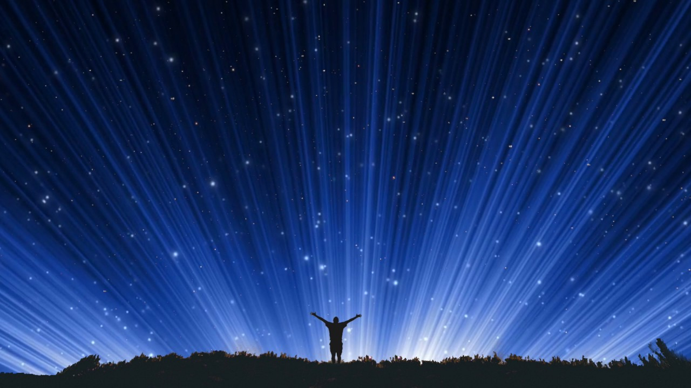
Doxology -- Please stand
Praise God, from Whom all blessings flow;
Praise Him, all creatures here below;
Praise Him above, ye heavenly host; Praise Father, Son, and Holy Ghost
Amen

Slide 20
Benediction

