Slide 1
Scripture Reading
Isaiah 9:1-7
Page 680-81 in the seat back bibles

Slide 2
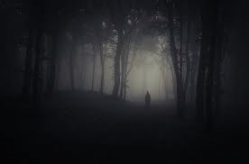
I. Distress, darkness, and the gloom of anguish.
“The Lord will bring you and your king whom you set over you to a nation that neither you nor your fathers have known. And there you shall serve other gods of wood and stone.” Deuteronomy 28:36

Slide 3
I. Distress, darkness, and the gloom of anguish.
“They will pass through the land, greatly distressed and hungry. And when they are hungry, they will be enraged and will speak contemptuously against their king and their God and turn their faces upward. And they will look to the earth, but behold, distress and darkness, the gloom of anguish. And they will be thrust into thick darkness.” Isaiah 8:21-22

Slide 4
II. The people who walked in darkness have seen a great light! (verses 1-2)
1 But there will be no gloom for her who was in anguish. In the former time he brought into contempt the land of Zebulun and the land of Naphtali, but in the latter time he has made glorious the way of the sea, the land beyond the Jordan, Galilee of the nations. 2 The people who walked in darkness have seen a great light; those who dwelt in a land of deep darkness, on them has light shone.
“The word of the Lord proves true; he is a shield for all those who take refuge in him.” Psalm 18:30

Slide 5
II. The people who walked in darkness have seen a great light! (verses 1-2)
1 But there will be no gloom for her who was in anguish. In the former time he brought into contempt the land of Zebulun and the land of Naphtali, but in the latter time he has made glorious the way of the sea, the land beyond the Jordan, Galilee of the nations. 2 The people who walked in darkness have seen a great light; those who dwelt in a land of deep darkness, on them has light shone.
“Can anything good come out of Nazareth?” John 1:46

Slide 6
III. The peoples’ joy will prosper (verses 3-5)
The promise of verses 1-2 came to pass, “because of the tender mercy of our God, whereby the sunrise shall visit us from on high to give light to those who sit in darkness and in the shadow of death…” Luke 1:78-79
“The word of the Lord proves true; he is a shield for all those who take refuge in him.” Psalm 18:30

Slide 7
III. The peoples’ joy will prosper (verses 3-5)
3 You have multiplied the nation; you have increased its joy; they rejoice before you as with joy at the harvest, as they are glad when they divide the spoil.
“All these blessings shall come upon you and overtake you, if you obey the voice of the Lord your God.” Deuteronomy 28:2
“Blessed shall be the fruit of your womb and the fruit of your ground and the fruit of your cattle, the increase of your herds and the young of your flock. Blessed shall be your basket and your kneading bowl.” Deuteronomy 28:4–5

Slide 8
III. The peoples’ joy will prosper (verses 3-5)
3 You have multiplied the nation; you have increased its joy; they rejoice before you as with joy at the harvest, as they are glad when they divide the spoil.
“All these blessings shall come upon you and overtake you, if you obey the voice of the Lord your God.” Deuteronomy 28:2
“The Lord will cause your enemies who rise against you to be defeated before you. They shall come out against you one way and flee before you seven ways.” Deuteronomy 28:7

Slide 9
III. The peoples’ joy will prosper (verses 3-5)
4 For the yoke of his burden, and the staff for his shoulder, the rod of his oppressor, you have broken as on the day of Midian. 5 For every boot of the tramping warrior in battle tumult and every garment rolled in blood will be burned as fuel for the fire.
“The Midianites and the Amalekites and all the people of the East lay along the valley like locusts in abundance.” Judges 7:12

Slide 10
“On that day I will make Jerusalem a heavy stone for all the peoples. All who lift it will surely hurt themselves. And all the nations of the earth will gather against it. On that day, declares the Lord, I will strike every horse with panic, and its rider with madness. But for the sake of the house of Judah I will keep my eyes open, when I strike every horse of the peoples with blindness. Then the clans of Judah shall say to themselves, ‘The inhabitants of Jerusalem have strength through the Lord of hosts, their God.’ “On that day I will make the clans of Judah like a blazing pot in the midst of wood, like a flaming torch among sheaves. And they shall devour to the right and to the left all the surrounding peoples, while Jerusalem shall again be inhabited in its place, in Jerusalem.” Zechariah 12:3-6

Slide 11
IV. The peoples’ joy will prosper because the Christ has come! (verses 6-7)
6 For to us a child is born, to us a son is given; and the government shall be upon his shoulder, and his name shall be called Wonderful Counselor, Mighty God, Everlasting Father, Prince of Peace. 7 Of the increase of his government and of peace there will be no end, on the throne of David and over his kingdom, to establish it and to uphold it with justice and with righteousness from this time forth and forevermore. The zeal of the Lord of hosts will do this.
“Therefore the Lord himself will give you a sign. Behold, the virgin shall conceive and bear a son, and shall call his name Immanuel.” Isaiah 7:14

Slide 12
IV. The peoples’ joy will prosper because the Christ has come! (verses 6-7)
6 For to us a child is born, to us a son is given; and the government shall be upon his shoulder, and his name shall be called Wonderful Counselor, Mighty God, Everlasting Father, Prince of Peace. 7 Of the increase of his government and of peace there will be no end, on the throne of David and over his kingdom, to establish it and to uphold it with justice and with righteousness from this time forth and forevermore. The zeal of the Lord of hosts will do this.
As the Lord promised David in 2nd Samuel 7:16, “your house and your kingdom shall be made sure forever before me. Your throne shall be established forever.”

Slide 13
IV. The peoples’ joy will prosper because the Christ has come! (verses 6-7)
6 For to us a child is born, to us a son is given; and the government shall be upon his shoulder, and his name shall be called Wonderful Counselor, Mighty God, Everlasting Father, Prince of Peace. 7 Of the increase of his government and of peace there will be no end, on the throne of David and over his kingdom, to establish it and to uphold it with justice and with righteousness from this time forth and forevermore. The zeal of the Lord of hosts will do this.

Slide 14
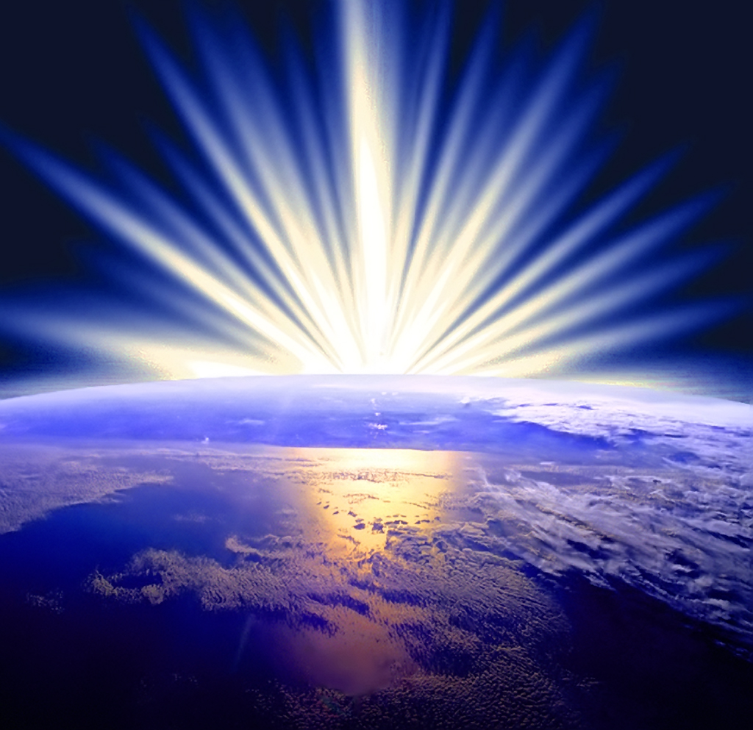
The Christ is our great light!

Slide 15
The Christ is our great light!
In Malachi 3:16-17, Malachi speaks of “those who feared the Lord and esteemed his name. ‘They shall be mine, says the Lord of hosts, in the day when I make up my treasured possession, and I will spare them as a man spares his son who serves him.’”

Slide 16
The Christ is our great light!
“I am the light of the world. Whoever follows me will not walk in darkness, but will have the light of life.” John 8:12

Slide 17
The Christ is our great light!
This is the very heart of faith in the Lord: the belief that time and the hardship of life have no power to dim our hope in His promises. As Hebrews 11:35 teaches us about the great saints of old, “Women received back their dead by resurrection. Some were tortured, refusing to accept release, so that they might rise again to a better life.”

Slide 18
The Christ is our great light!
Jesus Christ is our great light, not because He’s still in a manger, but because He “grew and became strong, filled with wisdom. And the favor of God was upon him.” Luke 2:40
And He lived His life, not as One “who is unable to sympathize with our weaknesses, but one who in every respect has been tempted as we are, yet without sin.” Hebrews 4:15

Slide 19
The Christ is our great light!
And “For our sake he made him to be sin who knew no sin, so that in him we might become the righteousness of God” (2nd Corinthians 5:21), for He “was delivered up for our trespasses and raised for our justification” (Romans 4:25).

Slide 20
The Christ is our great light!
“And if I go and prepare a place for you, I will come again and will take you to myself, that where I am you may be also.” John 14:3
“‘Surely I am coming soon.’ Amen. Come, Lord Jesus!” Revelation 22:20

Slide 21
Benediction

