Slide 2
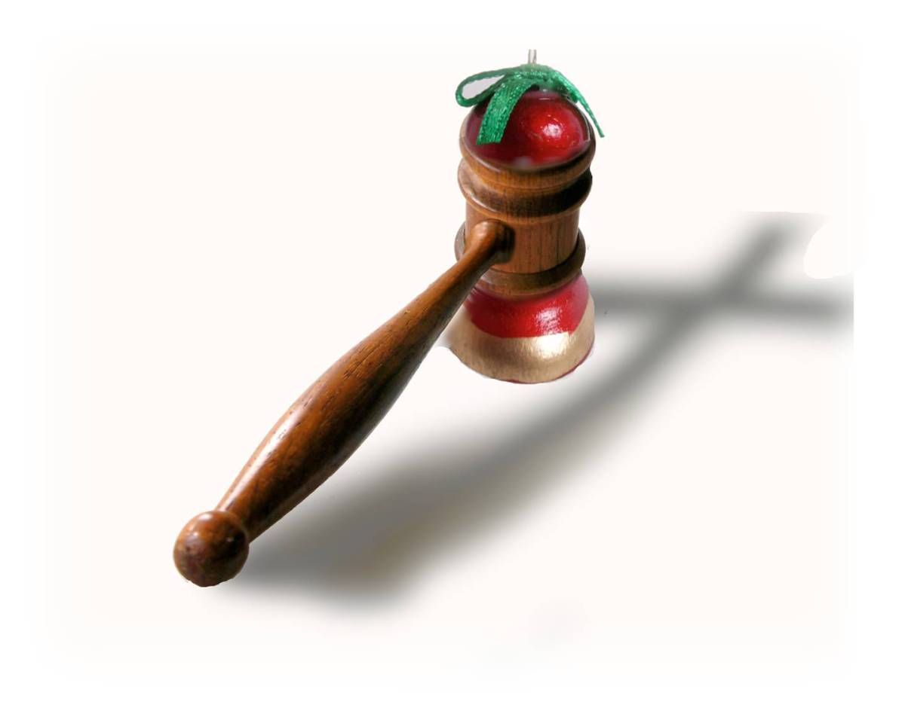
Church Discipline 101
Matthew 18:15-35

Slide 3
I. Jesus commands the church to routinely practice church discipline (verses 15-20)
Church discipline entails loving correction that seeks repentance (15-17)
15“If your brother sins against you, go and tell him his fault, between you and him alone. If he listens to you, you have gained your brother. 16 But if he does not listen, take one or two others along with you, that every charge may be established by the evidence of two or three witnesses. 17 If he refuses to listen to them, tell it to the church. And if he refuses to listen even to the church, let him be to you as a Gentile and a tax collector.

Slide 4
I. Jesus commands the church to routinely practice church discipline (verses 15-20)
Church discipline entails loving correction that seeks repentance (15-17)
“Effective church discipline requires an investment before the first step. We must be involved in one another’s lives—sharing life experiences, showing trust and transparency, learning one another’s nonverbal language, priorities, dreams, and fears. Our successful involvement in the Father’s pursuit of the straying brother depends on our prior investment in the relationship.” Stu Weber

Slide 5
I. Jesus commands the church to routinely practice church discipline (verses 15-20)
Church discipline entails loving correction that seeks repentance (15-17)
15“If your brother sins against you, go and tell him his fault, between you and him alone. If he listens to you, you have gained your brother. 16 But if he does not listen, take one or two others along with you, that every charge may be established by the evidence of two or three witnesses. 17 If he refuses to listen to them, tell it to the church. And if he refuses to listen even to the church, let him be to you as a Gentile and a tax collector.

Slide 6
I. Jesus commands the church to routinely practice church discipline (verses 15-20)
Church discipline entails loving correction that seeks repentance (15-17)
15“If your brother sins against you, go and tell him his fault, between you and him alone. If he listens to you, you have gained your brother.
“Brothers, if anyone is caught in any transgression, you who are spiritual should restore him in a spirit of gentleness. Keep watch on yourself, lest you too be tempted.” Galatians 6:1

Slide 7
I. Jesus commands the church to routinely practice church discipline (verses 15-20)
Church discipline entails loving correction that seeks repentance (15-17)
15“If your brother sins against you, go and tell him his fault, between you and him alone. If he listens to you, you have gained your brother.
“Whoever would foster love covers over an offense, but whoever repeats the matter separates close friends.” Proverbs 17:9, Christian Standard Bible

Slide 8
I. Jesus commands the church to routinely practice church discipline (verses 15-20)
Church discipline entails loving correction that seeks repentance (15-17)
15“If your brother sins against you, go and tell him his fault, between you and him alone. If he listens to you, you have gained your brother. 16 But if he does not listen, take one or two others along with you, that every charge may be established by the evidence of two or three witnesses. 17 If he refuses to listen to them, tell it to the church. And if he refuses to listen even to the church, let him be to you as a Gentile and a tax collector.

Slide 9
I. Jesus commands the church to routinely practice church discipline (verses 15-20)
Church discipline entails loving correction that seeks repentance (15-17)
15“If your brother sins against you, go and tell him his fault, between you and him alone. If he listens to you, you have gained your brother. 16 But if he does not listen, take one or two others along with you, that every charge may be established by the evidence of two or three witnesses. 17 If he refuses to listen to them, tell it to the church. And if he refuses to listen even to the church, let him be to you as a Gentile and a tax collector.

Slide 10
I. Jesus commands the church to routinely practice church discipline (verses 15-20)
Church discipline entails loving correction that seeks repentance (15-17)
17 If he refuses to listen to them, tell it to the church. And if he refuses to listen even to the church, let him be to you as a Gentile and a tax collector.
“But now I am writing to you not to associate with anyone who bears the name of brother if he is guilty…not even to eat with such a one… “Purge the evil person from among you.” 1st Corinthians 5:11 & 13

Slide 11
I. Jesus commands the church to routinely practice church discipline (verses 15-20)
Church discipline rests upon faithfulness to Jesus’ directions (18-20)
18 Truly, I say to you, whatever you bind on earth shall be bound in heaven, and whatever you loose on earth shall be loosed in heaven. 19 Again I say to you, if two of you agree on earth about anything they ask, it will be done for them by my Father in heaven. 20 For where two or three are gathered in my name, there am I among them.”

Slide 12
I. Jesus commands the church to routinely practice church discipline (verses 15-20)
These verses are confirmation that every charge…established by the evidence of two or three witnesses can be made with confidence that Jesus agrees with the charge if the process of church discipline has been faithful to Jesus’ directions both in attitude and action.
Church discipline rests upon faithfulness to Jesus’ directions (18-20)
18 Truly, I say to you, whatever you bind on earth shall be bound in heaven, and whatever you loose on earth shall be loosed in heaven. 19 Again I say to you, if two of you agree on earth about anything they ask, it will be done for them by my Father in heaven. 20 For where two or three are gathered in my name, there am I among them.”

Slide 13
II. The aim of church discipline is forgiveness and restoration (verses 21-35)
“…you must throw this man out and hand him over to Satan so that his sinful nature will be destroyed and he himself will be saved on the day the Lord returns.” 1st Corinthians 5:5, NLT
“I am not overstating it when I say that the man who caused all the trouble hurt all of you more than he hurt me. Most of you opposed him, and that was punishment enough. Now, however, it is time to forgive and comfort him. Otherwise he may be overcome by discouragement. So I urge you now to reaffirm your love for him.” 2nd Corinthians 2:5-8, NLT

Slide 14
II. The aim of church discipline is forgiveness and restoration (verses 21-35)
Believers must always forgive a repentant brother or sister (21-22)
21 Then Peter came up and said to him, “Lord, how often will my brother sin against me, and I forgive him? As many as seven times?” 22 Jesus said to him, “I do not say to you seven times, but seventy-seven times.

Slide 15
II. The aim of church discipline is forgiveness and restoration (verses 21-35)
Believers must always forgive because we have been immeasurably forgiven by God (23-27)
23“Therefore the kingdom of heaven may be compared to a king who wished to settle accounts with his servants.

Slide 16
II. The aim of church discipline is forgiveness and restoration (verses 21-35)
Believers must always forgive because we have been immeasurably forgiven by God (23-27)
24 When he began to settle, one was brought to him who owed him ten thousand talents. 25 And since he could not pay, his master ordered him to be sold, with his wife and children and all that he had, and payment to be made.

Slide 17
II. The aim of church discipline is forgiveness and restoration (verses 21-35)
Believers must always forgive because we have been immeasurably forgiven by God (23-27)
26 So the servant fell on his knees, imploring him, ‘Have patience with me, and I will pay you everything.’ 27 And out of pity for him, the master of that servant released him and forgave him the debt.

Slide 18
II. The aim of church discipline is forgiveness and restoration (verses 21-35)
When believers fail to forgive a repentant brother or sister, we invite God’s judgment upon ourselves (28-35)
28 But when that same servant went out, he found one of his fellow servants who owed him a hundred denarii, and seizing him, he began to choke him, saying, ‘Pay what you owe.’ 29 So his fellow servant fell down and pleaded with him, ‘Have patience with me, and I will pay you.’ 30 He refused and went and put him in prison until he should pay the debt.

Slide 19
II. The aim of church discipline is forgiveness and restoration (verses 21-35)
When believers fail to forgive a repentant brother or sister, we invite God’s judgment upon ourselves (28-35)
31 When his fellow servants saw what had taken place, they were greatly distressed, and they went and reported to their master all that had taken place. 32 Then his master summoned him and said to him, ‘You wicked servant! I forgave you all that debt because you pleaded with me.

Slide 20
II. The aim of church discipline is forgiveness and restoration (verses 21-35)
When believers fail to forgive a repentant brother or sister, we invite God’s judgment upon ourselves (28-35)
33 And should not you have had mercy on your fellow servant, as I had mercy on you?’ 34 And in anger his master delivered him to the jailers, until he should pay all his debt.
“…you must throw this man out and hand him over to Satan so that his sinful nature will be destroyed and he himself will be saved on the day the Lord returns.” 1st Corinthians 5:5, NLT

Slide 21
II. The aim of church discipline is forgiveness and restoration (verses 21-35)
When believers fail to forgive a repentant brother or sister, we invite God’s judgment upon ourselves (28-35)
35 “So also my heavenly Father will do to every one of you, if you do not forgive your brother from your heart.”

