Slide 1
Scripture Reading
Matthew 18:1-14
Page 978-79 in the seat back bibles

Slide 2
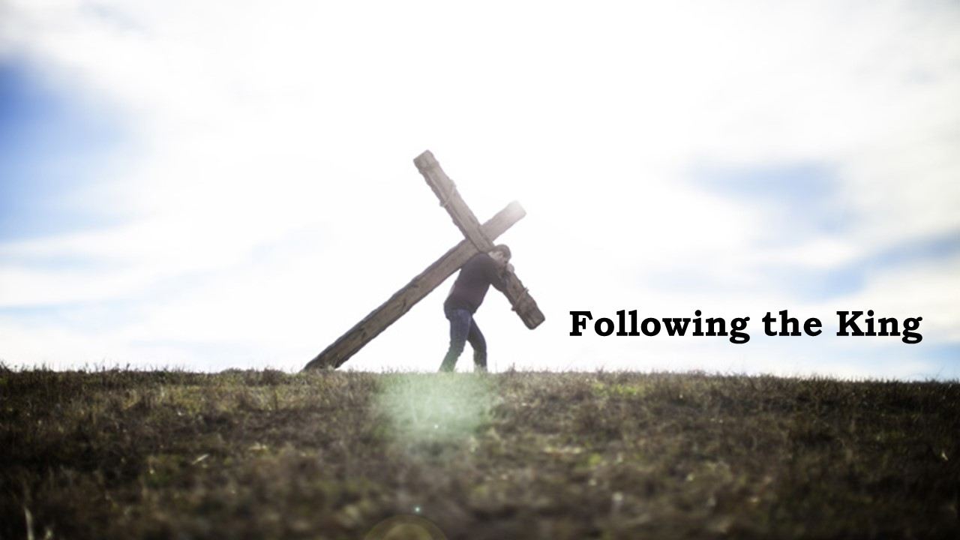

Slide 3
“You cannot yell people into holiness. You cannot terrify people into the sacred. My yelling was a far worse violation of the holy place than his picking a few flowers. I do that a lot, bluster and yell on behalf of God‘s holy presence, instead of taking off my shoes myself, kneeling on holy ground, and inviting whoever happens to be around to join with me.” Eugene Peterson

Slide 4
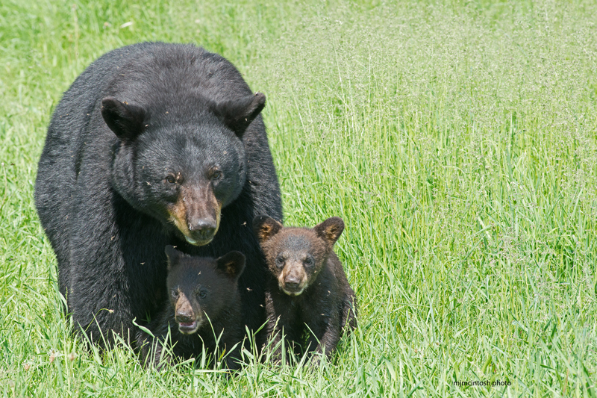
God opposes the proud for the sake of His children
Matthew 18:1-14

Slide 5
I. God’s children are those who humble themselves like a child (verses 1-6)
True humility is the mark of greatness in the kingdom of heaven (1-4)
1 At that time the disciples came to Jesus, saying, “Who is the greatest in the kingdom of heaven?”
“But they kept silent, for on the way they had argued with one another about who was the greatest.” Mark 9:34
“But Jesus, knowing the reasoning of their hearts, took a child and put him by his side.” Luke 9:47

Slide 6
I. God’s children are those who humble themselves like a child (verses 1-6)
True humility is the mark of greatness in the kingdom of heaven (1-4)
2 And calling to him a child, he put him in the midst of them 3 and said, “Truly, I say to you, unless you turn and become like children, you will never enter the kingdom of heaven.

Slide 7
I. God’s children are those who humble themselves like a child (verses 1-6)
True humility is the mark of greatness in the kingdom of heaven (1-4)
2 And calling to him a child, he put him in the midst of them 3 and said, “Truly, I say to you, unless you turn and become like children, you will never enter the kingdom of heaven.

Slide 8
I. God’s children are those who humble themselves like a child (verses 1-6)
True humility is the mark of greatness in the kingdom of heaven (1-4)
4 Whoever humbles himself like this child is the greatest in the kingdom of heaven.

Slide 9
I. God’s children are those who humble themselves like a child (verses 1-6)
True humility is confirmed by real love for God’s children (5-6)
5“Whoever receives one such child in my name receives me, 6 but whoever causes one of these little ones who believe in me to sin, it would be better for him to have a great millstone fastened around his neck and to be drowned in the depth of the sea.

Slide 10
I. God’s children are those who humble themselves like a child (verses 1-6)
True humility is confirmed by real love for God’s children (5-6)
5“Whoever receives one such child in my name receives me, 6 but whoever causes one of these little ones who believe in me to sin, it would be better for him to have a great millstone fastened around his neck and to be drowned in the depth of the sea.

Slide 11
II. The enemy of true humility is pride (verses 7-10)
The world will be judged for its sinful pride (7)
7 “Woe to the world for temptations to sin! For it is necessary that temptations come, but woe to the one by whom the temptation comes!

Slide 12
II. The enemy of true humility is pride (verses 7-10)
God’s children must not partner with the world’s sinful pride (8-10)
8 And if your hand or your foot causes you to sin, cut it off and throw it away. It is better for you to enter life crippled or lame than with two hands or two feet to be thrown into the eternal fire. 9 And if your eye causes you to sin, tear it out and throw it away. It is better for you to enter life with one eye than with two eyes to be thrown into the hell of fire.
“It is the Spirit who gives life; the flesh profits nothing.” John 6:63, NASB

Slide 13
II. The enemy of true humility is pride (verses 7-10)
God’s children must not partner with the world’s sinful pride (8-10)
8 And if your hand or your foot causes you to sin, cut it off and throw it away… 9 And if your eye causes you to sin, tear it out and throw it away…
“This does not mean that the body is to be deprived of a necessary part through mutilation, but to [eradicate] all the ungodly reasonings of the soul.” Greek Lexicon of the New Testament

Slide 14
II. The enemy of true humility is pride (verses 7-10)
God’s children must not partner with the world’s sinful pride (8-10)
8 And if your hand or your foot causes you to sin, cut it off and throw it away. It is better for you to enter life crippled or lame than with two hands or two feet to be thrown into the eternal fire. 9 And if your eye causes you to sin, tear it out and throw it away. It is better for you to enter life with one eye than with two eyes to be thrown into the hell of fire.

Slide 15
II. The enemy of true humility is pride (verses 7-10)
God’s children must not partner with the world’s sinful pride (8-10)
10“See that you do not despise one of these little ones. For I tell you that in heaven their angels always see the face of my Father who is in heaven.”

Slide 16
II. The enemy of true humility is pride (verses 7-10)
God’s children must not partner with the world’s sinful pride (8-10)
10“See that you do not despise one of these little ones. For I tell you that in heaven their angels always see the face of my Father who is in heaven.”
Angels are “ministering spirits sent out to serve for the sake of those who are to inherit salvation.” Hebrews 1:14

Slide 17
III. God opposes the proud for the sake of His children (verses 10-14)
12 What do you think? If a man has a hundred sheep, and one of them has gone astray, does he not leave the ninety-nine on the mountains and go in search of the one that went astray? 13 And if he finds it, truly, I say to you, he rejoices over it more than over the ninety-nine that never went astray.

Slide 18
III. God opposes the proud for the sake of His children (verses 10-14)
14 So it is not the will of my Father who is in heaven that one of these little ones should perish.
“The Lord is not slow to fulfill his promise as some count slowness, but is patient toward you, not wishing that any should perish, but that all should reach repentance.” 2nd Peter 3:9

Slide 19
III. God opposes the proud for the sake of His children (verses 10-14)
“Do nothing out of selfish ambition or vain conceit. Rather, in humility value others above yourselves, not looking to your own interests but each of you to the interests of the others. In your relationships with one another, have the same mindset as Christ Jesus: Who, being in very nature God, did not consider equality with God something to be used to his own advantage; rather, he made himself nothing…” Philippians 2:3-7, NIV

Slide 20
Benediction

