Slide 2
12 Ways Your Phone Is Changing You, Tony Reinke
We’re distracted. We check our smartphone 85,000 times a year, or once every 4.3 minutes.
We’re a hazard to others. Texting and driving make us 23 times more likely to get in a car accident.
We crave approval. Each social media moment is another scene in our never-ending story about “me.”
We idolize celebrity as our attention drifts from the eternal toward the latest headlines and gossip.
We become lonely. Technology is drawing us apart, by design, leaving us to feel the sting of loneliness under an illusion of being connected.

Slide 3
12 Ways Your Phone Is Changing You, Tony Reinke
We get lost in the digital noise. The average daily social media and email output is larger than the Library of Congress.
We lose track of time (and waste an immense amount of time). The wonder of people, creation, and even God himself gets lost in the whirl of “urgent” notifications.

Slide 4
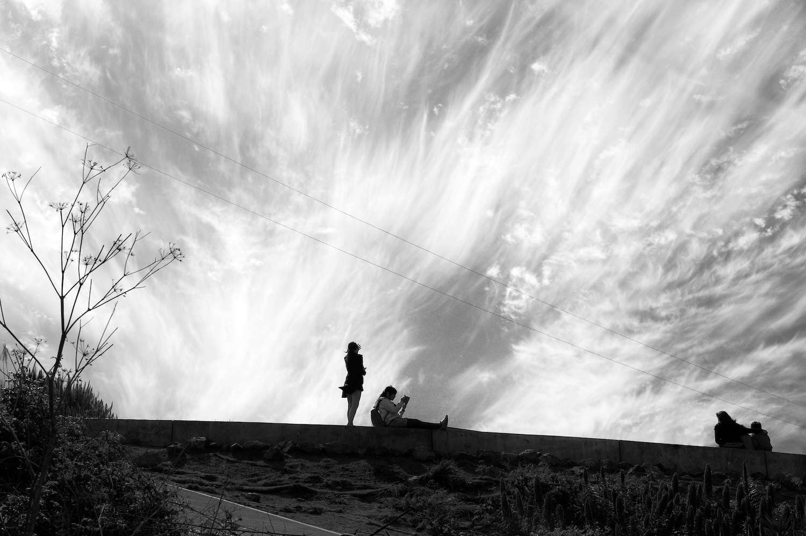
Set your mind on the things of god
Matthew 16:1-23

Slide 5
I. The religious leaders had their minds set on the things of this world (verses 1-4)
1 And the Pharisees and Sadducees came, and to test him they asked him to show them a sign from heaven.

Slide 6
I. The religious leaders had their minds set on the things of this world (verses 1-4)
2 He answered them, “When it is evening, you say, ‘It will be fair weather, for the sky is red.’ 3 And in the morning, ‘It will be stormy today, for the sky is red and threatening.’ You know how to interpret the appearance of the sky, but you cannot interpret the signs of the times. 4 An evil and adulterous generation seeks for a sign, but no sign will be given to it except the sign of Jonah.” So he left them and departed.

Slide 7
I. The religious leaders had their minds set on the things of this world (verses 1-4)
“What are we to do? For this man performs many signs. If we let him go on like this, everyone will believe in him, and the Romans will come and take away both our place and our nation.” John 11:47-48

Slide 8
I. The religious leaders had their minds set on the things of this world (verses 1-4)
2 He answered them, “When it is evening, you say, ‘It will be fair weather, for the sky is red.’ 3 And in the morning, ‘It will be stormy today, for the sky is red and threatening.’ You know how to interpret the appearance of the sky, but you cannot interpret the signs of the times. 4 An evil and adulterous generation seeks for a sign, but no sign will be given to it except the sign of Jonah.” So he left them and departed.
When Jesus was yet again confronted with a demand for a sign, “he sighed deeply in his spirit.” Mark 8:12

Slide 9
II. The disciples were following the religious leaders’ example (verses 5-12)
5 When the disciples reached the other side, they had forgotten to bring any bread. 6 Jesus said to them, “Watch and beware of the leaven of the Pharisees and Sadducees.”

Slide 10
II. The disciples were following the religious leaders’ example (verses 5-12)
7 And they began discussing it among themselves, saying, “We brought no bread.”

Slide 11
II. The disciples were following the religious leaders’ example (verses 5-12)
8 But Jesus, aware of this, said, “O you of little faith, why are you discussing among yourselves the fact that you have no bread? 9 Do you not yet perceive? Do you not remember the five loaves for the five thousand, and how many baskets you gathered? 10 Or the seven loaves for the four thousand, and how many baskets you gathered? 11 How is it that you fail to understand that I did not speak about bread? Beware of the leaven of the Pharisees and Sadducees.”

Slide 12
II. The disciples were following the religious leaders’ example (verses 5-12)
12 Then they understood that he did not tell them to beware of the leaven of bread, but of the teaching of the Pharisees and Sadducees.

Slide 13
III. To set your mind on the things of God is to set your mind on Christ (verses 13-20)
Embrace who He is and His work of building His church (13-20)
13 Now when Jesus came into the district of Caesarea Philippi, he asked his disciples, “Who do people say that the Son of Man is?” 14 And they said, “Some say John the Baptist, others say Elijah, and others Jeremiah or one of the prophets.”

Slide 14
III. To set your mind on the things of God is to set your mind on Christ (verses 13-20)
Embrace who He is and His work of building His church (13-20)
15 He said to them, “But who do you say that I am?” 16 Simon Peter replied, “You are the Christ, the Son of the living God.” 17 And Jesus answered him, “Blessed are you, Simon Bar-Jonah! For flesh and blood has not revealed this to you, but my Father who is in heaven.

Slide 15
III. To set your mind on the things of God is to set your mind on Christ (verses 13-20)
Embrace who He is and His work of building His church (13-20)
15 He said to them, “But who do you say that I am?” 16 Simon Peter replied, “You are the Christ, the Son of the living God.” 17 And Jesus answered him, “Blessed are you, Simon Bar-Jonah! For flesh and blood has not revealed this to you, but my Father who is in heaven.

Slide 16
III. To set your mind on the things of God is to set your mind on Christ (verses 13-20)
Embrace who He is and His work of building His church (13-20)
18 And I tell you, you are Peter, and on this rock I will build my church, and the gates of hell shall not prevail against it. 19 I will give you the keys of the kingdom of heaven, and whatever you bind on earth shall be bound in heaven, and whatever you loose on earth shall be loosed in heaven.”
Peter was prominent among the 12 as the first among equals through whom the work of Christ building His church would begin, “built on the foundation of the apostles and prophets, Christ Jesus himself being the cornerstone.” Ephesians 2:20

Slide 17
III. To set your mind on the things of God is to set your mind on Christ (verses 13-20)
Embrace who He is and His work of building His church (13-20)
18 And I tell you, you are Peter, and on this rock I will build my church, and the gates of hell shall not prevail against it. 19 I will give you the keys of the kingdom of heaven, and whatever you bind on earth shall be bound in heaven, and whatever you loose on earth shall be loosed in heaven.”
“Woe to you lawyers! For you have taken away the key of knowledge. You did not enter yourselves, and you hindered those who were entering.” Luke 11:51-52

Slide 18
III. To set your mind on the things of God is to set your mind on Christ (verses 13-20)
Embrace who He is and His work of building His church (13-20)
18 And I tell you, you are Peter, and on this rock I will build my church, and the gates of hell shall not prevail against it. 19 I will give you the keys of the kingdom of heaven, and whatever you bind on earth shall be bound in heaven, and whatever you loose on earth shall be loosed in heaven.”
“All this is from God, who through Christ reconciled us to himself and gave us the ministry of reconciliation; that is, in Christ God was reconciling the world to himself, not counting their trespasses against them, and entrusting to us the message of reconciliation.” 2nd Corinthians 5:18-19

Slide 19
III. To set your mind on the things of God is to set your mind on Christ (verses 13-20)
Embrace who He is and His work of building His church (13-20)
18 And I tell you, you are Peter, and on this rock I will build my church, and the gates of hell shall not prevail against it. 19 I will give you the keys of the kingdom of heaven, and whatever you bind on earth shall be bound in heaven, and whatever you loose on earth shall be loosed in heaven.”
19 …and whatever you bind on earth ﻿shall have been bound in heaven, and whatever you loose on earth ﻿shall have been loosed in heaven. NASB

Slide 20
III. To set your mind on the things of God is to set your mind on Christ (verses 13-20)
Embrace who He is and His work of building His church (13-20)
18 And I tell you, you are Peter, and on this rock I will build my church, and the gates of hell shall not prevail against it. 19 I will give you the keys of the kingdom of heaven, and whatever you bind on earth shall be bound in heaven, and whatever you loose on earth shall be loosed in heaven.”
The keys are possessed by any church faithful to the terms of the King.

Slide 21
III. To set your mind on the things of God is to set your mind on Christ (verses 13-20)
Embrace the necessity of Christ’s suffering, death, and resurrection (21-23)
21 From that time Jesus began to show his disciples that he must go to Jerusalem and suffer many things from the elders and chief priests and scribes, and be killed, and on the third day be raised. 22 And Peter took him aside and began to rebuke him, saying, “Far be it from you, Lord! This shall never happen to you.” 23 But he turned and said to Peter, “Get behind me, Satan! You are a hindrance to me. For you are not setting your mind on the things of God, but on the things of man.”

Slide 22
III. To set your mind on the things of God is to set your mind on Christ (verses 13-20)
Embrace the necessity of Christ’s suffering, death, and resurrection (21-23)
21 From that time Jesus began to show his disciples that he must go to Jerusalem and suffer many things from the elders and chief priests and scribes, and be killed, and on the third day be raised. 22 And Peter took him aside and began to rebuke him, saying, “Far be it from you, Lord! This shall never happen to you.” 23 But he turned and said to Peter, “Get behind me, Satan! You are a hindrance to me. For you are not setting your mind on the things of God, but on the things of man.”

Slide 23
III. To set your mind on the things of God is to set your mind on Christ (verses 13-20)
Embrace the necessity of Christ’s suffering, death, and resurrection (21-23)
To set your mind on the things of God is to embrace the necessity of Christ’s cross and the necessity for us to follow His example.

