Slide 1
Scripture Reading
Matthew 17:14-27
Page 978 in the seat back bibles

Slide 3
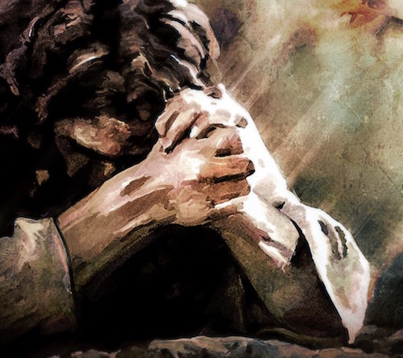
Matthew 17:14-27
Trust the King in All Things

Slide 4
I. Faith in God is essential for doing His will (verses 14-21)
“Taking God at His word and living my life accordingly.” My personal working definition of faith

Slide 5
I. Faith in God is essential for doing His will (verses 14-21)
The disciples fail to seek and trust in God’s provision (14-17)
14 And when they came to the crowd, a man came up to him and, kneeling before him, 15 said, “Lord, have mercy on my son, for he has seizures and he suffers terribly. For often he falls into the fire, and often into the water. 16 And I brought him to your disciples, and they could not heal him.” 17 And Jesus answered, “O faithless and twisted generation, how long am I to be with you? How long am I to bear with you? Bring him here to me.”

Slide 6
I. Faith in God is essential for doing His will (verses 14-21)
Jesus emphasizes the necessity of seeking and trusting God’s provision (18-21)
18 And Jesus rebuked the demon, and it came out of him, and the boy was healed instantly. 19 Then the disciples came to Jesus privately and said, “Why could we not cast it out?” 20 He said to them, “Because of your little faith. For truly, I say to you, if you have faith like a grain of mustard seed, you will say to this mountain, ‘Move from here to there,’ and it will move, and nothing will be impossible for you.”

Slide 7
I. Faith in God is essential for doing His will (verses 14-21)
Jesus emphasizes the necessity of seeking and trusting God’s provision (18-21)
21“﻿But this kind does not go out except by prayer and fasting.” NASB

Slide 8
II. God’s will is to bring salvation through the provision of His Son (verses 22-27)
Jesus’ provision is through His death and resurrection (22-23)
22 As they were gathering in Galilee, Jesus said to them, “The Son of Man is about to be delivered into the hands of men, 23 and they will kill him, and he will be raised on the third day.” And they were greatly distressed.
“Their hopes were dashed because their preconceptions about the promised Messiah were so deeply ingrained in their Jewish hearts. They also feared the repercussions of such persecution upon them as the followers of Jesus.” Stu Weber, Holman NT Commentary

Slide 9
II. God’s will is to bring salvation through the provision of His Son (verses 22-27)
Jesus’ provision is through His death and resurrection (22-23)
22 As they were gathering in Galilee, Jesus said to them, “The Son of Man is about to be delivered into the hands of men, 23 and they will kill him, and he will be raised on the third day.” And they were greatly distressed.

Slide 10
II. God’s will is to bring salvation through the provision of His Son (verses 24-27)
God will provide for the freedom of His children (24-27)
“We are offspring of Abraham and have never been enslaved to anyone” John 8:33
“So if the Son sets you free, you will be free indeed.” John 8:36

Slide 11
II. God’s will is to bring salvation through the provision of His Son (verses 24-27)
God will provide for the freedom of His children (24-27)
24 When they came to Capernaum, the collectors of the two-drachma tax went up to Peter and said, “Does your teacher not pay the tax?” 25 He said, “Yes.” And when he came into the house, Jesus spoke to him first, saying, “What do you think, Simon? From whom do kings of the earth take toll or tax? From their sons or from others?” 26 And when he said, “From others,” Jesus said to him, “Then the sons are free.

Slide 12
II. God’s will is to bring salvation through the provision of His Son (verses 24-27)
God will provide for the freedom of His children (24-27)
24 When they came to Capernaum, the collectors of the two-drachma tax went up to Peter and said, “Does your teacher not pay the tax?” 25 He said, “Yes.” And when he came into the house, Jesus spoke to him first, saying, “What do you think, Simon? From whom do kings of the earth take toll or tax? From their sons or from others?” 26 And when he said, “From others,” Jesus said to him, “Then the sons are free.

Slide 13
II. God’s will is to bring salvation through the provision of His Son (verses 24-27)
God will provide for the freedom of His children (24-27)
24 When they came to Capernaum, the collectors of the two-drachma tax went up to Peter and said, “Does your teacher not pay the tax?” 25 He said, “Yes.” And when he came into the house, Jesus spoke to him first, saying, “What do you think, Simon? From whom do kings of the earth take toll or tax? From their sons or from others?” 26 And when he said, “From others,” Jesus said to him, “Then the sons are free.

Slide 14
II. God’s will is to bring salvation through the provision of His Son (verses 24-27)
God will provide for the freedom of His children (24-27)
But in the Father’s kingdom, the liberty of the children does not entail the license for the children to walk in this world contrary to the Father’s ways.
27 However, not to give offense to them, go to the sea and cast a hook and take the first fish that comes up, and when you open its mouth you will find a shekel. Take that and give it to them for me and for yourself.”

Slide 15
III. Trust the King in all things
Trust Him with your ministry
“But by the grace of God I am what I am, and his grace toward me was not in vain. On the contrary, I worked harder than any of them, though it was not I, but the grace of God that is with me.” 1st Corinthians 15:10

Slide 16
III. Trust the King in all things
Trust Him with your trials
“For we do not want you to be unaware, brothers, of the affliction we experienced in Asia. For we were so utterly burdened beyond our strength that we despaired of life itself. Indeed, we felt that we had received the sentence of death. But that was to make us rely not on ourselves but on God who raises the dead.” 2nd Corinthians 1:8-9

Slide 17
III. Trust the King in all things
Trust Him with your freedom
“All authority in heaven and on earth has been given to me. Go therefore…” Matthew 28:18-19
The danger of giving thanks for our freedom to worship, as we often do, is to see that freedom as one given by a kingdom of this world and one that can be taken away by a kingdom of this world.

