Slide 1
Scripture Reading
Matthew 13:53 – 14:12

Slide 3
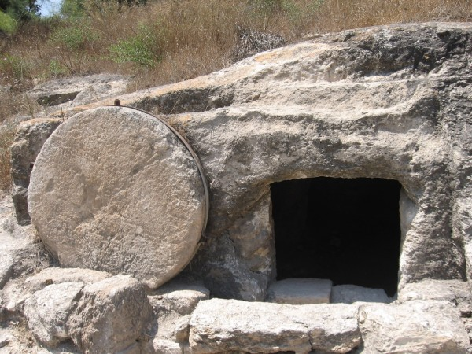
The Stone that makes men stumble
Matthew 13:53 – 14:12

Slide 4
I. Jesus caused His hometown to stumble (verses 53-58)
“Because they did not pursue it by faith, but as if it were based on works. They have stumbled over the stumbling stone, as it is written, ‘Behold, I am laying in Zion a stone of stumbling, and a rock of offense; and whoever believes in him will not be put to shame’” Romans 9:32-33

Slide 5
I. Jesus caused His hometown to stumble (verses 53-58)
53 And when Jesus had finished these parables, he went away from there, 54 and coming to his hometown he taught them in their synagogue…

Slide 6
I. Jesus caused His hometown to stumble (verses 53-58)
“The Spirit of the Lord is upon me, because he has anointed me to proclaim good news to the poor. He has sent me to proclaim liberty to the captives and recovering of sight to the blind, to set at liberty those who are oppressed, to proclaim the year of the Lord’s favor.” And he rolled up the scroll and gave it back to the attendant and sat down. And the eyes of all in the synagogue were fixed on him. And he began to say to them, “Today this Scripture has been fulfilled in your hearing.” Luke 4:18-21

Slide 7
I. Jesus caused His hometown to stumble (verses 53-58)
“And all spoke well of him and marveled at the gracious words that were coming from his mouth. And they said, ‘Is not this Joseph’s son?’” Luke 4:22
“Doubtless you will quote to me this proverb, “‘Physician, heal yourself.’ What we have heard you did at Capernaum, do here in your hometown as well.’” Luke 4:23

Slide 8
I. Jesus caused His hometown to stumble (verses 53-58)
54 … “Where did this man get this wisdom and these mighty works? 55 Is not this the carpenter’s son? Is not his mother called Mary? And are not his brothers James and Joseph and Simon and Judas? 56 And are not all his sisters with us? Where then did this man get all these things?”

Slide 9
I. Jesus caused His hometown to stumble (verses 53-58)
57 And they took offense at him. But Jesus said to them, “A prophet is not without honor except in his hometown and in his own household.” 58 And he did not do many mighty works there, because of their unbelief.

Slide 10
I. Jesus caused His hometown to stumble (verses 53-58)
57 And they took offense at him. But Jesus said to them, “A prophet is not without honor except in his hometown and in his own household.” 58 And he did not do many mighty works there, because of their unbelief.

Slide 11
II. John caused Herod to stumble (verses 1-12)
1 At that time Herod the tetrarch heard about the fame of Jesus, 2 and he said to his servants, “This is John the Baptist. He has been raised from the dead; that is why these miraculous powers are at work in him.” 3 For Herod had seized John and bound him and put him in prison for the sake of Herodias, his brother Philip’s wife, 4 because John had been saying to him, “It is not lawful for you to have her.”

Slide 12
II. John caused Herod to stumble (verses 1-12)
1 At that time Herod the tetrarch heard about the fame of Jesus, 2 and he said to his servants, “This is John the Baptist. He has been raised from the dead; that is why these miraculous powers are at work in him.” 3 For Herod had seized John and bound him and put him in prison for the sake of Herodias, his brother Philip’s wife, 4 because John had been saying to him, “It is not lawful for you to have her.”

Slide 13
II. John caused Herod to stumble (verses 1-12)
“And Herodias had a grudge against him and wanted to put him to death. But she could not, for Herod feared John, knowing that he was a righteous and holy man, and he kept him safe.” Mark 6:19-20
5 And though he wanted to put him to death, he feared the people, because they held him to be a prophet.

Slide 14
II. John caused Herod to stumble (verses 1-12)
6 But when Herod’s birthday came, the daughter of Herodias danced before the company and pleased Herod, 7 so that he promised with an oath to give her whatever she might ask. 8 Prompted by her mother, she said, “Give me the head of John the Baptist here on a platter.” 9 And the king was sorry, but because of his oaths and his guests* he commanded it to be given.
* “…nobles and military commanders and the leading men of Galilee.” Mark 6:21

Slide 15
II. John caused Herod to stumble (verses 1-12)
10 He sent and had John beheaded in the prison, 11 and his head was brought on a platter and given to the girl, and she brought it to her mother. 12 And his disciples came and took the body and buried it, and they went and told Jesus.
It won’t be long now before Jesus begins to teach His disciples that His mission will be accomplished through a death on a cross and that their calling would be (Matthew 16:24) to “deny himself and take up his cross and follow me.”

Slide 16
III. What is your stumbling stone?
The people in Nazareth were proud
Listen for the sake of understanding, not responding.
Don’t respond immediately. Let it sink in and carefully examine yourself to discern what, if anything that was said, was true to God’s word and true of you.
If there truly is a matter of sin in your life, confess and repent of it.
Prayerfully consider how you’ll respond to the person, and whatever your response, thank them for being concerned for your spiritual well-being.

Slide 17
III. What is your stumbling stone?
Herod was a man driven by external forces
Set boundaries with the people in your life who may lead you astray
Be willing to accept the consequences of being unpopular for being faithful
Be willing to accept the consequences for admitting your mistakes and repenting of them
Whenever you feel like your actions towards someone who can do nothing for you are being driven by a crowd who does things for you, reject that inclination

Slide 18
III. What is your stumbling stone?
John’s execution was a stark reality
“About that time Herod the king laid violent hands on some who belonged to the church. He killed James the brother of John with the sword, and when he saw that it pleased the Jews, he proceeded to arrest Peter also.” Acts 12:1-2
“If anyone would come after me, let him deny himself and take up his cross and follow me. For whoever would save his life will lose it, but whoever loses his life for my sake will find it.” Matthew 16:24-25

Slide 19
Benediction

