Slide 1
Scripture Reading
Matthew 15:21-39
Page 976 in the seat back bibles

Slide 3
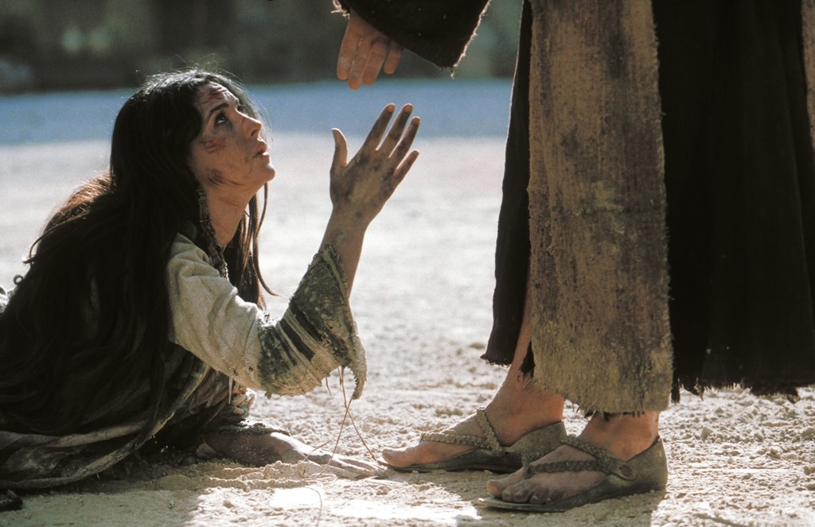
The Christ Is the savior of the world!
Matthew 15:21-39

Slide 4
I. The Christ brings salvation to the Jew first (verses 21-28)
21 And Jesus went away from there and withdrew to the district of Tyre and Sidon. 22 And behold, a Canaanite woman from that region came out and was crying, “Have mercy on me, O Lord, Son of David; my daughter is severely oppressed by a demon.”

Slide 5
I. The Christ brings salvation to the Jew first (verses 21-28)
23 But he did not answer her a word. And his disciples came and begged him, saying, “Send her away, for she is crying out after us.” 24 He answered, “I was sent only to the lost sheep of the house of Israel.”

Slide 6
I. The Christ brings salvation to the Jew first (verses 21-28)
25 But she came and knelt before him, saying, “Lord, help me.” 26 And he answered, “It is not right to take the children’s bread and throw it to the dogs.”

Slide 7
I. The Christ brings salvation to the Jew first (verses 21-28)
27 She said, “Yes, Lord, yet even the dogs eat the crumbs that fall from their masters’ table.” 28 Then Jesus answered her, “O woman, great is your faith! Be it done for you as you desire.” And her daughter was healed instantly.
She knows that God’s plan is to bring salvation to the Jew first, and that through Abraham’s “offspring [singular], all the nations of the earth shall be blessed” (Genesis 26:4). The bread of life will come to Gentiles as well, according to the Father’s plan.

Slide 8
I. The Christ brings salvation to the Jew first (verses 21-28)
27 She said, “Yes, Lord, yet even the dogs eat the crumbs that fall from their masters’ table.” 28 Then Jesus answered her, “O woman, great is your faith! Be it done for you as you desire.” And her daughter was healed instantly.
She knows that God’s plan is to bring salvation to the Jew first, and that through Abraham’s “offspring [singular], all the nations of the earth shall be blessed” (Genesis 26:4). The bread of life will come to Gentiles as well, according to the Father’s plan.

Slide 9
II. The Christ brings salvation to the Gentiles as well (verses 29-39)
The Gentiles give glory to God (29-31)
29 Jesus went on from there and walked beside the Sea of Galilee. And he went up on the mountain and sat down there. 30 And great crowds came to him, bringing with them the lame, the blind, the crippled, the mute, and many others, and they put them at his feet, and he healed them, 31 so that the crowd wondered, when they saw the mute speaking, the crippled healthy, the lame walking, and the blind seeing. And they glorified the God of Israel.

Slide 10
II. The Christ brings salvation to the Gentiles as well (verses 29-39)
The disciples fail to see what the Gentiles readily perceive (32-39)
32 Then Jesus called his disciples to him and said, “I have compassion on the crowd because they have been with me now three days and have nothing to eat. And I am unwilling to send them away hungry, lest they faint on the way.”

Slide 11
II. The Christ brings salvation to the Gentiles as well (verses 29-39)
The disciples fail to see what the Gentiles readily perceive (32-39)
33 And the disciples said to him, “Where are we to get enough bread in such a desolate place to feed so great a crowd?” 34 And Jesus said to them, “How many loaves do you have?” They said, “Seven, and a few small fish.” 35 And directing the crowd to sit down on the ground, 36 he took the seven loaves and the fish, and having given thanks he broke them and gave them to the disciples, and the disciples gave them to the crowds. 37 And they all ate and were satisfied. And they took up seven baskets full of the broken pieces left over.

Slide 12
II. The Christ brings salvation to the Gentiles as well (verses 29-39)
The disciples fail to see what the Gentiles readily perceive (32-39)
38 Those who ate were four thousand men, besides women and children.
In other words, this isn’t a case of the disciples forgetting what Jesus can do or not believing in what Jesus can do. It’s likely a case of not believing Jesus would do these things for “these people.”

Slide 13
II. The Christ brings salvation to the Gentiles as well (verses 29-39)
The disciples fail to see what the Gentiles readily perceive (32-39)
38 Those who ate were four thousand men, besides women and children.
“There is neither Jew nor Greek, there is neither slave nor free, there is no male and female, for you are all one in Christ Jesus.” Galatians 3:28

Slide 14
III. What are the barriers in your gospel?
I have a theory that the greatest barriers to the gospel within the church are cultural barriers, either taught to us through the world we live in or through the church “teaching as doctrines the commandments of men” (Matthew 15:9) and so, making “void the word of God” (Matthew 15:6).

Slide 15
III. What are the barriers in your gospel?
Theology
John 3:16 - For God so loved the world
“Yes! But what does world mean?”
“If God is sovereign, and Christ only died for the elect, then God in His sovereignty will ensure the elect are saved, therefore we don’t need to ‘Go therefore and make disciples of all nations’” (Matthew 28:19).

Slide 16
III. What are the barriers in your gospel?
Patriotism
George Marsden, Fundamentalism and American Culture
“Christianity and Patriotism are synonymous terms and hell and traitors are synonymous.” Billy Sunday

Slide 17
III. What are the barriers in your gospel?
Patriotism
George Marsden, Fundamentalism and American Culture
“As the war effort accelerated he used the rhetoric of Christian nativism to fan the fires of anti-German furor and was famous for sermons that ended with his jumping on the pulpit waving the flag.” (Marsden)
“If you turn hell upside down, you will find ‘made in Germany’ stamped on the bottom.” (B. Sunday)

Slide 18
III. What are the barriers in your gospel?
Patriotism
George Marsden, Fundamentalism and American Culture
Praying before the House of Representatives in 1918 he advised God that the Germans were a “great pack of wolfish Huns whose fangs drip with blood and gore.”(Marsden quoting Sunday)
“But I say to you, Love your enemies and pray for those who persecute you.” Matthew 5:44

Slide 19
III. What are the barriers in your gospel?
Politics
“Whoever says he abides in him ought to walk in the same way in which he walked.” 1st John 2:6
In the politics of our time, one way you know the church is off center with the gospel is by its focus and testimony.
In our day, politics drive Christians into camps the world establishes and then leads them to become willing soldiers in the war against other camps. How did the church ever get to the point where we do this and call it good?

Slide 20
Benediction

