Slide 1
“Commit thy way unto the Lord; trust also in him; and he shall bring it to pass.” Psalm 37:5
“You matter because you are you, you matter to the last moment of your life.”

Slide 2
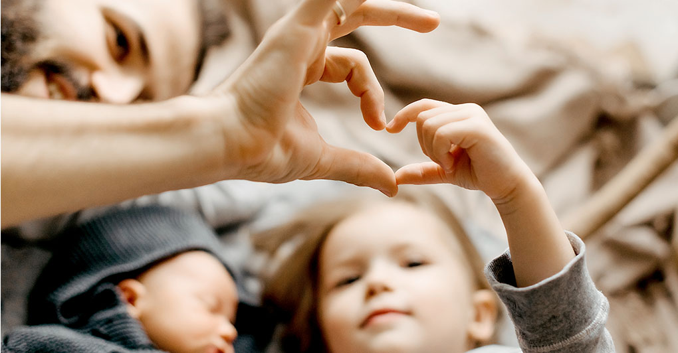
Be Compassionate and Faithful
Matthew 14:13-36
Compassion Sympathetic consciousness of others’ distress together with a desire to alleviate it. Websters

Slide 3
I. The King is compassionate (verses 13-21)
Indiscriminately so (13-14, 34-36)
13 Now when Jesus heard this, he withdrew from there in a boat to a desolate place by himself. But when the crowds heard it, they followed him on foot from the towns. 14 When he went ashore he saw a great crowd, and he had compassion on them and healed their sick.
“…a man of sorrows and acquainted with grief.” Isaiah 53:3

Slide 4
I. The King is compassionate (verses 13-21)
Indiscriminately so (13-14, 34-36)
34 And when they had crossed over, they came to land at Gennesaret. 35 And when the men of that place recognized him, they sent around to all that region and brought to him all who were sick 36 and implored him that they might only touch the fringe of his garment. And as many as touched it were made well.

Slide 5
I. The King is compassionate (verses 13-21)
Abundantly so (15-21)
15 Now when it was evening, the disciples came to him and said, “This is a desolate place, and the day is now over; send the crowds away to go into the villages and buy food for themselves.” 16 But Jesus said, “They need not go away; you give them something to eat.”

Slide 6
I. The King is compassionate (verses 13-21)
Abundantly so (15-21)
17 They said to him, “We have only five loaves here and two fish.” 18 And he said, “Bring them here to me.” 19 Then he ordered the crowds to sit down on the grass, and taking the five loaves and the two fish, he looked up to heaven and said a blessing. Then he broke the loaves and gave them to the disciples, and the disciples gave them to the crowds.

Slide 7
I. The King is compassionate (verses 13-21)
Abundantly so (15-21)
20 And they all ate and were satisfied. And they took up twelve baskets full of the broken pieces left over. 21 And those who ate were about five thousand men, besides women and children.

Slide 8
I. The King is compassionate (verses 13-21)
Abundantly so (15-21)
20 And they all ate and were satisfied. And they took up twelve baskets full of the broken pieces left over. 21 And those who ate were about five thousand men, besides women and children.

Slide 9
II. The King is faithful (verses 22-33)
“We can keep ourselves so busy, fill our lives with so many diversions, stuff our heads with so much knowledge, involve ourselves with so many people, and cover so much ground that we never have time to probe the fearful and wonderful world within … By middle life most of us are accomplished fugitives from ourselves.” John Gardner, member of President Lyndon Johnson’s cabinet

Slide 10
II. The King is faithful (verses 22-33)
Before the Father (22-24)
22 Immediately he made the disciples get into the boat and go before him to the other side, while he dismissed the crowds. 23 And after he had dismissed the crowds, he went up on the mountain by himself to pray. When evening came, he was there alone, 24 but the boat by this time was a long way from the land, beaten by the waves, for the wind was against them.
Jesus “emptied himself, by taking the form of a servant, being born in the likeness of men.” Philippians 2:7

Slide 11
II. The King is faithful (verses 22-33)
Before the Father (22-24)
22 Immediately he made the disciples get into the boat and go before him to the other side, while he dismissed the crowds. 23 And after he had dismissed the crowds, he went up on the mountain by himself to pray. When evening came, he was there alone, 24 but the boat by this time was a long way from the land, beaten by the waves, for the wind was against them.
Jesus “emptied himself, by taking the form of a servant, being born in the likeness of men.” Philippians 2:7

Slide 12
II. The King is faithful (verses 22-33)
To His people (25-33)
25 And in the fourth watch of the night he came to them, walking on the sea. 26 But when the disciples saw him walking on the sea, they were terrified, and said, “It is a ghost!” and they cried out in fear. 27 But immediately Jesus spoke to them, saying, “Take heart; it is I. Do not be afraid.”

Slide 13
II. The King is faithful (verses 22-33)
To His people (25-33)
28 And Peter answered him, “Lord, if it is you, command me to come to you on the water.” 29 He said, “Come.” So Peter got out of the boat and walked on the water and came to Jesus. 30 But when he saw the wind, he was afraid, and beginning to sink he cried out, “Lord, save me.” 31 Jesus immediately reached out his hand and took hold of him, saying to him, “O you of little faith, why did you doubt?”

Slide 14
II. The King is faithful (verses 22-33)
To His people (25-33)
28 And Peter answered him, “Lord, if it is you, command me to come to you on the water.” 29 He said, “Come.” So Peter got out of the boat and walked on the water and came to Jesus. 30 But when he saw the wind, he was afraid, and beginning to sink he cried out, “Lord, save me.” 31 Jesus immediately reached out his hand and took hold of him, saying to him, “O you of little faith, why did you doubt?”

Slide 15
II. The King is faithful (verses 22-33)
To His people (25-33)
32 And when they got into the boat, the wind ceased.
“He had not come to put on impressive shows in an attempt to create faith where none existed. However, faith did exist in Peter, although it was small. Jesus, like a patient parent teaching a baby to walk, allowed Peter this demonstration of his power to nurture Peter’s faith to the next level of maturity.” Stu Weber

Slide 16
II. The King is faithful (verses 22-33)
To His people (25-33)
33 And those in the boat worshiped him, saying, “Truly you are the Son of God.”
As Jesus will tell the disciples soon before His crucifixion with words full of His faithfulness and compassion, “I will not leave you as orphans.” John 14:18

Slide 17
III. Be Compassionate and Faithful
We need to see everyone through the same lens Cicely Saunders saw her patients: as people with the inherent worth they have because our Savior died for them.
Let’s follow the Lord’s example of being patient with one another and intentional in helping each other be people who can say we abide in Him because we “walk in the same way in which he walked.” 1st John 2:6

