Slide 1
Scripture Reading
Matthew 13:24-43
Pages 973-74 in the seat back bibles

Slide 3
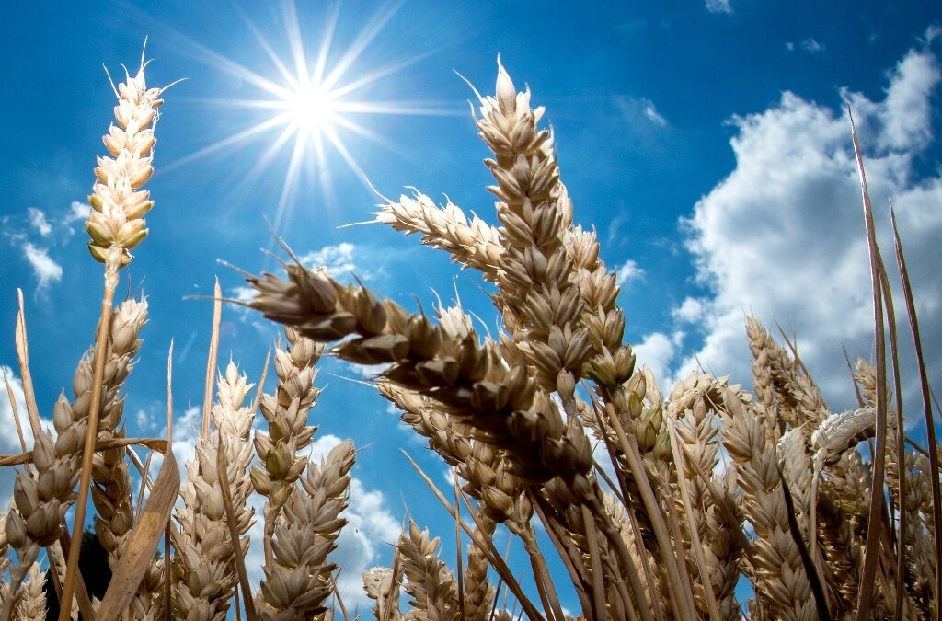
The King will make his kingdom shine! Matthew 13:24-43
“In that day, declares the Lord, I will assemble the lame and gather those who have been driven away and those whom I have afflicted; and the lame I will make the remnant, and those who were cast off, a strong nation; and the Lord will reign over them in Mount Zion from this time forth and forevermore.” Micah 4:6-7

Slide 4
I. Jesus’ teaching about the Kingdom is new revelation (verses 34-35)
34 All these things Jesus said to the crowds in parables; indeed, he said nothing to them without a parable. 35 This was to fulfill what was spoken by the prophet: “I will open my mouth in parables; I will utter what has been hidden since the foundation of the world.”

Slide 5
II. The kingdom will grow in great ways from humble beginnings (verses 31-32)
31 He put another parable before them, saying, “The kingdom of heaven is like a grain of mustard seed that a man took and sowed in his field. 32 It is the smallest of all seeds, but when it has grown it is larger than all the garden plants and becomes a tree, so that the birds of the air come and make nests in its branches.”

Slide 6
II. The kingdom will grow in great ways from humble beginnings (verses 31-32)
“For consider your calling, brothers: not many of you were wise according to worldly standards, not many were powerful, not many were of noble birth. But God chose what is foolish in the world to shame the wise; God chose what is weak in the world to shame the strong; God chose what is low and despised in the world, even things that are not, to bring to nothing things that are…” 1st Corinthians 1:26-28

Slide 7
III. The kingdom will grow through the inner transformation of its citizens (verse 33)
33 He told them another parable. “The kingdom of heaven is like leaven that a woman took and hid in three measures of flour, till it was all leavened.”
“Having purified your souls by your obedience to the truth for a sincere brotherly love, love one another earnestly from a pure heart, since you have been born again, not of perishable seed but of imperishable, through the living and abiding word of God…” 1st Peter 1:22-23

Slide 8
IV. The kingdom of heaven will grow together with Satan’s kingdom until the final judgment (verses 24-30 & 36-42)
36 Then he left the crowds and went into the house. And his disciples came to him, saying, “Explain to us the parable of the weeds of the field.”

Slide 9
IV. The kingdom of heaven will grow together with Satan’s kingdom until the final judgment (verses 24-30 & 36-42)
24 He put another parable before them, saying, “The kingdom of heaven may be compared to a man who sowed good seed in his field, 25 but while his men were sleeping, his enemy came and sowed weeds among the wheat and went away.
37 He answered, “The one who sows the good seed is the Son of Man. 38 The field is the world, and the good seed is the sons of the kingdom. The weeds are the sons of the evil one, 39 and the enemy who sowed them is the devil.
“And you were dead in the trespasses and sins in which you once walked, following the course of this world, following the prince of the power of the air…” Ephesians 2:1-2

Slide 10
IV. The kingdom of heaven will grow together with Satan’s kingdom until the final judgment (verses 24-30 & 36-42)
26 So when the plants came up and bore grain, then the weeds appeared also. 27 And the servants of the master of the house came and said to him, ‘Master, did you not sow good seed in your field? How then does it have weeds?’ 28 He said to them, ‘An enemy has done this.’ So the servants said to him, ‘Then do you want us to go and gather them?’ 29 But he said, ‘No, lest in gathering the weeds you root up the wheat along with them. 30 Let both grow together until the harvest…

Slide 11
IV. The kingdom of heaven will grow together with Satan’s kingdom until the final judgment (verses 24-30 & 36-42)
30 Let both grow together until the harvest, and at harvest time I will tell the reapers, “Gather the weeds first and bind them in bundles to be burned, but gather the wheat into my barn.”

Slide 12
IV. The kingdom of heaven will grow together with Satan’s kingdom until the final judgment (verses 24-30 & 36-42)
39 …The harvest is the end of the age, and the reapers are angels. 40 Just as the weeds are gathered and burned with fire, so will it be at the end of the age. 41 The Son of Man will send his angels, and they will gather out of his kingdom all causes of sin and all law-breakers, 42 and throw them into the fiery furnace. In that place there will be weeping and gnashing of teeth.

Slide 13
V. The King will make His kingdom shine! (Verse 43)
43 Then the righteous will shine like the sun in the kingdom of their Father. He who has ears, let him hear.
“Truly, truly, I say to you, unless one is born again he cannot see the kingdom of God.” John 3:3

Slide 14
V. The King will make His kingdom shine! (Verse 43)
“For I consider that the sufferings of this present time are not worth comparing with the glory that is to be revealed to us. For the creation waits with eager longing for the revealing of the sons of God. For the creation was subjected to futility, not willingly, but because of him who subjected it, in hope that the creation itself will be set free from its bondage to corruption and obtain the freedom of the glory of the children of God.” Romans 8:18-21

Slide 15
Benediction

