Slide 1
Scripture Reading
Matthew 12:1-21
Page 970-71 in the seat back bibles

Slide 2
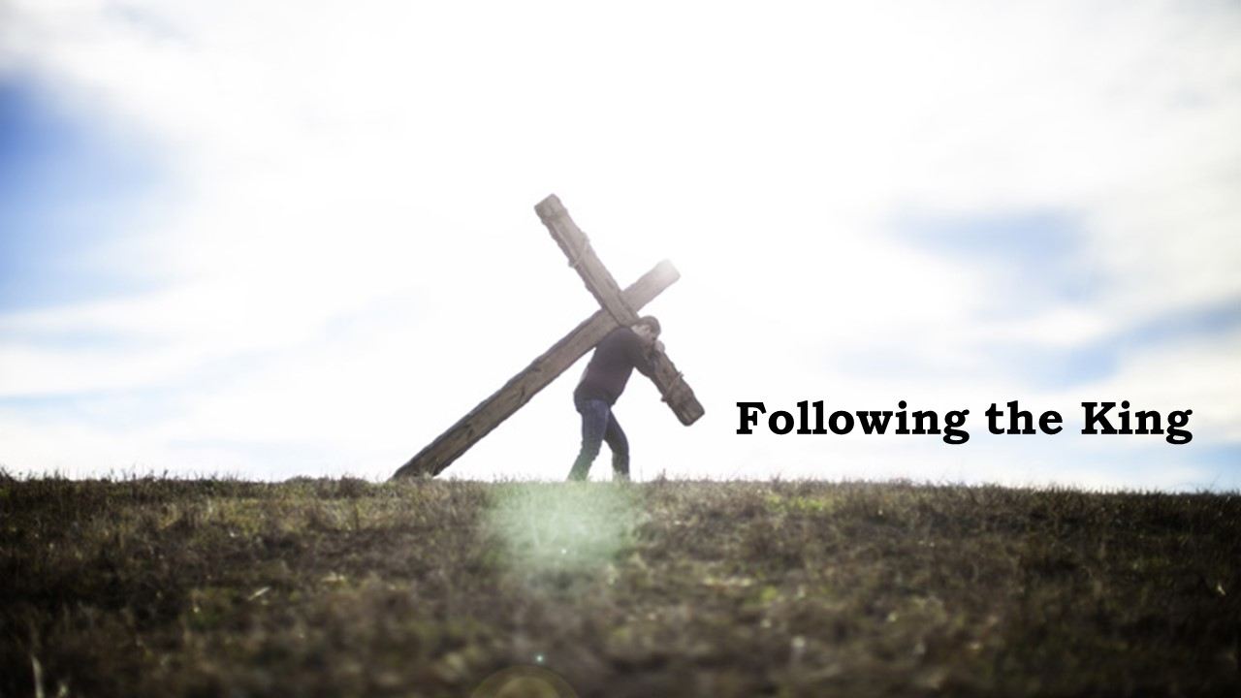

Slide 3
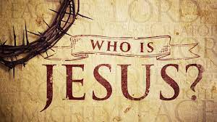
Matthew 12:1-21

Slide 4
I. Jesus is the Lord of the Sabbath (verses 1-8)
“For in six days the Lord made heaven and earth, the sea, and all that is in them, and rested on the seventh day.” Exodus 20:11
“Take my yoke upon you, and learn from me, for I am gentle and lowly in heart, and you will find rest for your souls.” Matthew 11:29
“Come to me, all who labor and are heavy laden…” Matthew 11:28

Slide 5
I. Jesus is the Lord of the Sabbath (verses 1-8)
He is greater than David (1-4)
1 At that time Jesus went through the grainfields on the Sabbath. His disciples were hungry, and they began to pluck heads of grain and to eat. 2 But when the Pharisees saw it, they said to him, “Look, your disciples are doing what is not lawful to do on the Sabbath.”
“If you go into your neighbor’s standing grain, you may pluck the ears with your hand, but you shall not put a sickle to your neighbor’s standing grain.” Deuteronomy 23:25

Slide 6
I. Jesus is the Lord of the Sabbath (verses 1-8)
He is greater than David (1-4)
3 He said to them, “Have you not read what David did when he was hungry, and those who were with him: 4 how he entered the house of God and ate the bread of the Presence, which it was not lawful for him to eat nor for those who were with him, but only for the priests?

Slide 7
I. Jesus is the Lord of the Sabbath (verses 1-8)
He is greater than the temple (5-8)
5 Or have you not read in the Law how on the Sabbath the priests in the temple profane the Sabbath and are guiltless? 6 I tell you, something greater than the temple is here.
“The law that established the Sabbath also established the right of the priests, formally speaking, to ‘break’ it.” D.A. Carson

Slide 8
I. Jesus is the Lord of the Sabbath (verses 1-8)
He is greater than the temple (5-8)
5 Or have you not read in the Law how on the Sabbath the priests in the temple profane the Sabbath and are guiltless? 6 I tell you, something greater than the temple is here.
“The law that established the Sabbath also established the right of the priests, formally speaking, to ‘break’ it.” D.A. Carson

Slide 9
I. Jesus is the Lord of the Sabbath (verses 1-8)
He is greater than the temple (5-8)
“Go and learn what this means: ‘I desire mercy, and not sacrifice.’” Matthew 9:13
7And if you had known what this means, ‘I desire mercy, and not sacrifice,’ you would not have condemned the guiltless.
“And I will be gracious to whom I will be gracious, and will show mercy on whom I will show mercy.” Exodus 33:19
8 For the Son of Man is lord of the Sabbath.”

Slide 10
II. Jesus is the Good Shepherd (verses 9-14)
9 He went on from there and entered their synagogue. 10 And a man was there with a withered hand. And they asked him, “Is it lawful to heal on the Sabbath?”—so that they might accuse him.

Slide 11
II. Jesus is the Good Shepherd (verses 9-14)
11 He said to them, “Which one of you who has a sheep,* if it falls into a pit on the Sabbath, will not take hold of it and lift it out? 12 Of how much more value is a man than a sheep! So, it is lawful to do good on the Sabbath.”
* if you had one sheep… Greek Text

Slide 12
II. Jesus is the Good Shepherd (verses 9-14)
11 He said to them, “Which one of you who has a sheep,* if it falls into a pit on the Sabbath, will not take hold of it and lift it out? 12 Of how much more value is a man than a sheep! So, it is lawful to do good on the Sabbath.”
* if you had one sheep… Greek Text

Slide 13
II. Jesus is the Good Shepherd (verses 9-14)
13 Then he said to the man, “Stretch out your hand.” And the man stretched it out, and it was restored, healthy like the other.
“I am the good shepherd. The good shepherd lays down his life for the sheep.” John 10:11
Being the Good Shepherd is dangerous. It puts one in opposition to the thieves who come “only to steal and kill and destroy.” John 10:10

Slide 14
II. Jesus is the Good Shepherd (verses 9-14)
“And he looked around at them with anger, grieved at their hardness of heart.” Mark 3:5
14 But the Pharisees went out and conspired against him, how to destroy him.

Slide 15
III. Jesus is a gentle and compassionate Savior (verses 15-21)
“…at the right time Christ died for the ungodly.” Romans 5:6
“My hour has not yet come.” John 2:4
15 Jesus, aware of this, withdrew from there. And many followed him, and he healed them all 16 and ordered them not to make him known.
He truly is “gentle and lowly in heart.” Matthew 11:29

Slide 16
III. Jesus is a gentle and compassionate Savior (verses 15-21)
“…at the right time Christ died for the ungodly.” Romans 5:6
“My hour has not yet come.” John 2:4
15 Jesus, aware of this, withdrew from there. And many followed him, and he healed them all 16 and ordered them not to make him known.
17 This was to fulfill what was spoken by the prophet Isaiah:

Slide 17
III. Jesus is a gentle and compassionate Savior (verses 15-21)
18“Behold, my servant whom I have chosen, my beloved with whom my soul is well pleased. I will put my Spirit upon him, and he will proclaim justice to the Gentiles.

Slide 18
III. Jesus is a gentle and compassionate Savior (verses 15-21)
18“Behold, my servant whom I have chosen, my beloved with whom my soul is well pleased. I will put my Spirit upon him, and he will proclaim justice to the Gentiles.
The One “Who, being in very nature God, did not consider equality with God something to be used to his own advantage…” Philippians 2:6, NIV

Slide 19
III. Jesus is a gentle and compassionate Savior (verses 15-21)
19 He will not quarrel or cry aloud, nor will anyone hear his voice in the streets;
“When he was reviled, he did not revile in return; when he suffered, he did not threaten, but continued entrusting himself to him who judges justly.” 1st Peter 2:23

Slide 20
III. Jesus is a gentle and compassionate Savior (verses 15-21)
20 a bruised reed he will not break, and a smoldering wick he will not quench, until he brings justice to victory; 21 and in his name the Gentiles will hope.”
“He does not crush the weak.” The Living Bible

Slide 21
III. Jesus is a gentle and compassionate Savior (verses 15-21)
20 a bruised reed he will not break, and a smoldering wick he will not quench, until he brings justice to victory; 21 and in his name the Gentiles will hope.”
“He does not…quench the smallest hope” The Living Bible

Slide 22
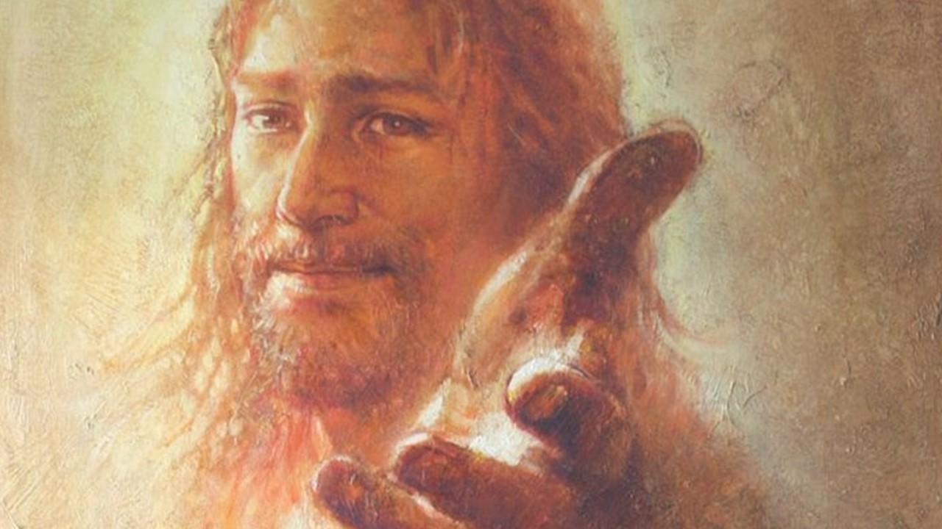
Who is Jesus?
He is a real Savior. In the end, He will bring victory. The victory of God’s justice prevailing over the entire world, and (Matthew11:28) all who Come to Him, all who labor and are heavy laden, will receive the rest of living in such a world together with Jesus forever.

Slide 23
Who is Jesus?
He is the Lord of the Sabbath. He is the Good Shepherd. He is the gentle and compassionate Savior who loves you so much that He left His throne in heaven to come into this world as a man so that He could die for you on a cross to make this wonderful eternal life of justice and rest possible for you. He is the Savior who says “Come to me.”

Slide 24
Benediction

