Slide 1
Scripture Reading
Matthew 11:20-30
Page 970 in the seat back bibles

Slide 3
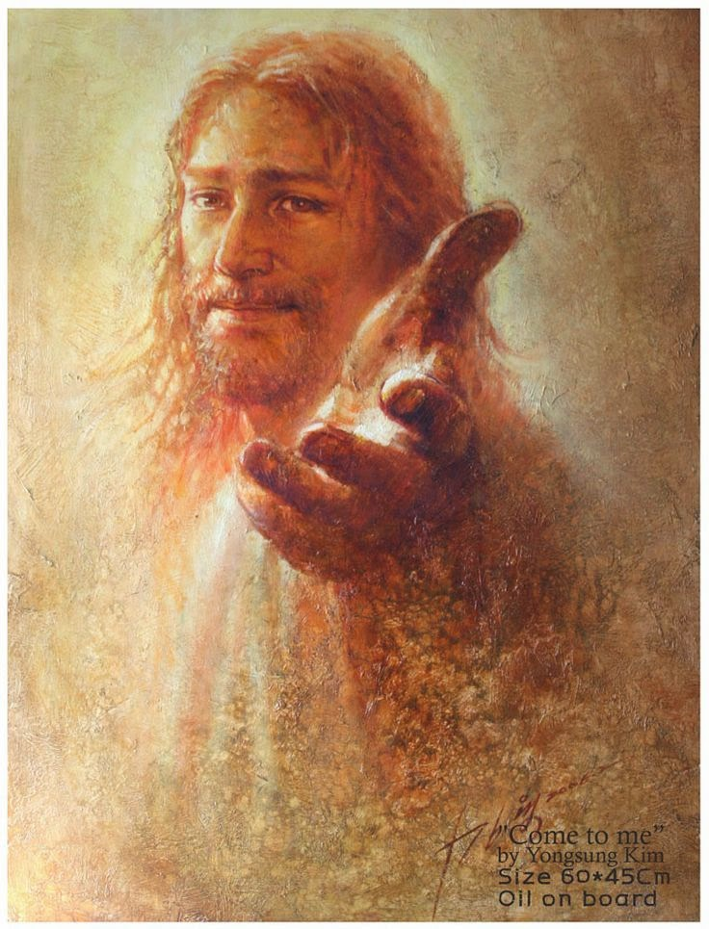
Come to the king for salvation!
Matthew 11:20-30

Slide 4
I. There will be no salvation for those who reject the King (verses 20-24)
When Jesus Christ is made known to you, you must repent!
20 Then he began to denounce the cities where most of his mighty works had been done, because they did not repent.
“…he rebuked them for their unbelief and hardness of heart, because they had not believed those who saw him after he had risen.” Mark 16:14

Slide 5
I. There will be no salvation for those who reject the King (verses 20-24)
When Jesus Christ is made known to you, you must repent!
21“Woe to you, Chorazin! Woe to you, Bethsaida! For if the mighty works done in you had been done in Tyre and Sidon, they would have repented long ago in sackcloth and ashes. 22 But I tell you, it will be more bearable on the day of judgment for Tyre and Sidon than for you. 23 And you, Capernaum, will you be exalted to heaven? You will be brought down to Hades. For if the mighty works done in you had been done in Sodom, it would have remained until this day.

Slide 6
I. There will be no salvation for those who reject the King (verses 20-24)
When Jesus Christ is made known to you, you must repent!
21“Woe to you, Chorazin! Woe to you, Bethsaida! For if the mighty works done in you had been done in Tyre and Sidon, they would have repented long ago in sackcloth and ashes. 22 But I tell you, it will be more bearable on the day of judgment for Tyre and Sidon than for you. 23 And you, Capernaum, will you be exalted to heaven? You will be brought down to Hades. For if the mighty works done in you had been done in Sodom, it would have remained until this day.

Slide 7
I. There will be no salvation for those who reject the King (verses 20-24)
The greater the revelation, the greater the consequences for rejecting Christ
21“Woe to you, Chorazin! Woe to you, Bethsaida! For if the mighty works done in you had been done in Tyre and Sidon, they would have repented long ago in sackcloth and ashes. 22 But I tell you, it will be more bearable on the day of judgment for Tyre and Sidon than for you. 23 And you, Capernaum, will you be exalted to heaven? You will be brought down to Hades. For if the mighty works done in you had been done in Sodom, it would have remained until this day. 24 But I tell you that it will be more tolerable on the day of judgment for the land of Sodom than for you.”

Slide 8
I. There will be no salvation for those who reject the King (verses 20-24)
The greater the revelation, the greater the consequences for rejecting Christ
21“Woe to you, Chorazin! Woe to you, Bethsaida! For if the mighty works done in you had been done in Tyre and Sidon, they would have repented long ago in sackcloth and ashes. 22 But I tell you, it will be more bearable on the day of judgment for Tyre and Sidon than for you. 23 And you, Capernaum, will you be exalted to heaven? You will be brought down to Hades. For if the mighty works done in you had been done in Sodom, it would have remained until this day. 24 But I tell you that it will be more tolerable on the day of judgment for the land of Sodom than for you.”

Slide 9
II. Those who receive the King do so by God’s grace alone (verses 25-27)
Romans 9 - God is always good and just, and His grace alone brings salvation, yet in a way that is ultimately beyond our understanding.
“As it is written, ‘Jacob I loved, but Esau I hated.’ What shall we say then? Is there injustice on God’s part? By no means! For he says to Moses, ‘I will have mercy on whom I have mercy, and I will have compassion on whom I have compassion.’ So then it depends not on human will or exertion, but on God, who has mercy.” Romans 9:13-16

Slide 10
II. Those who receive the King do so by God’s grace alone (verses 25-27)
Romans 9 - God is always good and just, and His grace alone brings salvation, yet in a way that is ultimately beyond our understanding.
“You will say to me then, ‘Why does he still find fault? For who can resist his will?’” Romans 9:19
“But who are you, O man, to answer back to God?” Romans 9:20
“Oh, the depth of the riches and wisdom and knowledge of God! How unsearchable are his judgments and how inscrutable his ways!” Romans 11:33

Slide 11
II. Those who receive the King do so by God’s grace alone (verses 25-27)
The Father’s gracious will in salvation is worthy of our praise (25-26)
25 At that time Jesus declared, “I thank you, Father, Lord of heaven and earth, that you have hidden these things from the wise and understanding and revealed them to little children; 26 yes, Father, for such was your gracious will.

Slide 12
II. Those who receive the King do so by God’s grace alone (verses 25-27)
The Father’s gracious will in salvation is worthy of our praise (25-26)
“These are ‘the wise and learned’ from whom the real significance of Jesus’ ministry is concealed. The point of interest is not their education, any more than the point of interest in the ‘little children’ is their age or size. The contrast is between those who are self-sufficient and deem themselves wise and those who are dependent and love to be taught.” D.A. Carson

Slide 13
II. Those who receive the King do so by God’s grace alone (verses 25-27)
The Son is the Father’s agent to bring salvation to people (27)
27 All things have been handed over to me by my Father, and no one knows the Son except the Father, and no one knows the Father except the Son and anyone to whom the Son chooses to reveal him.

Slide 14
III. Come to the King for salvation! (verses 28-30)
Jesus “saw the crowds, he had compassion for them, because they were harassed and helpless.” Matthew 9:36
The Lord rebuked Israel’s leaders, telling them “With force and harshness you have ruled them.” Ezekiel 34:4
“They tie up heavy burdens, hard to bear, and lay them on people’s shoulders, but they themselves are not willing to move them with their finger.” Matthew 23:4

Slide 15
III. Come to the King for salvation! (verses 28-30)
28 Come to me, all who labor and are heavy laden, and I will give you rest. 29 Take my yoke upon you, and learn from me, for I am gentle and lowly in heart, and you will find rest for your souls. 30 For my yoke is easy, and my burden is light.”

Slide 16
III. Come to the King for salvation! (verses 28-30)
28 Come to me, all who labor and are heavy laden, and I will give you rest. 29 Take my yoke upon you, and learn from me, for I am gentle and lowly in heart, and you will find rest for your souls. 30 For my yoke is easy, and my burden is light.”
“Give all your worries and cares to God, for he cares about you.” 1 Peter 5:7, NLT

Slide 17
Come to the king for salvation!

Slide 19
Benediction

