Slide 1
Scripture Reading
Matthew 11:1-19
Pages 969-70 in the seat back bibles

Slide 2
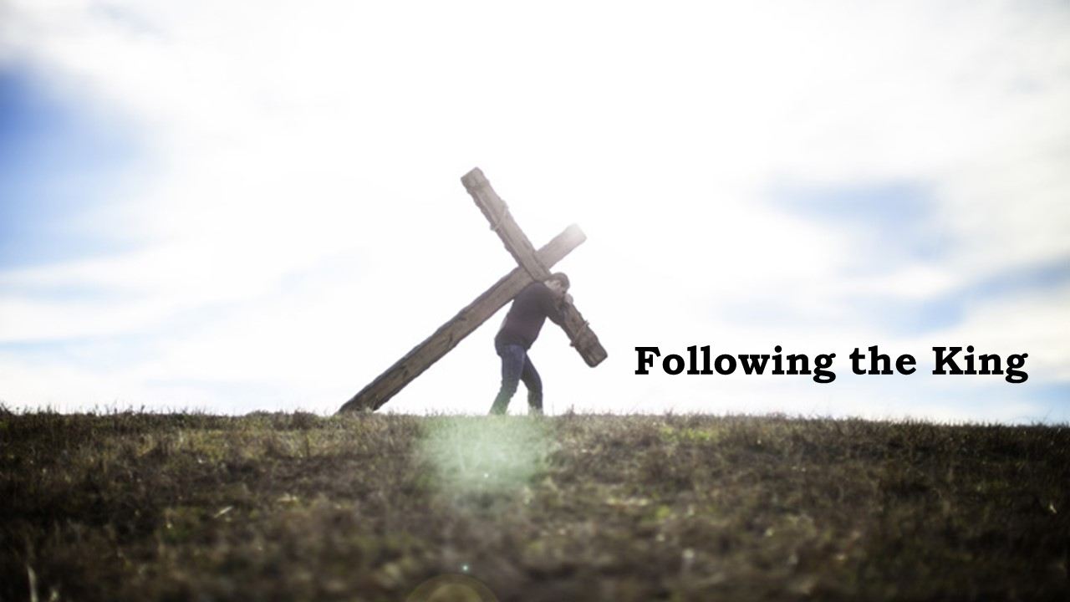

Slide 3
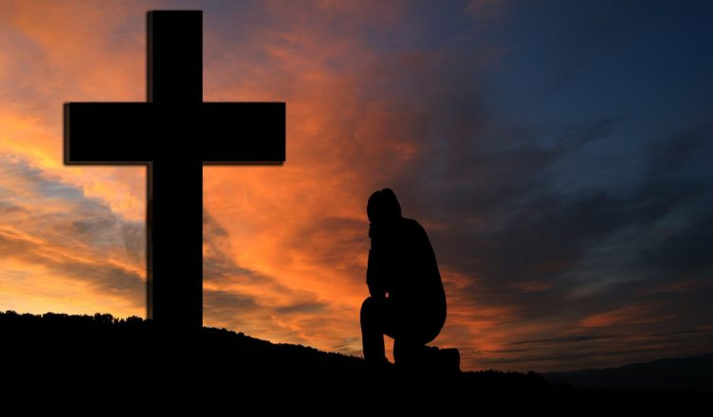
Will you stand with the King?
Matthew 11:1-19

Slide 4
I. To stand with the King is to set aside your doubts about Him (verses 1-6)
1 When Jesus had finished instructing his twelve disciples, he went on from there to teach and preach in their cities.
“But the Pharisees said, ‘He casts out demons by the prince of demons.’” Matthew 9:34
It’s important for us to understand that as Jesus resumes His ministry of preaching and teaching “in their cities,” He does so in a very different spiritual landscape.

Slide 5
I. To stand with the King is to set aside your doubts about Him (verses 1-6)
2 Now when John heard in prison about the deeds of the Christ, he sent word by his disciples 3 and said to him, “Are you the one who is to come, or shall we look for another?”
“I baptize you with water for repentance, but he who is coming after me is mightier than I, whose sandals I am not worthy to carry. He will baptize you with the Holy Spirit and fire. His winnowing fork is in his hand, and he will clear his threshing floor and gather his wheat into the barn, but the chaff he will burn with unquenchable fire.” Matthew 3:11-12

Slide 6
I. To stand with the King is to set aside your doubts about Him (verses 1-6)
4 And Jesus answered them, “Go and tell John what you hear and see: 5 the blind receive their sight and the lame walk, lepers are cleansed and the deaf hear, and the dead are raised up, and the poor have good news preached to them.
“Behold, your God will come with vengeance, with the recompense of God. He will come and save you.” Isaiah 35:4
The Christ would “proclaim the year of the Lord’s favor, and the day of vengeance of our God.” Isaiah 61:2

Slide 7
I. To stand with the King is to set aside your doubts about Him (verses 1-6)
6 And blessed is the one who is not offended by me.”
6 And he added, “God blesses those who do not fall away because of me.” NLT

Slide 8
II. To stand with the King is to understand the way of His Kingdom (verses 7-15)
7 As they went away, Jesus began to speak to the crowds concerning John: “What did you go out into the wilderness to see? A reed shaken by the wind? 8 What then did you go out to see? A man dressed in soft clothing? Behold, those who wear soft clothing are in kings’ houses. 9 What then did you go out to see? A prophet? Yes, I tell you, and more than a prophet.

Slide 9
II. To stand with the King is to understand the way of His Kingdom (verses 7-15)
10 This is he of whom it is written, “‘Behold, I send my messenger before your face, who will prepare your way before you.’ 11 Truly, I say to you, among those born of women there has arisen no one greater than John the Baptist…

Slide 10
II. To stand with the King is to understand the way of His Kingdom (verses 7-15)
10 This is he of whom it is written, “‘Behold, I send my messenger before your face, who will prepare your way before you.’ 11 Truly, I say to you, among those born of women there has arisen no one greater than John the Baptist…

Slide 11
II. To stand with the King is to understand the way of His Kingdom (verses 7-15)
11 …Yet the one who is least in the kingdom of heaven is greater than he. 12 From the days of John the Baptist until now the kingdom of heaven has suffered violence, and the violent take it by force. 13 For all the Prophets and the Law prophesied until John, 14 and if you are willing to accept it, he is Elijah who is to come.
“You know him, for he dwells with you and will be in you.” John 14:17

Slide 12
II. To stand with the King is to understand the way of His Kingdom (verses 7-15)
11 …Yet the one who is least in the kingdom of heaven is greater than he. 12 From the days of John the Baptist until now the kingdom of heaven has suffered violence, and the violent take it by force. 13 For all the Prophets and the Law prophesied until John, 14 and if you are willing to accept it, he is Elijah who is to come.
“And all these, though commended through their faith, did not receive what was promised, since God had provided something better for us, that apart from us they should not be made perfect.” Hebrews 11:39-40

Slide 13
II. To stand with the King is to understand the way of His Kingdom (verses 7-15)
11 …Yet the one who is least in the kingdom of heaven is greater than he. 12 From the days of John the Baptist until now the kingdom of heaven has suffered violence, and the violent take it by force. 13 For all the Prophets and the Law prophesied until John, 14 and if you are willing to accept it, he is Elijah who is to come.
“And all these, though commended through their faith, did not receive what was promised, since God had provided something better for us, that apart from us they should not be made perfect.” Hebrews 11:39-40

Slide 14
II. To stand with the King is to understand the way of His Kingdom (verses 7-15)
11 …Yet the one who is least in the kingdom of heaven is greater than he. 12 From the days of John the Baptist until now the kingdom of heaven has suffered violence, and the violent take it by force. 13 For all the Prophets and the Law prophesied until John, 14 and if you are willing to accept it, he is Elijah who is to come.
“Behold, I will send you Elijah the prophet before the great and awesome day of the Lord comes. And he will turn the hearts of fathers to their children and the hearts of children to their fathers, lest I come and strike the land with a decree of utter destruction.” Malachi 4:5-6

Slide 15
II. To stand with the King is to understand the way of His Kingdom (verses 7-15)
11 …Yet the one who is least in the kingdom of heaven is greater than he. 12 From the days of John the Baptist until now the kingdom of heaven has suffered violence, and the violent take it by force. 13 For all the Prophets and the Law prophesied until John, 14 and if you are willing to accept it, he is Elijah who is to come.
12 And from the time John the Baptist began preaching until now, the Kingdom of Heaven has been forcefully advancing, and violent people are attacking it.” NLT

Slide 16
II. To stand with the King is to understand the way of His Kingdom (verses 7-15)
12 And from the time John the Baptist began preaching until now, the Kingdom of Heaven has been forcefully advancing, and violent people are attacking it.”
“In the world you will have tribulation. But take heart; I have overcome the world.” John 16:33
To stand with the King is to understand that this is the way of His kingdom on earth until He returns.
15 He who has ears to hear, let him hear.

Slide 17
III. To stand with the King is to be fully contented with Him (verses 16-19)
16 “But to what shall I compare this generation? It is like children sitting in the marketplaces and calling to their playmates, 17 “‘We played the flute for you, and you did not dance; we sang a dirge, and you did not mourn.’

Slide 18
III. To stand with the King is to be fully contented with Him (verses 16-19)
18 For John came neither eating nor drinking, and they say, ‘He has a demon.’ 19 The Son of Man came eating and drinking, and they say, ‘Look at him! A glutton and a drunkard, a friend of tax collectors and sinners!’ Yet wisdom is justified by her deeds.”
People who do “not agree with the sound words of our Lord Jesus Christ and the teaching that accords with godliness…are depraved in mind and deprived of the truth, imagining that godliness is a means of gain. But godliness with contentment is great gain.” 1 Timothy 6:3, 5-6

Slide 19
Benediction

