Slide 1
Scripture Reading
Luke 19:11-40

Slide 3
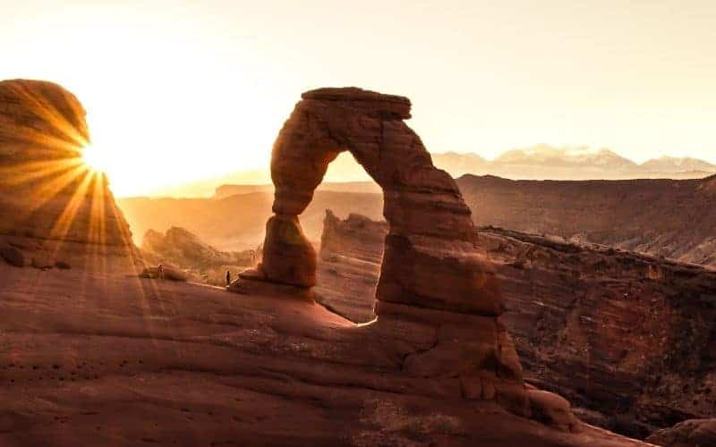
Don’t wait for the rocks to sing!
Luke 11:19-40

Slide 4
I. The King has come and will return (verses 11-27)
Be about the King’s business until He returns (11-19)
“Lord, will you at this time restore the kingdom to Israel?” Acts 1:6
11 As they heard these things, he proceeded to tell a parable, because he was near to Jerusalem, and because they supposed that the kingdom of God was to appear immediately.

Slide 5
I. The King has come and will return (verses 11-27)
Be about the King’s business until He returns (11-19)
12 He said therefore, “A nobleman went into a far country to receive for himself a kingdom and then return. 13 Calling ten of his servants, he gave them ten minas, and said to them, ‘Engage in business until I come.’ 14 But his citizens hated him and sent a delegation after him, saying, ‘We do not want this man to reign over us.’ 15 When he returned, having received the kingdom, he ordered these servants to whom he had given the money to be called to him, that he might know what they had gained by doing business.

Slide 6
I. The King has come and will return (verses 11-27)
Be about the King’s business until He returns (11-19)
16 The first came before him, saying, ‘Lord, your mina has made ten minas more.’ 17 And he said to him, ‘Well done, good servant! Because you have been faithful in a very little, you shall have authority over ten cities.’ 18 And the second came, saying, ‘Lord, your mina has made five minas.’ 19 And he said to him, ‘And you are to be over five cities.’

Slide 7
I. The King has come and will return (verses 11-27)
The King will judge those who fail to serve Him (20-27)
20 Then another came, saying, ‘Lord, here is your mina, which I kept laid away in a handkerchief; 21 for I was afraid of you, because you are a severe man. You take what you did not deposit, and reap what you did not sow.’
23 Why then did you not put my money in the bank, and at my coming I might have collected it with interest?’

Slide 8
I. The King has come and will return (verses 11-27)
The King will judge those who fail to serve Him (20-27)
20 Then another came, saying, ‘Lord, here is your mina, which I kept laid away in a handkerchief; 21 for I was afraid of you, because you are a severe man. You take what you did not deposit, and reap what you did not sow.’
22 He said to him, ‘I will condemn you with your own words, you wicked servant! You knew that I was a severe man, taking what I did not deposit and reaping what I did not sow?

Slide 9
I. The King has come and will return (verses 11-27)
The King will judge those who fail to serve Him (20-27)
24 And he said to those who stood by, ‘Take the mina from him, and give it to the one who has the ten minas.’ 25 And they said to him, ‘Lord, he has ten minas!’ 26 ‘I tell you that to everyone who has, more will be given, but from the one who has not, even what he has will be taken away.

Slide 10
I. The King has come and will return (verses 11-27)
The King will judge those who fail to serve Him (20-27)
14 But his citizens hated him and sent a delegation after him, saying, ‘We do not want this man to reign over us.’
27 But as for these enemies of mine, who did not want me to reign over them, bring them here and slaughter them before me.’”

Slide 11
II. The King has come and He is worthy of glory and honor and praise (verses 28-38)
28 And when he had said these things, he went on ahead, going up to Jerusalem. 29 When he drew near to Bethphage and Bethany, at the mount that is called Olivet, he sent two of the disciples…

Slide 12
II. The King has come and He is worthy of glory and honor and praise (verses 28-38)
29 …he sent two of the disciples, 30 saying, “Go into the village in front of you, where on entering you will find a colt tied, on which no one has ever yet sat. Untie it and bring it here. 31 If anyone asks you, ‘Why are you untying it?’ you shall say this: ‘The Lord has need of it.’ 32 So those who were sent went away and found it just as he had told them. 33 And as they were untying the colt, its owners said to them, “Why are you untying the colt?” 34 And they said, “The Lord has need of it.”

Slide 13
II. The King has come and He is worthy of glory and honor and praise (verses 28-38)
35 And they brought it to Jesus, and throwing their cloaks on the colt, they set Jesus on it. 36 And as he rode along, they spread their cloaks on the road.
“Rejoice greatly, O daughter of Zion! Shout aloud, O daughter of Jerusalem! Behold, your king is coming to you; righteous and having salvation is he, humble and mounted on a donkey, on a colt, the foal of a donkey.” Zechariah 9:9

Slide 14
II. The King has come and He is worthy of glory and honor and praise (verses 28-38)
37 As he was drawing near—already on the way down the Mount of Olives—the whole multitude of his disciples began to rejoice and praise God with a loud voice for all the mighty works that they had seen, 38 saying, “Blessed is the King who comes in the name of the Lord! Peace in heaven and glory in the highest!”

Slide 15
III. Don’t wait for the rocks to sing! (verses 39-40)
“The church speaks the language of the End, so that we will know just how high the stakes are in the present.”
39 And some of the Pharisees in the crowd said to him, “Teacher, rebuke your disciples.” 40 He answered, “I tell you, if these were silent, the very stones would cry out.”
27 But as for these enemies of mine, who did not want me to reign over them, bring them here and slaughter them before me.’”

Slide 16
III. Don’t wait for the rocks to sing! (verses 39-40)
“Seek the Lord while he may be found; call upon him while he is near; let the wicked forsake his way, and the unrighteous man his thoughts; let him return to the Lord, that he may have compassion on him, and to our God, for he will abundantly pardon.” Isaiah 55:6-7
“For you shall go out in joy and be led forth in peace; the mountains and the hills before you shall break forth into singing, and all the trees of the field shall clap their hands.” Isaiah 55:12

Slide 17
III. Don’t wait for the rocks to sing! (verses 39-40)
And when we do the possible with the mina He’s given us, He multiplies our service in the building of His kingdom in impossible ways so that He can one day give to us that very kingdom as our inheritance to be shared with Him.

Slide 18
III. Don’t wait for the rocks to sing! (verses 39-40)
“Do not be deceived: God is not mocked, for whatever one sows, that will he also reap...let us not grow weary of doing good, for in due season we will reap, if we do not give up. So then, as we have opportunity, let us do good to everyone, and especially to those who are of the household of faith.” Galatians 6:7-10

Slide 19
Benediction

