Slide 1
Scripture Reading
Matthew 7:13-29
Pages 965-966 in the seat back bibles

Slide 2
“There is a way that seems right to a man, but its end is the way to death.” Proverbs 16:25

Slide 3
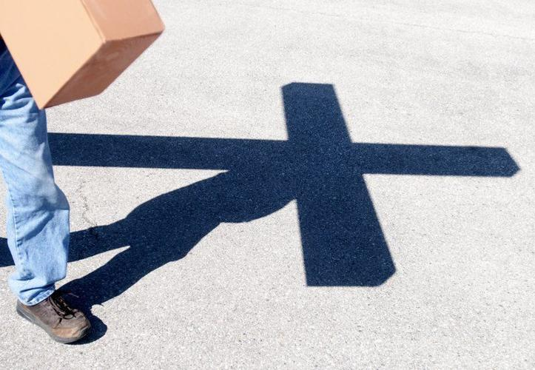
Submit to the authority of the king’s teaching
Matthew 7:13-29

Slide 4
I. Choose the narrow way that leads to life (verses 13-14)
13 “Enter by the narrow gate. For the gate is wide and the way is easy that leads to destruction, and those who enter by it are many. 14 For the gate is narrow and the way is hard that leads to life, and those who find it are few.”
“Truly, truly, I say to you, I am the door of the sheep…If anyone enters by me, he will be saved and will go in and out and find pasture.” John 10:7 & 9
13 You can enter God’s Kingdom only through the narrow gate. The highway to hell is broad, and its gate is wide for the many who choose that way. NLT

Slide 5
I. Choose the narrow way that leads to life (verses 13-14)
13 “Enter by the narrow gate. For the gate is wide and the way is easy that leads to destruction, and those who enter by it are many. 14 For the gate is narrow and the way is hard that leads to life, and those who find it are few.”

Slide 6
I. Choose the narrow way that leads to life (verses 13-14)
13 “Enter by the narrow gate. For the gate is wide and the way is easy that leads to destruction, and those who enter by it are many. 14 For the gate is narrow and the way is hard that leads to life, and those who find it are few.”
“…through many tribulations we must enter the kingdom of God.” Acts 14:22

Slide 7
II. Beware of those who do not bear the fruit of a Christlike life (verses 15-20)
15 “Beware of false prophets, who come to you in sheep’s clothing but inwardly are ravenous wolves.
“Neither the damage these false prophets do nor their brand of false teaching is stated, but the flow of the Sermon on the Mount and its OT background suggest they neither acknowledge nor teach the narrow way to life subject to persecution.” D.A. Carson

Slide 8
II. Beware of those who do not bear the fruit of a Christlike life (verses 15-20)
15 “Beware of false prophets, who come to you in sheep’s clothing but inwardly are ravenous wolves.
“They went out from us, but they were not of us; for if they had been of us, they would have continued with us. But they went out, that it might become plain that they all are not of us.” 1 John 2:19

Slide 9
II. Beware of those who do not bear the fruit of a Christlike life (verses 15-20)
16 You will recognize them by their fruits. Are grapes gathered from thornbushes, or figs from thistles? 17 So, every healthy tree bears good fruit, but the diseased tree bears bad fruit. 18 A healthy tree cannot bear bad fruit, nor can a diseased tree bear good fruit. 19 Every tree that does not bear good fruit is cut down and thrown into the fire. 20 Thus you will recognize them by their fruits.

Slide 10
II. Beware of those who do not bear the fruit of a Christlike life (verses 15-20)
16 You will recognize them by their fruits. Are grapes gathered from thornbushes, or figs from thistles? 17 So, every healthy tree bears good fruit, but the diseased tree bears bad fruit. 18 A healthy tree cannot bear bad fruit, nor can a diseased tree bear good fruit. 19 Every tree that does not bear good fruit is cut down and thrown into the fire. 20 Thus you will recognize them by their fruits.
“…that those who do such things will not inherit the kingdom of God.” Galatians 5:21

Slide 11
II. Beware of those who do not bear the fruit of a Christlike life (verses 15-20)
“And the Lord’s servant must not be quarrelsome but kind to everyone, able to teach, patiently enduring evil, correcting his opponents with gentleness. God may perhaps grant them repentance leading to a knowledge of the truth, and they may come to their senses and escape from the snare of the devil, after being captured by him to do his will.” 2nd Timothy 2:24-26

Slide 12
III. Do the will of your heavenly Father (verses 21-27)
The foolish person rejects the King by not following His teaching
21 “Not everyone who says to me, ‘Lord, Lord,’ will enter the kingdom of heaven, but the one who does the will of my Father who is in heaven. 22 On that day many will say to me, ‘Lord, Lord, did we not prophesy in your name, and cast out demons in your name, and do many mighty works in your name?’ 23 And then will I declare to them, ‘I never knew you; depart from me, you workers of lawlessness.’”

Slide 13
III. Do the will of your heavenly Father (verses 21-27)
The foolish person rejects the King by not following His teaching
21 “Not everyone who says to me, ‘Lord, Lord,’ will enter the kingdom of heaven, but the one who does the will of my Father who is in heaven. 22 On that day many will say to me, ‘Lord, Lord, did we not prophesy in your name, and cast out demons in your name, and do many mighty works in your name?’ 23 And then will I declare to them, ‘I never knew you; depart from me, you workers of lawlessness.’”

Slide 14
III. Do the will of your heavenly Father (verses 21-27)
The foolish person rejects the King by not following His teaching
26 And everyone who hears these words of mine and does not do them will be like a foolish man who built his house on the sand. 27 And the rain fell, and the floods came, and the winds blew and beat against that house, and it fell, and great was the fall of it.”
13 …For the gate is wide and the way is easy that leads to destruction.

Slide 15
III. Do the will of your heavenly Father (verses 21-27)
The foolish person rejects the King by not following His teaching
26 And everyone who hears these words of mine and does not do them will be like a foolish man who built his house on the sand. 27 And the rain fell, and the floods came, and the winds blew and beat against that house, and it fell, and great was the fall of it.”
“There is a way that seems right to a man, but its end is the way to death.” Proverbs 16:25

Slide 16
III. Do the will of your heavenly Father (verses 21-27)
The wise person will be received by the King for following His teaching
“But the evil spirit answered them, ‘Jesus I know, and Paul I recognize, but who are you?’” Acts 19:15

Slide 17
III. Do the will of your heavenly Father (verses 21-27)
The wise person will be received by the King for following His teaching
24 “Everyone then who hears these words of mine and does them will be like a wise man who built his house on the rock. 25 And the rain fell, and the floods came, and the winds blew and beat on that house, but it did not fall, because it had been founded on the rock.

Slide 18
III. Do the will of your heavenly Father (verses 21-27)
The wise person will be received by the King for following His teaching
How Firm a Foundation
When through fiery trials thy pathway shall lie
My grace, all sufficient, shall be thy supply
The flame shall not hurt thee; I only design
Thy dross to consume, and thy gold to refine

Slide 19
III. Do the will of your heavenly Father (verses 21-27)
The wise person will be received by the King for following His teaching
How Firm a Foundation
The soul that on Jesus hath leaned for repose
I will not, I will not desert to his foes
That soul, though all hell should endeavor to shake
I’ll never, no, never, no, never forsake!

Slide 20
III. Do the will of your heavenly Father (verses 21-27)
The wise person will be received by the King for following His teaching
“All authority in heaven and on earth has been given to me…And behold, I am with you always, to the end of the age.” Matthew 28:18 & 20

Slide 21
IV. Submit to the authority of the King’s teaching (verses 28-29)
28 And when Jesus finished these sayings, the crowds were astonished at his teaching, 29 for he was teaching them as one who had authority, and not as their scribes.
“I call heaven and earth to witness against you today, that I have set before you life and death, blessing and curse. Therefore choose life, that you and your offspring may live, loving the Lord your God, obeying his voice and holding fast to him.” Deuteronomy 30:19-20
“Enter by the narrow gate…For the gate is narrow and the way is hard that leads to life.”

Slide 22
Benediction

