Slide 1
How big is your God?
Jehovah-Sabaoth: The Lord of Hosts

Slide 2
Jehovah-Sabaoth

Slide 3
For who in the skies can be compared to the Lord?
Who among the heavenly beings is like the Lord,
a God greatly to be feared
in the council of the holy ones,
and awesome above all who are around him?
O Lord God of hosts,
who is mighty as you are,
O Lord, with your faithfulness all around you?
Psalm 89:6–8

Slide 4
Jehovah-Sabaoth shows up in real life situations
Joshua
Hannah
David

Slide 5
Isaiah 6:1-3
A visit to the throne room of Jehovah-Sabaoth

Slide 6
A visit to the throne room of Jehovah-Sabaoth
He is alive
He has authority
He is sovereign
He is magnificent
He is admired
He is holy
He is glorious

Slide 7
Jehovah-Sabaoth

Slide 8
Jehovah Sabaoth’s plan for accomplishing His purposes is people

Slide 9
Jehovah Sabaoth is alive and sovereign in 2023
Identify your mission
Bang on the doors of heaven
You have not because you ask not
You take action!

Slide 10
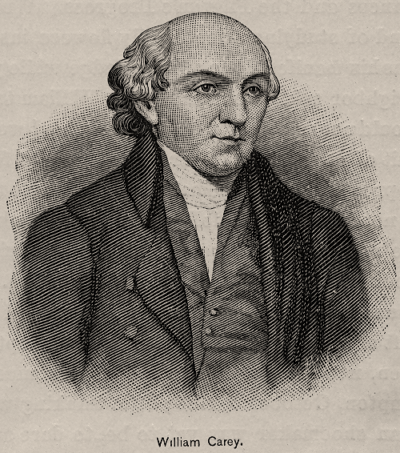
William Carey
Father of Modern Missions

Slide 11
Expect great things from God, attempt great things for God
William Carey in 1792
Father of Modern Missions

Slide 13
“How Big is Your God?”

