Slide 2
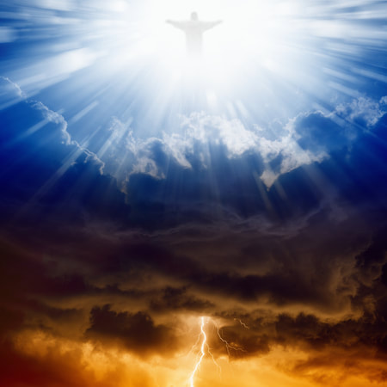
The king is coming
Malachi 4:1-6

Slide 3
I. The King is coming to make the distinction between the righteous and the wicked (verses 1-3)
“Then once more you shall see the distinction between the righteous and the wicked, between one who serves God and one who does not serve him.” Malachi 3:18

Slide 4
I. The King is coming to make the distinction between the righteous and the wicked (verses 1-3)
The wicked will be thoroughly eradicated from His kingdom (verse 1)
1 “For behold, the day is coming, burning like an oven, when all the arrogant and all evildoers will be stubble. The day that is coming shall set them ablaze, says the Lord of hosts, so that it will leave them neither root nor branch.”
“You rebuke the insolent, accursed ones, who wander from your commandments.” Psalm 119:21

Slide 5
I. The King is coming to make the distinction between the righteous and the wicked (verses 1-3)
The wicked will be thoroughly eradicated from His kingdom (verse 1)
“I baptize you with water for repentance, but he who is coming after me is mightier than I, whose sandals I am not worthy to carry. He will baptize you with the Holy Spirit and fire. His winnowing fork is in his hand, and he will clear his threshing floor and gather his wheat into the barn, but the chaff he will burn with unquenchable fire.” Matthew 3:11-12

Slide 6
I. The King is coming to make the distinction between the righteous and the wicked (verses 1-3)
The righteous will be thoroughly healed and vindicated in His kingdom (verses 2-3)
2 “But for you who fear my name, the sun of righteousness shall rise with healing in its wings. You shall go out leaping like calves from the stall. 3 And you shall tread down the wicked, for they will be ashes under the soles of your feet, on the day when I act, says the Lord of hosts.”
“the sunrise shall visit us from on high to give light to those who sit in darkness and in the shadow of death, to guide our feet into the way of peace.” Luke 1:78-79

Slide 7
I. The King is coming to make the distinction between the righteous and the wicked (verses 1-3)
The righteous will be thoroughly healed and vindicated in His kingdom (verses 2-3)
2 “But for you who fear my name, the sun of righteousness shall rise with healing in its wings. You shall go out leaping like calves from the stall. 3 And you shall tread down the wicked, for they will be ashes under the soles of your feet, on the day when I act, says the Lord of hosts.”
“… And you will go out and frolic like well-fed calves.” NIV

Slide 8
I. The King is coming to make the distinction between the righteous and the wicked (verses 1-3)
The righteous will be thoroughly healed and vindicated in His kingdom (verses 2-3)
2 “But for you who fear my name, the sun of righteousness shall rise with healing in its wings. You shall go out leaping like calves from the stall. 3 And you shall tread down the wicked, for they will be ashes under the soles of your feet, on the day when I act, says the Lord of hosts.”

Slide 9
II. The King will send His messenger to prepare the way before Him (verses 4-7)
4 “Remember the law of my servant Moses, the statutes and rules that I commanded him at Horeb for all Israel. 5 “Behold, I will send you Elijah the prophet before the great and awesome day of the Lord comes.
“…those who feared the Lord and esteemed his name.” Malachi 3:16

Slide 10
II. The King will send His messenger to prepare the way before Him (verses 4-7)
4 “Remember the law of my servant Moses, the statutes and rules that I commanded him at Horeb for all Israel. 5 “Behold, I will send you Elijah the prophet before the great and awesome day of the Lord comes.

Slide 11
John the Baptist and Elijah who is to come
“…the disciples asked him, ‘Then why do the scribes say that first Elijah must come?’ He answered, ‘Elijah does come, and he will restore all things. But I tell you that Elijah has already come, and they did not recognize him, but did to him whatever they pleased…’ Then the disciples understood that he was speaking to them of John the Baptist.” Matthew 17:10-13, following The Transfiguration
“For all the Prophets and the Law prophesied until John, and if you are willing to accept it, he is Elijah who is to come.” Matthew 11:13-14

Slide 12
II. The King will send His messenger to prepare the way before Him (verses 4-7)
6 And he will turn the hearts of fathers to their children and the hearts of children to their fathers, lest I come and strike the land with a decree of utter destruction.”
“And he will turn many of the children of Israel to the Lord their God, and he will go before him in the spirit and power of Elijah, to turn the hearts of the fathers to the children, and the disobedient to the wisdom of the just, to make ready for the Lord a people prepared.” Luke 1:16-17

Slide 13
II. The King will send His messenger to prepare the way before Him (verses 4-7)
6 And he will turn the hearts of fathers to their children and the hearts of children to their fathers, lest I come and strike the land with a decree of utter destruction.”
“And many of those who sleep in the dust of the earth shall awake, some to everlasting life, and some to shame and everlasting contempt. And those who are wise shall shine like the brightness of the sky above; and those who turn many to righteousness, like the stars forever and ever.” Daniel 12:2-3

Slide 14
III. The King is coming
Be on the right side of His distinction
“The meaning of Christmas is that love will triumph and that we will be able to put together a world of unity and peace.” Old New York Times Advertisement
“Do not think that I have come to bring peace to the earth. I have not come to bring peace, but a sword.” Matthew 10:34
“Glory to God in the highest, and on earth peace among those with whom he is pleased!” Luke 2:14

Slide 15
III. The King is coming
Rejoice in your freedom
2 “…You shall go out leaping like calves from the stall.”
Your soul has been set free from those burdens so that you, as Paul writes in Romans 6:4 “might walk in newness of life.”

