Slide 1
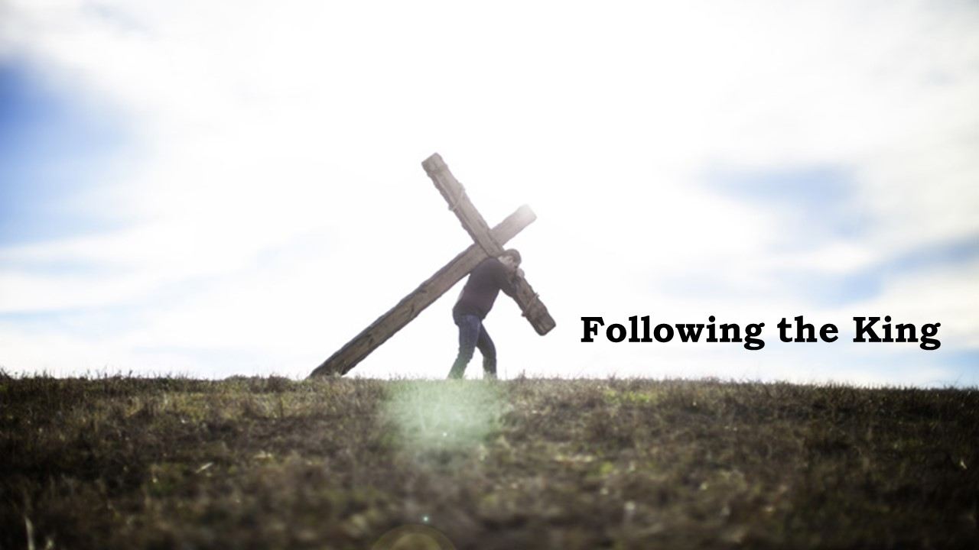

Slide 2


The King is born
Matthew 1:18-25

Slide 3
I. The King is born by grace and mercy (verses 18-20a)
18 Now the birth of Jesus Christ took place in this way. When his mother Mary had been betrothed to Joseph, before they came together she was found to be with child from the Holy Spirit. 19 And her husband Joseph, being a just man and unwilling to put her to shame, resolved to divorce her quietly.

Slide 4
I. The King is born by grace and mercy (verses 18-20a)
18 Now the birth of Jesus Christ took place in this way. When his mother Mary had been betrothed to Joseph, before they came together she was found to be with child from the Holy Spirit. 19 And her husband Joseph, being a just man and unwilling to put her to shame, resolved to divorce her quietly.
God’s grace and mercy working in and through Joseph and Mary would provide the Son of God a godly home where Jesus would, as Luke writes in Luke 2:52, grow “in wisdom and in stature and in favor with God and man.”

Slide 5
II. The King is born to the glory of God (verses 20-23)
He was conceived by the power of the Holy Spirit (20)
20 But as he considered these things, behold, an angel of the Lord appeared to him in a dream, saying, “Joseph, son of David, do not fear to take Mary as your wife, for that which is conceived in her is from the Holy Spirit.
In Matthew 1:16, Matthew doesn’t write “and Jacob the father of Joseph, and Joseph the father of Jesus.” He writes “and Jacob the father of Joseph the husband of Mary, of whom Jesus was born, who is called Christ.”

Slide 6
II. The King is born to the glory of God (verses 20-23)
He was born to bring God’s salvation (21)
21 She will bear a son, and you shall call his name Jesus,* for he will save his people from their sins.”
“We do not have a high priest who is unable to sympathize with our weaknesses, but one who in every respect has been tempted as we are, yet without sin.” Hebrews 4:15
* Yahweh is Salvation

Slide 7
II. The King is born to the glory of God (verses 20-23)
By His birth, God is with us (22-23)
22 All this took place to fulfill what the Lord had spoken by the prophet :* 23 “Behold, the virgin shall conceive and bear a son, and they shall call his name Immanuel” (which means, God with us).
* Isaiah 7:14

Slide 8
II. The King is born to the glory of God (verses 20-23)
By His birth, God is with us (22-23)
“For to us a child is born, to us a son is given; and the government shall be upon his shoulder, and his name shall be called Wonderful Counselor, Mighty God, Everlasting Father, Prince of Peace. Of the increase of his government and of peace there will be no end, on the throne of David and over his kingdom, to establish it and to uphold it with justice and with righteousness from this time forth and forevermore. The zeal of the Lord of hosts will do this.” Isaiah 9:6-7

Slide 9
III. The King is born into a faithful family (verses 24-25)
24 When Joseph woke from sleep, he did as the angel of the Lord commanded him: he took his wife, 25 but knew her not until she had given birth to a son. And he called his name Jesus.
“And Mary said, ‘Behold, I am the servant of the Lord; let it be to me according to your word.’” Luke 1:38

Slide 10
III. The King is born into a faithful family (verses 24-25)
“But to all who did receive him, who believed in his name, he gave the right to become children of God, who were born, not of blood nor of the will of the flesh nor of the will of man, but of God.” John 1:12-13
Adam is the template for humanity: “sin came into the world through one man, and death through sin, and so death spread to all men because all sinned.” Romans 5:12
Jesus brings a new template to those who receive Him as Savior. A “free gift”! And the free gift is this: “For as by the one man’s disobedience the many were made sinners, so by the one man’s obedience the many will be made righteous.” Romans 5:19

Slide 11
III. The King is born into a faithful family (verses 24-25)
23 “Behold, the virgin shall conceive and bear a son, and they shall call his name Immanuel” (which means, God with us).
“And behold, I am with you always, to the end of the age.” Matthew 28:20

