Slide 1
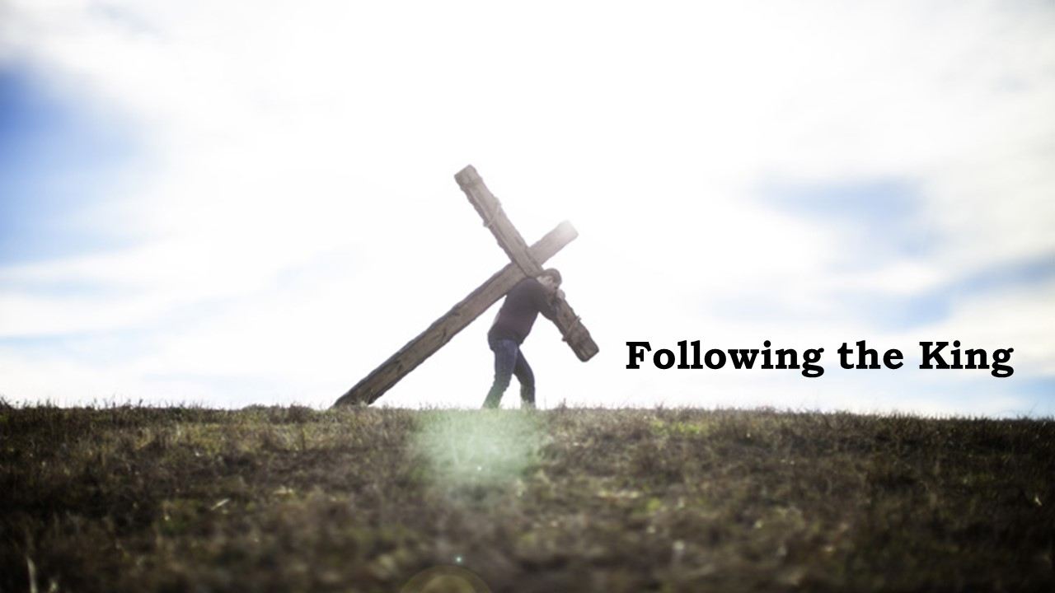

Slide 2


“Rabbi, you are the Son of God! You are the King of Israel!” John 1:49
Clues to the kingdom
Matthew 1:1-17

Slide 3
I. Jesus fulfills God’s promises to David (verses 1, 6-11, 16-17)
1 The book of the genealogy of Jesus Christ, the son of David, the son of Abraham.
“And your house and your kingdom shall be made sure forever before me. Your throne shall be established forever.” 2 Samuel 7:16
6 and Jesse the father of David the king…
16 and Jacob the father of Joseph the husband of Mary, of whom Jesus was born, who is called Christ.

Slide 4
I. Jesus fulfills God’s promises to David (verses 1, 6-11, 16-17)
17 So all the generations from Abraham to David were fourteen generations, and from David to the deportation to Babylon fourteen generations, and from the deportation to Babylon to the Christ fourteen generations.
דָּוִד
4 6 4 = 14

Slide 5
I. Jesus fulfills God’s promises to David (verses 1, 6-11, 16-17)
“And behold, you will conceive in your womb and bear a son, and you shall call his name Jesus. He will be great and will be called the Son of the Most High. And the Lord God will give to him the throne of his father David, and he will reign over the house of Jacob forever, and of his kingdom there will be no end.” Luke 1:31-33

Slide 6
II. Jesus fulfills God’s promises to Abraham (1-3, 5-6)
1 The book of the genealogy of Jesus Christ, the son of David, the son of Abraham.
“I will surely bless you, and I will surely multiply your offspring as the stars of heaven and as the sand that is on the seashore. And your offspring shall possess the gate of his enemies, and in your offspring shall all the nations of the earth be blessed, because you have obeyed my voice.” Genesis 22:17-18

Slide 7
II. Jesus fulfills God’s promises to Abraham (1-3, 5-6)
3 and Judah the father of Perez and Zerah by Tamar, and Perez the father of Hezron, and Hezron the father of Ram… 5 and Salmon the father of Boaz by Rahab, and Boaz the father of Obed by Ruth, and Obed the father of Jesse, 6 and Jesse the father of David the king. And David was the father of Solomon by the wife of Uriah…

Slide 8
II. Jesus fulfills God’s promises to Abraham (1-3, 5-6)
1 The book of the genealogy of Jesus Christ, the son of David, the son of Abraham.
“I will surely bless you…and in your offspring shall all the nations of the earth be blessed…” Genesis 22:18

Slide 9
III. Jesus will restore the kingdom to Israel (11-12, 17)
“Then Jacob called his sons and said, ‘Gather yourselves together, that I may tell you what shall happen to you in days to come.’” Genesis 49:1
“The scepter will not depart from Judah, nor the ruler’s staff from his descendants, until the coming of the one to whom it belongs, the one whom all nations will honor.” Genesis 49:10, NLT

Slide 10
III. Jesus will restore the kingdom to Israel (11-12, 17)
11 and Josiah the father of Jechoniah and his brothers, at the time of the deportation to Babylon. 12 And after the deportation to Babylon: Jechoniah was the father of Shealtiel, and Shealtiel the father of Zerubbabel… 17 So all the generations from Abraham to David were fourteen generations, and from David to the deportation to Babylon fourteen generations, and from the deportation to Babylon to the Christ fourteen generations.

Slide 11
III. Jesus will restore the kingdom to Israel (11-12, 17)
11 and Josiah the father of Jechoniah and his brothers, at the time of the deportation to Babylon. 12 And after the deportation to Babylon: Jechoniah was the father of Shealtiel, and Shealtiel the father of Zerubbabel… 17 So all the generations from Abraham to David were fourteen generations, and from David to the deportation to Babylon fourteen generations, and from the deportation to Babylon to the Christ fourteen generations.

Slide 12
III. Jesus will restore the kingdom to Israel (11-12, 17)
“Now after Jesus was born in Bethlehem of Judea in the days of Herod the king, behold, wise men from the east came to Jerusalem, saying, ‘Where is he who has been born king of the Jews?’” Matthew 2:1-2

Slide 13
III. Jesus will restore the kingdom to Israel (11-12, 17)
“But you, O Bethlehem Ephrathah, who are too little to be among the clans of Judah, from you shall come forth for me one who is to be ruler in Israel, whose coming forth is from of old, from ancient days. Therefore he shall give them up until the time when she who is in labor has given birth; then the rest of his brothers shall return to the people of Israel. And he shall stand and shepherd his flock in the strength of the Lord, in the majesty of the name of the Lord his God. And they shall dwell secure, for now he shall be great to the ends of the earth. And he shall be their peace.” Micah 5:2-5

Slide 14
III. Jesus will restore the kingdom to Israel (11-12, 17)
“So when they had come together, they asked him, ‘Lord, will you at this time restore the kingdom to Israel?” Acts 1:6
“It is not for you to know times or seasons that the Father has fixed by his own authority.” Acts 1:7

Slide 15
IV. Jesus brings the blessings of salvation to the world (6-7, 10-11, 16)
10 and Hezekiah the father of Manasseh, and Manasseh the father of Amos…
“And when he was in distress, he entreated the favor of the Lord his God and humbled himself greatly before the God of his fathers. He prayed to him, and God was moved by his entreaty and heard his plea and brought him again to Jerusalem into his kingdom. Then Manasseh knew that the Lord was God.” 2 Chronicles 33:12-13

Slide 16
IV. Jesus brings the blessings of salvation to the world (6-7, 10-11, 16)
16 and Jacob
the father of Joseph
the husband of Mary,
of whom Jesus was born,
who is called Christ.

