Slide 1
Having ears to hear
“He who has an ear, let him hear what the Spirit says to the churches.” Revelation 2:7

Slide 2
Useless Things
The “not so helpful” subtitle

Slide 3
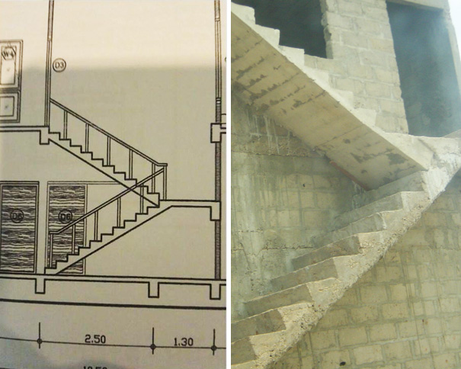
Useless Things
“Here you go boss, just like in your design!”

Slide 4
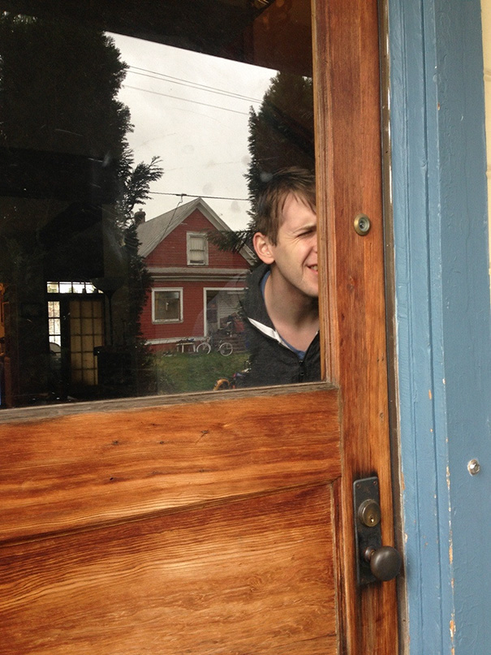
Useless Things
The pointless peep hole

Slide 5
Useless Things
This one should be self-explanatory ☺

Slide 6
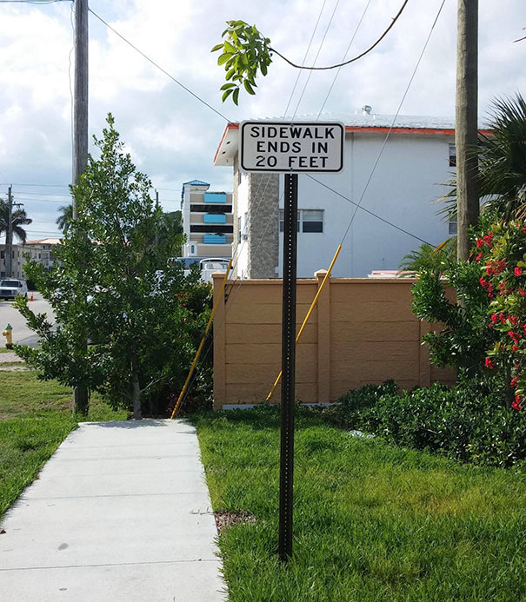
Useless Things
And this one should just make you shake your head…

Slide 7
Revelation 3:14-22
“Everyone who drinks of this water will be thirsty again, but whoever drinks of the water that I will give him will never be thirsty again. The water that I will give him will become in him a spring of water welling up to eternal life.” John 4:13-14
Open the door and let Him in!

Slide 8
I. Jesus Christ is the true and trustworthy Lord of all creation (verse 14)
14 “And to the angel of the church in Laodicea write: ‘The words of the Amen, the faithful and true witness, the beginning of God’s creation.

Slide 9
I. Jesus Christ is the true and trustworthy Lord of all creation (verse 14)
14 “And to the angel of the church in Laodicea write: ‘The words of the Amen, the faithful and true witness, the beginning of God’s creation.
14 … the ruler of God’s creation. NIV
“For by him all things were created, in heaven and on earth, visible and invisible, whether thrones or dominions or rulers or authorities—all things were created through him and for him.” Colossians 1:16

Slide 10
II. The church at Laodicea was useless to Jesus Christ (verses 15-17)
15 “‘I know your works: you are neither cold nor hot. Would that you were either cold or hot! 16 So, because you are lukewarm, and neither hot nor cold, I will spit you out of my mouth.

Slide 11
II. The church at Laodicea was useless to Jesus Christ (verses 15-17)
15 “‘I know your works: you are neither cold nor hot. Would that you were either cold or hot! 16 So, because you are lukewarm, and neither hot nor cold, I will spit you out of my mouth.
16 …I am going to vomit you out of my mouth. NET

Slide 12
II. The church at Laodicea was useless to Jesus Christ (verses 15-17)
15 “‘I know your works: you are neither cold nor hot. Would that you were either cold or hot! 16 So, because you are lukewarm, and neither hot nor cold, I will spit you out of my mouth.
17 For you say, I am rich, I have prospered, and I need nothing, not realizing that you are wretched, pitiable, poor, blind, and naked.
“Whoever abides in me and I in him, he it is that bears much fruit, for apart from me you can do nothing.” John 15:5

Slide 13
III. The church at Laodicea needed to need Jesus Christ (verse 18)
18 I counsel you to buy from me gold refined by fire, so that you may be rich, and white garments so that you may clothe yourself and the shame of your nakedness may not be seen, and salve to anoint your eyes, so that you may see.
“Beloved, do not be surprised at the fiery trial when it comes upon you to test you, as though something strange were happening to you. But rejoice insofar as you share Christ’s sufferings.” 1 Peter 4:12-13

Slide 14
III. The church at Laodicea needed to need Jesus Christ (verse 18)
18 I counsel you to buy from me gold refined by fire, so that you may be rich, and white garments so that you may clothe yourself and the shame of your nakedness may not be seen, and salve to anoint your eyes, so that you may see.
Then the eyes of both were opened, and they knew that they were naked. And they sewed fig leaves together and made themselves loincloths. Genesis 3:7
“…the Lord God made for Adam and for his wife garments of skins and clothed them.” Genesis 3:21

Slide 15
III. The church at Laodicea needed to need Jesus Christ (verse 18)
18 I counsel you to buy from me gold refined by fire, so that you may be rich, and white garments so that you may clothe yourself and the shame of your nakedness may not be seen, and salve to anoint your eyes, so that you may see.
“One thing I do know, that though I was blind, now I see.” John 9:25

Slide 16
IV. The church at Laodicea needed to receive Jesus Christ (verses 19-20)
19 Those whom I love, I reprove and discipline, so be zealous and repent. 20 Behold, I stand at the door and knock. If anyone hears my voice and opens the door, I will come in to him and eat with him, and he with me.
“It is for discipline that you have to endure. God is treating you as sons. For what son is there whom his father does not discipline? If you are left without discipline, in which all have participated, then you are illegitimate children and not sons.” Hebrews 12:7-8

Slide 17
IV. The church at Laodicea needed to receive Jesus Christ (verses 19-20)
19 Those whom I love, I reprove and discipline, so be zealous* and repent. 20 Behold, I stand at the door and knock. If anyone hears my voice and opens the door, I will come in to him and eat with him, and he with me.
“My sheep hear my voice, and I know them, and they follow me.” John 10:27
* to be intensely serious about something

Slide 18
V. Open the door and let Him in! (verses 21-22)
And you will receive more than a seat at His table! (21-22)
21 The one who conquers, I will grant him to sit with me on my throne, as I also conquered and sat down with my Father on his throne.
“As Christ overcame through his suffering and death (John 16:33) and entered into the highest honor God could bestow—that of being seated at his ‘right hand’ of sovereignty…so believers who suffer with Christ, even to the point of death, will share in the honor of Christ’s exalted position.” Alan Johnson’s commentary

Slide 19
V. Open the door and let Him in! (verses 21-22)
And you will receive more than a seat at His table! (21-22)
21 The one who conquers, I will grant him to sit with me on my throne, as I also conquered and sat down with my Father on his throne.
“The Spirit himself bears witness with our spirit that we are children of God, and if children, then heirs—heirs of God and fellow heirs with Christ, provided we suffer with him in order that we may also be glorified with him.” Romans 8:16-17

Slide 20
V. Open the door and let Him in! (verses 21-22)
And you will receive more than a seat at His table! (21-22)
22 He who has an ear, let him hear what the Spirit says to the churches.

Slide 21
V. Open the door and let Him in! (verses 21-22)
And buy what He’s selling!
“There are, in the end, only two ways open to us: to honestly and honorably make an admission of how far we are from the Christianity of the New Testament, or to perform skillful tricks to conceal the true situation.” 19th century Danish Theologian Soren Kierkegaard

Slide 22
V. Open the door and let Him in! (verses 21-22)
And enjoy fellowship with Him!

