Slide 2
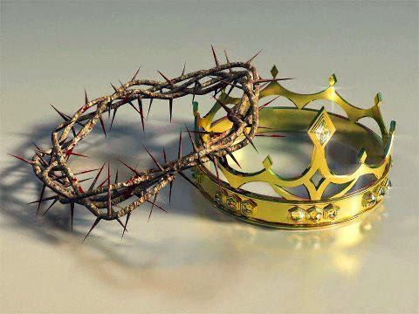
The greatest of kings
2 Samuel 7:8-17

Slide 3
I. The Lord made David a great king (verses 8-9)
8 Now, therefore, thus you shall say to my servant David, ‘Thus says the Lord of hosts, I took you from the pasture, from following the sheep, that you should be prince over my people Israel. 9 And I have been with you wherever you went and have cut off all your enemies from before you. And I will make for you a great name, like the name of the great ones of the earth.
“Then Samuel took the horn of oil and anointed him in the midst of his brothers. And the Spirit of the Lord rushed upon David from that day forward.” 1 Samuel 16:13

Slide 4
I. The Lord made David a great king (verses 8-9)
8 Now, therefore, thus you shall say to my servant David, ‘Thus says the Lord of hosts, I took you from the pasture, from following the sheep, that you should be prince over my people Israel. 9 And I have been with you wherever you went and have cut off all your enemies from before you. And I will make for you a great name, like the name of the great ones of the earth.
“…David became famous after he returned from striking down eighteen thousand Edomites in the Valley of Salt.” 2 Samuel 8:13, NIV

Slide 5
II. The Lord made great promises to Israel (verses 10-11a)
10 And I will appoint a place for my people Israel and will plant them, so that they may dwell in their own place and be disturbed no more. And violent men shall afflict them no more, as formerly, 11 from the time that I appointed judges over my people Israel. And I will give you rest from all your enemies…
“Every place on which the sole of your foot treads shall be yours. Your territory shall be from the wilderness to the Lebanon and from the River, the river Euphrates, to the western sea.” Deuteronomy 11:24

Slide 6
II. The Lord made great promises to Israel (verses 10-11a)
“Behold, the days are coming, declares the Lord, when I will raise up for David a righteous Branch, and he shall reign as king and deal wisely, and shall execute justice and righteousness in the land. In his days Judah will be saved, and Israel will dwell securely. And this is the name by which he will be called: ‘The Lord is our righteousness.’” Jeremiah 23:5-6

Slide 7
III. The Lord made great promises to David’s descendants (verses 11b-15)
11 …Moreover, the Lord declares to you that the Lord will make you a house. 12 When your days are fulfilled and you lie down with your fathers, I will raise up your offspring after you, who shall come from your body, and I will establish his kingdom. 13 He shall build a house for my name, and I will establish the throne of his kingdom forever.

Slide 8
III. The Lord made great promises to David’s descendants (verses 11b-15)
11 …Moreover, the Lord declares to you that the Lord will make you a house. 12 When your days are fulfilled and you lie down with your fathers, I will raise up your offspring after you, who shall come from your body, and I will establish his kingdom. 13 He shall build a house for my name, and I will establish the throne of his kingdom forever.

Slide 9
III. The Lord made great promises to David’s descendants (verses 11b-15)
14 I will be to him a father, and he shall be to me a son. When he commits iniquity, I will discipline him with the rod of men, with the stripes of the sons of men, 15 but my steadfast love will not depart from him, as I took it from Saul, whom I put away from before you.
“They slaughtered the sons of Zedekiah before his eyes, and put out the eyes of Zedekiah and bound him in chains and took him to Babylon.” 2 Kings 25:7
13 I will establish the throne of his kingdom forever.

Slide 10
IV. The Lord made promises only the greatest of kings could fulfill (verses 16-17)
16 And your house and your kingdom shall be made sure forever before me. Your throne shall be established forever.’” 17 In accordance with all these words, and in accordance with all this vision, Nathan spoke to David.
“The Lord says to my Lord: ‘Sit at my right hand, until I make your enemies your footstool.’” Psalm 110:1

Slide 11
IV. The Lord made promises only the greatest of kings could fulfill (verses 16-17)
“More than any other, Christ fulfills the promises of the Davidic covenant. The failure of the kings generally leads not to disillusion with kingship but to the hope of a future king who will fulfill the kingship ideal—a hope which provides the most familiar way of understanding the significance of Jesus of Nazareth, the Christ coming in his kingdom.” A.G. Herbert, The Throne of David

