Slide 1
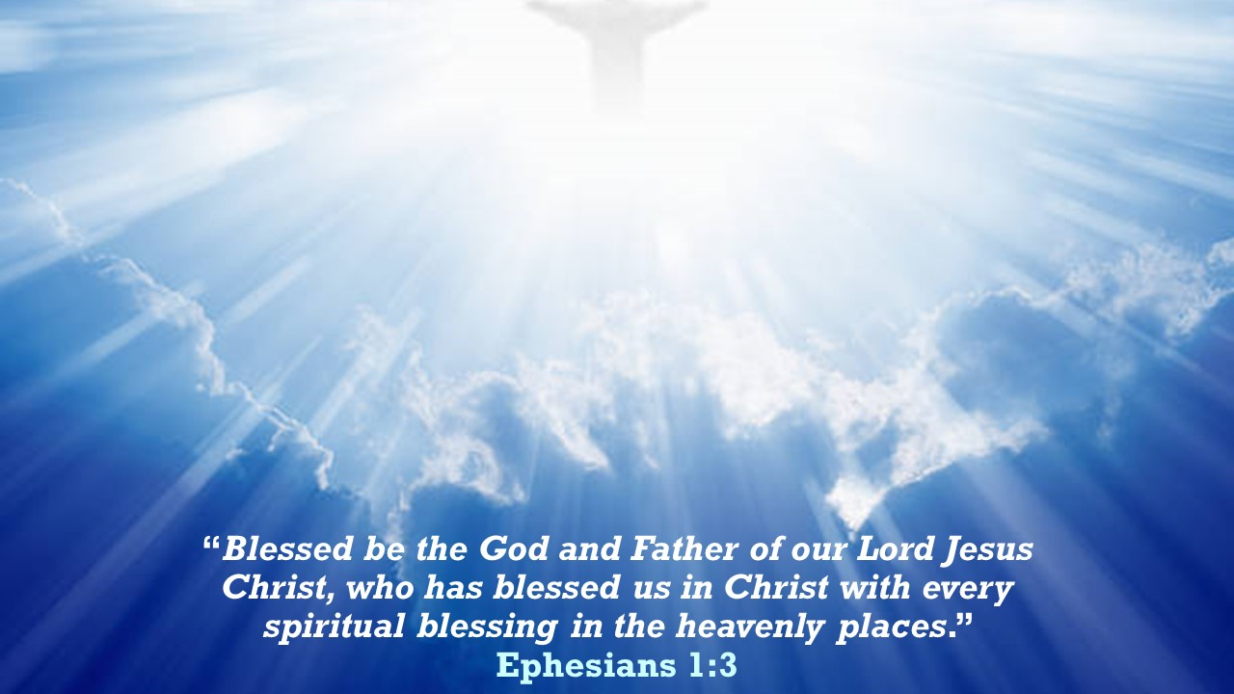

Slide 2
“If there lurks in most modern minds the notion that to desire our own good and earnestly to hope for the enjoyment of it is a bad thing, I submit that this notion has crept in from Kant and the Stoics, and is no part of the Christian faith. Indeed, if we consider the unblushing promises of reward and the staggering nature of the rewards promised in the Gospels, it would seem that our Lord finds our desires not too strong, but too weak. We are half-hearted creatures, fooling about with drink and sex and ambition when infinite joy is offered us, like an ignorant child who wants to go on making mud pies in a slum because he cannot imagine what is meant by the offer of a holiday at the sea. We are far too easily pleased.” C. S. Lewis, The Weight of Glory

Slide 3
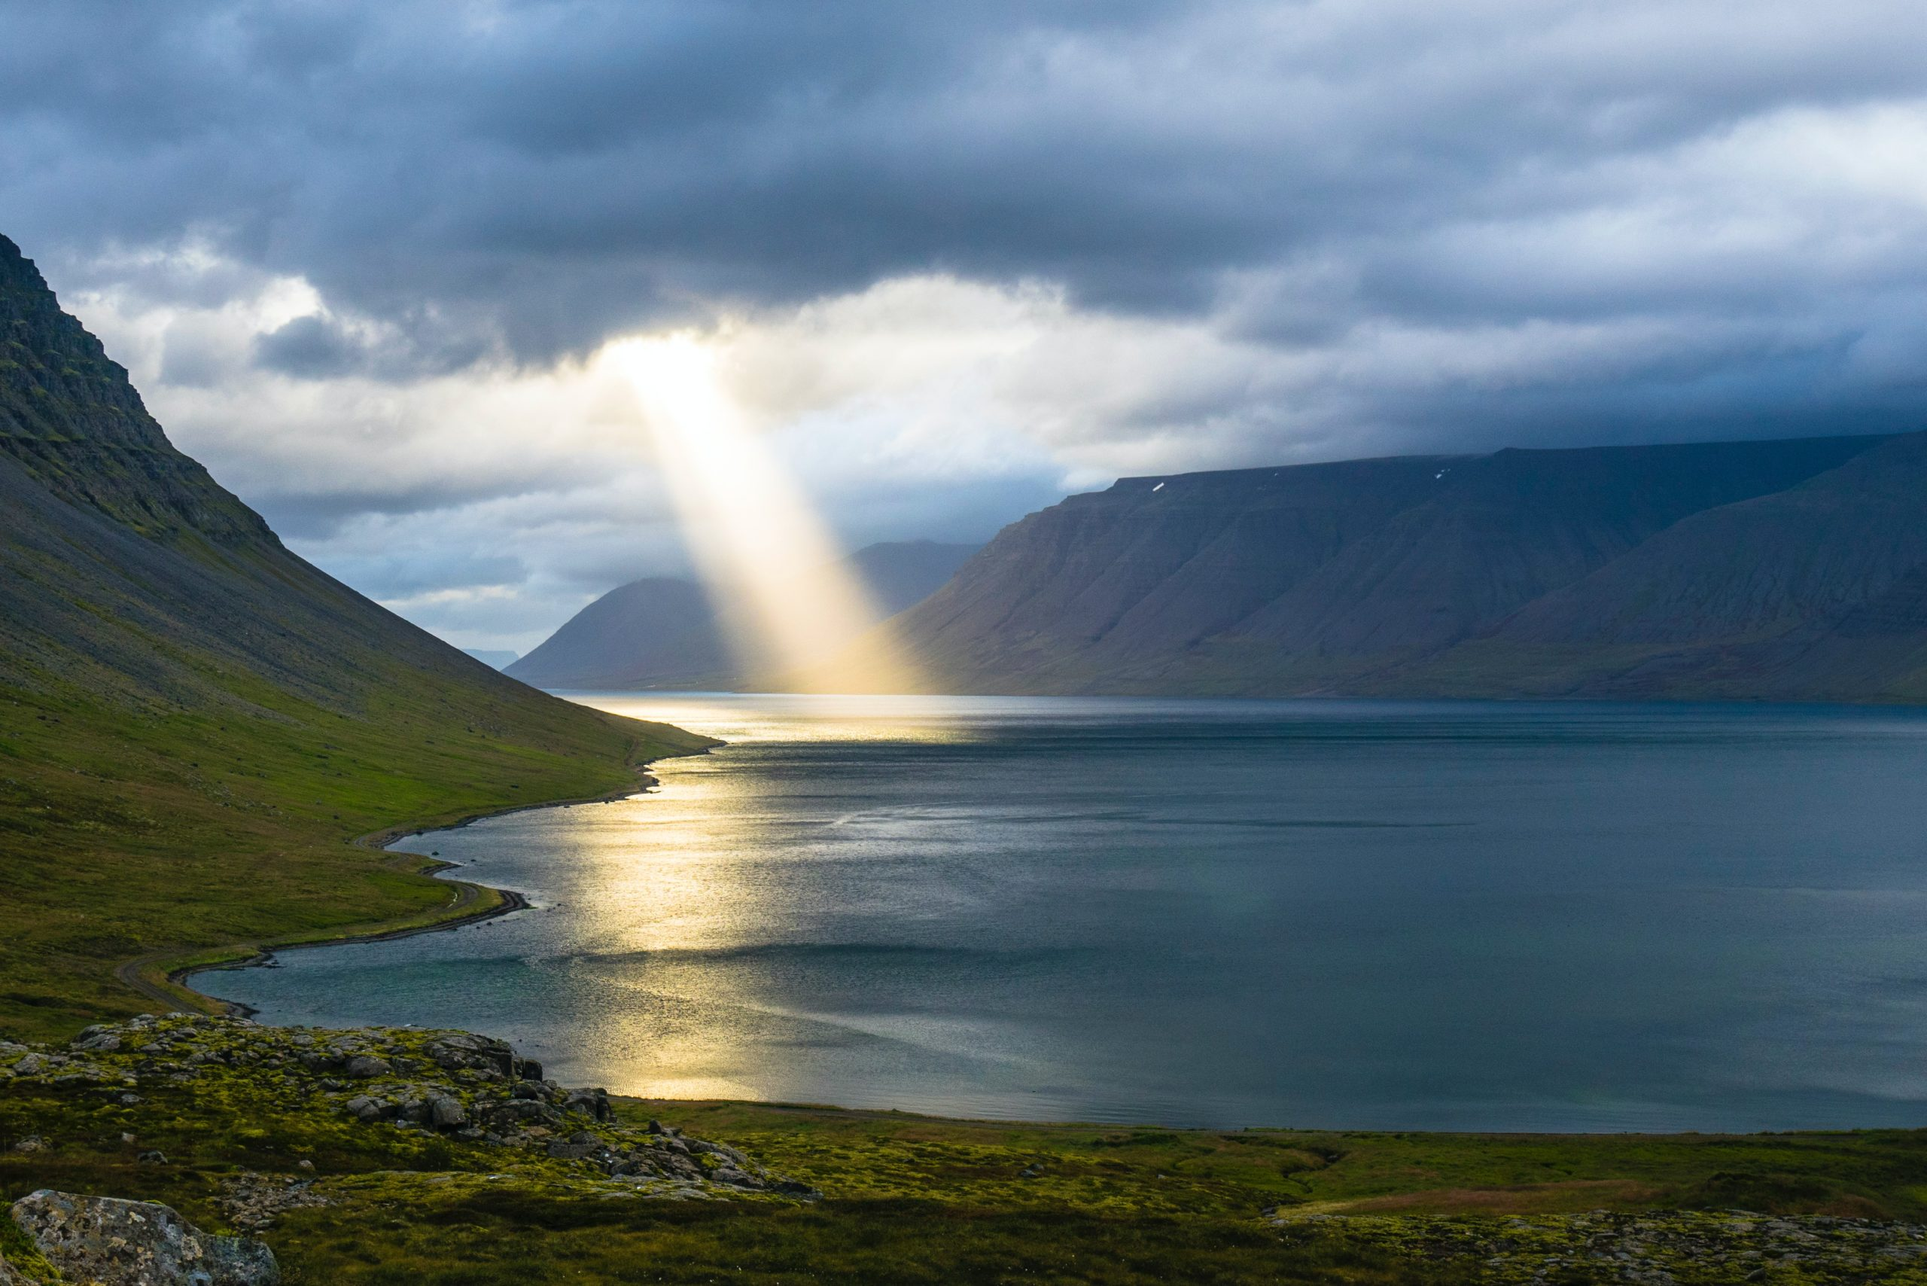

“We all, with unveiled face, beholding the glory of the Lord, are being transformed into the same image from one degree of glory to another.” 2 Corinthians 3:18
Pray for glorious things!
Ephesians 1:15-23

Slide 4
“But we ought always to give thanks to God for you, brothers beloved by the Lord, because God chose you as the firstfruits to be saved, through sanctification by the Spirit and belief in the truth. To this he called you through our gospel, so that you may obtain the glory of our Lord Jesus Christ.” 2 Thessalonians 2:13-14
Pray for glorious things!
Ephesians 1:15-23

Slide 5
I. When God’s people live faithfully, pray for them ceaselessly (verses 15-16)
15 For this reason, because I have heard of your faith in the Lord Jesus and your love toward all the saints, 16 I do not cease to give thanks for you, remembering you in my prayers…

Slide 6
II. Pray that God’s people would continue to grow in their knowledge and understanding of Him and His ways (verses 17-21)
“And this is eternal life, that they know you, the only true God, and Jesus Christ whom you have sent.” John 17:3

Slide 7
II. Pray that God’s people would continue to grow in their knowledge and understanding of Him and His ways (verses 17-21)
Pray that God would give us a deep understanding of Him that leads us to live well for Him (verse 17-18a)
17 that the God of our Lord Jesus Christ, the Father of glory, may give you the Spirit of wisdom and of revelation in the knowledge of him, 18 having the eyes of your hearts enlightened…
“…whatever you ask of the Father in my name, he will give it to you…Ask, and you will receive, that your joy may be full.” John 16:23

Slide 8
“Thus says the Lord: ‘Let not the wise man boast in his wisdom, let not the mighty man boast in his might, let not the rich man boast in his riches, but let him who boasts boast in this, that he understands and knows me, that I am the Lord who practices steadfast love, justice, and righteousness in the earth. For in these things I delight, declares the Lord.’” Jeremiah 9:23-24

Slide 9
II. Pray that God’s people would continue to grow in their knowledge and understanding of Him and His ways (verses 17-21)
Pray that God would give us a deep understanding of Him that leads us to live well for Him (verse 17-18a)
17 that the God of our Lord Jesus Christ, the Father of glory, may give you the Spirit of wisdom and of revelation in the knowledge of him, 18 having the eyes of your hearts enlightened…

Slide 10
II. Pray that God’s people would continue to grow in their knowledge and understanding of Him and His ways (verses 17-21)
Pray that God would lead us to live well for Him through a life of confident hope (verse 18b)
18 …that you may know what is the hope to which he has called you…

Slide 11
II. Pray that God’s people would continue to grow in their knowledge and understanding of Him and His ways (verses 17-21)
Pray that God would lead us to live well for Him through a life of confident hope (verse 18b)
“we rejoice in hope of the glory of God.” Romans 5:2
Romans 5:3-4 - How God leads us through times of suffering to transform our character into the likeness of Jesus
“and hope does not disappoint, because the love of God has been poured out within our hearts through the Holy Spirit who was given to us.” Romans 5:5, NASB

Slide 12
II. Pray that God’s people would continue to grow in their knowledge and understanding of Him and His ways (verses 17-21)
Pray that God would lead us to live well for Him through a life of confident hope (verse 18b)
“Christ in you, the hope of glory.” Colossians 1:27
“Him we proclaim, warning everyone and teaching everyone with all wisdom, that we may present everyone mature in Christ.” Colossians 1:28
A may be/might be/could be/probably will be hope???
“When Christ who is your life appears, then you also will appear with him in glory.” Colossians 3:4

Slide 13
II. Pray that God’s people would continue to grow in their knowledge and understanding of Him and His ways (verses 17-21)
Pray that God would lead us to live well for Him by knowing our great value to Him (verse 18c)
18 …what are the riches of his glorious inheritance in the saints…
18 his holy people who are his rich and glorious inheritance… NLT

Slide 14
II. Pray that God’s people would continue to grow in their knowledge and understanding of Him and His ways (verses 17-21)
Pray that God would lead us to live well for Him by knowing our great value to Him (verse 18c)
18 …what are the riches of his glorious inheritance in the saints…
“Then those who feared the Lord spoke with one another. The Lord paid attention and heard them, and a book of remembrance was written before him of those who feared the Lord and esteemed his name. “They shall be mine, says the Lord of hosts, in the day when I make up my treasured possession, and I will spare them as a man spares his son who serves him.” Malachi 3:16-17

Slide 15
II. Pray that God’s people would continue to grow in their knowledge and understanding of Him and His ways (verses 17-21)
Pray that God would lead us to live well for Him by trusting His mighty power towards us (verses 19-21)
19 and what is the immeasurable greatness of his power toward us who believe, according to the working of his great might 20 that he worked in Christ when he raised him from the dead and seated him at his right hand in the heavenly places, 21 far above all rule and authority and power and dominion, and above every name that is named, not only in this age but also in the one to come.

Slide 16
II. Pray that God’s people would continue to grow in their knowledge and understanding of Him and His ways (verses 17-21)
Pray that God would lead us to live well for Him by trusting His mighty power towards us (verses 19-21)
19 and what is the immeasurable greatness of his power toward us who believe, according to the working of his great might 20 that he worked in Christ when he raised him from the dead and seated him at his right hand in the heavenly places, 21 far above all rule and authority and power and dominion, and above every name that is named, not only in this age but also in the one to come.

Slide 17
II. Pray that God’s people would continue to grow in their knowledge and understanding of Him and His ways (verses 17-21)
Pray that God would lead us to live well for Him by trusting His mighty power towards us (verses 19-21)
For we do not wrestle against flesh and blood, but against the rulers, against the authorities, against the cosmic powers over this present darkness, against the spiritual forces of evil in the heavenly places. Therefore take up the whole armor of God, that you may be able to withstand in the evil day, and having done all, to stand firm. Ephesians 6:12-13

Slide 18
II. Pray that God’s people would continue to grow in their knowledge and understanding of Him and His ways (verses 17-21)
Pray that God would lead us to live well for Him by trusting His mighty power towards us (verses 19-21)
For we do not wrestle against flesh and blood, but against the rulers, against the authorities, against the cosmic powers over this present darkness, against the spiritual forces of evil in the heavenly places. Therefore take up the whole armor of God, that you may be able to withstand in the evil day, and having done all, to stand firm. Ephesians 6:12-13

Slide 19
II. Pray that God’s people would continue to grow in their knowledge and understanding of Him and His ways (verses 17-21)
Pray that God would lead us to live well for Him by believing He has given us everything in Christ (verses 22-23)
22 And he put all things under his feet and gave him as head over all things to the church, 23 which is his body, the fullness of him who fills all in all.

Slide 20
III. Pray for glorious things!
Pray without ceasing for our continued transformation into the image of Christ
We can probably measure the progress of our Christian life by what we pray for.
“Christ in you, the hope of glory.” Colossians 1:27

Slide 21
III. Pray for glorious things!
Pray that your prayer life would change
“Therefore do not be anxious, saying, ‘What shall we eat?’ or ‘What shall we drink?’ or ‘What shall we wear?’ For the Gentiles seek after all these things, and your heavenly Father knows that you need them all. But seek first the kingdom of God and his righteousness, and all these things will be added to you.” Matthew 6:31-33

Slide 22
III. Pray for glorious things!
Pray that your prayer life would change
As we pray, ask for the righteousness of Christ to be the all-consuming quality of His church so that He can work effectively through us to advance His “plan for the fullness of time, to unite all things in [Christ], things in heaven and things on earth.” Ephesians 1:10

Slide 23
III. Pray for glorious things!
Pray that our hearts would rejoice greatly because He reigns!
“Then I heard what seemed to be the voice of a great multitude, like the roar of many waters and like the sound of mighty peals of thunder, crying out, ‘Hallelujah! For the Lord our God the Almighty reigns. Let us rejoice and exult and give him the glory!” Revelation 19:6-7

