Slide 2
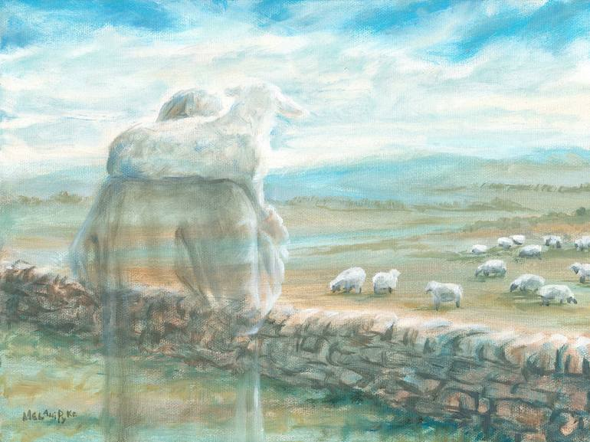
Who are you?
Ephesians 1:1-14

Slide 3
I. By God’s grace, you are set apart to live faithfully in relationship with Him (verses 1-2 )
1 Paul, an apostle of Christ Jesus by the will of God, To the saints who are in Ephesus, and are faithful in Christ Jesus: 2 Grace to you and peace from God our Father and the Lord Jesus Christ.
1 …God’s holy people NLT
“…your life is hidden with Christ in God.” Colossians 3:3

Slide 4
I. By God’s grace, you are set apart to live faithfully in relationship with Him (verses 1-2 )
1 Paul, an apostle of Christ Jesus by the will of God, To the saints who are in Ephesus, and are faithful in Christ Jesus: 2 Grace to you and peace from God our Father and the Lord Jesus Christ.
1 …God’s holy people NLT
“…your life is hidden with Christ in God.” Colossians 3:3

Slide 5
II. In Christ, you have every spiritual blessing in the heavenly places (verse 3 )
3 Blessed be the God and Father of our Lord Jesus Christ, who has blessed us in Christ with every spiritual blessing in the heavenly places.
“…we do not wrestle against flesh and blood, but against…the cosmic powers over this present darkness, against the spiritual forces of evil in the heavenly places.” Ephesians 6:12

Slide 6
III. In Christ, God’s unstoppable plan is to make you holy and blameless before him (verse 4 )
4 even as he chose us in him before the foundation of the world, that we should be holy and blameless before him. In love…

Slide 7
III. In Christ, God’s unstoppable plan is to make you holy and blameless before him (verse 4 )
4 even as he chose us in him before the foundation of the world, that we should be holy and blameless before him. In love…

Slide 8
IV. In Christ, God’s unstoppable plan is to adopt you into His family (verses 5-6 )
4 …in love 5 he predestined* us for adoption to himself as sons through Jesus Christ, according to the purpose of his will, 6 to the praise of his glorious grace, with which he has blessed us in the Beloved.
* He determined beforehand for His Son to come into the world and complete the work of bringing salvation to the world, and He determined beforehand that certain and many wonderful things will be true for those who come to His Son in faith.

Slide 9
IV. In Christ, God’s unstoppable plan is to adopt you into His family (verses 5-6 )
4 …in love 5 he predestined* us for adoption to himself as sons through Jesus Christ, according to the purpose of his will, 6 to the praise of his glorious grace, with which he has blessed us in the Beloved.
* He determined beforehand for His Son to come into the world and complete the work of bringing salvation to the world, and He determined beforehand that certain and many wonderful things will be true for those who come to His Son in faith.

Slide 10
IV. In Christ, God’s unstoppable plan is to adopt you into His family (verses 5-6 )
4 …in love 5 he predestined us for adoption to himself as sons through Jesus Christ, according to the purpose of his will, 6 to the praise of his glorious grace, with which he has blessed us in the Beloved.
5 according to the kind intention of His will. NASB
“…so that in the ages to come He might show the surpassing riches of His grace in kindness toward us in Christ Jesus.” Ephesians 2:7

Slide 11
IV. In Christ, God’s unstoppable plan is to adopt you into His family (verses 5-6 )
4 …in love 5 he predestined us for adoption to himself as sons through Jesus Christ, according to the purpose of his will, 6 to the praise of his glorious grace, with which he has blessed us in the Beloved.

Slide 12
V. In Christ, God’s unstoppable plan is to fully deliver you and the entire universe from sin’s power and consequences (verses 7-10 )
7 In him we have redemption through his blood, the forgiveness of our trespasses, according to the riches of his grace.

Slide 13
V. In Christ, God’s unstoppable plan is to fully deliver you and the entire universe from sin’s power and consequences (verses 7-10 )
7 In him we have redemption through his blood, the forgiveness of our trespasses, according to the riches of his grace.
8 which he lavished upon us, in all wisdom and insight 9 making known to us the mystery of his will, according to his purpose, which he set forth in Christ 10 as a plan for the fullness of time, to unite all things in him, things in heaven and things on earth.

Slide 14
V. In Christ, God’s unstoppable plan is to fully deliver you and the entire universe from sin’s power and consequences (verses 7-10 )
7 In him we have redemption through his blood, the forgiveness of our trespasses, according to the riches of his grace.
8 which he lavished upon us, in all wisdom and insight 9 making known to us the mystery of his will, according to his purpose, which he set forth in Christ 10 as a plan for the fullness of time, to unite all things in him, things in heaven and things on earth.

Slide 15
V. In Christ, God’s unstoppable plan is to fully deliver you and the entire universe from sin’s power and consequences (verses 7-10 )
10 as a plan for the fullness of time, to unite all things in him, things in heaven and things on earth.
“Christ will unify and transform the entire universe, physical and spiritual. In other words, all of history and all of reality point in one grand direction, namely, subordination to Christ…He is the end toward which everything moves.” William Klein, Commentary on verse 10

Slide 16
VI. In Christ, God’s unstoppable plan is to make you fellow-heirs with His Son to His glory (verses 11-12 )
11 In him we have obtained an inheritance, having been predestined according to the purpose of him who works all things according to the counsel of his will, 12 so that we who were the first to hope in Christ might be to the praise of his glory.
“but in these last days he has spoken to us by his Son, whom he appointed the heir of all things…” Hebrews 1:2
“The Spirit himself bears witness with our spirit that we are children of God, and if children, then heirs—heirs of God and fellow heirs with Christ…” Romans 8:16-17

Slide 17
VI. In Christ, God’s unstoppable plan is to make you fellow-heirs with His Son to His glory (verses 11-12 )
11 In him we have obtained an inheritance, having been predestined according to the purpose of him who works all things according to the counsel of his will, 12 so that we who were the first to hope in Christ might be to the praise of his glory.

Slide 18
VII. In Christ, God guarantees all of these blessings to you by sealing you with His Holy Spirit to His glory (verses 13-14 )
13 In him you also, when you heard the word of truth, the gospel of your salvation, and believed in him, were sealed with the promised Holy Spirit, 14 who is the guarantee of our inheritance until we acquire possession of it, to the praise of his glory.

Slide 19
VII. In Christ, God guarantees all of these blessings to you by sealing you with His Holy Spirit to His glory (verses 13-14 )
13 In him you also, when you heard the word of truth, the gospel of your salvation, and believed in him, were sealed with the promised Holy Spirit, 14 who is the guarantee* of our inheritance until we acquire possession of it, to the praise of his glory.
* The payment of part of a purchase price in advance.

Slide 20
Who are you?
You are set apart to live faithfully for Him in right relationship with Him forever.
You are His daughters and sons whom He will make holy and blameless before Him.
You are united with Christ in every way, truly set free from bondage to sin and it’s corrupting power by the power of His redeeming blood.
You are fellow-heirs with Jesus Christ of all things in a universe made forever new and forever good.
You are in Christ, blessed with every spiritual blessing in the heavenly places.

