Slide 1
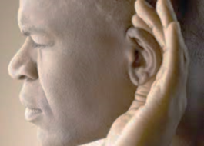
Having ears to hear
“He who has an ear, let him hear what the Spirit says to the churches.” Revelation 2:7

Slide 2
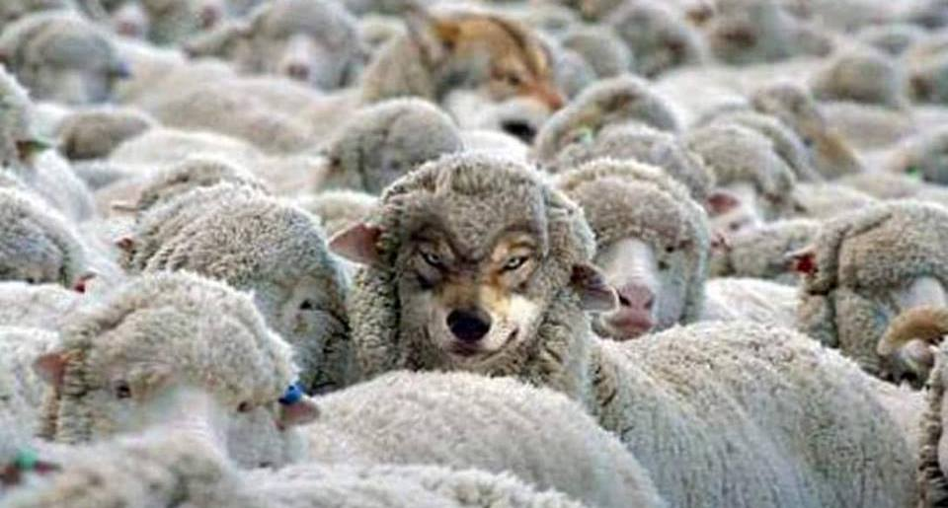
Revelation 2:12-17
Beware of False Teaching
Part 1

Slide 3
I. Jesus Christ is an almighty warrior (verse 12)
12 “And to the angel of the church in Pergamum write: ‘The words of him who has the sharp two-edged sword.

Slide 4
II. The Lord commended the church at Pergamum for great faithfulness amid great wickedness (verse 13)
13 “‘I know where you dwell, where Satan’s throne is. Yet you hold fast my name, and you did not deny my faith even in the days of Antipas my faithful witness, who was killed among you, where Satan dwells.

Slide 5
III. The Lord rebuked the church at Pergamum for permitting false teaching within the church (verses 14-15)
14 But I have a few things against you: you have some there who hold the teaching of Balaam, who taught Balak to put a stumbling block before the sons of Israel, so that they might eat food sacrificed to idols and practice sexual immorality. 15 So also you have some who hold the teaching of the Nicolaitans.

Slide 6
III. The Lord rebuked the church at Pergamum for permitting false teaching within the church (verses 14-15)
14 But I have a few things against you: you have some there who hold the teaching of Balaam, who taught Balak to put a stumbling block before the sons of Israel, so that they might eat food sacrificed to idols and practice sexual immorality. 15 So also you have some who hold the teaching of the Nicolaitans.
15 In a similar way, you have some Nicolaitans among you who follow the same teaching. NLT

Slide 7
IV. The Lord commanded the church at Pergamum to repent with a deadly warning and a powerful promise (verses 16-17)
16 Therefore repent. If not, I will come to you soon and war against them with the sword of my mouth. 17 He who has an ear, let him hear what the Spirit says to the churches. To the one who conquers I will give some of the hidden manna, and I will give him a white stone, with a new name written on the stone that no one knows except the one who receives it.’

Slide 8
IV. The Lord commanded the church at Pergamum to repent with a deadly warning and a powerful promise (verses 16-17)
16 Therefore repent. If not, I will come to you soon and war against them with the sword of my mouth. 17 He who has an ear, let him hear what the Spirit says to the churches. To the one who conquers I will give some of the hidden manna, and I will give him a white stone, with a new name written on the stone that no one knows except the one who receives it.’
“…it was not Moses who gave you the bread from heaven, but my Father gives you the true bread from heaven. For the bread of God is he who comes down from heaven and gives life to the world.” John 6:32-33

Slide 9
IV. The Lord commanded the church at Pergamum to repent with a deadly warning and a powerful promise (verses 16-17)
16 Therefore repent. If not, I will come to you soon and war against them with the sword of my mouth. 17 He who has an ear, let him hear what the Spirit says to the churches. To the one who conquers I will give some of the hidden manna, and I will give him a white stone, with a new name written on the stone that no one knows except the one who receives it.’
“Blessed are those who are invited to the marriage supper of the Lamb.” Revelation 19:9

Slide 10
V. Beware of false teaching
Culture cuts deep
“But when Cephas came to Antioch, I opposed him to his face, because he stood condemned. For before certain men came from James, he was eating with the Gentiles; but when they came he drew back and separated himself, fearing the circumcision party.” Galatians 2:11-12

Slide 11
whoever says he abides in him ought to walk in the same way in which he walked. 1 John 2:6
The way of Christ /
The Gospel of Christ
End Times Teaching
Calendar over Character

Slide 12
whoever says he abides in him ought to walk in the same way in which he walked. 1 John 2:6
The way of Christ /
The Gospel of Christ
End Times Teaching
Sexual Immorality
Love = Acceptance of Sin

Slide 13
whoever says he abides in him ought to walk in the same way in which he walked. 1 John 2:6
The way of Christ /
The Gospel of Christ
End Times Teaching
Sexual Immorality
Politics
Political Agendas become the mission and the walk

Slide 14
whoever says he abides in him ought to walk in the same way in which he walked. 1 John 2:6
The way of Christ /
The Gospel of Christ
End Times Teaching
Sexual Immorality
Politics
Money
The prosperity Gospel

Slide 15
V. Beware of false teaching
Handle the word of truth rightly (2 Timothy 2:15)
“Do your best to present yourself to God as one approved, a worker who has no need to be ashamed, rightly handling the word of truth. But avoid irreverent babble, for it will lead people into more and more ungodliness…” 2 Timothy 2:15-16

Slide 16
V. Beware of false teaching
Gently instruct those who oppose the truth (2 Timothy 2:25, NLT)
“And the Lord’s servant must not be quarrelsome but kind to everyone, able to teach, patiently enduring evil, correcting his opponents with gentleness. God may perhaps grant them repentance leading to a knowledge of the truth, and they may come to their senses and escape from the snare of the devil, after being captured by him to do his will.” 2 Timothy 2:24-26

Slide 17
V. Beware of false teaching
Gently instruct those who oppose the truth (2 Timothy 2:25, NLT)
“And the Lord’s servant must not be quarrelsome but kind to everyone, able to teach, patiently enduring evil, correcting his opponents with gentleness. God may perhaps grant them repentance leading to a knowledge of the truth, and they may come to their senses and escape from the snare of the devil, after being captured by him to do his will.” 2 Timothy 2:24-26

