Slide 1
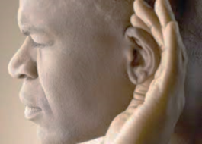
Having ears to hear
“He who has an ear, let him hear what the Spirit says to the churches.” Revelation 2:7

Slide 2
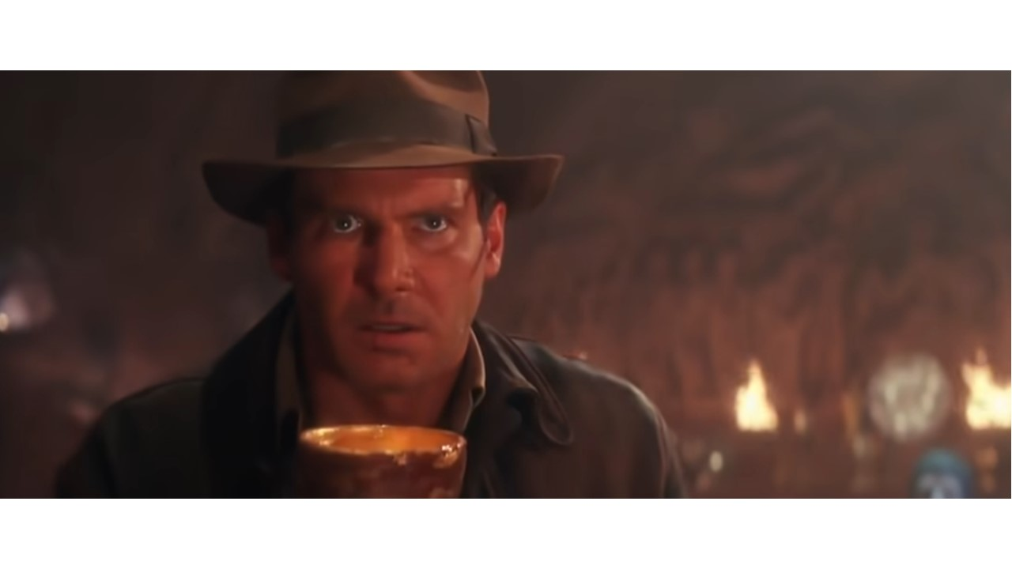
Revelation 3:7-13
Hold fast to what will last
“You don’t have much strength, I know that; you used what you had to keep my Word.” Revelation 3:8, The Message

Slide 3
I. Jesus is THE way, THE truth, and THE life (verse 7)
7 “And to the angel of the church in Philadelphia write: ‘The words of the holy one, the true one, who has the key of David, who opens and no one will shut, who shuts and no one opens.
“I am the way, and the truth, and the life. No one comes to the Father except through me.” John 14:6

Slide 4
I. Jesus is THE way, THE truth, and THE life (verse 7)
7 “And to the angel of the church in Philadelphia write: ‘The words of the holy one, the true one, who has the key of David, who opens and no one will shut, who shuts and no one opens.
“I am the way, and the truth, and the life. No one comes to the Father except through me.” John 14:6

Slide 5
I. Jesus is THE way, THE truth, and THE life (verse 7)
7 “And to the angel of the church in Philadelphia write: ‘The words of the holy one, the true one, who has the key of David, who opens and no one will shut, who shuts and no one opens.
“I am the way, and the truth, and the life. No one comes to the Father except through me.” John 14:6
“And he shall be a father to the inhabitants of Jerusalem and to the house of Judah. And I will place on his shoulder the key of the house of David. He shall open, and none shall shut; and he shall shut, and none shall open. And I will fasten him like a peg in a secure place, and he will become a throne of honor to his father’s house.” Isaiah 22:21-23

Slide 6
I. Jesus is THE way, THE truth, and THE life (verse 7)
7 “And to the angel of the church in Philadelphia write: ‘The words of the holy one, the true one, who has the key of David, who opens and no one will shut, who shuts and no one opens.
“I am the way, and the truth, and the life. No one comes to the Father except through me.” John 14:6
“And he shall be a father to the inhabitants of Jerusalem and to the house of Judah. And I will place on his shoulder the key of the house of David. He shall open, and none shall shut; and he shall shut, and none shall open. And I will fasten him like a peg in a secure place, and he will become a throne of honor to his father’s house.” Isaiah 22:21-23

Slide 7
II. Jesus highly commends the church at Philadelphia… (verses 8-10)
…for the great significance of their faith in Him (8)
8 “‘I know your works. Behold, I have set before you an open door, which no one is able to shut. I know that you have but little* power, and yet you have kept my word and have not denied my name.
8 …because you have a little* power… NASB
* unimportant, insignificant

Slide 8
II. Jesus highly commends the church at Philadelphia… (verses 8-10)
…for the great love they were worthy of (9)
9 Behold, I will make those of the synagogue of Satan who say that they are Jews and are not, but lie—behold, I will make them come and bow down before your feet, and they will learn that I have loved you.
“…that at the name of Jesus every knee should bow, in heaven and on earth and under the earth…” Philippians 2:10

Slide 9
II. Jesus highly commends the church at Philadelphia… (verses 8-10)
…for the great love they were worthy of (9)
9 Behold, I will make those of the synagogue of Satan who say that they are Jews and are not, but lie—behold, I will make them come and bow down before your feet, and they will learn that I have loved you.
“Whoever has my commandments and keeps them, he it is who loves me. And he who loves me will be loved by my Father, and I will love him and manifest myself to him.” John 14:21

Slide 10
II. Jesus highly commends the church at Philadelphia… (verses 8-10)
…for following Jesus’ example of patient endurance (10)
10 Because you have kept my word about patient endurance,* I will keep you from the hour of trial that is coming on the whole world, to try those who dwell on the earth.
10 Because you have kept the word of my perseverance*… NASB
* the capacity to hold out or bear up in the face of difficulty

Slide 11
II. Jesus highly commends the church at Philadelphia… (verses 8-10)
…for following Jesus’ example of patient endurance (10)
10 Because you have kept my word about patient endurance,* I will keep you from the hour of trial that is coming on the whole world, to try those who dwell on the earth.
10 Because you have kept the word of my perseverance*… NASB
* the capacity to hold out or bear up in the face of difficulty

Slide 12
III. Jesus commands the church at Philadelphia to hold fast what you have (verse 11)
11 I am coming soon. Hold fast what you have, so that no one may seize your crown.*
* Given as an award or prize for exceptional service or conduct

Slide 13
IV. Jesus promises the church at Philadelphia the highest of honor in eternity (verses 12-13)
12 The one who conquers, I will make him a pillar* in the temple of my God. Never shall he go out of it, and I will write on him the name of my God, and the name of the city of my God, the new Jerusalem, which comes down from my God out of heaven, and my own new name.
“And I saw no temple in the city, for its temple is the Lord God the Almighty and the Lamb.” Revelation 21:22
* A person or community recognized for spiritual leadership

Slide 14
IV. Jesus promises the church at Philadelphia the highest of honor in eternity (verses 12-13)
12 The one who conquers, I will make him a pillar in the temple of my God. Never shall he go out of it, and I will write on him the name of my God, and the name of the city of my God, the new Jerusalem, which comes down from my God out of heaven, and my own new name.
“The inscribed name signifies identification and ownership. To those who have ‘little strength’ (little influence) because of being ostracized, Christ promises recognition in his kingdom worthy of the most noble hero of any society.” Alan Johnson, commentary on verse 12

Slide 15
IV. Jesus promises the church at Philadelphia the highest of honor in eternity (verses 12-13)
12 The one who conquers, I will make him a pillar in the temple of my God. Never shall he go out of it, and I will write on him the name of my God, and the name of the city of my God, the new Jerusalem, which comes down from my God out of heaven, and my own new name.
“So we do not lose heart. Though our outer self is wasting away, our inner self is being renewed day by day. For this light momentary affliction is preparing for us an eternal weight of glory beyond all comparison, as we look not to the things that are seen but to the things that are unseen. For the things that are seen are transient, but the things that are unseen are eternal.” 2 Corinthians 4:16-18

Slide 16
V. Hold fast to what will last
“Since all these things are thus to be dissolved, what sort of people ought you to be in lives of holiness and godliness?” 2 Peter 3:11
“And the world is passing away along with its desires, but whoever does the will of God abides forever.” 1 John 2:17

Slide 17
V. Hold fast to what will last
Learn the lesson of little power
“Christ promises recognition in his kingdom worthy of the most noble hero of any society.” Alan Johnson, commentary on verse 12
We must not fail to take note of the fact that it was this kind of church that was found faultless by our Lord, and that it was this kind of church that received, by far, Christ’s highest commendation among all of the 7 churches.

Slide 18
V. Hold fast to what will last
Don’t lose so great a crown
11 ... Hold fast what you have, so that no one may seize your crown.
“If the work that anyone has built on the foundation survives, he will receive a reward. If anyone’s work is burned up, he will suffer loss, though he himself will be saved, but only as through fire.” 1 Corinthians 3:14-15

