Slide 1
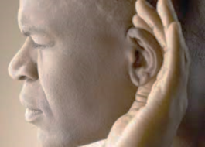
Having ears to hear
“He who has an ear, let him hear what the Spirit says to the churches.” Revelation 2:7

Slide 2
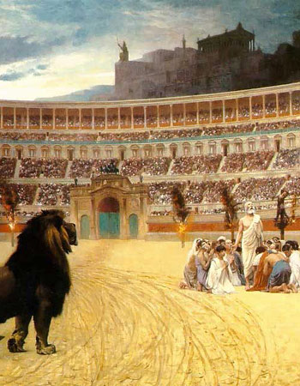
Revelation 2:8-11
Be faithful unto death

Slide 3
I. Jesus Christ is the Lord of history and the Lord of life (verse 8)
8 “And to the angel of the church in Smyrna write: ‘The words of the first and the last, who died and came to life.

Slide 4
II. The Lord commended the church in Smyrna for being rich toward God (verse 9)
9 “‘I know your tribulation* and your poverty (but you are rich) and the slander of those who say that they are Jews and are not, but are a synagogue of Satan.
* The experience of trouble that inflicts distress.
“He was despised and rejected by men, a man of sorrows and acquainted with grief.” Isaiah 55:3

Slide 5
II. The Lord commended the church in Smyrna for being rich toward God (verse 9)
9 “‘I know your tribulation* and your poverty (but you are rich) and the slander of those who say that they are Jews and are not, but are a synagogue of Satan.
* The experience of trouble that inflicts distress.
“Foxes have holes, and birds of the air have nests, but the Son of Man has nowhere to lay his head.” Matthew 8:20

Slide 6
II. The Lord commended the church in Smyrna for being rich toward God (verse 9)
9 “‘I know your tribulation and your poverty (but you are rich) and the slander of those who say that they are Jews and are not, but are a synagogue of Satan.
“For you know the grace of our Lord Jesus Christ, that though he was rich, yet for your sake he became poor, so that you by his poverty might become rich.” 2 Corinthians 8:9
To be faithful in following Jesus Christ always and in all things is to store up “treasures in heaven, where neither moth nor rust destroys and where thieves do not break in and steal.” Matthew 6:20

Slide 7
III. The Lord commanded the church in Smyrna to choose faithfulness over fear (verses 10-11)
The temptation to be fearful could arise over the prospect of suffering tribulation (10a)
10 Do not fear what you are about to suffer…
“When I saw him, I fell at his feet as though dead. But he laid his right hand on me, saying, ‘Fear not.’” Revelation 1:17

Slide 8
III. The Lord commanded the church in Smyrna to choose faithfulness over fear (verses 10-11)
The purpose of suffering tribulation is to test the faithfulness of the church (10b)
10 …Behold, the devil is about to throw some of you into prison, that you may be tested, and for ten days you will have tribulation.
“We do not wrestle against flesh and blood, but…against the cosmic powers over this present darkness, against the spiritual forces of evil in the heavenly places.” Ephesians 6:12

Slide 9
III. The Lord commanded the church in Smyrna to choose faithfulness over fear (verses 10-11)
The purpose of suffering tribulation is to test the faithfulness of the church (10b)
10 …Behold, the devil is about to throw some of you into prison, that you may be tested,* and for ten days you will have tribulation.
* To entice to improper behavior

Slide 10
III. The Lord commanded the church in Smyrna to choose faithfulness over fear (verses 10-11)
The purpose of suffering tribulation is to test the faithfulness of the church (10b)
10 …Behold, the devil is about to throw some of you into prison, that you may be tested, and for ten days you will have tribulation.

Slide 11
III. The Lord commanded the church in Smyrna to choose faithfulness over fear (verses 10-11)
The church passes the test of suffering tribulation when it is faithful unto death (10c)
10 …Be faithful unto death, and I will give you the crown of life.
The command to be faithful unto death is more than being faithful to your last breath. It entails being faithful when the circumstances you’ve been cast into to test your faith may lead to your death. Like Polycarp, it is a faith that passes the test in the face of death when options (temptations) are available to you to escape death by being faithless.

Slide 12
III. The Lord commanded the church in Smyrna to choose faithfulness over fear (verses 10-11)
The church passes the test of suffering tribulation when it is faithful unto death (10c)
10 …Be faithful unto death, and I will give you the crown of life.
“Blessed is the man who remains steadfast under trial, for when he has stood the test he will receive the crown of life, which God has promised to those who love him.” James 1:12

Slide 13
III. The Lord commanded the church in Smyrna to choose faithfulness over fear (verses 10-11)
The reward for being faithful unto death is a life saved from the second death (11)
11 He who has an ear, let him hear what the Spirit says to the churches. The one who conquers will not be hurt by the second death.’
“No, in all these things we are more than conquerors through him who loved us.” Romans 8:37
All these things are what Paul lists in verses 35-36: tribulation, distress, persecution, famine, nakedness, danger, sword, and being regarded as sheep to be slaughtered.

Slide 14
III. The Lord commanded the church in Smyrna to choose faithfulness over fear (verses 10-11)
The reward for being faithful unto death is a life saved from the second death (11)
11 He who has an ear, let him hear what the Spirit says to the churches. The one who conquers will not be hurt by the second death.’

Slide 15
IV. Be faithful unto death
Trust the Lord of history and the Lord of life
Jesus “…gave himself for our sins to deliver us from the present evil age.” Galatians 1:4
“What has been is what will be, and what has been done is what will be done, and there is nothing new under the sun.” Ecclesiastes 1:9
“Say not, ‘Why were the former days better than these?’ For it is not from wisdom that you ask this.” Ecclesiastes 7:10

Slide 16
IV. Be faithful unto death
Fear not!

Slide 17
IV. Be faithful unto death
Keep your eyes on the prize
Keep your eyes on the prize. Be faithful unto death, knowing that “the sufferings of this present time are not worth comparing with the glory that is to be revealed to us.” Romans 8:18

