Slide 1
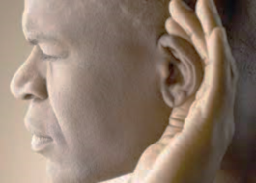
Having ears to hear
“He who has an ear, let him hear what the Spirit says to the churches.” Revelation 2:7

Slide 2
“Be fruitful and multiply and fill the earth and subdue it, and have dominion over the fish of the sea and over the birds of the heavens and over every living thing that moves on the earth.” Genesis 1:28
In essence, Wallnau sees Revelation 11:15 – “The kingdom of the world has become the kingdom of our Lord and of his Christ, and he shall reign forever and ever” - as an outcome the Church is commanded to bring to pass before Christ returns.

Slide 3
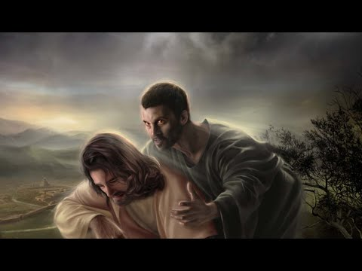
Revelation 2:18-29
“My kingdom is not of this world. If my kingdom were of this world, my servants would have been fighting, that I might not be delivered over to the Jews.” John 18:36
Beware of False Teaching
Part 2

Slide 4
I. The Son of God is the perfect and mighty judge of all (verse 18)
18 “And to the angel of the church in Thyatira write: ‘The words of the Son of God, who has eyes like a flame of fire, and whose feet are like burnished bronze.”
His feet…like burnished bronze indicates that He is ready and able to act in judgment in ways, as Psalm 2:12 indicates, where “his wrath is quickly kindled.”

Slide 5
II. he Lord gave the highest of commendations to the faithful in Thyatira (verse 19)
19 “‘I know your works, your love and faith and service and patient endurance, and that your latter works exceed the first.’

Slide 6
III. The Lord gave fearsome warnings to the immoral in Thyatira (verses 20-23)
To the unrepentant (20-23)
20 But I have this against you, that you tolerate that woman Jezebel, who calls herself a prophetess and is teaching and seducing my servants to practice sexual immorality and to eat food sacrificed to idols. 21 I gave her time to repent, but she refuses to repent of her sexual immorality. 22 Behold, I will throw her onto a sickbed, and those who commit adultery with her I will throw into great tribulation, unless they repent of her works, 23 and I will strike her children dead. And all the churches will know that I am he who searches mind and heart, and I will give to each of you according to your works.

Slide 7
III. The Lord gave fearsome warnings to the immoral in Thyatira (verses 20-23)
To the unrepentant (20-23)
20 But I have this against you, that you tolerate that woman Jezebel, who calls herself a prophetess and is teaching and seducing my servants to practice sexual immorality and to eat food sacrificed to idols. 21 I gave her time to repent, but she refuses to repent of her sexual immorality. 22 Behold, I will throw her onto a sickbed, and those who commit adultery with her I will throw into great tribulation, unless they repent of her works, 23 and I will strike her children dead. And all the churches will know that I am he who searches mind and heart, and I will give to each of you according to your works.

Slide 8
III. The Lord gave fearsome warnings to the immoral in Thyatira (verses 20-23)
To the unrepentant (20-23)
This is reminiscent of the Lord striking Ananias and Sapphira dead in Acts 5 for lying to the Holy Spirit; an action with a testimony Luke describes this way in Acts 5:11. “And great fear came upon the whole church and upon all who heard of these things.” When a church is unrepentant in matters that dishonor Christ and lead His flock astray, Jesus is both willing and able to take extreme measures to preserve His name and protect the holiness of His people.

Slide 9
III. The Lord gave fearsome warnings to the immoral in Thyatira (verses 20-23)
To those with time yet to repent (20 & 22)
20 But I have this against you, that you tolerate that woman Jezebel, who calls herself a prophetess and is teaching and seducing my servants to practice sexual immorality and to eat food sacrificed to idols. 21 I gave her time to repent, but she refuses to repent of her sexual immorality. 22 Behold, I will throw her onto a sickbed, and those who commit adultery with her I will throw into great tribulation, unless they repent of her works, 23 and I will strike her children dead. And all the churches will know that I am he who searches mind and heart, and I will give to each of you according to your works.

Slide 10
IV. The Lord commands the faithful to hold fast (verses 24-25)
24 But to the rest of you in Thyatira, who do not hold this teaching, who have not learned what some call the deep things of Satan, to you I say, I do not lay on you any other burden. 25 Only hold fast what you have until I come.

Slide 11
V. The Lord promises the faithful the authority to rule with Him in His kingdom when He returns (verses 26-29)
The surest sign that the church’s mission can’t be to transform the culture of this world in “the present evil age” (Galatians 1:4) is that Jesus will have rebellious kingdoms to deal with when He returns. Psalm 2:9-12 describes this relationship between the King of kings and the kings of the earth at that time. “You shall break them with a rod of iron and dash them in pieces like a potter’s vessel. Now therefore, O kings, be wise; be warned, O rulers of the earth. Serve the Lord with fear, and rejoice with trembling. Kiss the Son, lest he be angry, and you perish in the way, for his wrath is quickly kindled.”

Slide 12
V. The Lord promises the faithful the authority to rule with Him in His kingdom when He returns (verses 26-29)
26 The one who conquers and who keeps my works until the end,* to him I will give authority over the nations, 27 and he will rule them with a rod of iron, as when earthen pots are broken in pieces, even as I myself have received authority from my Father.
28 And I will give him the morning star.
* 25 … hold fast what you have until I come

Slide 13
VI. Beware of false teachers
“But they went out, that it might become plain that they all are not of us.” 1 John 2:19

Slide 14
VI. Beware of false teaching
False teaching is based on God’s word
“There are some things in them that are hard to understand, which the ignorant and unstable twist to their own destruction, as they do the other Scriptures.” 2 Peter 3:16
“What shall we say then? Are we to continue in sin that grace may abound?” Romans 6:1

Slide 15
VI. Beware of false teaching
False teaching is based on God’s word
Using Paul’s teaching in 1 Corinthians 9:22 where he writes “I have become all things to all people, that by all means I might save some,” this church’s ministry philosophy was “to get as close as possible to sin.”

Slide 16
VI. Beware of false teaching
Beware of teaching based on “deep things”
Someone may say to you, “Let’s ask the mediums and those who consult the spirits of the dead. With their whisperings and mutterings, they will tell us what to do.” But shouldn’t people ask God for guidance? Should the living seek guidance from the dead? Look to God’s instructions and teachings! People who contradict his word are completely in the dark. Isaiah 8:19-20, NLT

Slide 17
VI. Beware of false teaching
Don’t claim authority Christ hasn’t given you
Let every person be subject to the governing authorities. For there is no authority except from God, and those that exist have been instituted by God. Romans 13:1
“Although changing our society by calling it back to a safer morality is a noble goal, that has never been Christ's goal for His church.” John MacArthur

