Slide 1
Insist On These Things
Titus 3:1-8

Slide 2
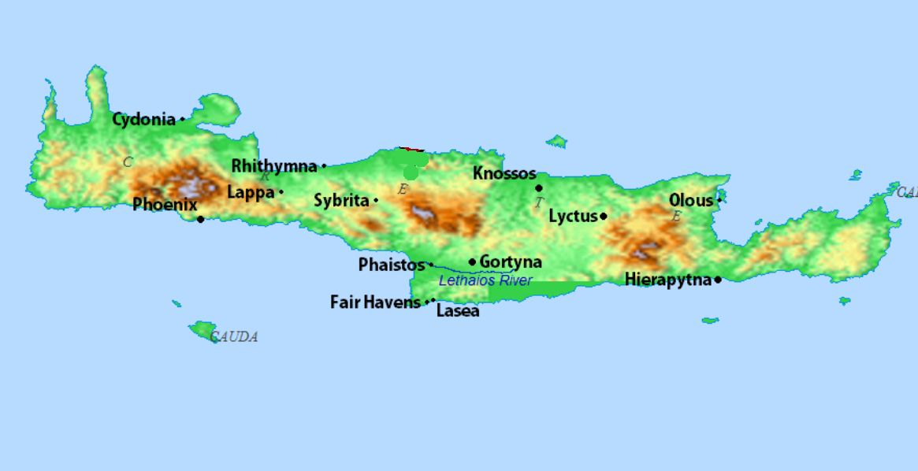

Slide 3
Titus 2:9-15
• Be submissive (2:9-10)
• God’s grace appeared bringing salvation (11)
• Training us to renounce ungodliness (12)
Live godly lives in the present age (12)
• Waiting for our hope of Christ’s return (13)
• Who purified us to be zealous for good works (14)
• Declare these things, let no one disregard you (15)

Slide 4
Titus 3:1-8
• Remind them to be submissive (3:1)
• The goodness and kindness of God appeared • Bringing salvation (3:4)
• By regeneration and renewal (3:5)
• So we might have hope of eternal life (3:7)
• Be careful to devote yourselves to good works (3:8)
• Insist on these things (3:8)

Slide 5
Insist On These Things
“Declare these things; exhort and rebuke with all authority. Let no one disregard you.”
(Titus 2:15 ESV)
“The saying is trustworthy, and I want you to insist on these things, so that those who have believed in God may be careful to devote themselves to good works. These things are excellent and profitable for people.” (Titus 3:8 ESV)

Slide 6
“But when the goodness and loving kindness
of God our Savior appeared, He saved us,
not because of works done by us in righteousness,
but according to his own mercy,
by the washing of regeneration
and renewal of the Holy Spirit,
Whom he poured out on us richly
through Jesus Christ our Savior,
so that being justified by his grace
we might become heirs according to
the hope of eternal life.” Titus 3:4–7 ESV)

Slide 7
The Goodness of God Appeared
“But when the goodness and loving kindness of God our Savior appeared,” (Titus 3:4 ESV)

Slide 8
The Goodness of God Appeared
“But when the goodness and loving kindness of God our Savior appeared,” (Titus 3:4 ESV)
“Oh, how abundant is your goodness, which you have stored up for those who fear you and worked for those who take refuge in you, in the sight of the children of mankind!” (Psa. 31:19 ESV)

Slide 9
The Goodness of God Appeared
“Do you suppose, O man—you who judge those who practice such things and yet do them yourself—that you will escape the judgment of God? Or do you presume on the riches of his kindness and forbearance and patience, not knowing that God’s kindness is meant to lead you to repentance?” (Rom. 2:3–4 ESV)

Slide 10
The Goodness of God Appeared
“[But God…] raised us up with him and seated us with him in the heavenly places in Christ Jesus, so that in the coming ages he might show the immeasurable riches of his grace in kindness toward us in Christ Jesus. For by grace you have been saved through faith. And this is not your own doing; it is the gift of God,” (Eph. 2:6–8 ESV)

Slide 11
The Goodness of God Appeared
“You have led in your steadfast love the people whom you have redeemed; you have guided them by your strength to your holy abode.” (Ex. 15:13 ESV)

Slide 12
Not because of anything we had done
“he saved us, not because of works done by us in righteousness, but according to his own mercy, by the washing of regeneration and renewal of the Holy Spirit,” (Titus 3:5 ESV)

Slide 13
He saved us
He “saved us and called us to a holy calling”.
(2 Timothy 1:9)
“The LORD is my strength and my song; he has
become my salvation” (Exodus 15:2)
“God so loved the world, that he gave his only Son …
in order that the world might be saved through
him”. (John 3:16, 17)
“The LORD preserves the simple; when I was brought
low, he saved me.” (Psalm 116:6 ESV)

Slide 14
Not because of anything we had done
“God, who saved us and called us to a holy calling, not because of our works but because of his own purpose and grace, which he gave us in Christ Jesus before the ages began, and which now has been manifested through the appearing of our Savior Christ Jesus”
(2 Tim. 1:8–10a ESV)

Slide 15
God Saved us According to His Mercy
“he saved us, not because of works done by us in righteousness, but according to his own mercy, by the washing of regeneration and renewal of the Holy Spirit,” (Titus 3:5 ESV)

Slide 16
God Saved us According to His Mercy
“And you, child, will be called the prophet of the Most High; for you will go before the Lord to prepare his ways, to give knowledge of salvation to his people in the forgiveness of their sins, because of the tender mercy of our God, whereby the sunrise shall visit us from on high to give light to those who sit in darkness and in the shadow of death, to guide our feet into the way of peace.”” (Luke 1:76–79 ESV)

Slide 17
God Saved us by the Washing of Regeneration
“he saved us, not because of works done by us in righteousness, but according to his own mercy, by the washing of regeneration and renewal of the Holy Spirit,” (Titus 3:5 ESV)

Slide 18
God Saved us by the Washing of Regeneration
“I will sprinkle clean water on you, and you shall be clean from all your uncleannesses, and from all your idols I will cleanse you. And I will give you a new heart, and a new spirit I will put within you. And I will remove the heart of stone from your flesh and give you a heart of flesh. And I will put my Spirit within you, and cause you to walk in my statutes and be careful to obey my rules.” (Ezek. 36:25–27 ESV)

Slide 19
God Saved us by the Renewal of the Holy Spirit
“he saved us, not because of works done by us in righteousness, but according to his own mercy, by the washing of regeneration and renewal of the Holy Spirit,” (Titus 3:5 ESV)

Slide 20
God Saved us by the Renewal of the Holy Spirit
“Do not be conformed to this world, but be transformed by the renewal of your mind, that by testing you may discern what is the will of God, what is good and acceptable and perfect.” (Rom. 12:2 ESV)

Slide 21
God poured out the Holy Spirit Richly
“The Holy Spirit, whom he poured out on us richly through Jesus Christ our Savior,” (Titus 3:5–6 ESV)

Slide 22
God poured out the Holy Spirit Richly
“For I will pour water on the thirsty land, and streams on the dry ground; I will pour my Spirit upon your offspring, and my blessing on your descendants. They shall spring up among the grass like willows by flowing streams.” (Is. 44:3–4 ESV)

Slide 23
God poured out the Holy Spirit Richly
““And it shall come to pass afterward, that I will pour out my Spirit on all flesh; your sons and your daughters shall prophesy, your old men shall dream dreams, and your young men shall see visions. Even on the male and female servants in those days I will pour out my Spirit.” (Joel 2:28–29 ESV)

Slide 24
Heirs According to Eternal Life
“so that being justified by his grace we might become heirs according to the hope of eternal life.” (Titus 3:7 ESV)

Slide 25
Heirs According to Eternal Life
““Father, the hour has come; glorify your Son that the Son may glorify you, since you have given him authority over all flesh, to give eternal life to all whom you have given him. And this is eternal life, that they know you, the only true God, and Jesus Christ whom you have sent.” (John 17:1–3 ESV)

Slide 26
Heirs According to Eternal Life
“Beloved, we are God’s children now, and what we will be has not yet appeared; but we know that when he appears we shall be like him, because we shall see him as he is.” (1 John 3:2 ESV)

Slide 27
“But when the goodness and loving kindness
of God our Savior appeared, He saved us,
not because of works done by us in righteousness,
but according to his own mercy,
by the washing of regeneration
and renewal of the Holy Spirit,
Whom he poured out on us richly
through Jesus Christ our Savior,
so that being justified by his grace
we might become heirs according to
the hope of eternal life.” Titus 3:4–7 ESV)

Slide 28
This Saying is Trustworthy
“The saying is trustworthy, and I want you to insist on these things, so that those who have believed in God may be careful to devote themselves to good works.” (Titus 3:8 ESV)

Slide 29
This Saying is Trustworthy
“must hold firm to the trustworthy word as taught, so that he may be able to give instruction in sound doctrine and also to rebuke those who contradict it.” (Titus 1:9 ESV)

Slide 30
This Saying is Trustworthy
“The saying is trustworthy and deserving of full acceptance, that Christ Jesus came into the world to save sinners, of whom I am the foremost.” (1 Tim. 1:15 ESV)

Slide 31
This Saying is Trustworthy
“Therefore I endure everything for the sake of the elect, that they also may obtain the salvation that is in Christ Jesus with eternal glory. The saying is trustworthy, for: If we have died with him, we will also live with him; if we endure, we will also reign with him; if we deny him, he also will deny us; if we are faithless, he remains faithful— for he cannot deny himself.” (2 Tim. 2:10–13 ESV)

Slide 32
What We Were (and others still are)
“For we ourselves were once foolish, disobedient, led astray, slaves to various passions and pleasures, passing our days in malice and envy, hated by others and hating one another.” (Titus 3:3 ESV)

Slide 33
We were Foolish, Disobedient
“To the pure, all things are pure, but to the defiled and unbelieving, nothing is pure; but both their minds and their consciences are defiled. They profess to know God, but they deny him by their works. They are detestable, disobedient, unfit for any good work.” (Titus 1:15–16 ESV)

Slide 34
We were Foolish, Disobedient
“But those who want to be rich fall into temptation, a trap, and many foolish and harmful desires, which plunge people into ruin and destruction. For the love of money is a root of all kinds of evil, and by craving it, some have wandered away from the faith and pierced themselves with many griefs.” (1 Tim. 6:9–10 CSB17)

Slide 35
We were Led Astray
“For we ourselves were once foolish, disobedient, led astray, slaves to various passions and pleasures, passing our days in malice and envy, hated by others and hating one another.” (Titus 3:3 ESV)

Slide 36
We were Led Astray
“The pride of your heart has deceived you, you who live in the clefts of the rock, in your lofty dwelling, who say in your heart, “Who will bring me down to the ground?”” (Obad. 1:3 ESV)
“For if anyone thinks he is something, when he is nothing, he deceives himself.” (Gal. 6:3 ESV)

Slide 37
What We Were (and others still are)
“For we ourselves were once foolish, disobedient, led astray, slaves to various passions and pleasures, passing our days in malice and envy, hated by others and hating one another.” (Titus 3:3 ESV)

Slide 38
What We Were (and others still are)
“For the wrath of God is revealed from heaven against all ungodliness and unrighteousness of men” (Rom. 1:18 ESV)
“They were filled with all manner of unrighteousness, evil, covetousness, malice. They are full of envy, murder, strife, deceit, maliciousness. They are gossips, slanderers, haters of God,” (Rom. 1:29–30 ESV)

Slide 39
What we Are To Be Because of the Gospel
“But when the goodness and loving kindness of God our Savior appeared, he saved us,” (Titus 3:4–5 ESV)

Slide 40
Be careful to devote yourself to good works
“so that those who have believed in God may be careful to devote themselves to good works.” (Titus 3:8 ESV)

Slide 41
Be careful to devote yourself to good works
“so that those who have believed in God may be careful to devote themselves to good works.” (Titus 3:8 ESV)
“For we are his workmanship, created in Christ Jesus for good works, which God prepared beforehand, that we should walk in them.” (Eph. 2:10 ESV)

Slide 42
Be submissive to rulers
“Remind them to be submissive to rulers and authorities, to be obedient, to be ready for every good work,” (Titus 3:1 ESV)

Slide 43
Be submissive to rulers
“Let every person be subject to the governing authorities. For there is no authority except from God, and those that exist have been instituted by God. Therefore whoever resists the authorities resists what God has appointed, and those who resist will incur judgment.” (Rom. 13:1–2 ESV)

Slide 44
Be submissive to rulers
“Therefore one must be in subjection, not only to avoid God’s wrath but also for the sake of conscience. For because of this you also pay taxes, for the authorities are ministers of God, attending to this very thing. Pay to all what is owed to them: taxes to whom taxes are owed, revenue to whom revenue is owed, respect to whom respect is owed, honor to whom honor is owed.” (Rom. 13:5–7 ESV)

Slide 45
Speak evil of no one
“to speak evil of no one, to avoid quarreling, to be gentle, and to show perfect courtesy toward all people.” (Titus 3:2 ESV)

Slide 46
“Let no corrupting talk come out of your mouths, but only such as is good for building up, as fits the occasion, that it may give grace to those who hear. And do not grieve the Holy Spirit of God, by whom you were sealed for the day of redemption. Let all bitterness and wrath and anger and clamor and slander be put away from you, along with all malice. Be kind to one another, tenderhearted, forgiving one another, as God in Christ forgave you.” (Eph. 4:29–32 ESV)

Slide 47
“Have nothing to do with foolish, ignorant controversies; you know that they breed quarrels. And the Lord’s servant must not be quarrelsome but kind to everyone, able to teach, patiently enduring evil, correcting his opponents with gentleness. God may perhaps grant them repentance leading to a knowledge of the truth, and they may come to their senses and escape from the snare of the devil, after being captured by him to do his will.”
(2 Tim. 2:23–26 ESV)

Slide 48
“Therefore, if anyone is in Christ, he is a new creation. The old has passed away; behold, the new has come.” (2 Cor. 5:17 ESV)
“But the fruit of the Spirit is love, joy, peace, patience, kindness, goodness, faithfulness, gentleness, self-control; against such things there is no law. And those who belong to Christ Jesus have crucified the flesh with its passions and desires.” (Gal. 5:22–24 ESV)

