Slide 1
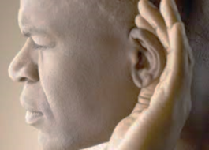
Having ears to hear
“He who has an ear, let him hear what the Spirit says to the churches.” Revelation 2:7

Slide 2
Revelation 2:1-7
Don’t let love fade

Slide 3
I. The Lord commended the church in Ephesus… (verses 1-3, 6)
…for their persistence in good works (2, 6)
1 “To the angel of the church in Ephesus write: ‘The words of him who holds the seven stars in his right hand, who walks among the seven golden lampstands. 2 “‘I know your works, your toil and your patient endurance, and how you cannot bear with those who are evil, but have tested those who call themselves apostles and are not, and found them to be false. 3 I know you are enduring patiently and bearing up for my name’s sake, and you have not grown weary…
6 Yet this you have: you hate the works of the Nicolaitans, which I also hate.

Slide 4
I. The Lord commended the church in Ephesus… (verses 1-3, 6)
…for their persistence in good works (2, 6)
1 “To the angel of the church in Ephesus write: ‘The words of him who holds the seven stars in his right hand, who walks among the seven golden lampstands. 2 “‘I know your works, your toil and your patient endurance, and how you cannot bear with those who are evil, but have tested those who call themselves apostles and are not, and found them to be false. 3 I know you are enduring patiently and bearing up for my name’s sake, and you have not grown weary…
6 Yet this you have: you hate the works of the Nicolaitans, which I also hate.

Slide 5
I. The Lord commended the church in Ephesus… (verses 1-3, 6)
…for their patient endurance under persecution (2-3)
2 “‘I know your works, your toil and your patient endurance*, and how you cannot bear with those who are evil, but have tested those who call themselves apostles and are not, and found them to be false. 3 I know you are enduring patiently* and bearing up for my name’s sake, and you have not grown weary…
* The capacity to hold out or bear up in the face of difficulty

Slide 6
I. The Lord commended the church in Ephesus… (verses 1-3, 6)
…for their patient endurance under persecution (2-3)
2 “‘I know your works, your toil and your patient endurance, and how you cannot bear with those who are evil, but have tested those who call themselves apostles and are not, and found them to be false. 3 I know you are enduring patiently and bearing up for my name’s sake, and you have not grown weary…
Patient Endurance/Enduring Patiently: Luke 21:12-19, Romans 5:2-5, 2 Corinthians 6:4-5, 2 Thessalonians 1:4, Hebrews 10:32-36 and 12:1-4, James 1:2-4, and Revelation 13:10

Slide 7
I. The Lord commended the church in Ephesus… (verses 1-3, 6)
…for their zeal for purity in doctrine and practice (1-3, 6)
2 “‘I know your works, your toil and your patient endurance, and how you cannot bear with those who are evil, but have tested those who call themselves apostles and are not, and found them to be false.
6 Yet this you have: you hate the works of the Nicolaitans, which I also hate.

Slide 8
I. The Lord commended the church in Ephesus… (verses 1-3, 6)
…for their zeal for purity in doctrine and practice (1-3, 6)
“I know that after my departure fierce wolves will come in among you, not sparing the flock; and from among your own selves will arise men speaking twisted things, to draw away the disciples after them.” Acts 20:29-30, ~ 35 years prior to Revelation being written
Ignatius of Antioch (109 A.D.) – Commended the church at Ephesus for refusing to give a “home” to any kind of heresy

Slide 9
II. The Lord rebuked the church in Ephesus for being unloving (verse 4)
4 But I have this against you, that you have abandoned the love you had at first.
4 But I have this complaint against you. You don’t love me or each other as you did at first! New Living Translation

Slide 10
II. The Lord rebuked the church in Ephesus for being unloving (verse 4)
Can you separate love for God and people?
“Just as I have loved you, you also are to love one another” (John 13:34) and “You shall love your neighbor as yourself” (Matthew 22:39).
What are the greatest commandments left for us to keep after Deuteronomy 6:5?
“If you love me, you will keep my commandments.” John 14:15
How do we show our love for God?
“You shall love the Lord your God with all your heart and with all your soul and with all your might.” Deuteronomy 6:5

Slide 11
II. The Lord rebuked the church in Ephesus for being unloving (verse 4)
4 But I have this against you, that you have abandoned the love you had at first.
4 But I have this complaint against you. You don’t love me or each other as you did at first! New Living Translation
We show our love for God, first and foremost, by obeying His commands to love everyone else!
If you truly love God, then you love people.

Slide 12
II. The Lord rebuked the church in Ephesus for being unloving (verse 4)
What would abandoning love for people look like?
Being impatient and unkind
Being rude
Being unwilling to put up with people who may be challenging to put up with
Rejoicing when someone stumbles or falls
Being irritable or resentful towards others
Insisting on your own way
Having a “me” attitude that thinks a lot about yourself and looks down on others
Wanting what others have

Slide 13
III. The Lord commanded the church in Ephesus to repent for being unloving (verse 5)
5 Remember therefore from where you have fallen; repent, and do the works you did at first. If not, I will come to you and remove your lampstand from its place, unless you repent.
In other words, “let love be the driving and all-consuming motivation behind the good works you do, to include the works Jesus has commended you for!”

Slide 14
III. The Lord commanded the church in Ephesus to repent for being unloving (verse 5)
5 Remember therefore from where you have fallen; repent, and do the works you did at first. If not, I will come to you and remove your lampstand from its place, unless you repent.
“Although Christ has promised to build his church worldwide (Matt. 16:18), he guarantees permanence to no individual congregation. A loveless church is no longer truly a church, and Christ has the right to extinguish such a congregation.” Kendall Easley, Holman NT Commentary

Slide 15
IV. The Lord promised eternal life to the church in Ephesus if they truly repented (verse 7)
7 He who has an ear, let him hear what the Spirit says to the churches. To the one who conquers I will grant to eat of the tree of life, which is in the paradise of God.’

Slide 16
IV. The Lord promised eternal life to the church in Ephesus if they truly repented (verse 7)
7 He who has an ear, let him hear what the Spirit says to the churches. To the one who conquers I will grant to eat of the tree of life, which is in the paradise of God.’

Slide 17
V. Don’t Let Love Fade
Do all your works as though you were working for the Lord
“Whatever you do, work heartily, as for the Lord and not for men.” Colossians 3:23
Destructive and unloving motivations in ministry
Competition
A spirit of judgment
Disdain towards others
Pride

Slide 18
V. Don’t Let Love Fade
Be forgiving in times of trouble
Peter failed miserably under pressure, yet mere hours before Peter failed, Jesus told Peter (Luke 22:32) “I have prayed for you that your faith may not fail. And when you have turned again, strengthen your brothers.”

Slide 19
V. Don’t Let Love Fade
Hate the sin; love the sinner
6 Yet this you have: you hate the works of the Nicolaitans, which I also hate.

Slide 20
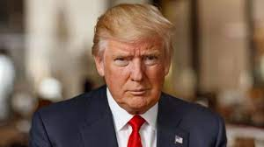
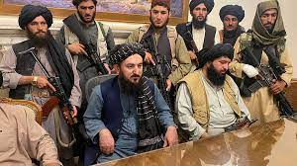
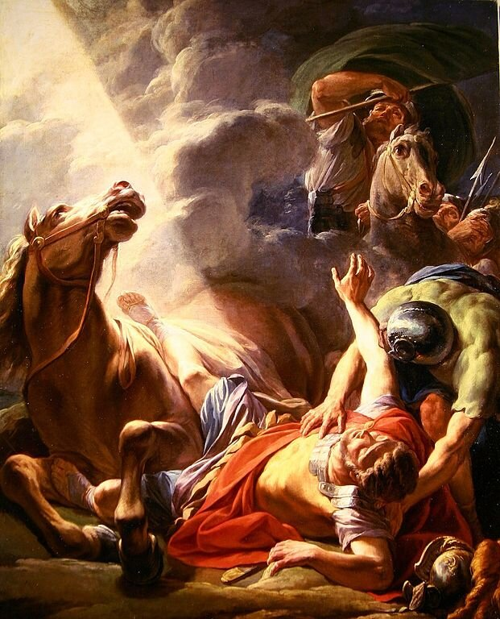
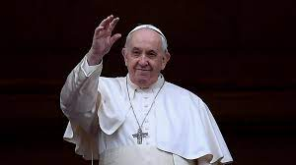
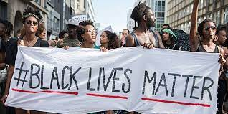
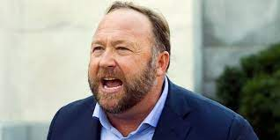
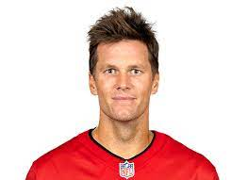
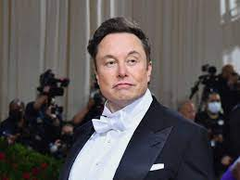
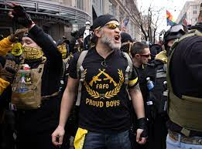
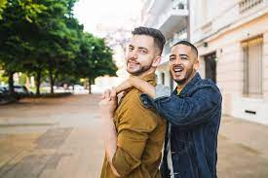
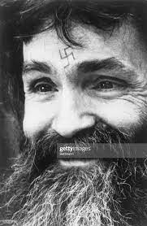
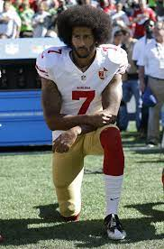
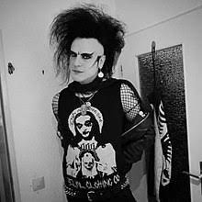
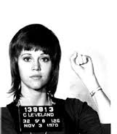
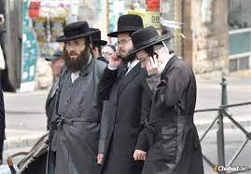
“…God so loved the world, that he gave his only Son, that whoever believes in him should not perish but have eternal life”

Slide 21
Don’t let love fade

