Slide 1
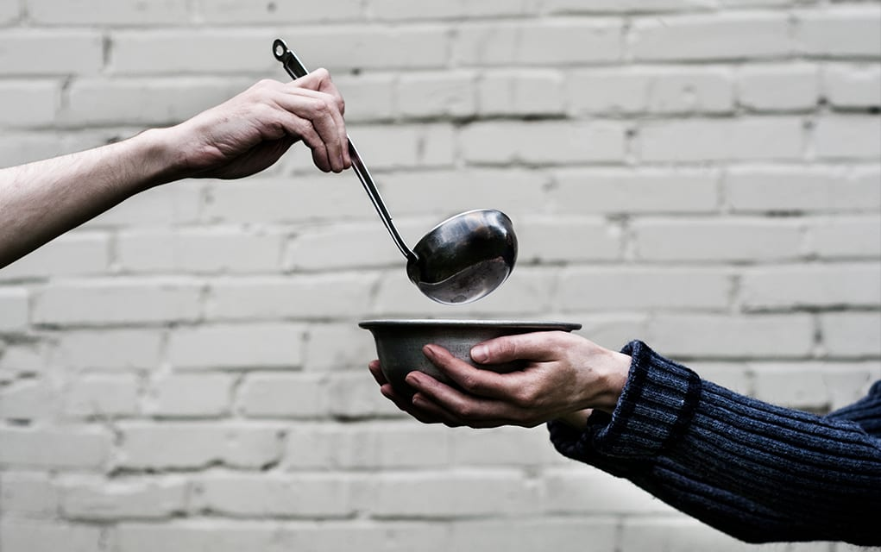
A living Faith
“So also faith by itself, if it does not have works, is dead.” James 2:17

Slide 2
Be patient, therefore, brothers, until the coming of the Lord. James 5:7
“Then they will deliver you up to tribulation and put you to death, and you will be hated by all nations for my name’s sake.” Matthew 24:9

Slide 3
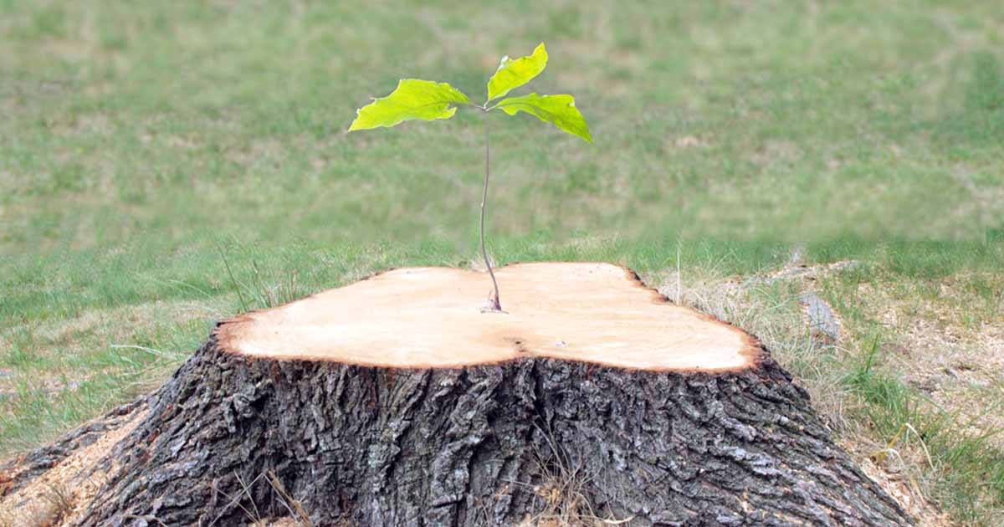
James 5:7-12
Endure to the end and be saved

Slide 4
I. Endure patiently through trials and the Lord will strengthen you (verses 7-8)
7 Be patient, therefore, brothers, until the coming of the Lord. See how the farmer waits for the precious fruit of the earth, being patient about it, until it receives the early and the late rains.

Slide 5
I. Endure patiently through trials and the Lord will strengthen you (verses 7-8)
7 Be patient, therefore, brothers, until the coming of the Lord. See how the farmer waits for the precious fruit of the earth, being patient about it, until it receives the early and the late rains.
“But if when you do good and suffer for it you endure, this is a gracious thing in the sight of God. For to this you have been called, because Christ also suffered for you, leaving you an example, so that you might follow in his steps. He committed no sin, neither was deceit found in his mouth. When he was reviled, he did not revile in return; when he suffered, he did not threaten, but continued entrusting himself to him who judges justly.” 1 Peter 2:20-23

Slide 6
I. Endure patiently through trials and the Lord will strengthen you (verses 7-8)
7 Be patient, therefore, brothers, until the coming of the Lord. See how the farmer waits for the precious fruit of the earth, being patient about it, until it receives the early and the late rains.
8 You also, be patient. Establish your hearts, for the coming of the Lord is at hand.

Slide 7
II. Renounce pitfalls of faithlessness in trials which bring judgment (verses 9 & 12)
Don’t grumble against one another (9)
9 Do not grumble against one another, brothers, so that you may not be judged; behold, the Judge is standing at the door.
“What causes quarrels and what causes fights among you?” James 4:1

Slide 8
II. Renounce pitfalls of faithlessness in trials which bring judgment (verses 9 & 12)
If your word is true, then it doesn’t need any further help (12)
12 But above all, my brothers, do not swear, either by heaven or by earth or by any other oath, but let your “yes” be yes and your “no” be no, so that you may not fall under condemnation.
“But if when you do good and suffer for it you endure, this is a gracious thing in the sight of God.” 1 Peter 2:20
“When he was reviled, he did not revile in return; when he suffered, he did not threaten, but continued entrusting himself to him who judges justly.” 1 Peter 2:23

Slide 9
II. Renounce pitfalls of faithlessness in trials which bring judgment (verses 9 & 12)
If your word is true, then it doesn’t need any further help (12)
12 But above all, my brothers, do not swear, either by heaven or by earth or by any other oath, but let your “yes” be yes and your “no” be no, so that you may not fall under condemnation.
“Christians who face suffering can be easily tempted to make a frivolous appeal to God’s name to bargain their way out of trouble or difficulty.” Thomas Lea, Holman New Testament Commentary

Slide 10
III. Endure your trials to the end and be saved (verses 10-11)
“…we rejoice in our sufferings, knowing that suffering produces endurance, and endurance produces character, and character produces hope.” Romans 5:3-4

Slide 11
III. Endure your trials to the end and be saved (verses 10-11)
Endure your trials faithfully (10-11a)
10 As an example of suffering and patience, brothers, take the prophets who spoke in the name of the Lord. 11 Behold, we consider those blessed who remained steadfast*.
“O king, live forever! My God sent his angel and shut the lions’ mouths, and they have not harmed me, because I was found blameless before him; and also before you, O king, I have done no harm.” Daniel 6:21-22
* To maintain a belief or course of action in the face of opposition.

Slide 12
III. Endure your trials to the end and be saved (verses 10-11)
Endure your trials faithfully (10-11a)
10 As an example of suffering and patience, brothers, take the prophets who spoke in the name of the Lord. 11 Behold, we consider those blessed who remained steadfast.
When Jesus was betrayed into the hands of the Jewish authorities in Gethsemane, Peter responded by drawing his sword and cutting off the ear of the high priest’s servant (Matthew 26:51) which drew, not a blessing, but a rebuke from Jesus who told Peter (26:52) “Put your sword back into its place. For all who take the sword will perish by the sword.”

Slide 13
III. Endure your trials to the end and be saved (verses 10-11)
Receive the Lord’s blessing for patient endurance (11b)
“Then Job arose and tore his robe and shaved his head and fell on the ground and worshiped. And he said, ‘Naked I came from my mother’s womb, and naked shall I return. The Lord gave, and the Lord has taken away; blessed be the name of the Lord.’ In all this Job did not sin or charge God with wrong.” Job 1:20-22

Slide 14
III. Endure your trials to the end and be saved (verses 10-11)
Receive the Lord’s blessing for patient endurance (11b)
11 You have heard of the steadfastness of Job and you have seen the purpose of the Lord, how the Lord is compassionate and merciful.
“And the Lord restored the fortunes of Job…And the Lord gave Job twice as much as he had before” (Job 42:10). Furthermore, “He had also seven sons and three daughters” (Job 42:13).

Slide 15
III. Endure your trials to the end and be saved (verses 10-11)
Receive the Lord’s blessing for patient endurance (11b)
“Because you have kept my word about patient endurance, I will keep you from the hour of trial that is coming on the whole world, to try those who dwell on the earth. I am coming soon. Hold fast what you have, so that no one may seize your crown.” Revelation 3:10-11

