Slide 1
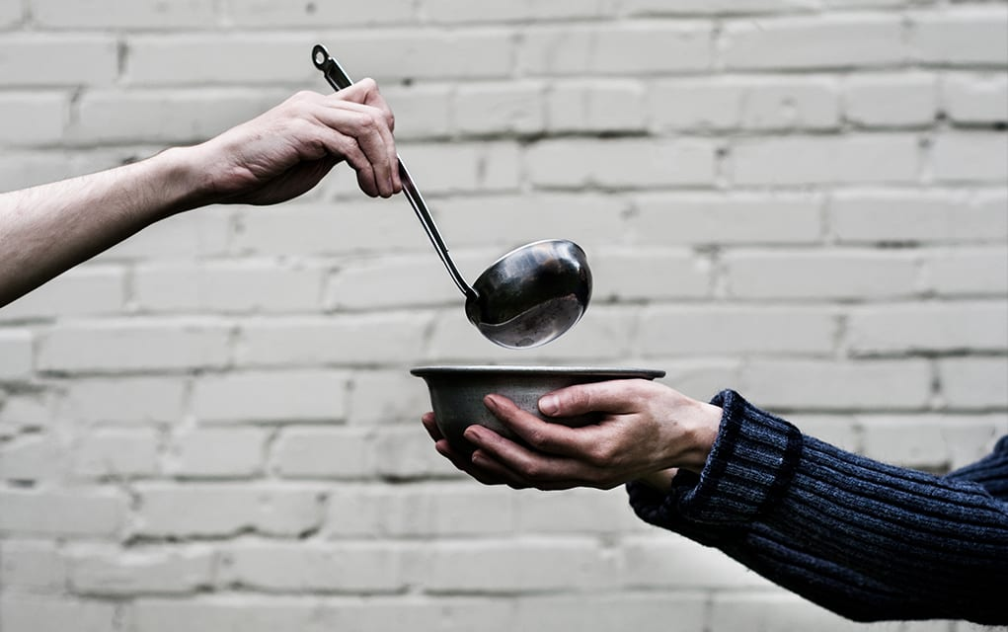
A living Faith
“So also faith by itself, if it does not have works, is dead.” James 2:17

Slide 2
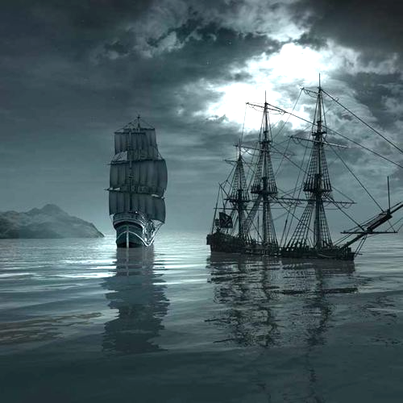
James 3:1-12
Seek God’s grace to speak God’s Grace
“Some have made shipwreck of their faith, among whom are Hymenaeus and Alexander.” 1 Timothy 1:19-20

Slide 3
I. Controlling our tongues is a sobering and challenging responsibility (verses 1-2)
1 Not many of you should become teachers, my brothers, for you know that we who teach will be judged with greater strictness. 2 For we all stumble in many ways. And if anyone does not stumble in what he says, he is a perfect man, able also to bridle his whole body.

Slide 4
I. Controlling our tongues is a sobering and challenging responsibility (verses 1-2)
1 Not many of you should become teachers, my brothers, for you know that we who teach will be judged with greater strictness. 2 For we all stumble in many ways. And if anyone does not stumble in what he says, he is a perfect man, able also to bridle his whole body.
A spiritually immature person can have the gift of teaching, but a person in the church should only seek to teach if they possess both the gift and the maturity to do so: one who, as Paul tells Timothy, can stand before “God as one approved, a worker who has no need to be ashamed, rightly handling the word of truth.” (2 Timothy 2:15)

Slide 5
II. Our tongues are a direct conduit of supernatural influences (verses 3-8)
Our tongues can be powerful conduits of God’s grace (3-5a)
3 If we put bits into the mouths of horses so that they obey us, we guide their whole bodies as well. 4 Look at the ships also: though they are so large and are driven by strong winds, they are guided by a very small rudder wherever the will of the pilot directs. 5 So also the tongue is a small member, yet it boasts of great things…

Slide 6
II. Our tongues are a direct conduit of supernatural influences (verses 3-8)
Our tongues can be powerful conduits of God’s grace (3-5a)
3 If we put bits into the mouths of horses so that they obey us, we guide their whole bodies as well. 4 Look at the ships also: though they are so large and are driven by strong winds, they are guided by a very small rudder wherever the will of the pilot directs. 5 So also the tongue is a small member, yet it boasts of great things…

Slide 7
II. Our tongues are a direct conduit of supernatural influences (verses 3-8)
Our tongues can be powerful conduits of God’s grace (3-5a)
3 If we put bits into the mouths of horses so that they obey us, we guide their whole bodies as well. 4 Look at the ships also: though they are so large and are driven by strong winds, they are guided by a very small rudder wherever the will of the pilot directs. 5 So also the tongue is a small member, yet it boasts of great things…

Slide 8
II. Our tongues are a direct conduit of supernatural influences (verses 3-8)
Our tongues can be powerful conduits of demonic influence (5b-8)
“You are of your father the devil, and your will is to do your father’s desires. He was a murderer from the beginning, and does not stand in the truth, because there is no truth in him. When he lies, he speaks out of his own character, for he is a liar and the father of lies.” John 8:44
“Your adversary the devil prowls around like a roaring lion, seeking someone to devour.” 1 Peter 5:8

Slide 9
II. Our tongues are a direct conduit of supernatural influences (verses 3-8)
Our tongues can be powerful conduits of demonic influence (5b-8)
5 …How great a forest is set ablaze by such a small fire! 6 And the tongue is a fire, a world of unrighteousness. The tongue is set among our members, staining the whole body, setting on fire the entire course of life, and set on fire by hell. 7 For every kind of beast and bird, of reptile and sea creature, can be tamed and has been tamed by mankind, 8 but no human being can tame the tongue. It is a restless evil, full of deadly poison.

Slide 10
II. Our tongues are a direct conduit of supernatural influences (verses 3-8)
Our tongues can be powerful conduits of demonic influence (5b-8)
5 …How great a forest is set ablaze by such a small fire! 6 And the tongue is a fire, a world of unrighteousness. The tongue is set among our members, staining the whole body, setting on fire the entire course of life, and set on fire by hell. 7 For every kind of beast and bird, of reptile and sea creature, can be tamed and has been tamed by mankind, 8 but no human being can tame the tongue. It is a restless evil, full of deadly poison.

Slide 11
II. Our tongues are a direct conduit of supernatural influences (verses 3-8)
Our tongues can be powerful conduits of demonic influence (5b-8)
5 …How great a forest is set ablaze by such a small fire! 6 And the tongue is a fire, a world of unrighteousness. The tongue is set among our members, staining the whole body, setting on fire the entire course of life, and set on fire by hell. 7 For every kind of beast and bird, of reptile and sea creature, can be tamed and has been tamed by mankind, 8 but no human being can tame the tongue. It is a restless evil, full of deadly poison.

Slide 12
III. Seek God’s grace to speak God’s grace (verses 9-12)
Recognize the destructive nature of our tongue (9-10)
9 With it we bless our Lord and Father, and with it we curse people who are made in the likeness of God. 10 From the same mouth come blessing and cursing. My brothers, these things ought not to be so.
8 …the tongue…is a restless evil.
The person whose faith is riddled with doubt is “…a double-minded man, unstable in all his ways.” James 1:8

Slide 13
III. Seek God’s grace to speak God’s grace (verses 9-12)
Recognize the destructive nature of our tongue (9-10)
9 With it we bless our Lord and Father, and with it we curse people who are made in the likeness of God. 10 From the same mouth come blessing and cursing. My brothers, these things ought not to be so.
8 …the tongue…is a restless evil.
The person whose faith is riddled with doubt is “…a double-minded man, unstable in all his ways.” James 1:8

Slide 14
III. Seek God’s grace to speak God’s grace (verses 9-12)
Recognize the destructive nature of our tongue (9-10)
9 With it we bless our Lord and Father, and with it we curse people who are made in the likeness of God. 10 From the same mouth come blessing and cursing. My brothers, these things ought not to be so.
“But I say to you who hear, Love your enemies, do good to those who hate you, bless those who curse you, pray for those who abuse you.” Luke 6:27-28

Slide 15
III. Seek God’s grace to speak God’s grace (verses 9-12)
Seek God’s grace to transform the nature of our tongue (11-12)
“…let every person be quick to hear, slow to speak.” James 1:19
“I have noticed that nothing I never said ever did me any harm.” Former President Calvin Coolidge
“The heart of the righteous ponders how to answer, but the mouth of the wicked pours out evil things.” Proverbs 15:28

Slide 16
III. Seek God’s grace to speak God’s grace (verses 9-12)
Seek God’s grace to transform the nature of our tongue (11-12)
11 Does a spring pour forth from the same opening both fresh and salt water? 12 Can a fig tree, my brothers, bear olives, or a grapevine produce figs? Neither can a salt pond yield fresh water.

Slide 17
Matthew 7:15-20
“Beware of false prophets, who come to you in sheep’s clothing but inwardly are ravenous wolves. You will recognize them by their fruits. Are grapes gathered from thornbushes, or figs from thistles? So, every healthy tree bears good fruit, but the diseased tree bears bad fruit. A healthy tree cannot bear bad fruit, nor can a diseased tree bear good fruit. Every tree that does not bear good fruit is cut down and thrown into the fire. Thus you will recognize them by their fruits.”

Slide 18
III. Seek God’s grace to speak God’s grace (verses 9-12)
Seek God’s grace to transform the nature of our tongue (11-12)
“A healthy tree cannot bear bad fruit.” Matthew 7:18
10 From the same mouth come blessing and cursing.
8 …no human being can tame the tongue.
2 If anyone does not stumble in what he says, he is mature. CSB

Slide 19
Matthew 7:15-20
“Beware of false prophets, who come to you in sheep’s clothing but inwardly are ravenous wolves. You will recognize them by their fruits. Are grapes gathered from thornbushes, or figs from thistles? So, every healthy tree bears good fruit, but the diseased tree bears bad fruit. A healthy tree cannot bear bad fruit, nor can a diseased tree bear good fruit. Every tree that does not bear good fruit is cut down and thrown into the fire. Thus you will recognize them by their fruits.”

