Slide 1
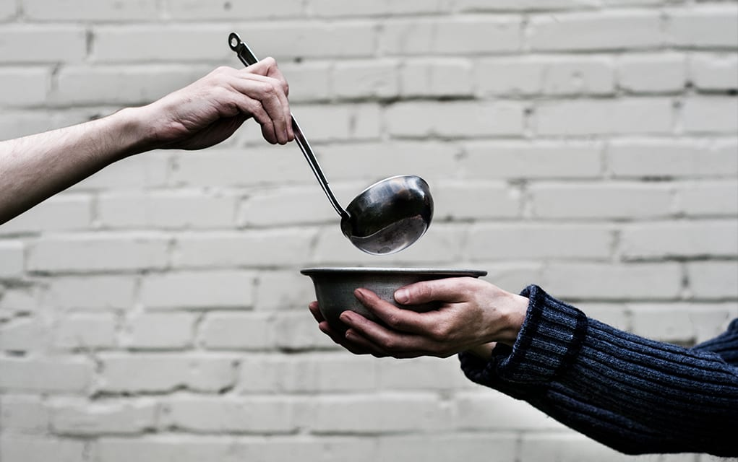
A living Faith
“So also faith by itself, if it does not have works, is dead.” James 2:17

Slide 2
“What comes into our minds when we think about God is the most important thing about us.”
A.W. Tozer
What do you think about God when your character is tested by trials or is being subject to temptation?

Slide 3
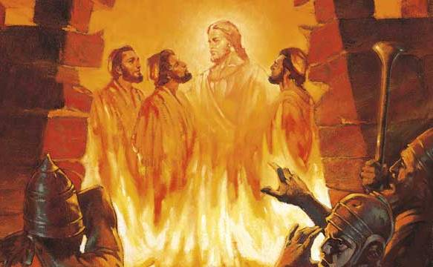
James 1:12-18
God’s aims are always good and true

Slide 4
I. God is the source and giver of life (verses 12-13)
12 Blessed is the man who remains steadfast under trial, for when he has stood the test he will receive the crown of life, which God has promised to those who love him.

Slide 5
I. God is the source and giver of life (verses 12-13)
12 Blessed is the man who remains steadfast under trial, for when he has stood the test he will receive the crown of life, which God has promised to those who love him.
“Do not fear what you are about to suffer. Behold, the devil is about to throw some of you into prison, that you may be tested, and for ten days you will have tribulation. Be faithful unto death, and I will give you the crown of life.” Revelation 2:10

Slide 6
I. God is the source and giver of life (verses 12-13)
13 Let no one say when he is tempted, “I am being tempted by God,” for God cannot be tempted with evil, and he himself tempts no one.

Slide 7
II. Every individual is the source of their own sin and death (verses 14-15)
14 But each person is tempted when he is lured* and enticed by his own desire. 15 Then desire when it has conceived gives birth to sin, and sin when it is fully grown brings forth death.
* to drag away, with the connotation of initial reluctance

Slide 8
II. Every individual is the source of their own sin and death (verses 14-15)
14 But each person is tempted when he is lured and enticed by his own desire. 15 Then desire when it has conceived gives birth to sin, and sin when it is fully grown brings forth death.

Slide 9
III. God’s aims are always good and true (verses 16-18)
Do not be deceived into believing otherwise (13 & 16)
16 Do not be deceived, my beloved brothers.
“Do not be deceived: God is not mocked, for whatever one sows, that will he also reap. For the one who sows to his own flesh will from the flesh reap corruption.” Galatians 6:7-8

Slide 10
III. God’s aims are always good and true (verses 16-18)
Do not be deceived into believing He has changed (17)
“You have heard that it was said, ‘You shall not commit adultery.’ But I say to you that everyone who looks at a woman with lustful intent has already committed adultery with her in his heart.” Matthew 5:27-28

Slide 11
III. God’s aims are always good and true (verses 16-18)
Do not be deceived into believing He has changed (17)
“The man said, ‘The woman whom you gave to be with me, she gave me fruit of the tree, and I ate.’” Genesis 3:8
15 “…and sin when it is fully grown brings forth death.”

Slide 12
III. God’s aims are always good and true (verses 16-18)
Do not be deceived into believing He has changed (17)
17 Every good gift and every perfect gift is from above, coming down from the Father of lights, with whom there is no variation or shadow due to change.

Slide 13
III. God’s aims are always good and true (verses 16-18)
Remember the life He has given you (18)
18 Of his own will he brought us forth by the word of truth, that we should be a kind of firstfruits of his creatures.
18 He chose to give us birth through the word of truth, that we might be a kind of firstfruits of all he created. NIV
“…to all who did receive him, who believed in his name, he gave the right to become children of God, who were born, not of blood nor of the will of the flesh nor of the will of man, but of God.” John 1:12-13

Slide 14
Children of God have a living faith that…
Tempers anger
Rejects wickedness
Cares in meaningful ways for the poor, the needy and the oppressed
Rejects partiality, quarrels and infighting in the family of God
Shows love to all
Controls the tongue
Seeks wisdom from God to live for Him well
Sets God’s will above our own plans
Approaches a life of riches with fear and trembling, knowing its dangers
Practices patience
Pursues peace
Endures suffering
Lives a life of integrity and repentance
Prays continually, trusting that by God’s grace, prayer has great power

