Slide 1
A living Faith
“So also faith by itself, if it does not have works, is dead.” James 2:17

Slide 2
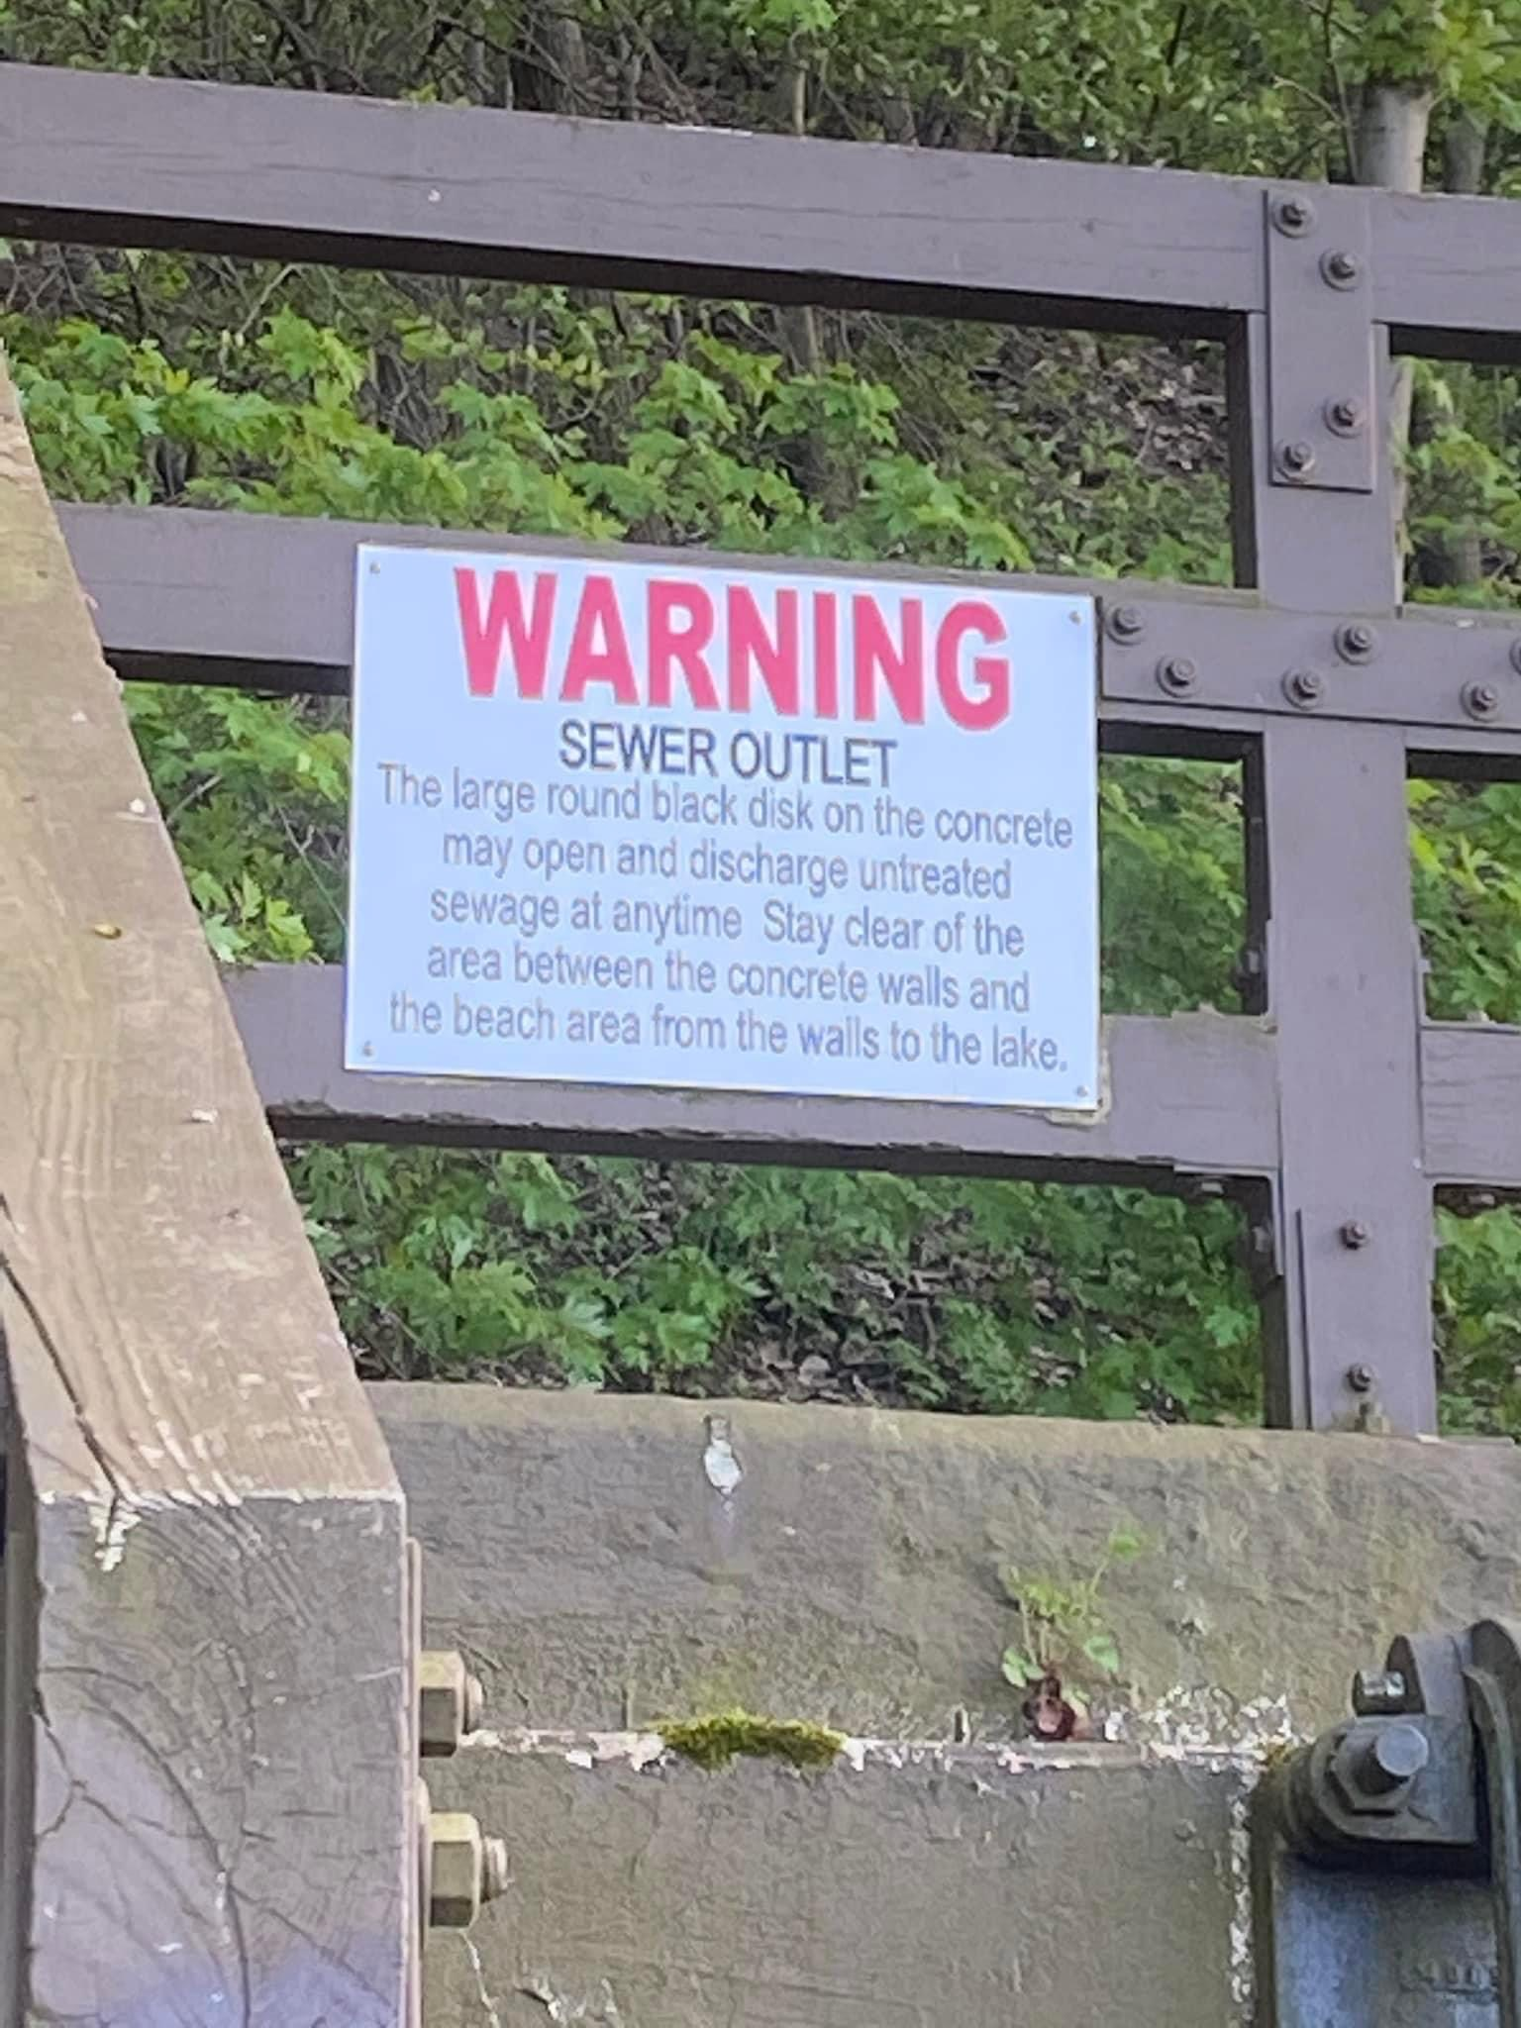

Slide 3
James 1:12-18
Be pure and undefiled before God the Father

Slide 4
I. The word of God must govern a Christian’s attitudes and speech (verses 19-21)
19 Know this, my beloved brothers: let every person be quick to hear, slow to speak, slow to anger; 20 for the anger of man does not produce the righteousness of God. 21 Therefore put away all filthiness and rampant wickedness and receive with meekness the implanted word, which is able to save your souls.
“Let no corrupting talk come out of your mouths, but only such as is good for building up, as fits the occasion, that it may give grace to those who hear.” Ephesians 4:29

Slide 5
I. The word of God must govern a Christian’s attitudes and speech (verses 19-21)
19 Know this, my beloved brothers: let every person be quick to hear, slow to speak, slow to anger; 20 for the anger of man does not produce the righteousness of God. 21 Therefore put away all filthiness and rampant wickedness and receive with meekness the implanted word, which is able to save your souls.
“Be angry and do not sin; do not let the sun go down on your anger.” Ephesians 4:26

Slide 6
I. The word of God must govern a Christian’s attitudes and speech (verses 19-21)
19 Know this, my beloved brothers: let every person be quick to hear, slow to speak, slow to anger; 20 for the anger of man does not produce the righteousness of God. 21 Therefore put away all filthiness and rampant wickedness and receive with meekness the implanted word, which is able to save your souls.
“For the word of God is living and active, sharper than any two-edged sword, piercing to the division of soul and of spirit, of joints and of marrow, and discerning the thoughts and intentions of the heart.” Hebrews 4:12

Slide 7
I. The word of God must govern a Christian’s attitudes and speech (verses 19-21)
19 Know this, my beloved brothers: let every person be quick to hear, slow to speak, slow to anger; 20 for the anger of man does not produce the righteousness of God. 21 Therefore put away all filthiness and rampant wickedness and receive with meekness the implanted word, which is able to save your souls.
“All Scripture is breathed out by God and profitable for teaching, for reproof, for correction, and for training in righteousness, that the man of God may be complete, equipped for every good work.” 2 Timothy 3:16-17

Slide 8
II. The word of God must govern a Christian’s actions (verses 22-25)
Christians delude themselves when they fail to be doers of the word (22-24)
22 But be doers of the word, and not hearers only, deceiving yourselves. 23 For if anyone is a hearer of the word and not a doer, he is like a man who looks intently at his natural face in a mirror. 24 For he looks at himself and goes away and at once forgets what he was like.

Slide 9
II. The word of God must govern a Christian’s actions (verses 22-25)
Christians delude themselves when they fail to be doers of the word (22-24)
22 But be doers of the word, and not hearers only, deceiving yourselves. 23 For if anyone is a hearer of the word and not a doer, he is like a man who looks intently at his natural face in a mirror. 24 For he looks at himself and goes away and at once forgets what he was like.

Slide 10
II. The word of God must govern a Christian’s actions (verses 22-25)
Christians are blessed when they are devoted doers of the word (25)
25 But the one who looks into the perfect law, the law of liberty, and perseveres, being no hearer who forgets but a doer who acts, he will be blessed in his doing.
A living faith is a faith in action that aligns with the truth of God’s word. It’s a faith that comes under the Father’s favor by way of “Every good gift and every perfect gift…from above” (1:17) in order to serve Him faithfully to His glory.

Slide 11
III. Be pure and undefiled before God the Father (verses 26-27)
26 If anyone thinks he is religious and does not bridle his tongue but deceives his heart, this person’s religion is worthless. 27 Religion that is pure and undefiled before God the Father is this: to visit orphans and widows in their affliction, and to keep oneself unstained from the world.

Slide 12
III. Be pure and undefiled before God the Father (verses 26-27)
26 If anyone thinks he is religious and does not bridle his tongue but deceives his heart, this person’s religion is worthless. 27 Religion that is pure and undefiled before God the Father is this: to visit* orphans and widows in their affliction, and to keep oneself unstained from the world.
“I was naked and you clothed me, I was sick and you visited me, I was in prison and you came to me.” Matthew 25:36
* To go to see a person with helpful intent

Slide 13
III. Be pure and undefiled before God the Father (verses 26-27)
26 If anyone thinks he is religious and does not bridle his tongue but deceives his heart, this person’s religion is worthless. 27 Religion that is pure and undefiled before God the Father is this: to visit orphans and widows in their affliction, and to keep oneself unstained from the world.
“Do you not know that your bodies are members of Christ?” 1 Corinthians 6:15

Slide 14
III. Be pure and undefiled before God the Father (verses 26-27)
26 If anyone thinks he is religious and does not bridle his tongue but deceives his heart, this person’s religion is worthless. 27 Religion that is pure and undefiled before God the Father is this: to visit orphans and widows in their affliction, and to keep oneself unstained from the world.
“Do you not know that your bodies are members of Christ? Shall I then take the members of Christ and make them members of a prostitute? Never!” 1 Corinthians 6:15

Slide 15
III. Be pure and undefiled before God the Father (verses 26-27)
26 If anyone thinks he is religious and does not bridle his tongue but deceives his heart, this person’s religion is worthless. 27 Religion that is pure and undefiled before God the Father is this: to visit orphans and widows in their affliction, and to keep oneself unstained from the world.
“Therefore, beloved, since you are waiting for these, be diligent to be found by him without spot or blemish, and at peace.” 2 Peter 3:14

