Slide 1
Midnight Proposal
By the Barley Heap

Slide 2
“Then Naomi her mother-in-law said to her, “My daughter, should I not seek rest for you, that it may be well with you?” (Ruth 3:1 ESV)

Slide 3
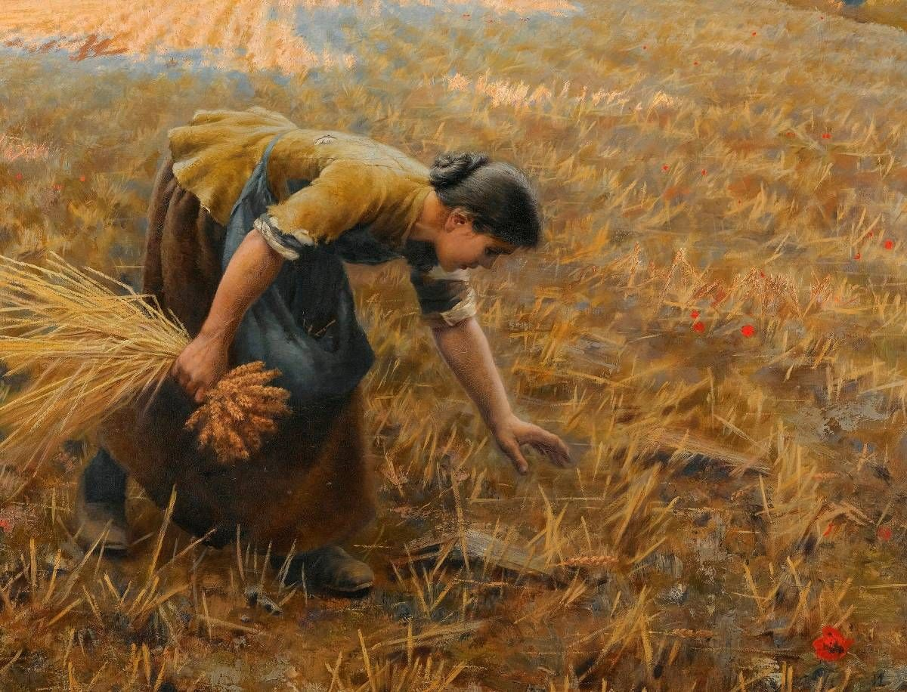
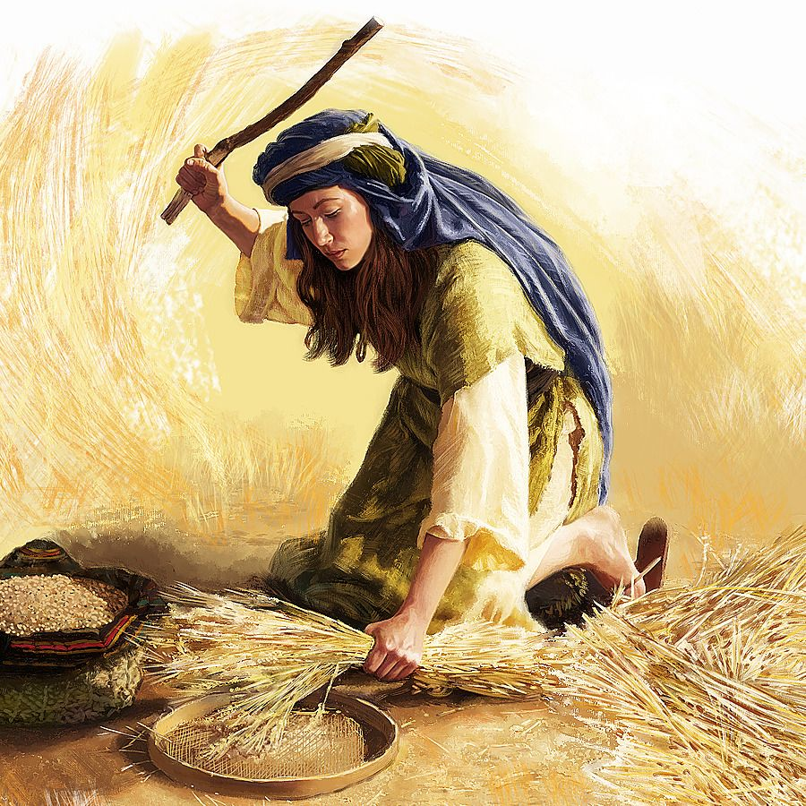
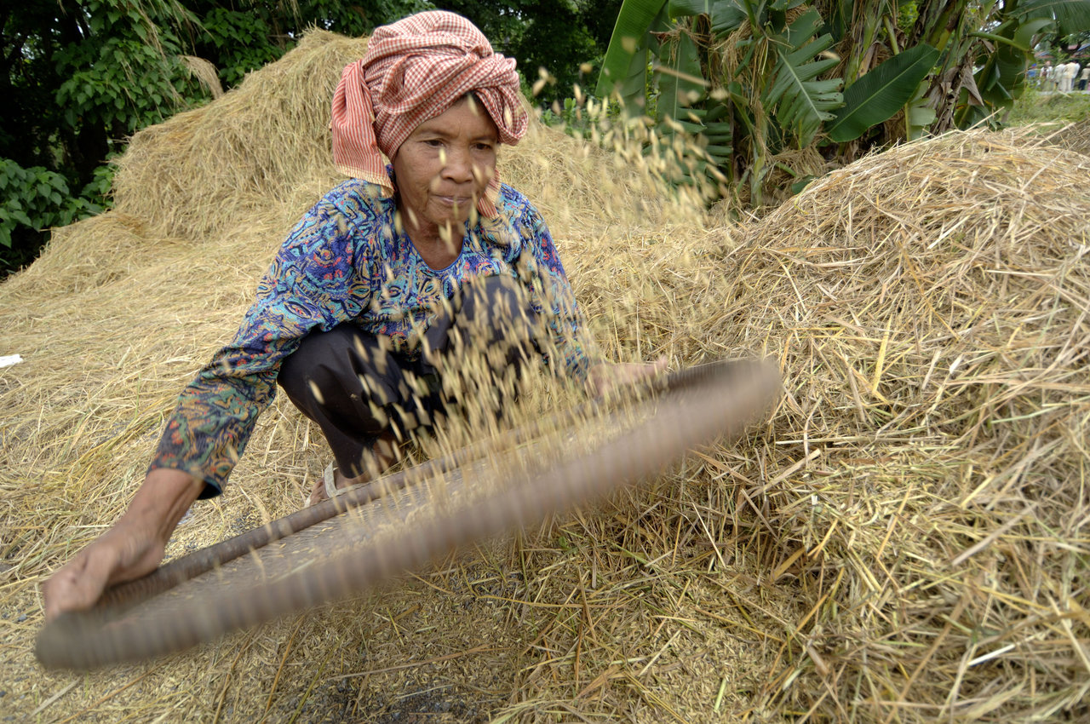
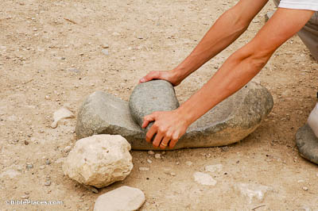

Slide 4
“Honor widows who are truly widows. But if a widow has children or grandchildren, let them first learn to show godliness to their own household and to make some return to their parents, for this is pleasing in the sight of God. She who is truly a widow, left all alone, has set her hope on God and continues in supplications and prayers night and day, but she who is self-indulgent is dead even while she lives. Command these things as well, so that they may be without reproach. But if anyone does not provide for his relatives, and especially for members of his household, he has denied the faith and is worse than an unbeliever.” (1 Timothy 5:3–8 ESV)

Slide 5
“Is not Boaz our relative, with whose young women you were? See, he is winnowing barley tonight at the threshing floor.” (Ruth 3:2 ESV)

Slide 6
“You shall observe the Feast of Weeks, the firstfruits of wheat harvest, and the Feast of Ingathering at the year’s end.” (Exodus 34:22 ESV)

Slide 7
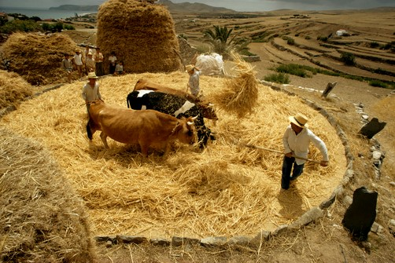
““You shall not muzzle an ox when it is treading out the grain.” (Deuteronomy 25:4 ESV)

Slide 9
“Wash therefore and anoint yourself, and put on your cloak and go down to the threshing floor, but do not make yourself known to the man until he has finished eating and drinking.” (Ruth 3:3 ESV)

Slide 10
“If ever you take your neighbor’s cloak in pledge, you shall return it to him before the sun goes down, for that is his only covering, and it is his cloak for his body; in what else shall he sleep? And if he cries to me, I will hear, for I am compassionate.” (Exodus 22:26–27 ESV)

Slide 11
“But when he lies down, observe the place where he lies. Then go and uncover his feet and lie down, and he will tell you what to do.” And she replied, “All that you say I will do.” So she went down to the threshing floor and did just as her mother-in-law had commanded her.” (Ruth 3:4–6 ESV)

Slide 12
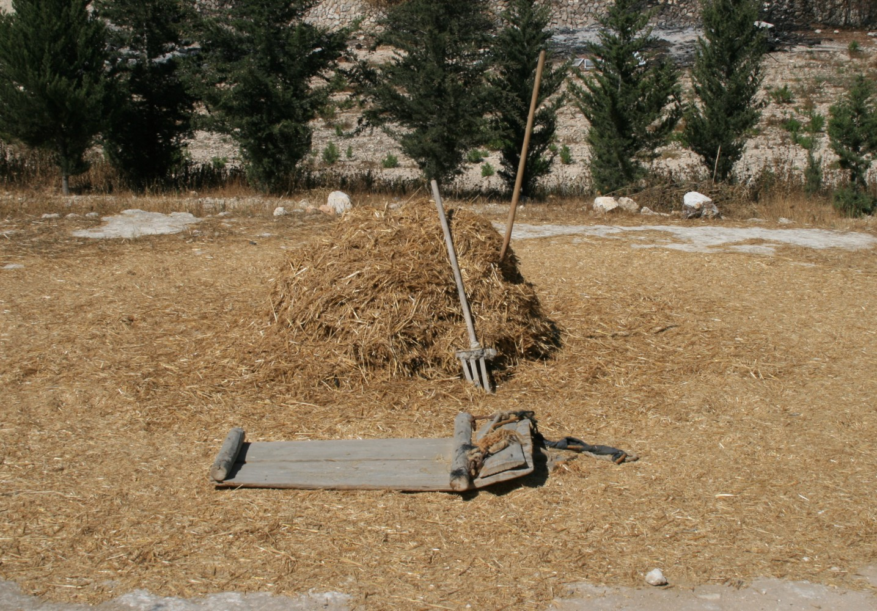
“And when Boaz had eaten and drunk, and his heart was merry, he went to lie down at the end of the heap of grain. Then she came softly and uncovered his feet and lay down.” (Ruth 3:7 ESV)

Slide 13
“My son, do not lose sight of these— keep sound wisdom and discretion, and they will be life for your soul and adornment for your neck. Then you will walk on your way securely, and your foot will not stumble. If you lie down, you will not be afraid; when you lie down, your sleep will be sweet.” (Proverbs 3:21–24 ESV)

Slide 14
“At midnight the man was startled and turned over, and behold, a woman lay at his feet! He said, “Who are you?” And she answered, “I am Ruth, your servant. Spread your wings over your servant, for you are a redeemer.”” (Ruth 3:8–9 ESV)

Slide 15
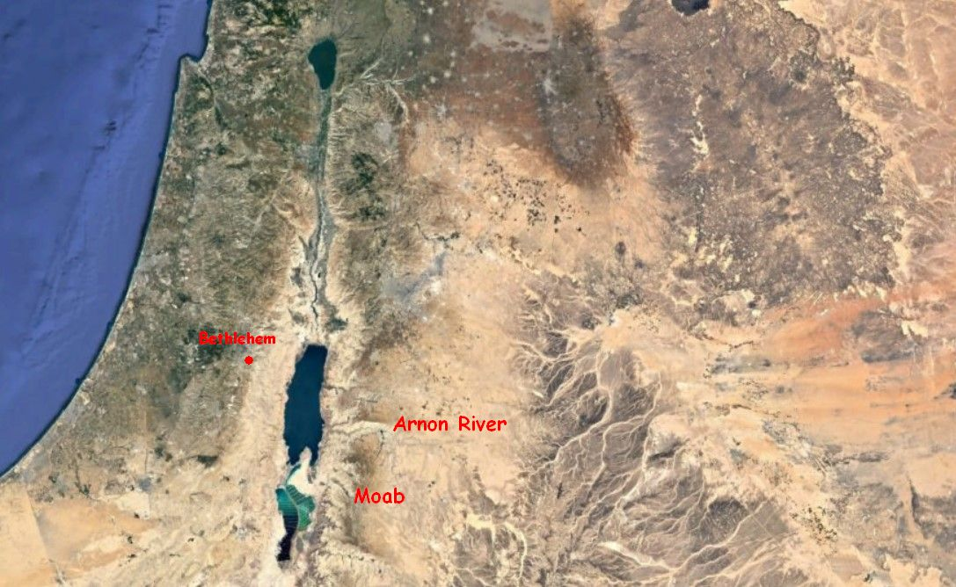

Slide 16
““No Ammonite or Moabite may enter the assembly of the LORD. Even to the tenth generation, none of them may enter the assembly of the LORD forever, because they did not meet you with bread and with water on the way, when you came out of Egypt, and because they hired against you Balaam the son of Beor from Pethor of Mesopotamia, to curse you. But the LORD your God would not listen to Balaam; instead the LORD your God turned the curse into a blessing for you, because the LORD your God loved you. You shall not seek their peace or their prosperity all your days forever.” (Deuteronomy 23:3–6 ESV)

Slide 17
“Say therefore to the people of Israel, ‘I am the LORD, and I will bring you out from under the burdens of the Egyptians, and I will deliver you from slavery to them, and I will redeem you with an outstretched arm and with great acts of judgment. I will take you to be my people, and I will be your God, and you shall know that I am the LORD your God, who has brought you out from under the burdens of the Egyptians.” (Exodus 6:6–7 ESV)

Slide 18
“And he said, “May you be blessed by the LORD, my daughter. You have made this last kindness greater than the first in that you have not gone after young men, whether poor or rich. And now, my daughter, do not fear. I will do for you all that you ask, for all my fellow townsmen know that you are a worthy woman.”
(Ruth 3:10–11 ESV)

Slide 19
“But when the goodness and loving kindness of God our Savior appeared, he saved us, not because of works done by us in righteousness, but according to his own mercy, by the washing of regeneration and renewal of the Holy Spirit, whom he poured out on us richly through Jesus Christ our Savior,” (Titus 3:4–6 ESV)

Slide 20
“And now it is true that I am a redeemer. Yet there is a redeemer nearer than I. Remain tonight, and in the morning, if he will redeem you, good; let him do it. But if he is not willing to redeem you, then, as the LORD lives, I will redeem you. Lie down until the morning.”” (Ruth 3:12–13 ESV)

Slide 21
“So she lay at his feet until the morning, but arose before one could recognize another. And he said, “Let it not be known that the woman came to the threshing floor.” And he said, “Bring the garment you are wearing and hold it out.” So she held it, and he measured out six measures of barley and put it on her. Then she went into the city.” (Ruth 3:14–15 ESV)

Slide 22
“And when she came to her mother-in-law, she said, “How did you fare, my daughter?” Then she told her all that the man had done for her, saying, “These six measures of barley he gave to me, for he said to me, ‘You must not go back empty-handed to your mother-in-law.’”” (Ruth 3:16–17 ESV)

Slide 23
“She replied, “Wait, my daughter, until you learn how the matter turns out, for the man will not rest but will settle the matter today.”” (Ruth 3:18 ESV)

Slide 24
“For while we were still weak, at the right time Christ died for the ungodly. For one will scarcely die for a righteous person—though perhaps for a good person one would dare even to die— but God shows his love for us in that while we were still sinners, Christ died for us.” (Romans 5:6–8 ESV)

